Slide 1
Pilon malunion
Case for small group discussion
AOTrauma—Foot & Ankle
Module 1b: Ankle trauma—pilon fractures
Notes:
Author: Stefan Rammelt, DE

Slide 2
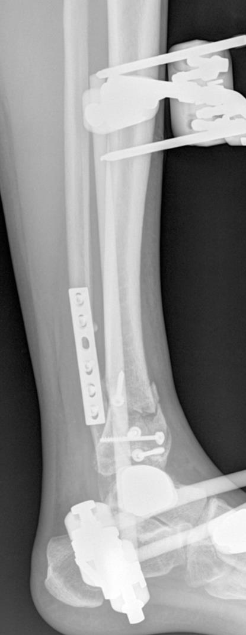
Case description
30-year-old woman
Motor vehicle accident
Minimally invasive fixation (no incisions to visualize the ankle)
Comments?
Notes:
MIPO without looking at the joint and poor fixation

Slide 3
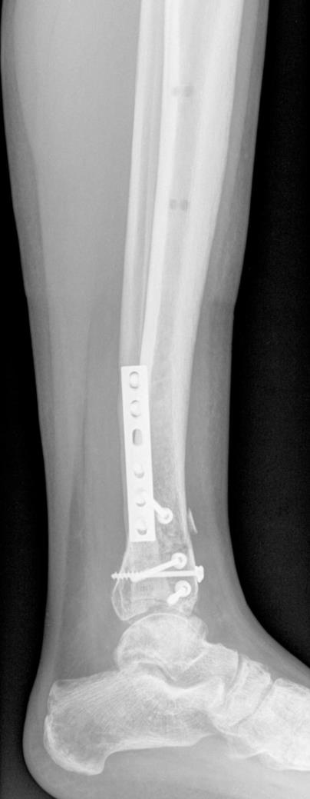
Follow-up 6 months post injury
Pain
Limited range of motion
Increasing varus deformity
Notes:
malunion

Slide 4
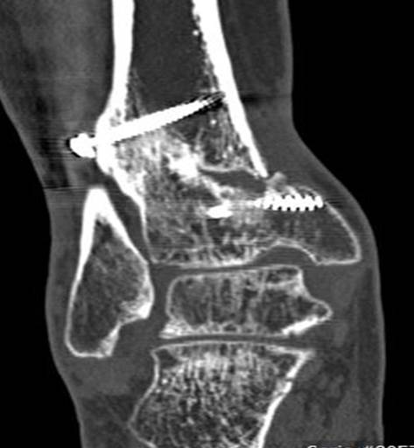
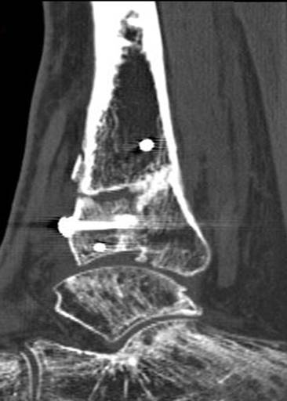
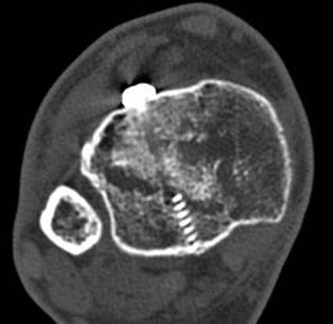
Discussion points
What type of deformity is present?
What is your treatment plan?

Slide 5
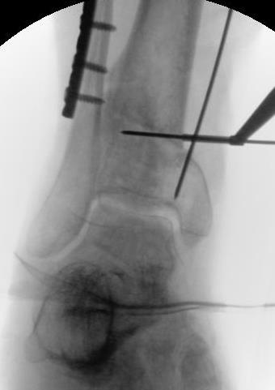
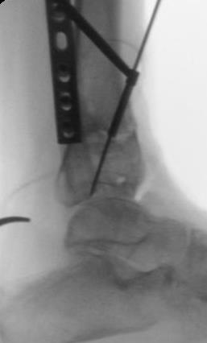
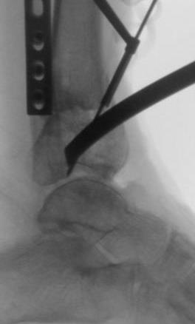
Correction
Resection of the metaphyseal necrosis
Osteotomy of medial malleolus and plafond

Slide 6
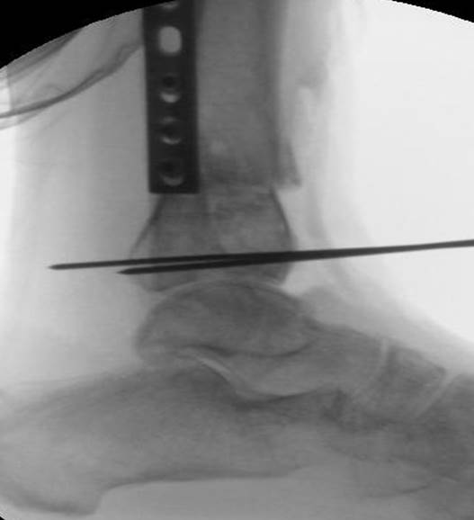
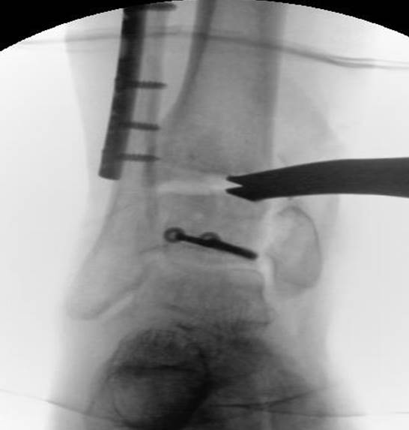
Correction

Slide 7
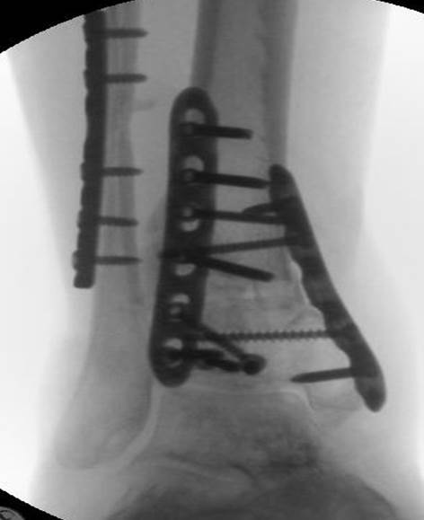
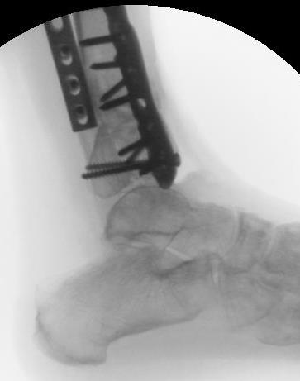
Internal fixation

Slide 8
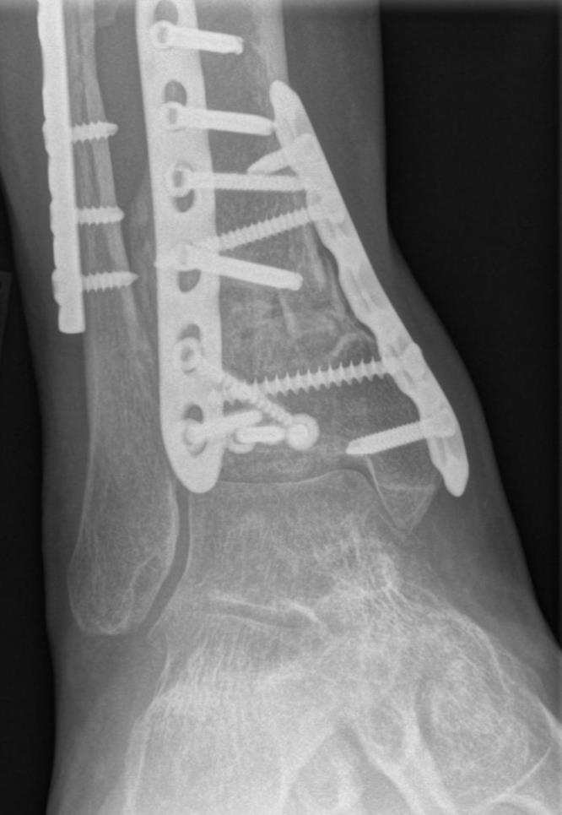
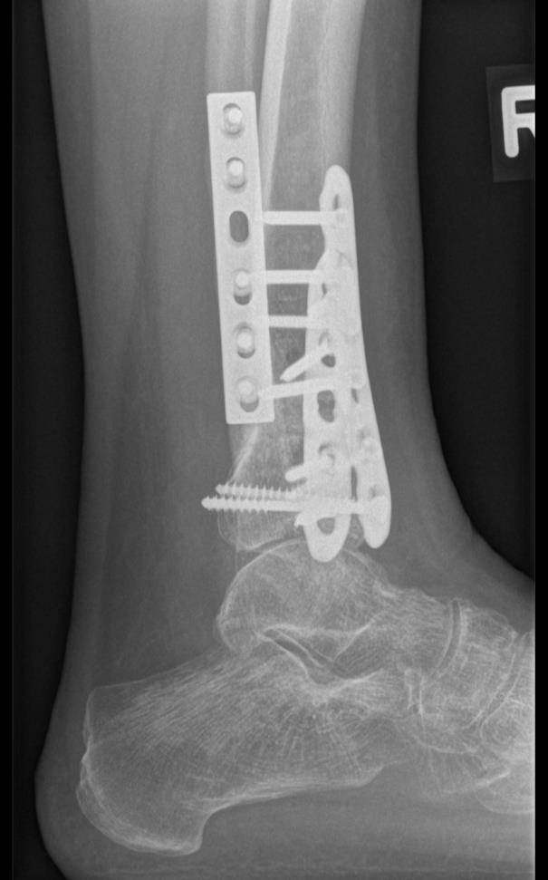
3 months postoperative

Slide 9
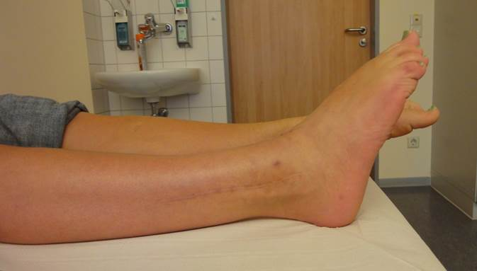
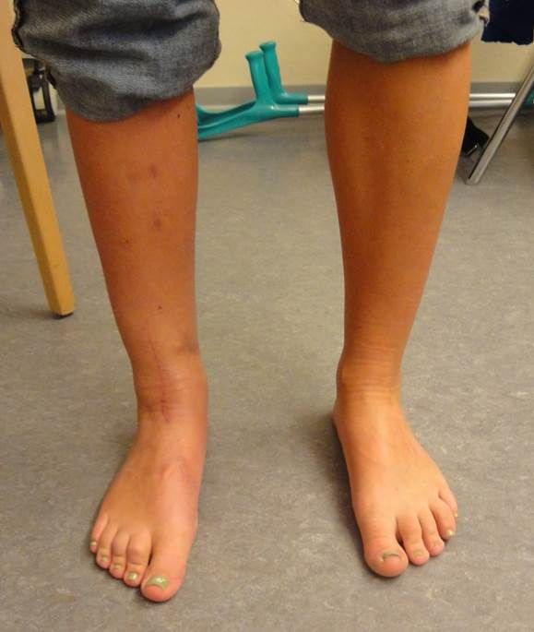
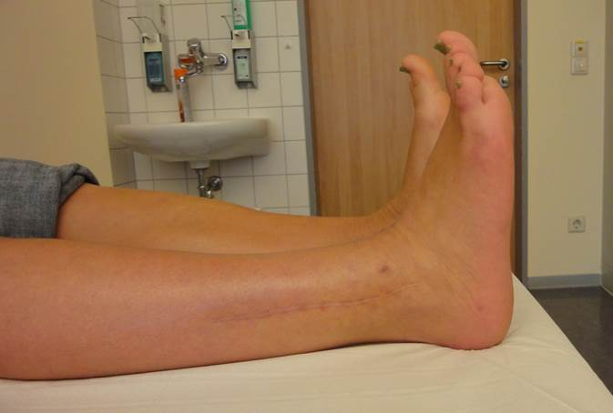
3 months postoperative
Pain free on weight bearing

Slide 10
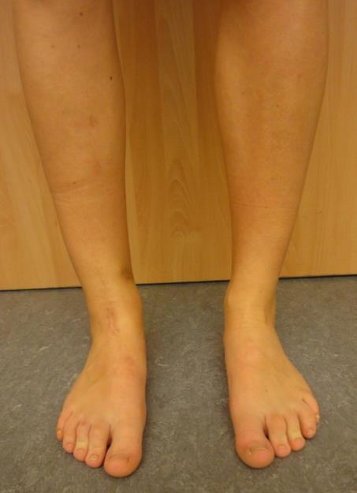
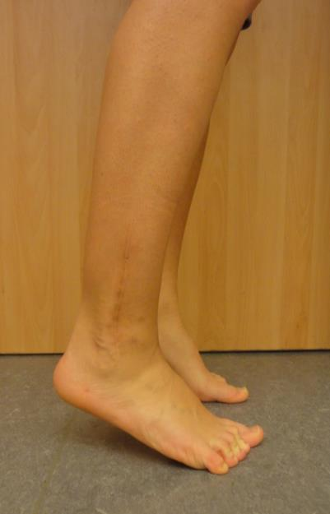
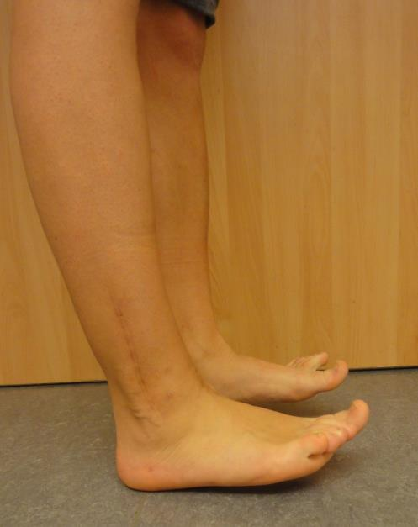
1.5-year follow-up
Some pain/swelling after 8 hours work (business administration)

Slide 11
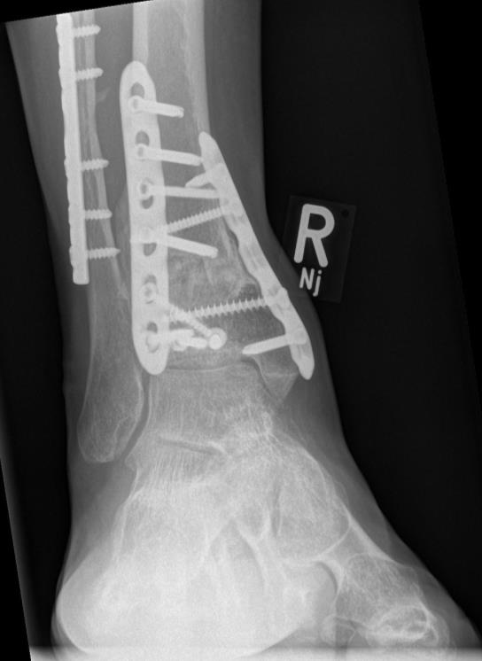
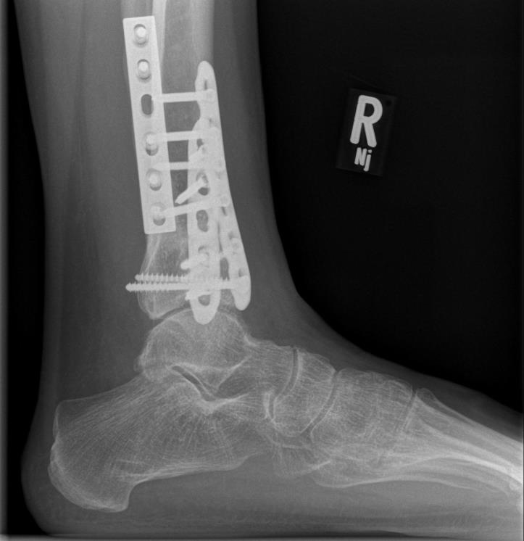
2.5-year follow-up x-rays
Limited dorsiflexion, little pain on exercise

Slide 12
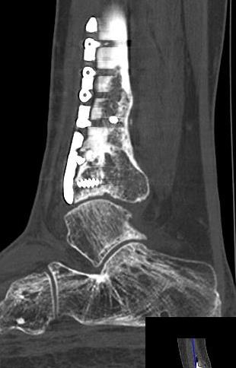
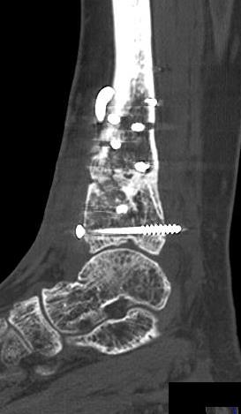
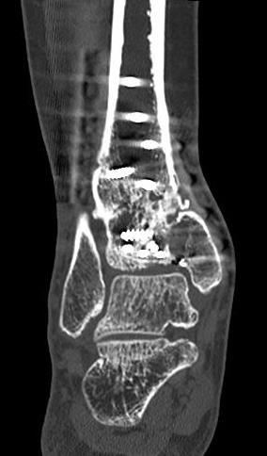
2.5-year follow-up CT scans

Slide 13
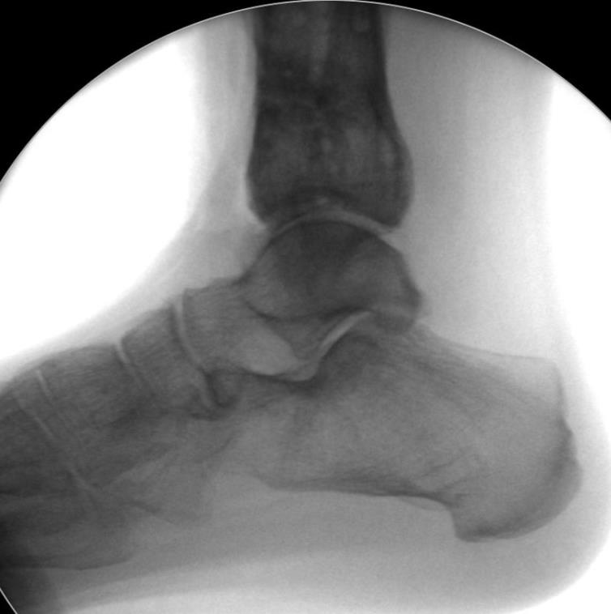
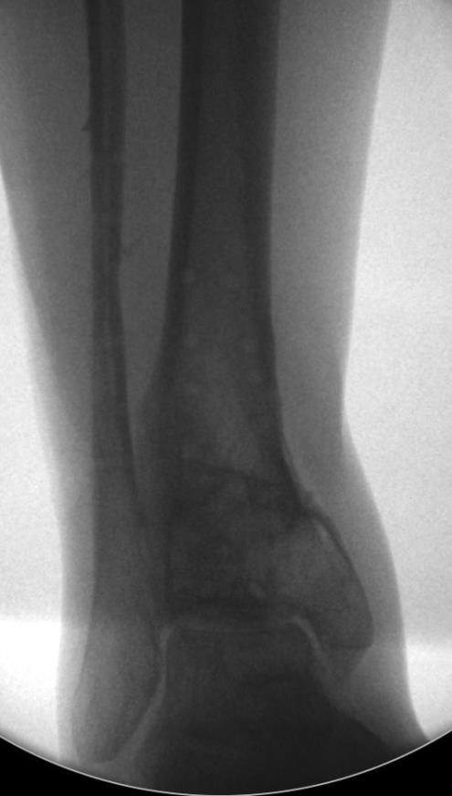
Removal of hardware and arthrolysis

Slide 14
Take-home messages
Risk of malunion with minimally invasive approaches:
Axial malalignment
Intraarticular step-off
Bone grafting of defects/necrosis
Intraarticular osteotomy with:
Good bone quality
Intact cartilage cover
Reliable patients

