Slide 1
Calcaneal malunion
Case for small group discussion
AOTrauma—Foot & Ankle
Module 8: Hindfoot arthritis
Notes:
Author: Stefan Rammelt, DE

Slide 2
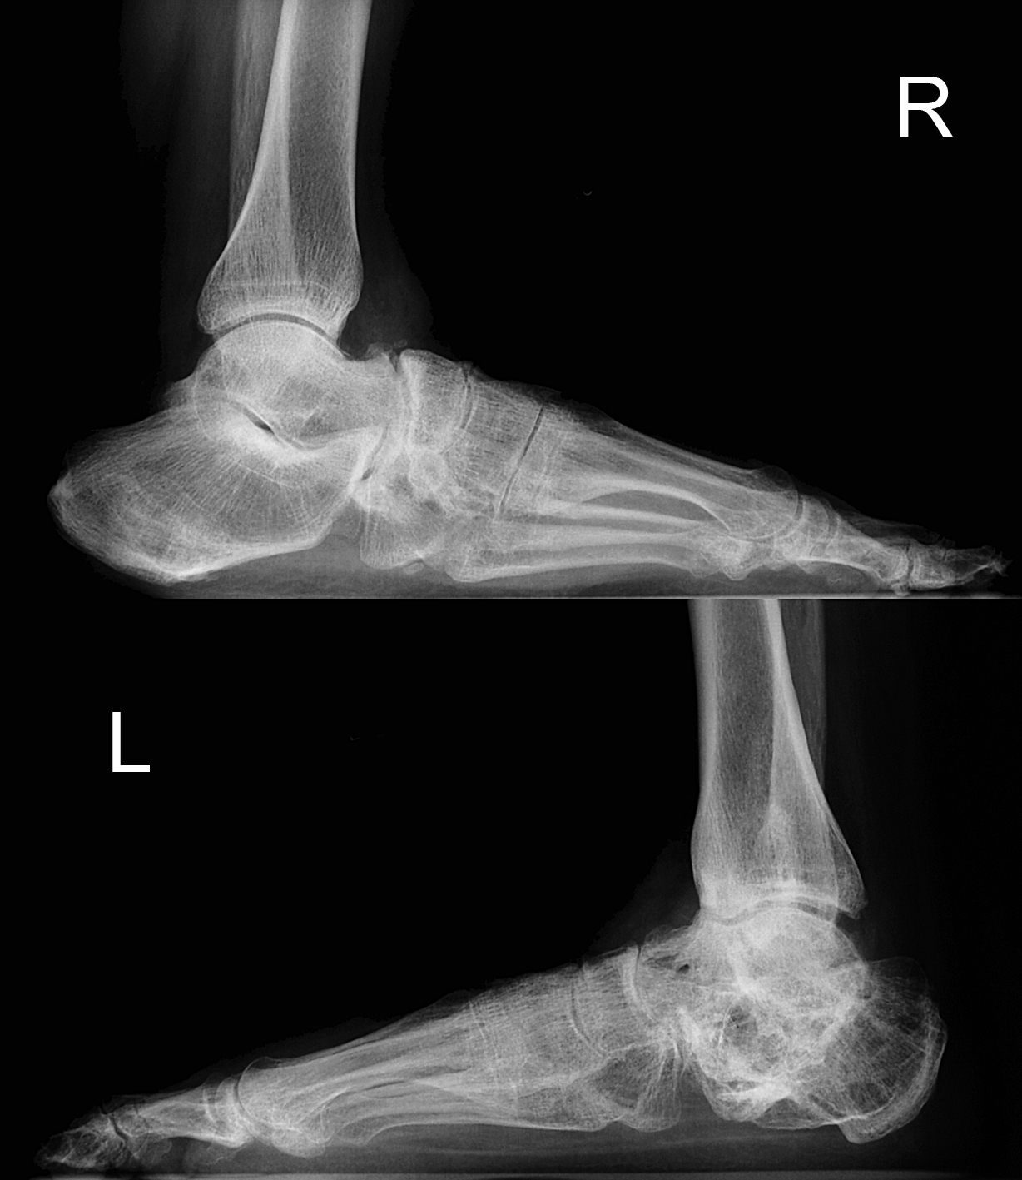
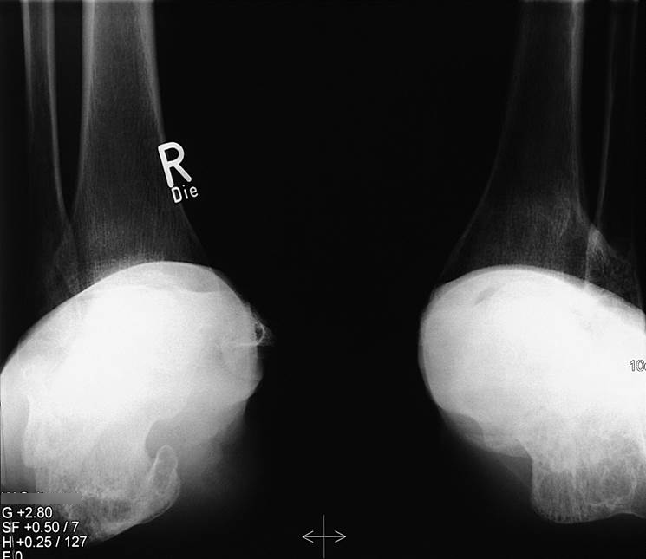
Case description
41-year-old woman, polytrauma after attempted suicide
Status post talar fracture (R) and calcaneal fracture (L)
Severe pain at left lateral malleolus and anterior ankle

Slide 3
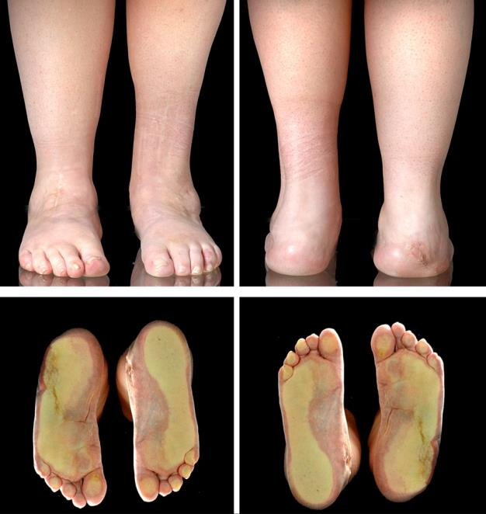
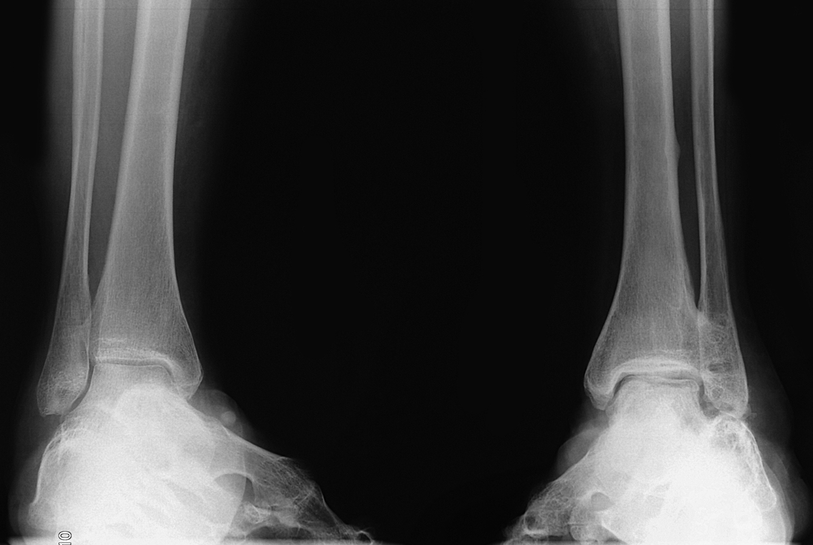
Type of deformity?
Loss of height
Talar tilt
Hindfoot valgus
Lateral translation
All of the above

Slide 4
What would you do now?
Skillful neglect (depression)
Subtalar distraction bone bloc fusion
Medial closing wedge osteotomy and subtalar fusion
Osteotomy along former fracture and subtalar fusion
Osteotomy and hindfoot fusion with retrograde nailing

Slide 5
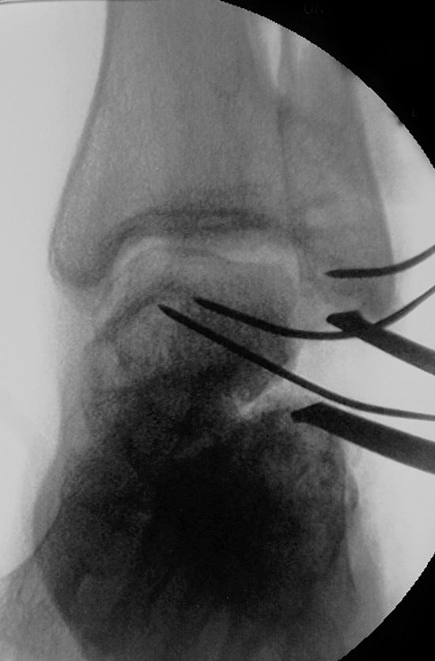
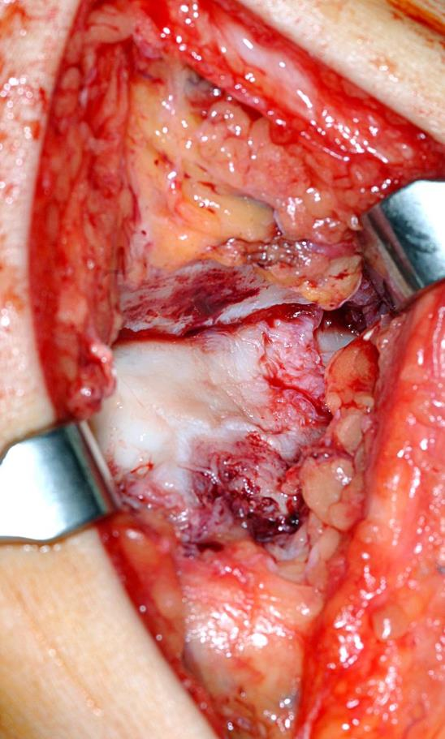
Procedure
Anterior approach to the ankle and debridement of soft-tissue ingrowth
Lateral approach to distal fibula and calcaneus for deformity correction
Notes:
Revision of tilted ankle and removal of ingrown tissue

Slide 6
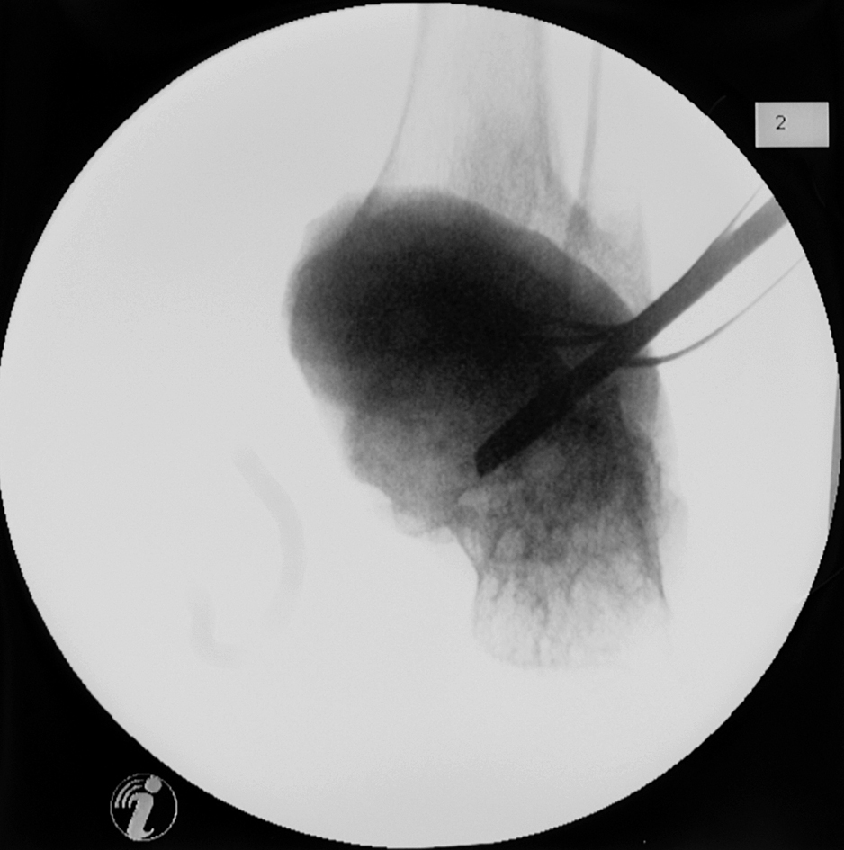
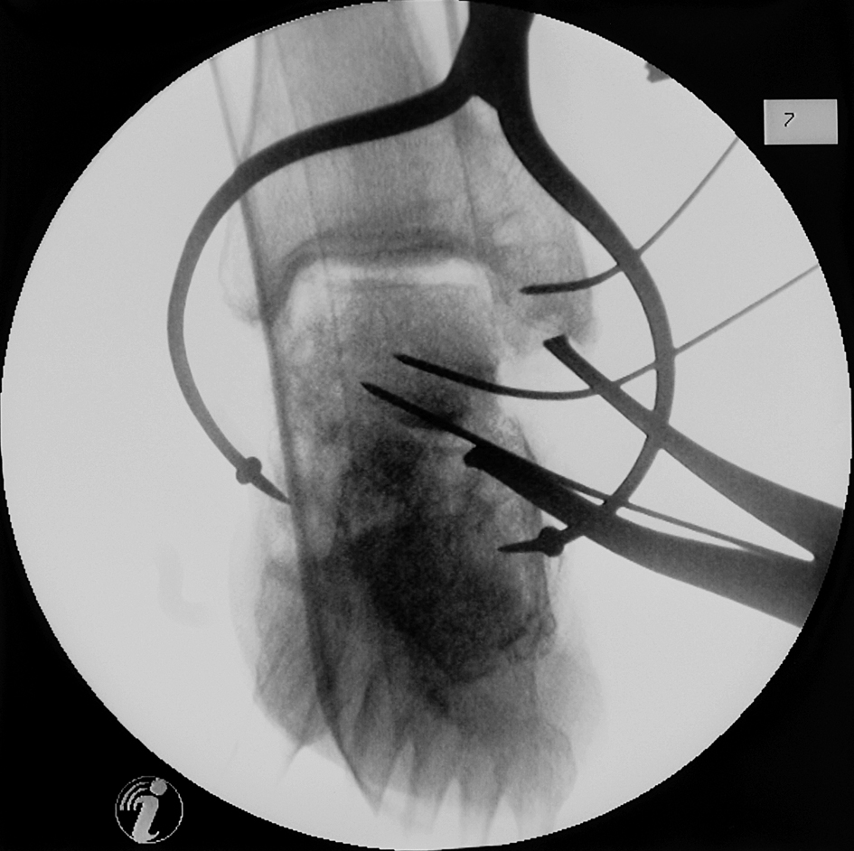
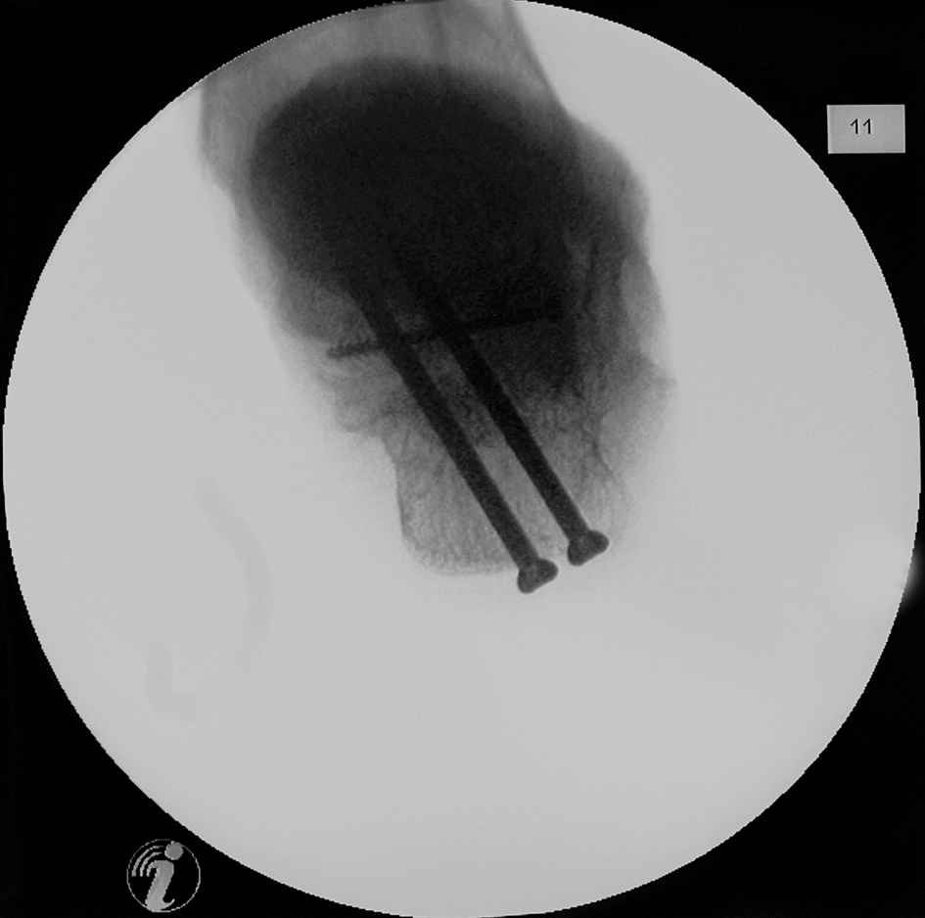
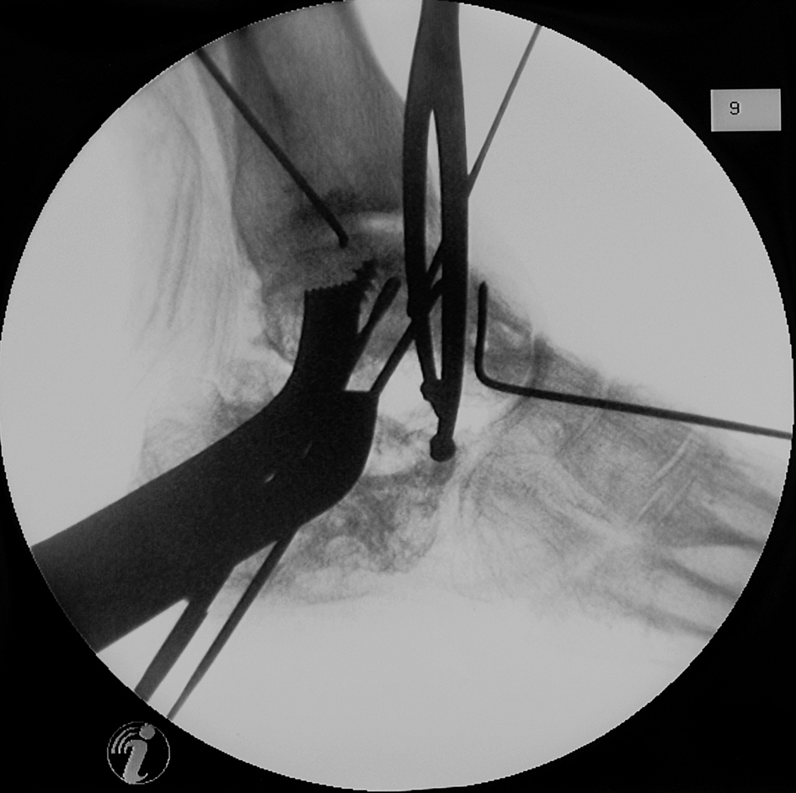
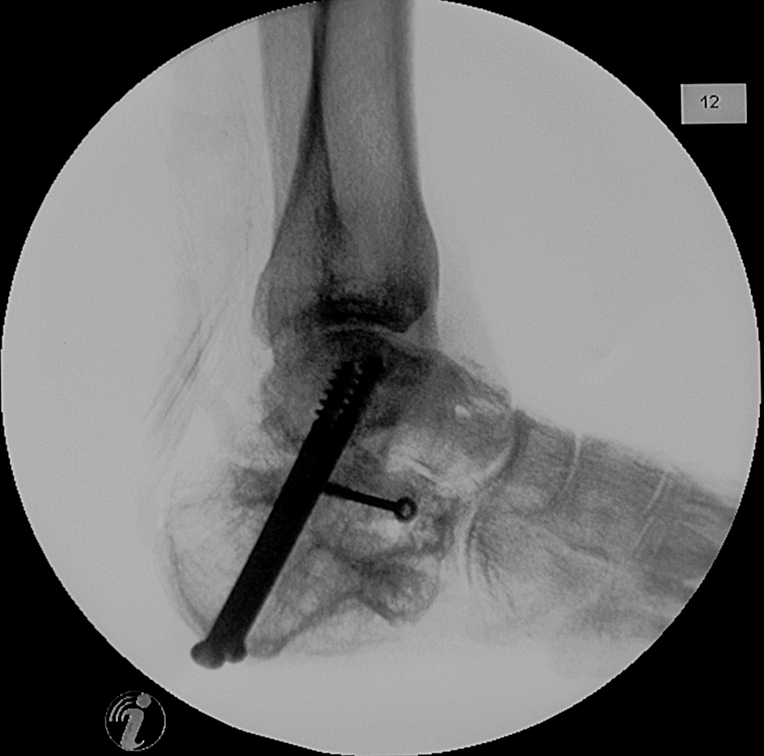
Osteotomy along former fracture
Corrective fusion of subtalar joint with bone block

Slide 7
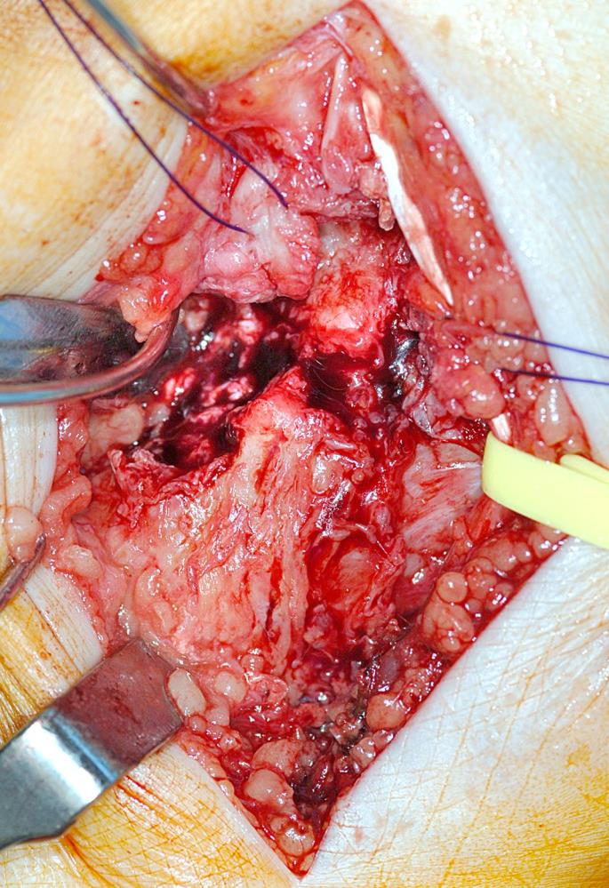
Additional procedures
Peroneal tendon rerouting
Achilles tendon lengthening
Ankle revision (lateral debridement, osteophyte excision)
Exostectomy of the lateral calcaneal wall
Fibula
Calcaneus

Slide 8
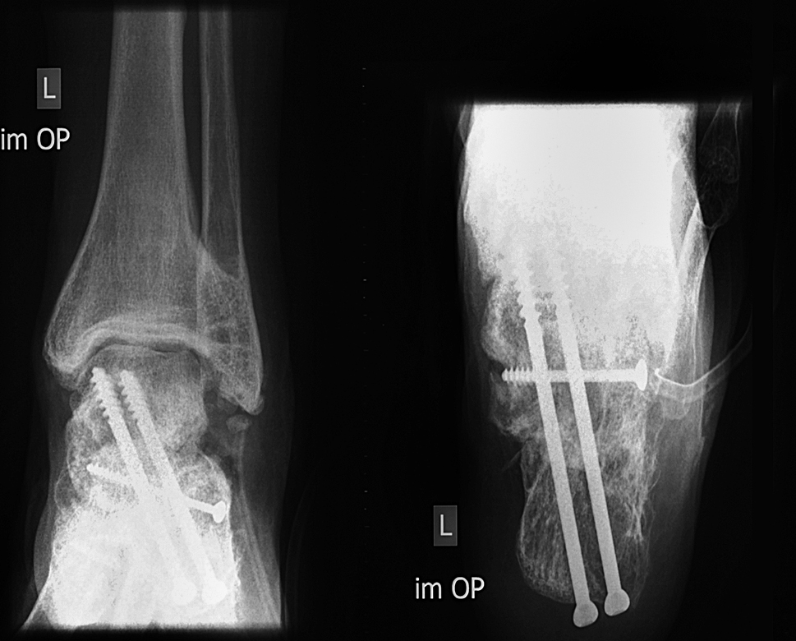
Preoperative x-rays
Postoperative x-rays
Pain
Pain
Pain

Slide 9
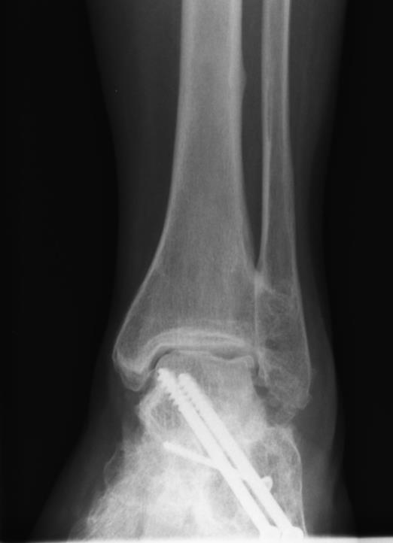
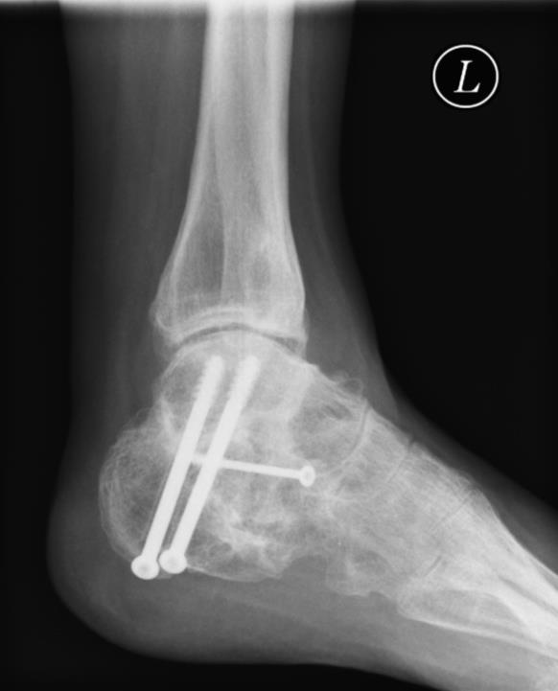
6-year follow-up x-rays
Pain substantially reduced
No deterioration at the ankle
Still psychological problems
Notes:
References:
Rammelt S, Zwipp H. Corrective arthrodeses and osteotomies for post-traumatic hindfoot malalignment: indications, techniques, results. Int Orthop. 2013 Sep;37(9):1707–1717.

Slide 10
Take-home messages
Fracture dislocations of the calcaneus are frequently overlooked due to atypical radiographic presentation
Evaluate sources of pain:
Fibulocalcaneal abutment and peroneal tendon displacement
Subtalar arthritis
Anterior ankle pain due to loss of heel height
3-D corrective osteotomy along former fracture plain followed by subtalar fusion
Soft-tissue procedures as needed
Rammelt et al. Int Orthop. 2013;37:1707–1717

