Slide 1
Calcaneal malunion
Case for small group discussion
AOTrauma—Foot & Ankle
Module 8: Hindfoot arthritis
Notes:
Author: Matej Andoljsek, SI

Slide 2
Case description
50-year-old man
Motor vehicle accident
Complicated calcaneal fracture (R)
Comminuted femoral and patellar fracture (L)
Polytrauma
Fat embolism

Slide 3
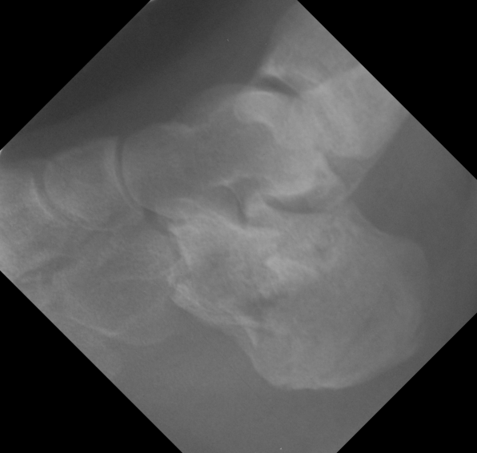
Injury
Medial heel wound
No x-rays

Slide 4
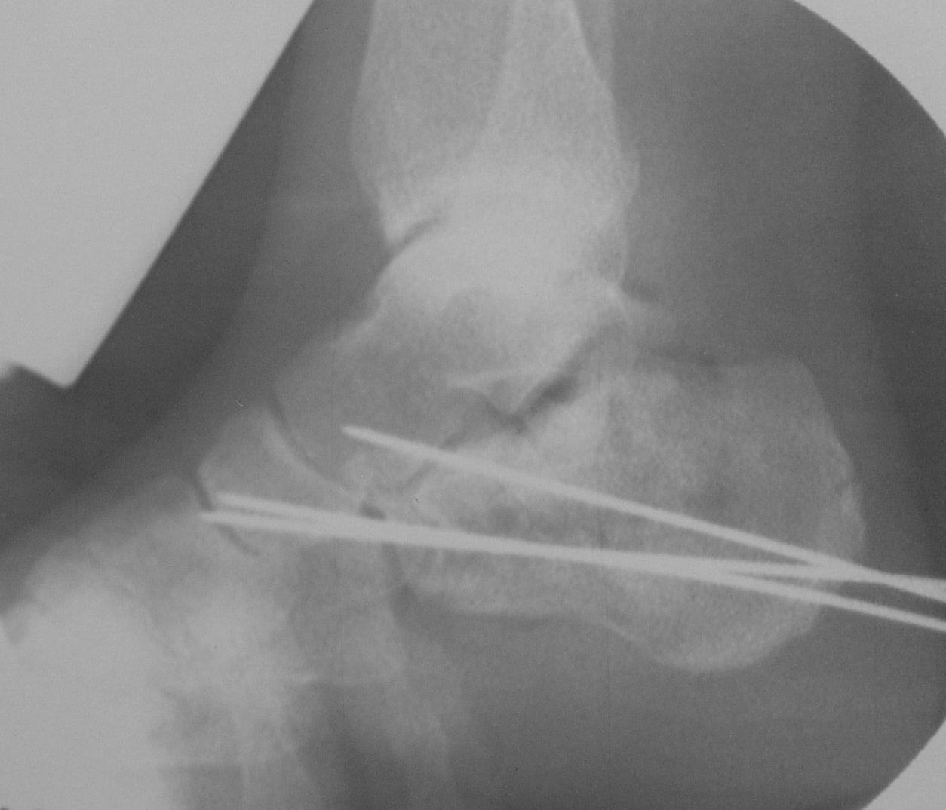
First surgery
Closed reduction, percutaneous pinning
Day 0

Slide 5
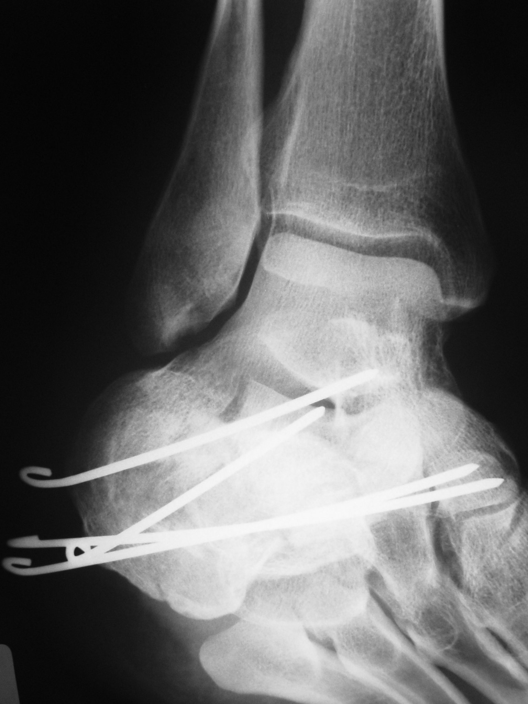
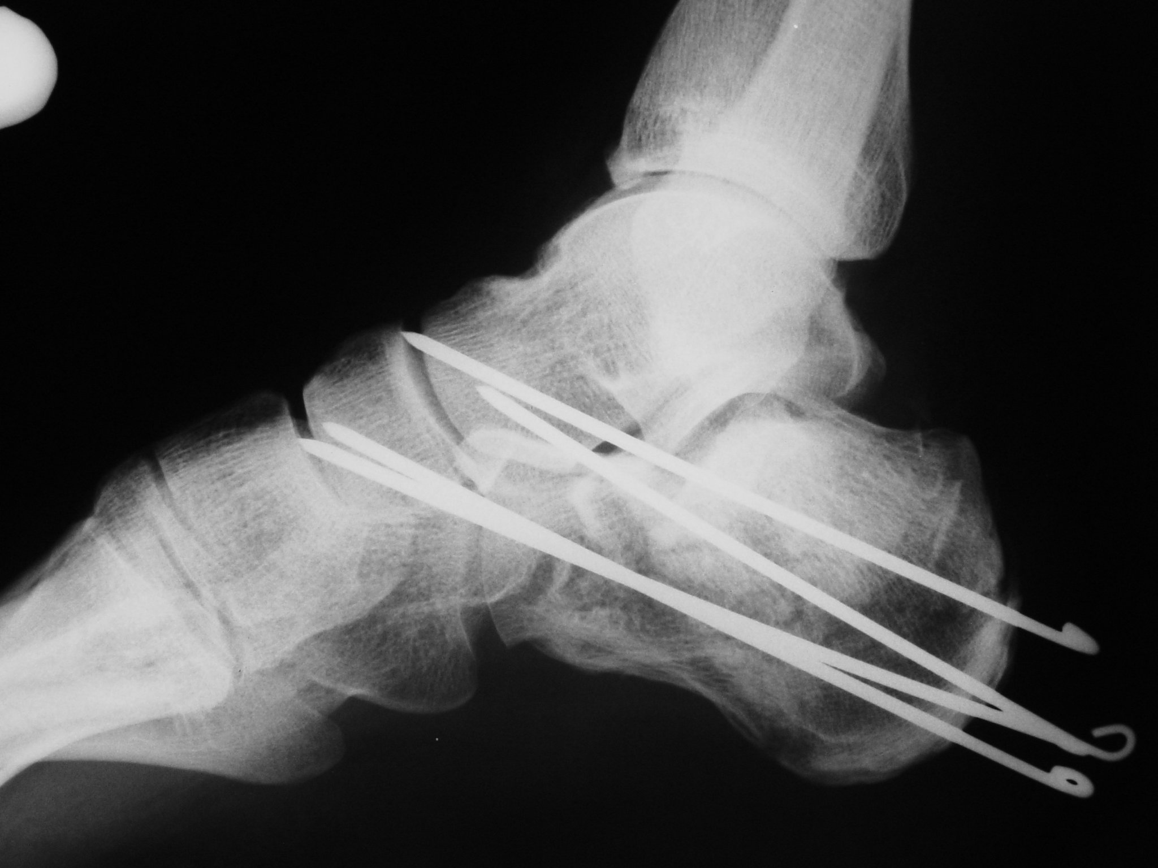
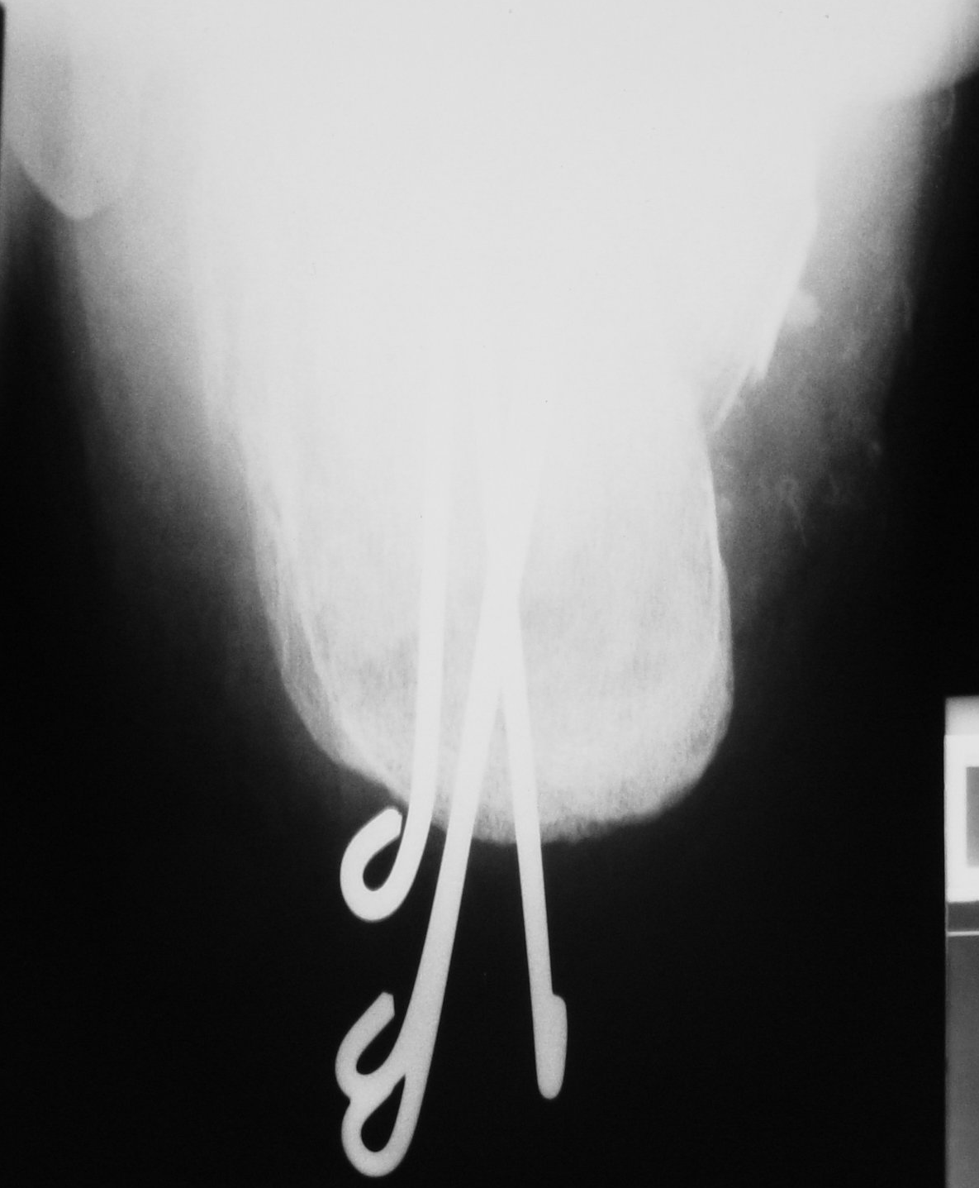
Postoperative x-rays
Week 1

Slide 6
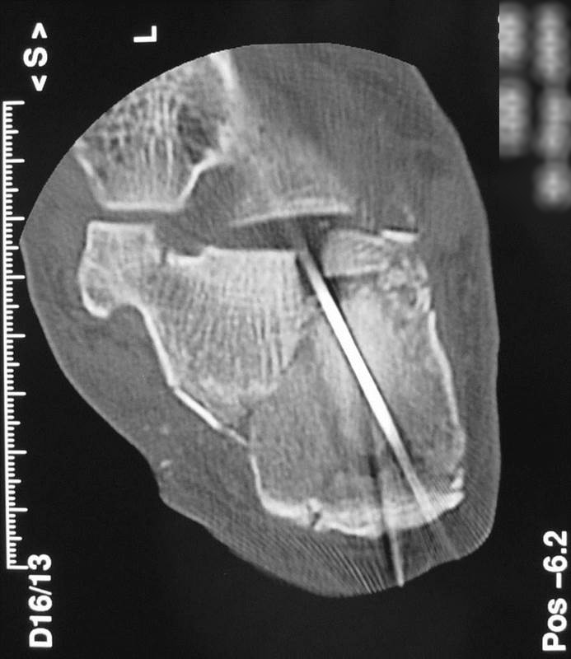
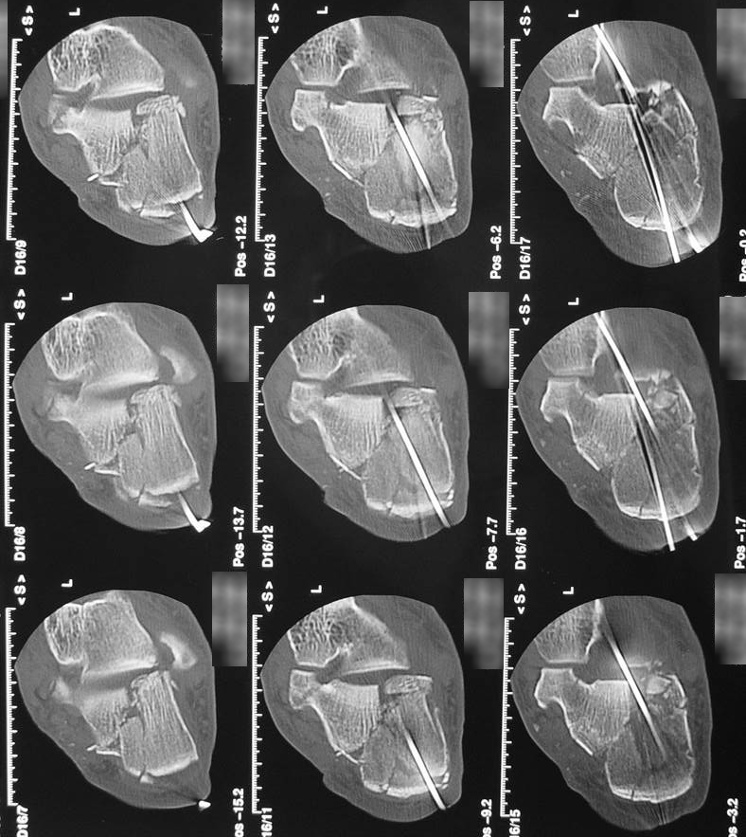
Postoperative CT scans
Week 1

Slide 7
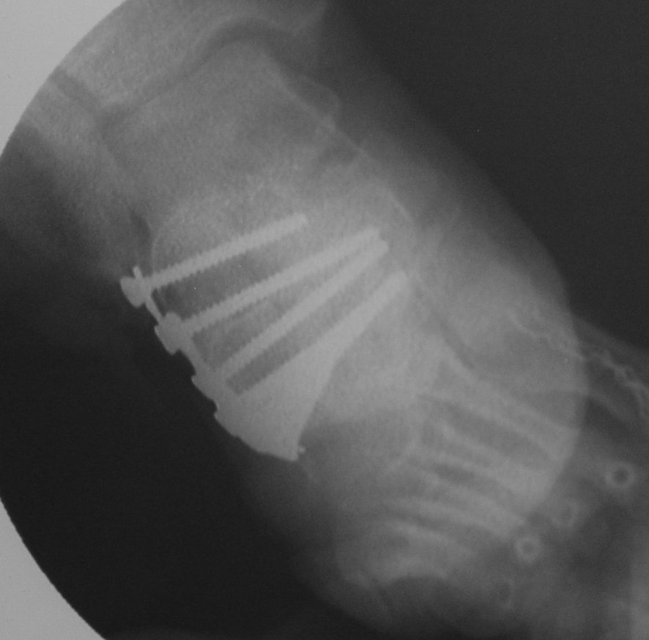
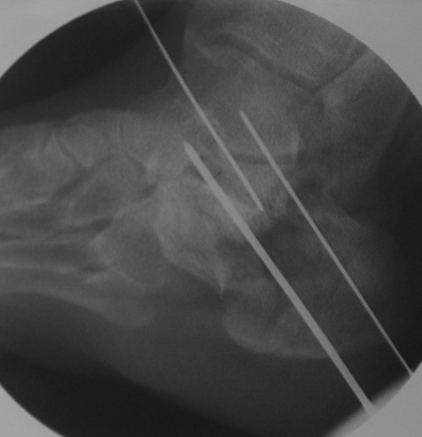
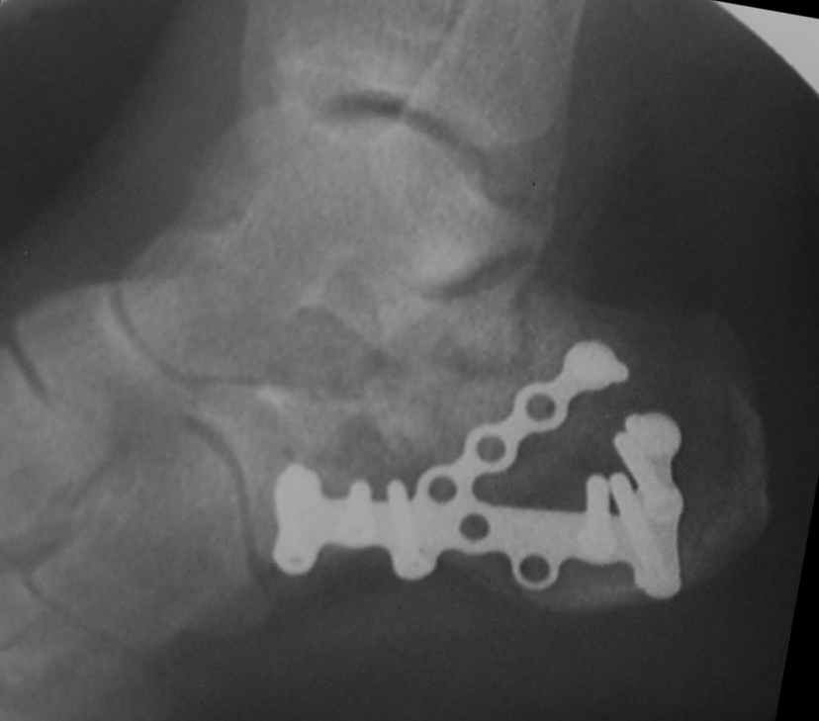
Second surgery
ORIF and autograft
Day 18

Slide 8
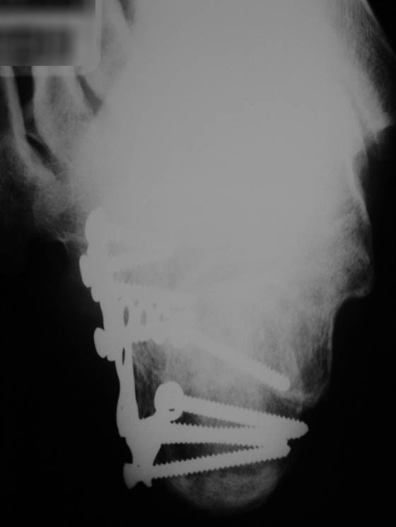
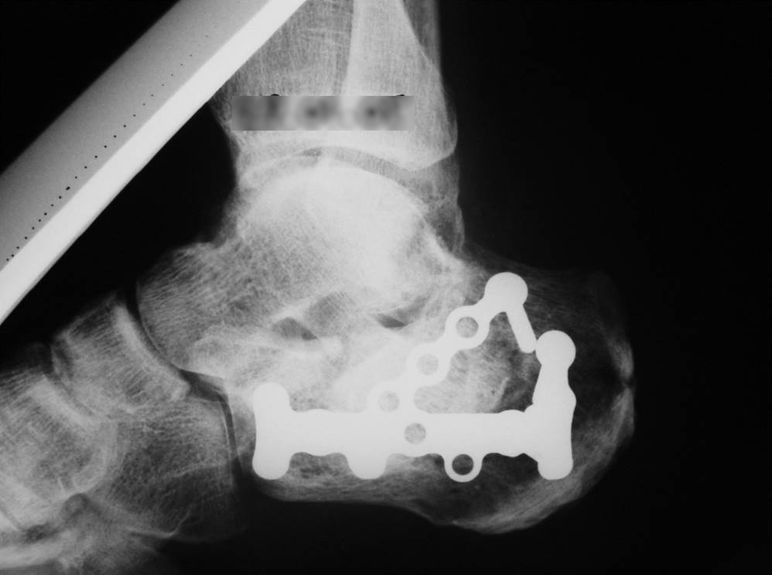
4-month follow-up

Slide 9
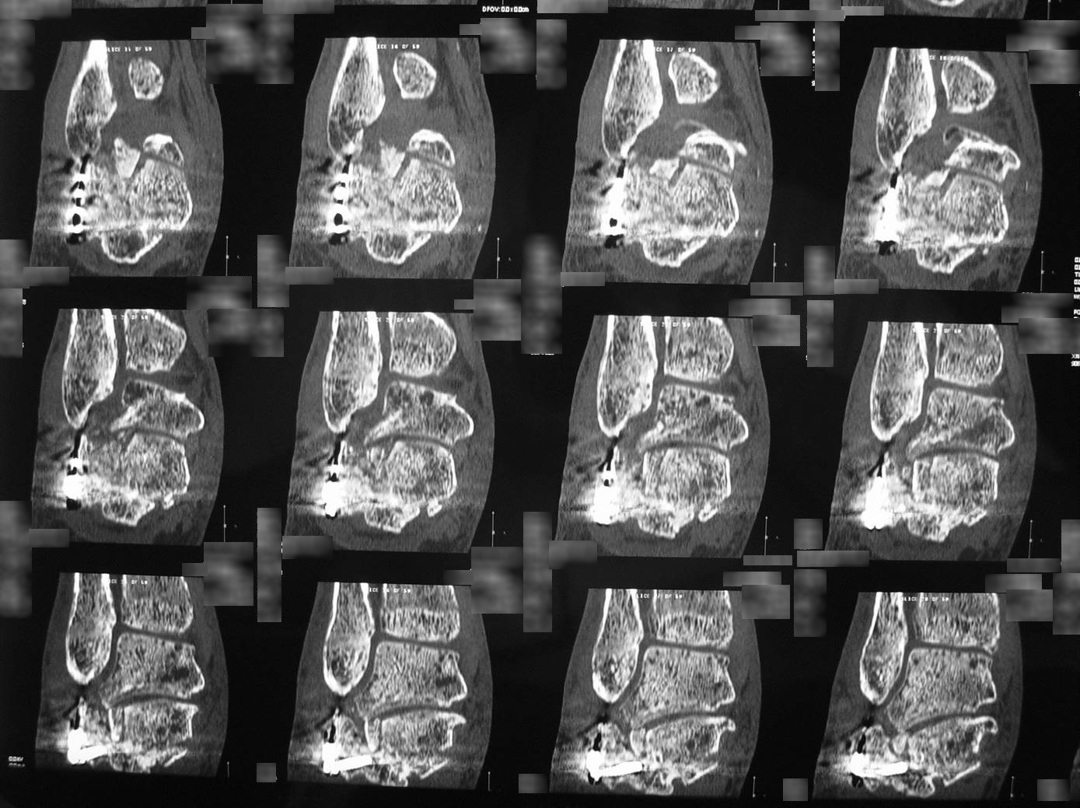

Slide 10
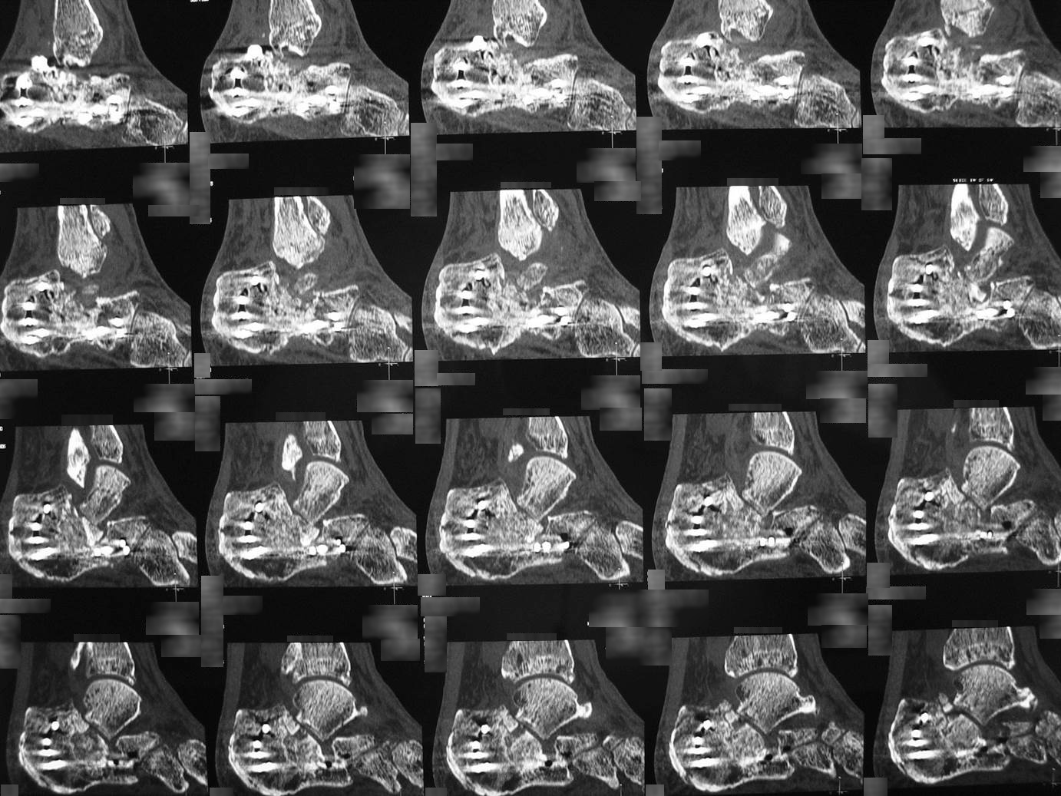

Slide 11
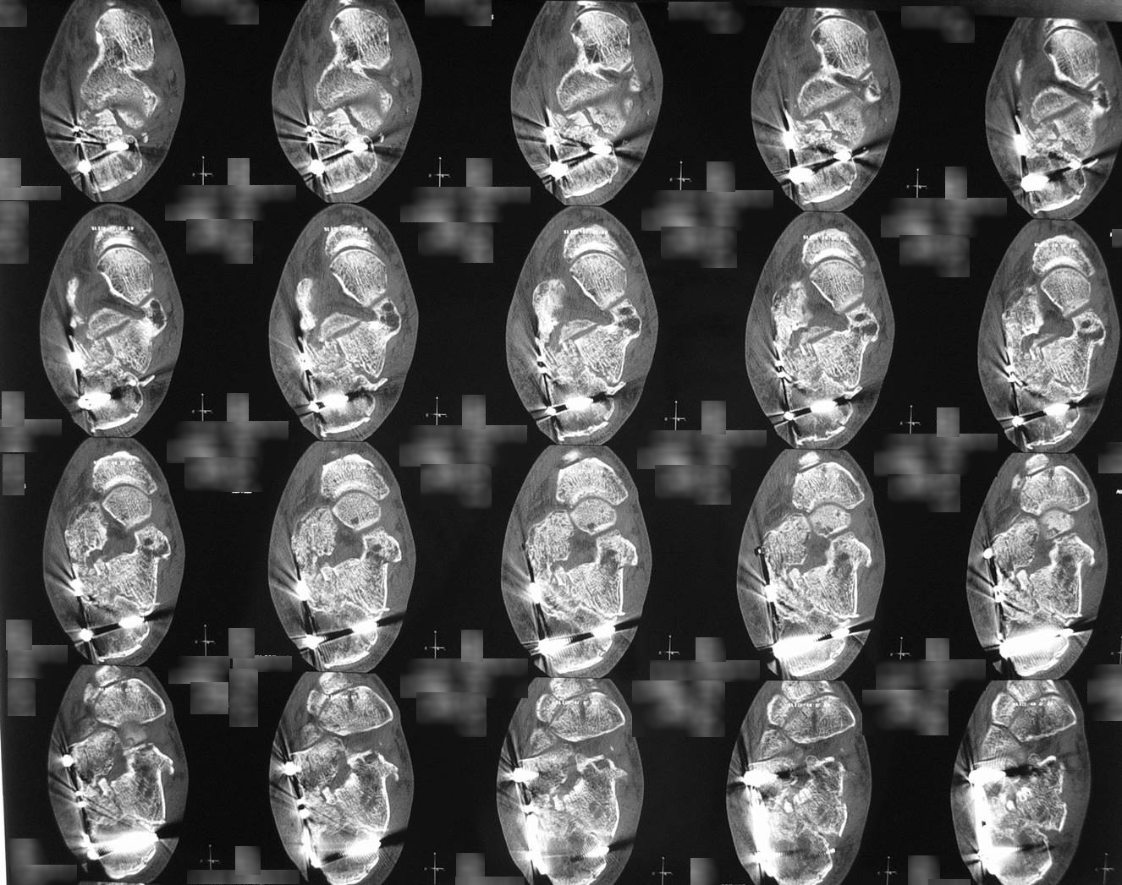

Slide 12
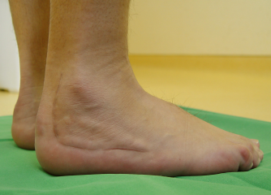
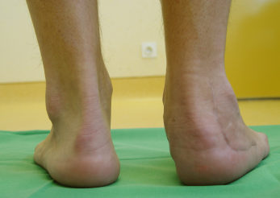
Referral at 6 months

Slide 13
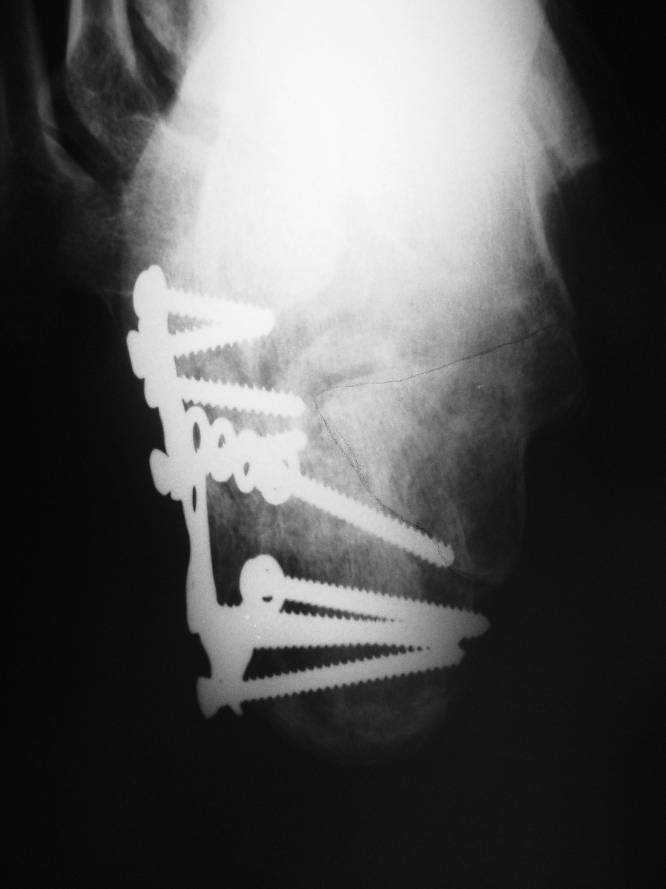
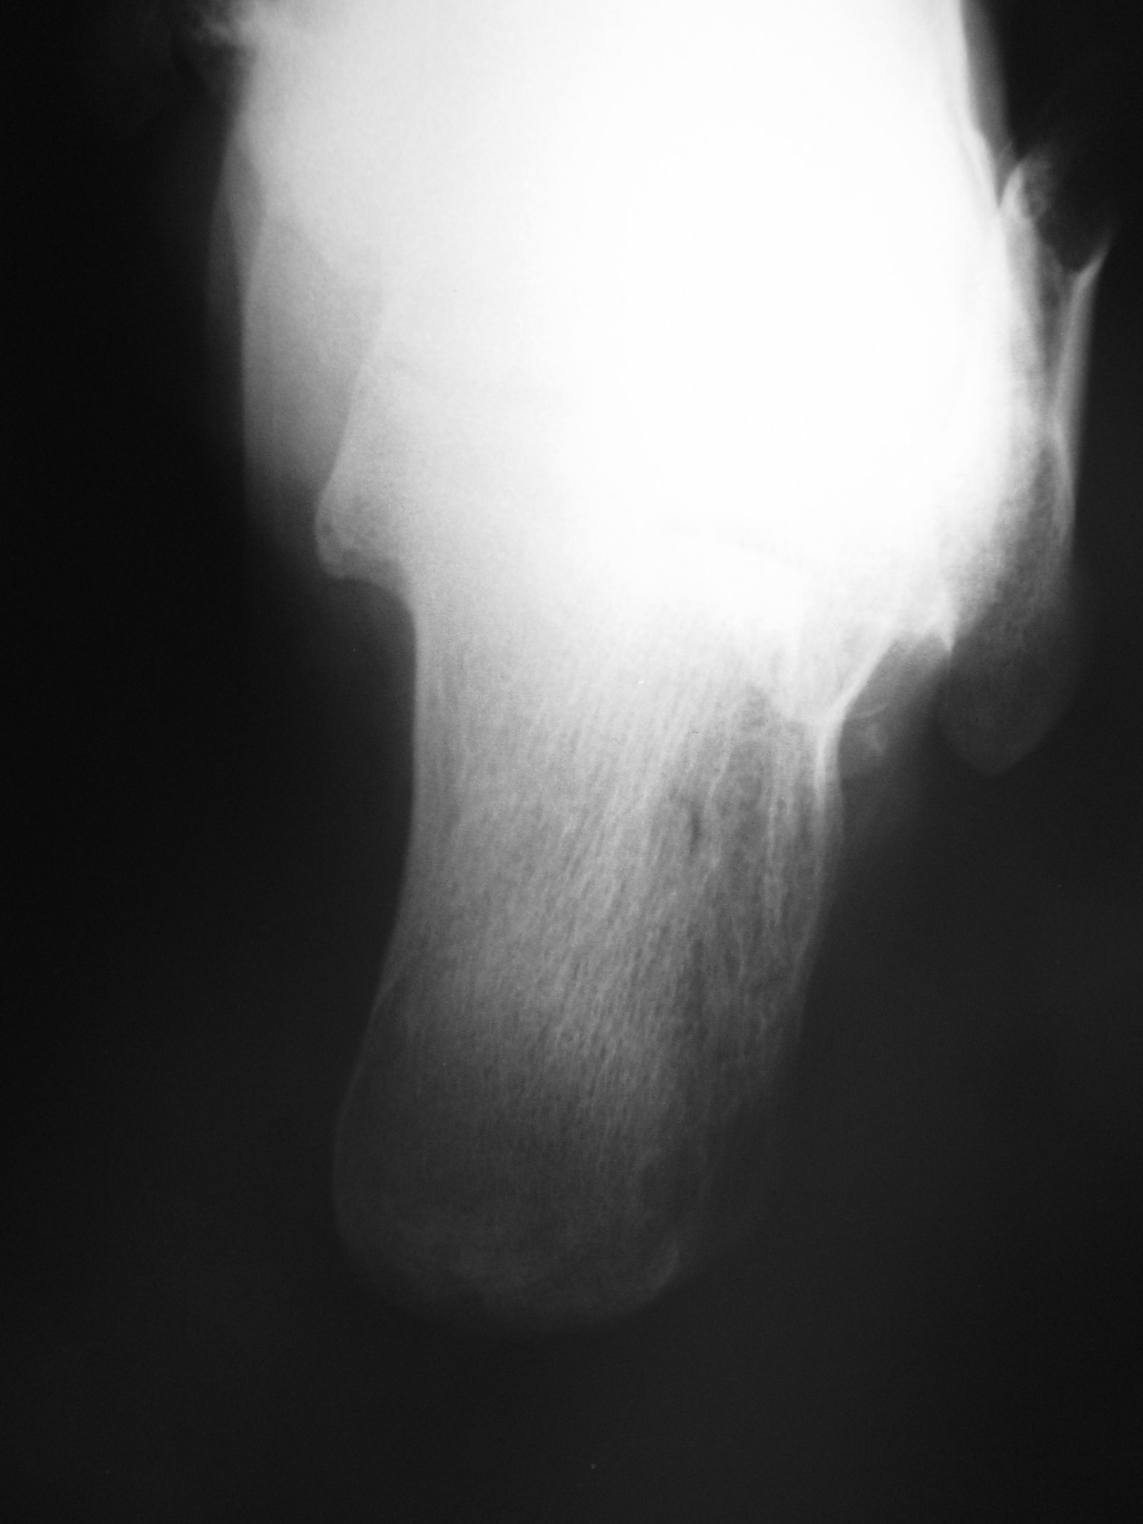
Referral at 6 months

Slide 14
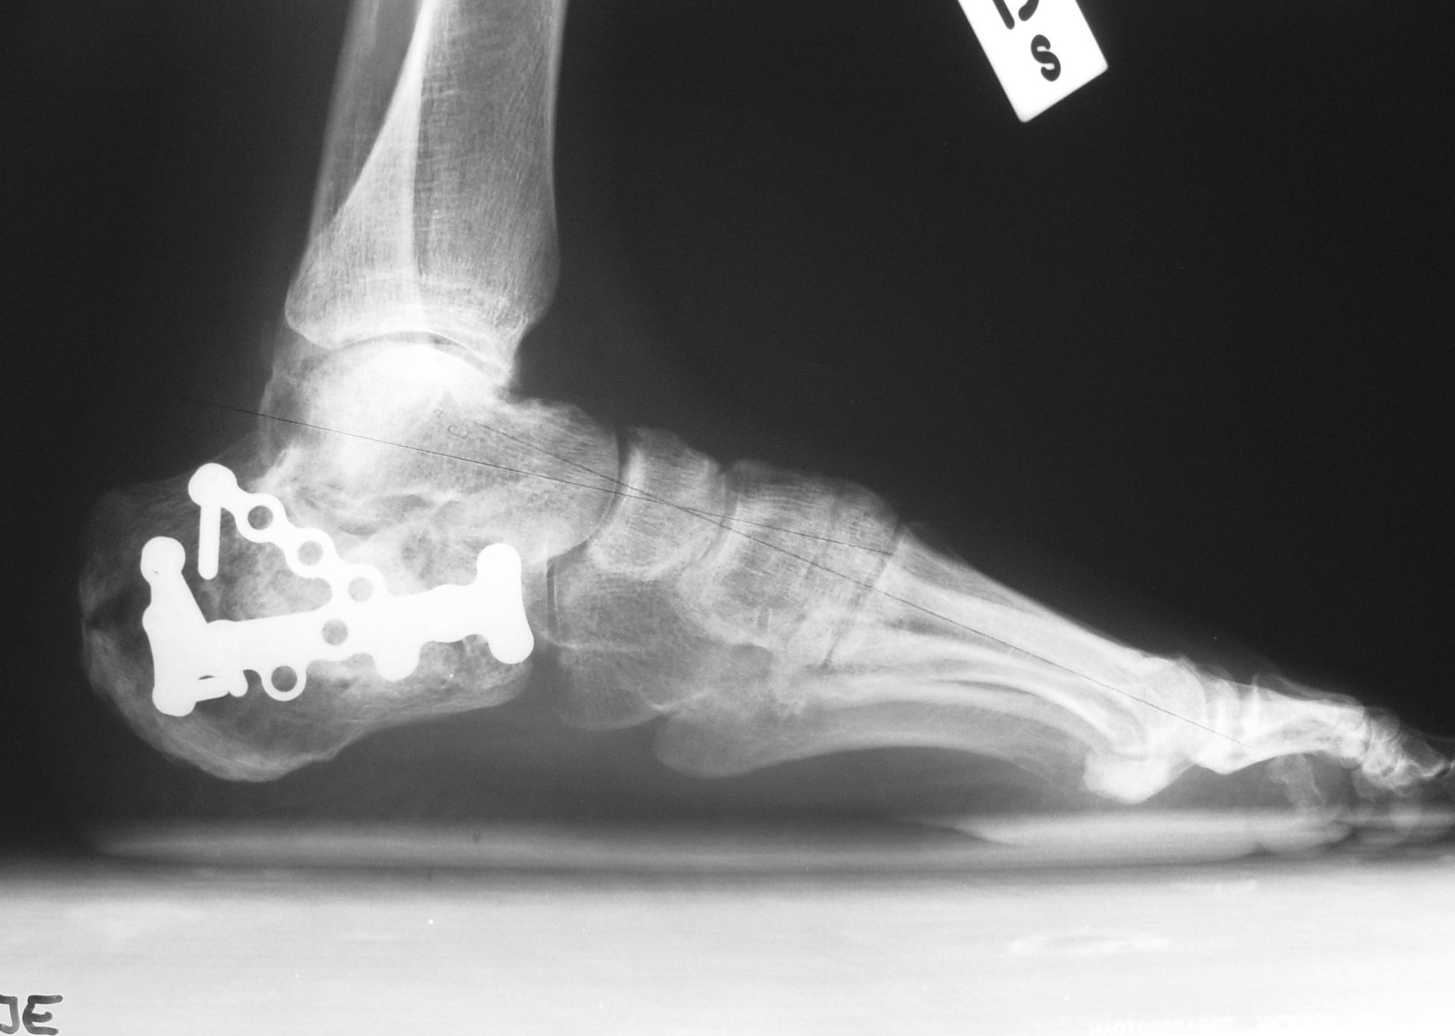
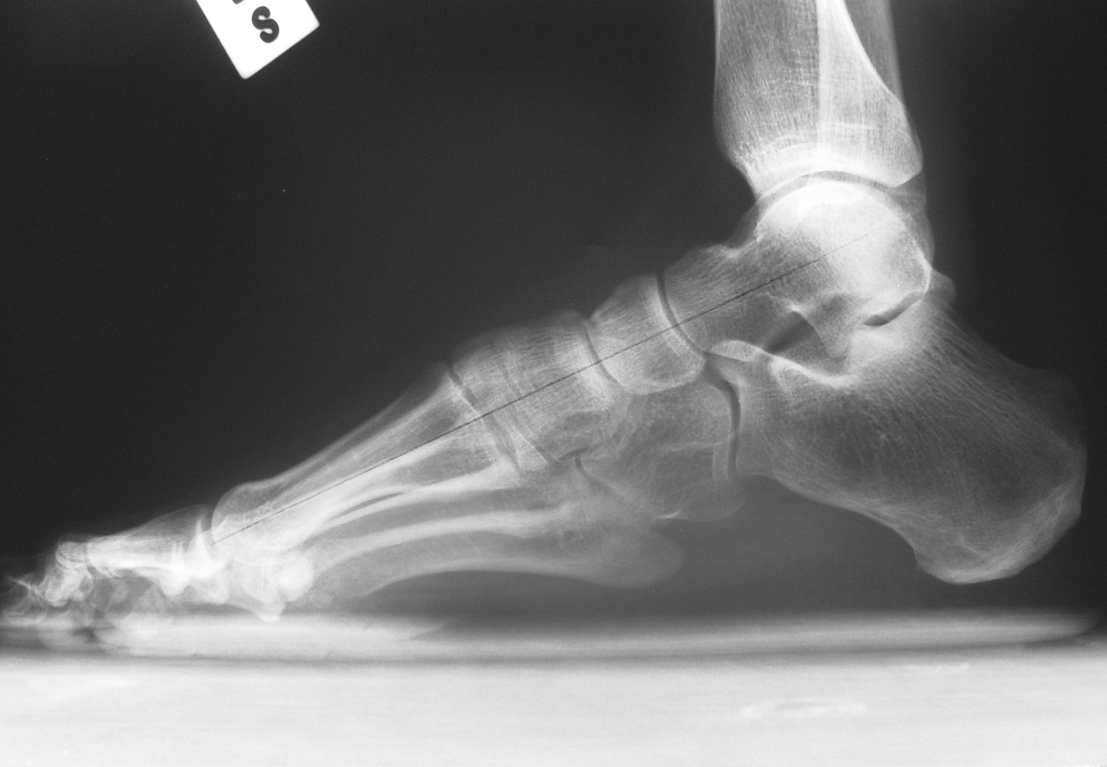
Weight bearing x-rays

Slide 15
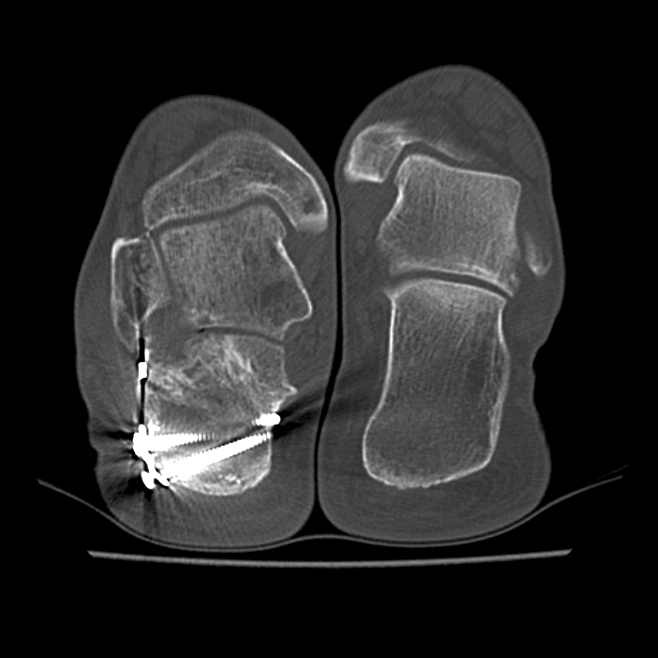

Slide 16
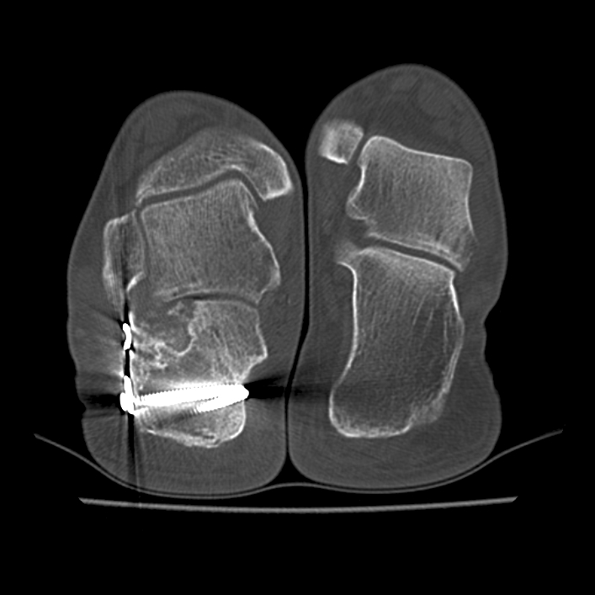

Slide 17
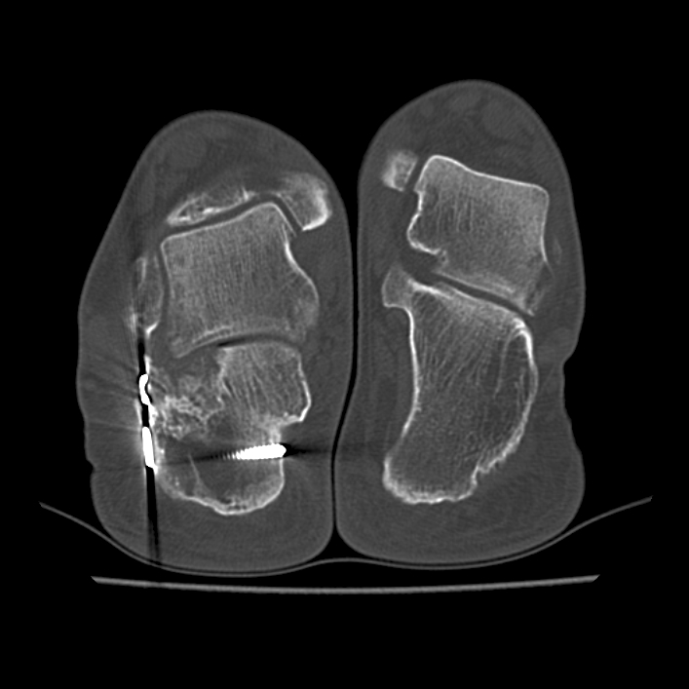

Slide 18
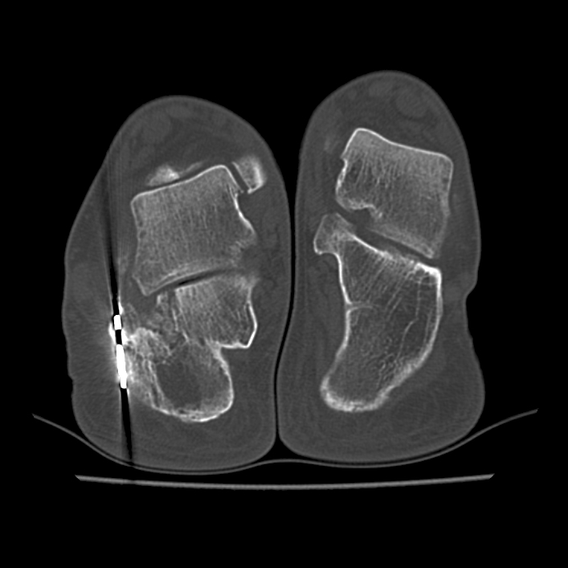

Slide 19
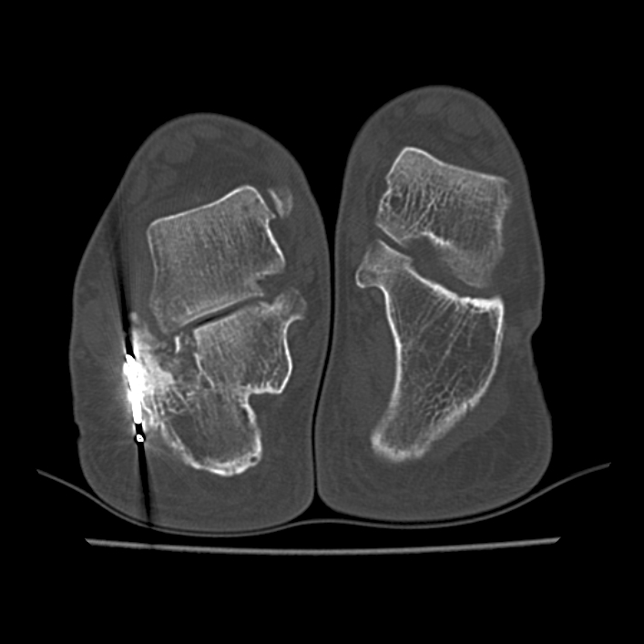

Slide 20
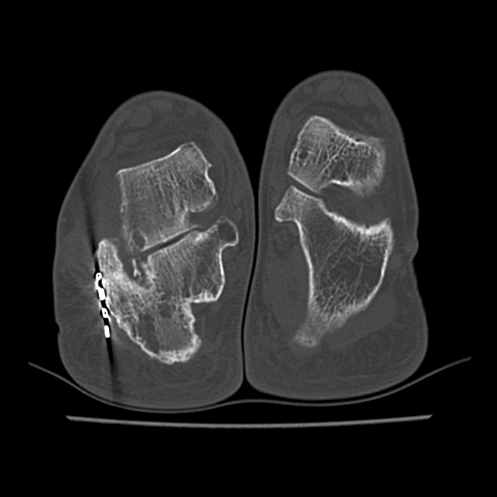

Slide 21
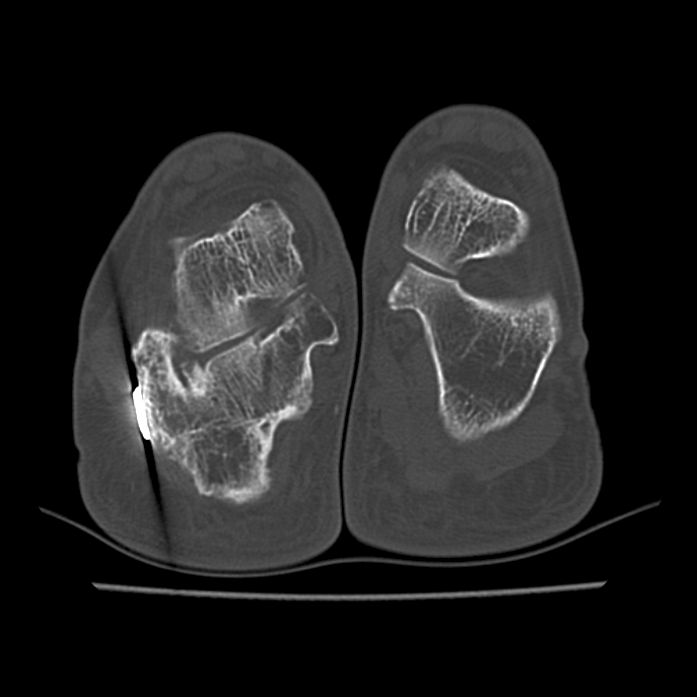

Slide 22
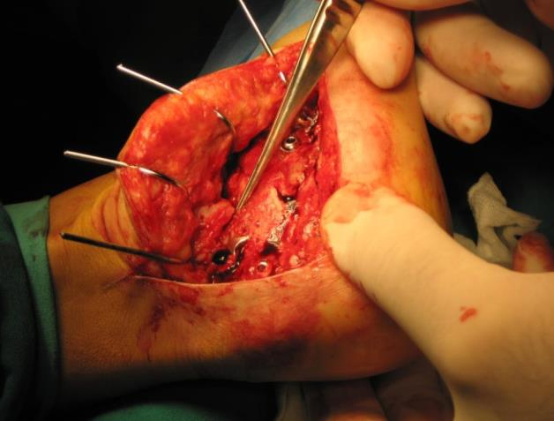
Third surgery
Subtalar corrective arthrodesis
1.5 years

Slide 23
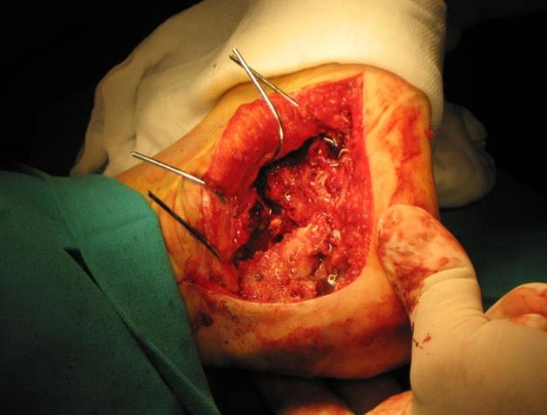
Third surgery
Subtalar corrective arthrodesis
1.5 years

Slide 24
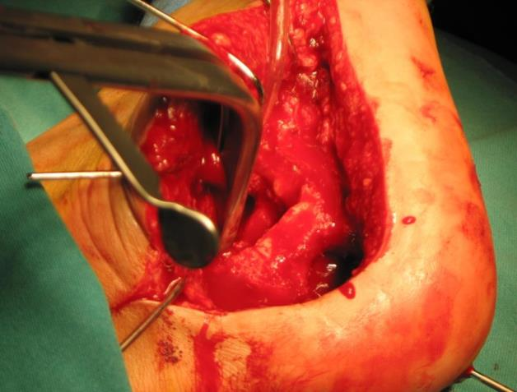
Third surgery
Subtalar corrective arthrodesis
1.5 years

Slide 25
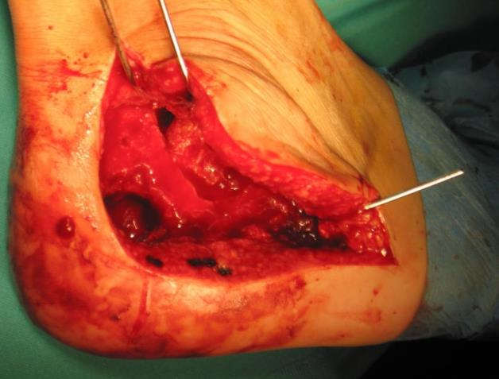
Third surgery
Subtalar corrective arthrodesis
1.5 years

Slide 26
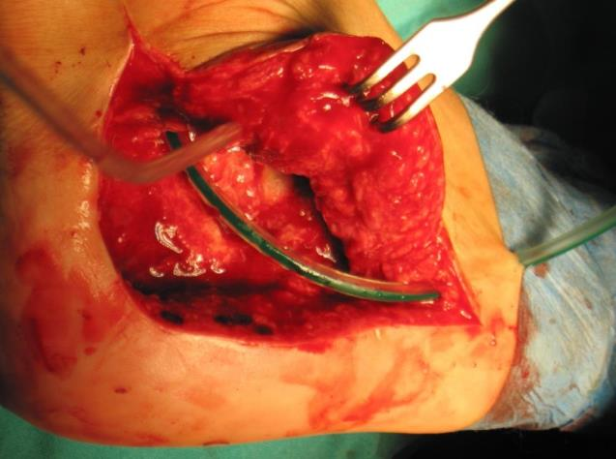
Third surgery
Subtalar corrective arthrodesis
1.5 years

Slide 27
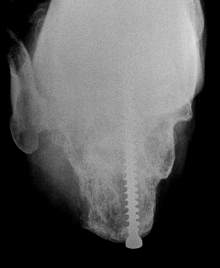
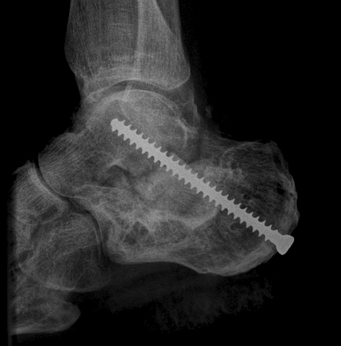
Postoperative x-rays
1.5 years

Slide 28
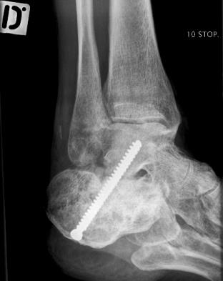
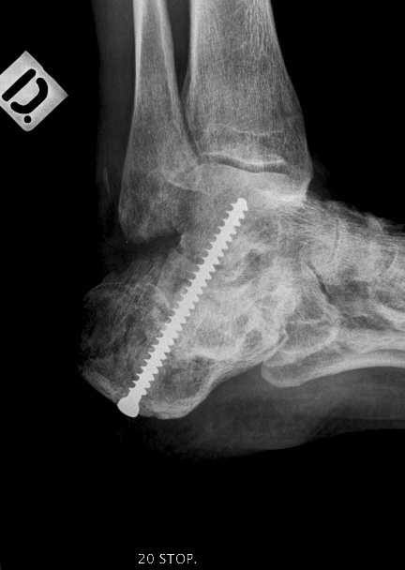
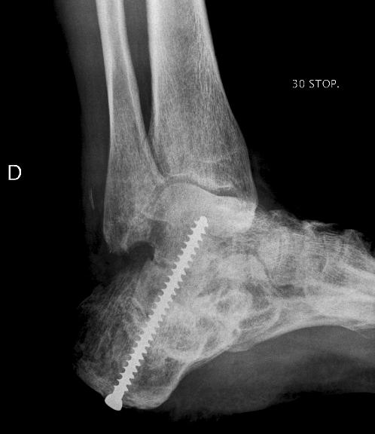
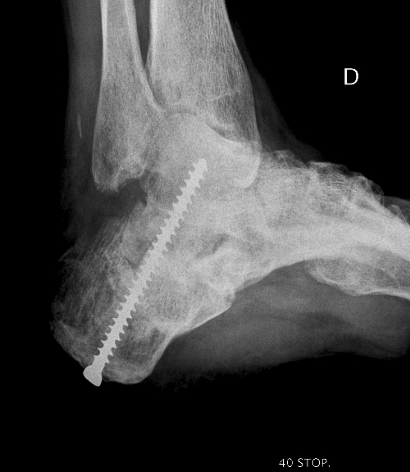

Slide 29
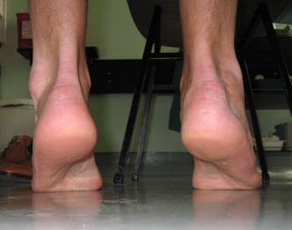
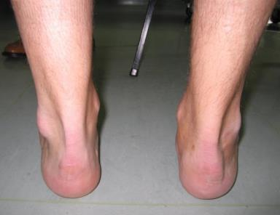
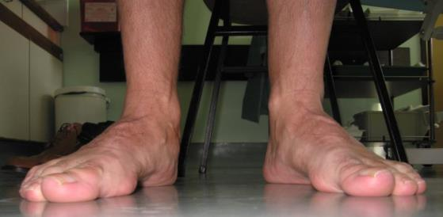
2-year follow-up

Slide 30
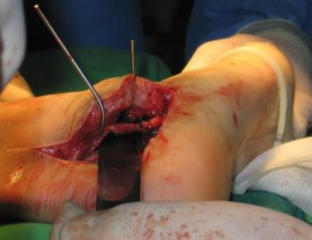
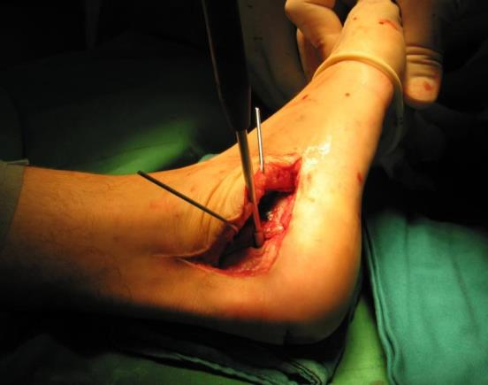
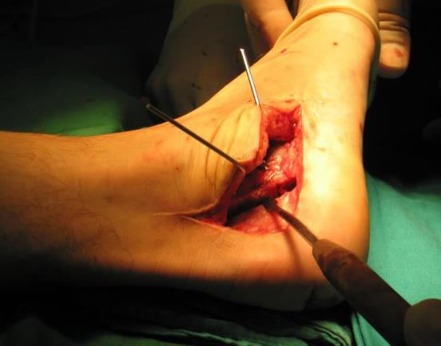
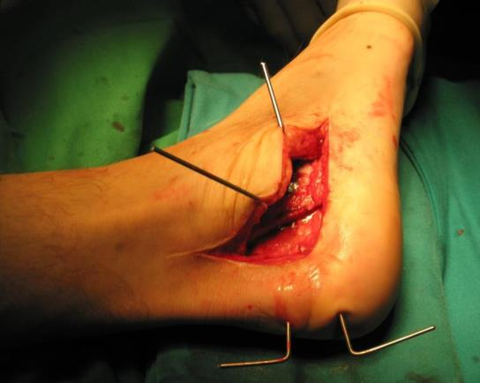
Fourth surgery
Osteotomy with tuber medialization
3.5 years

Slide 31
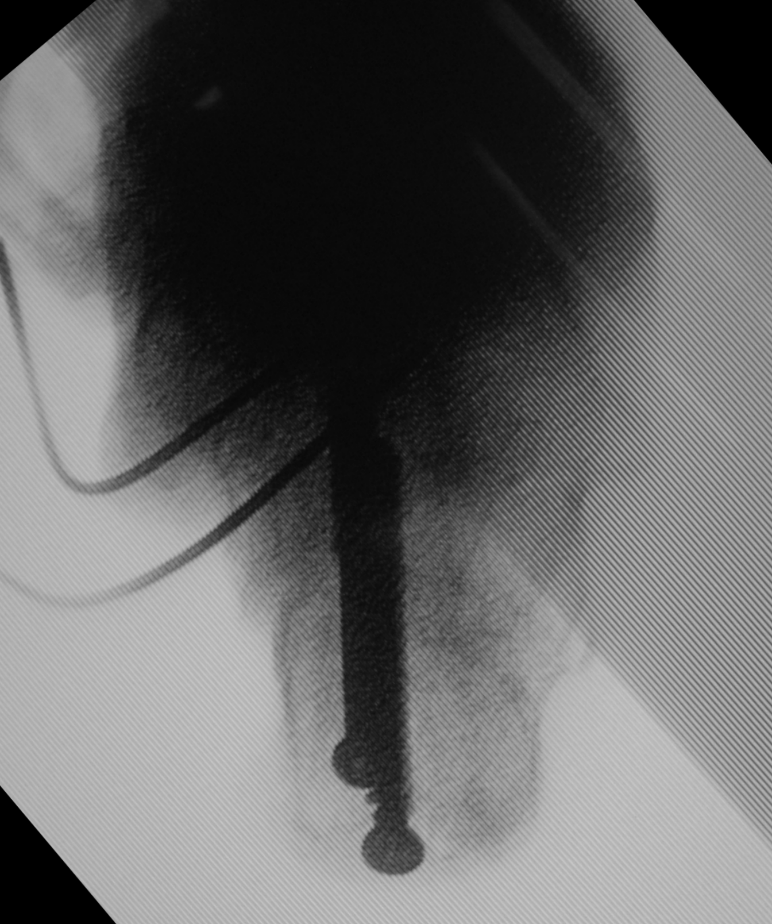
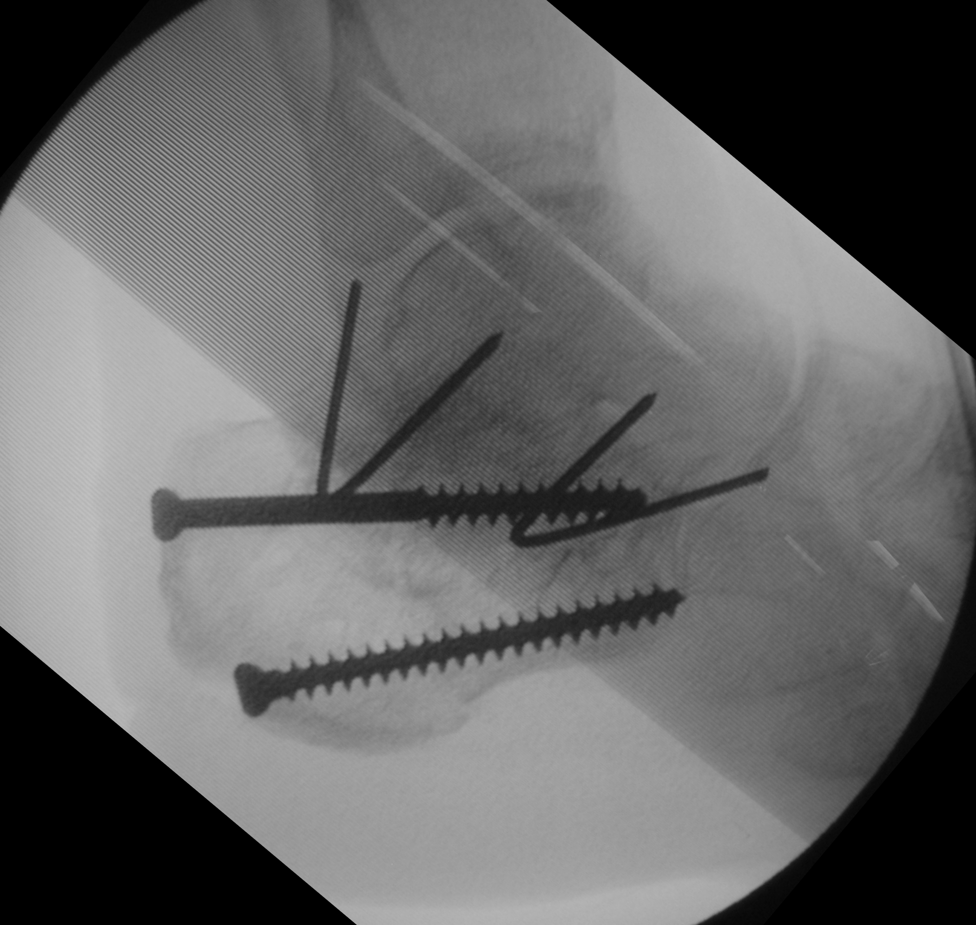
Postoperative x-rays
Osteotomy with tuber medialization

Slide 32
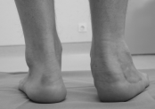
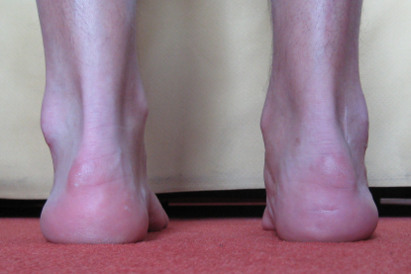
6.5-year follow-up

Slide 33
Summary
Operation 1 (day 0)—closed reduction, percutaneous pinning
Operation 2 (day 18)—ORIF, malunion
Operation 3 (1.5 years)—subtalar reconstructive arthrodesis
Operation 4 (3.5 years)—osteotomy with tuber medialization

Slide 34
Take-home messages
Primary treatment of open calcaneal fractures—role of damage control surgery in polytrauma
Restore 3-dimensional bony morphology with all calcaneal reconstructions
At time of subtalar corrective arthrodesis, address axis, length, height of the hindfoot to minimize need for further surgery
Fine-tuning after subtalar fusion for residual complaints/deformity
Preoperative CT scan in case of doubt

