Slide 1
Flatfoot deformity
Case for small group discussion
AOTrauma—Foot & Ankle
Module 9: Acquired flatfoot deformity
Notes:
Lateral column lengthening
Author: Les Grujic, AU

Slide 2
Case description
61-year-old man
Progressive flatfoot deformity
Gradually increasing pain and mobility restrictions

Slide 3
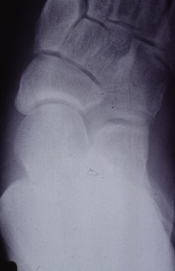
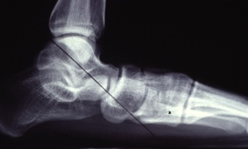
Preoperative x-rays
Notes:
Pes plano abductovalgus with dorsolateral peritalar subluxation of the navicular
Discuss talar head uncovering due to navicular shift and interruption of the talus—1st MT axis

Slide 4
Treatment options?
Lateral column lengthening
Fusions
Tendon transfers

Slide 5
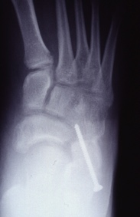
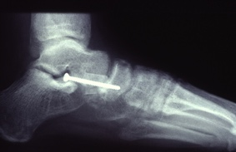
Postoperative x-rays
Lateral column lengthening with iliac autograft
Notes:
Good correction obviates need for sliding osteotomy of the calcaneal tuberosity.

Slide 6
Good correction after column lengthening and CC fusion

Slide 7
Take-home messages
The indication of lateral column lengthening procedures in adult acquired flatfoot is forefoot abduction deformity
Lateral column lengthening restores forefoot alignment by adduction and plantar flexion with an increase of the foot arch
There are a variety of lengthening techniques—anterior process of calcaneus different osteotomies and distraction calcaneocuboid arthrodesis
Nonarthritic and mobile hindfoot joints are a prerequisite to calcaneal osteotomies

