Slide 1
Charcot ankle
Case for small group discussion
AOTrauma—Foot & Ankle
Module 12: Charcot foot
Notes:
Author: Per-Henrik Agren, SE

Slide 2
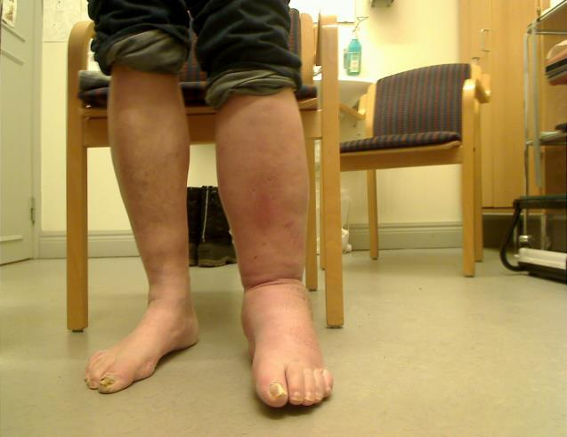
Case description
Diabetic type 1
Poor sensation
Swollen ankle after sprain 2-3 months previous

Slide 3
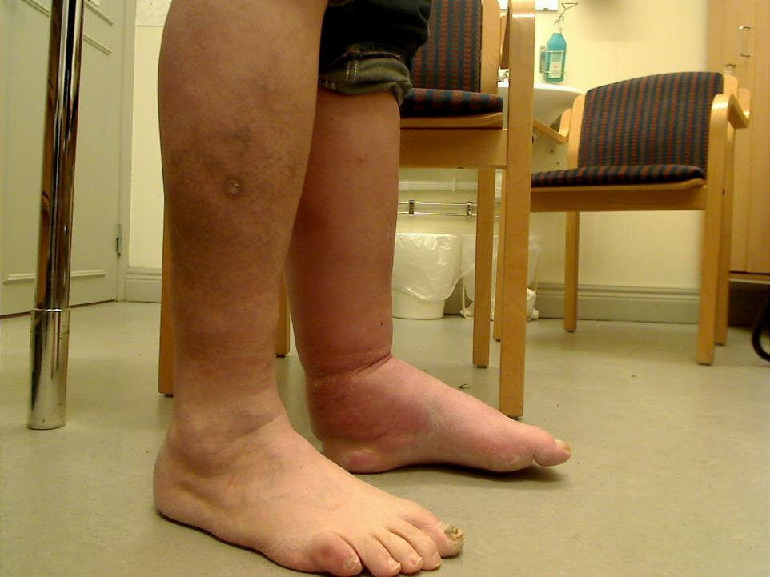
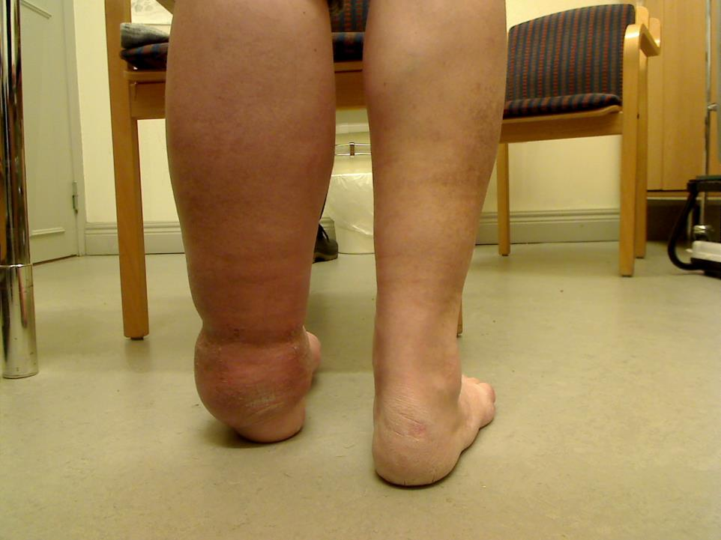
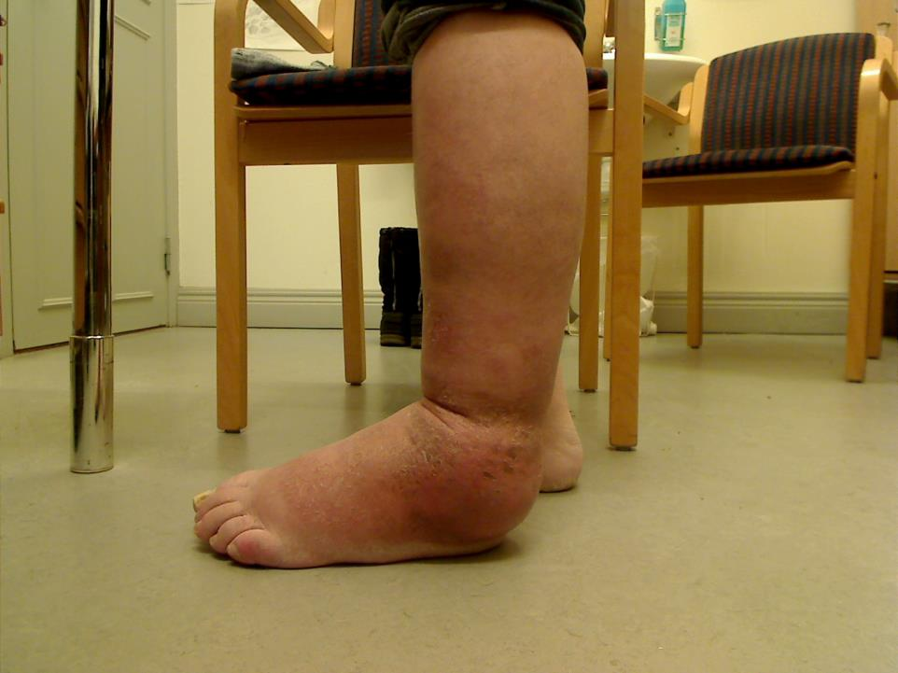

Slide 4
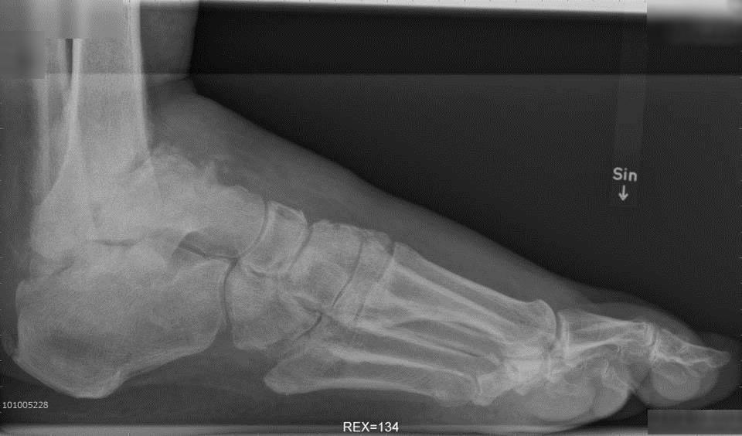
Preoperative x-ray

Slide 5
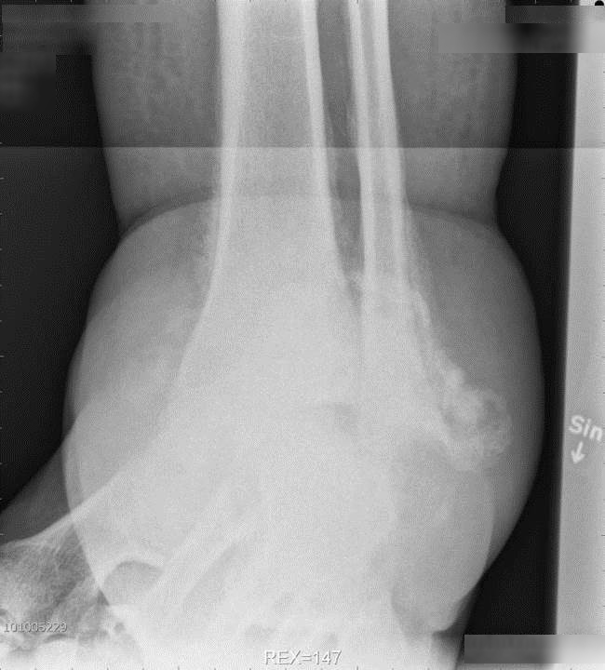

Slide 6
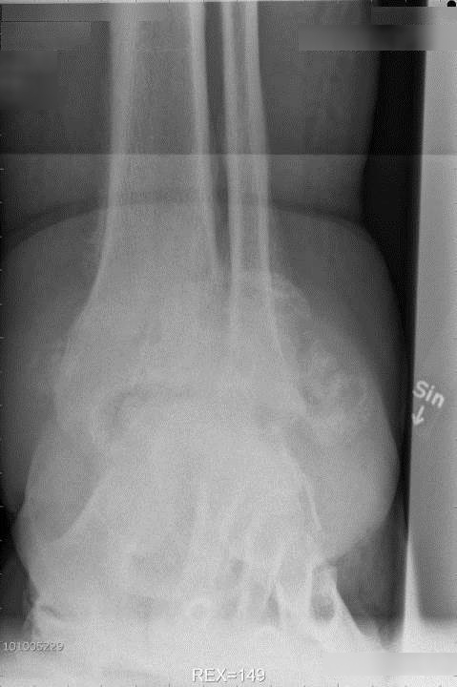

Slide 7
What options are available?
Fusion!
Technique?
Arthroscopic?
Screws?
Screw and plate?
IM-nail?
External fixator

Slide 8
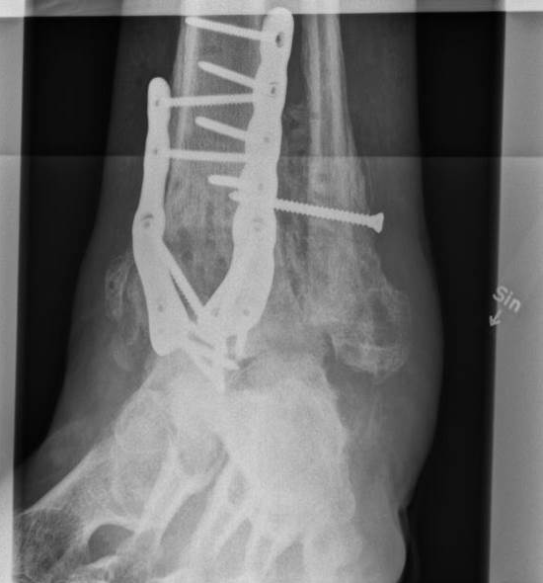
Anterior approach with distraction and plates

Slide 9
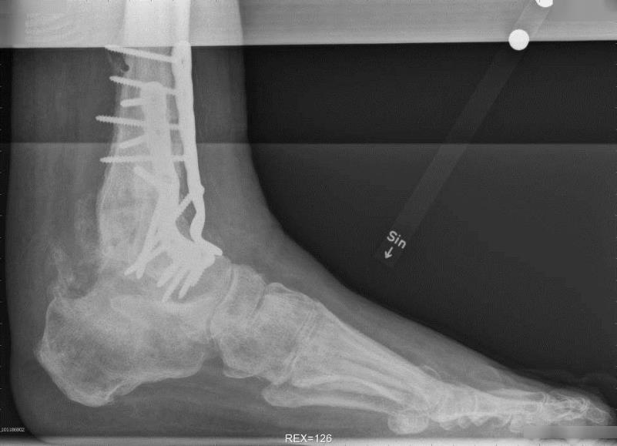
Anterior approach with distraction and plates

Slide 10
Postoperative protocol
Nonweight bearing until signs of healing
Protect for longer than normal
Serially review for progress of union

Slide 11
Take-home messages
A neuropathic patient is expected to have slower healing and increased risk of failure due to fixation
So plating or intramedullary nailing are recommended
If stable fixation and healing with good alignment are achieved, a good functional outcome can be expected

