Slide 1
Lisfranc malunion
Case for small group discussion
AOTrauma—Foot & Ankle
Module 13: Midfoot
Notes:
Author: Stefan Rammelt, DE

Slide 2
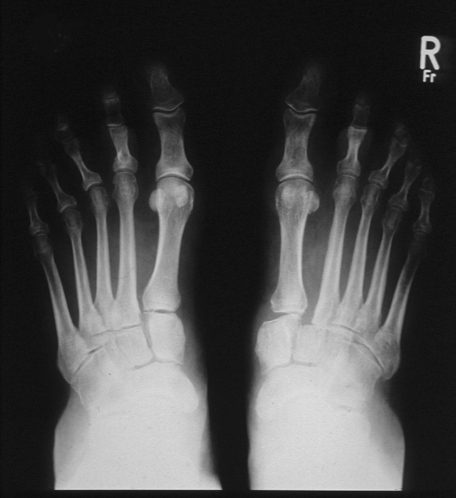
Case description
55-year-old woman
10 months after fall on stairs, pain over the midfoot with every step

Slide 3
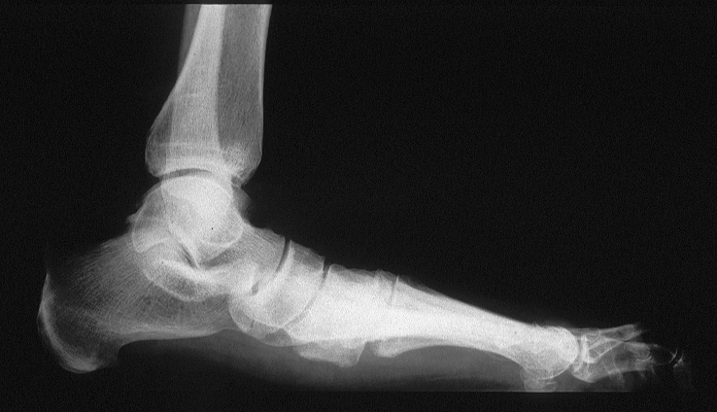
Clinical appearance—planovalgus foot

Slide 4
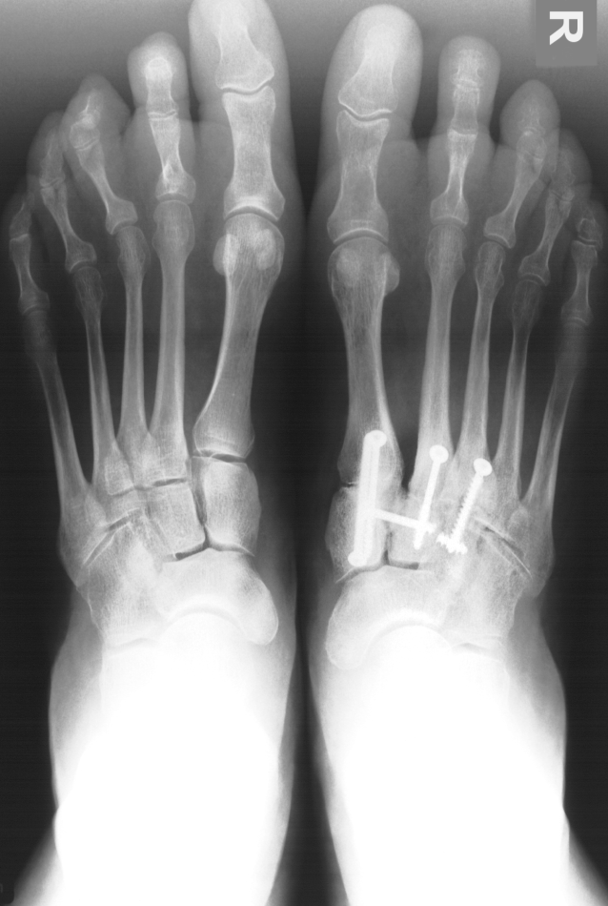
Malunion
1 year after correction

Slide 5
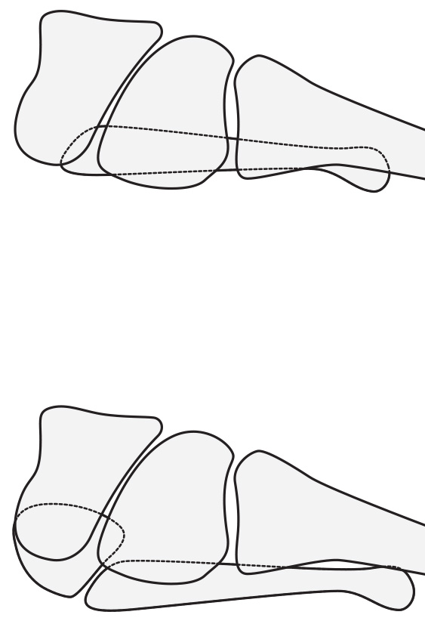
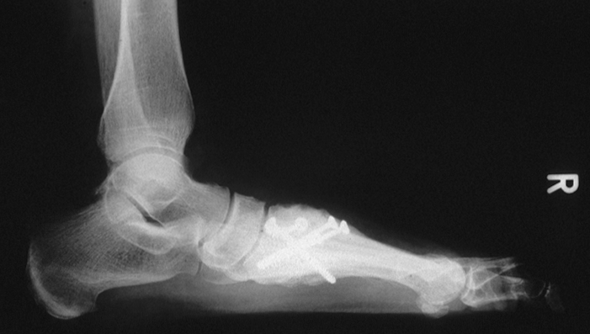
Talus-1st metatarsal axis
Malunion
1 year after correction
Notes:
Reference:
Faciszewski T, Burks RT, Manaster BJ. Subtle injuries of the Lisfranc joint. J Bone Joint Surg Am. 1990 Dec;72(10):1519–1522.

Slide 6
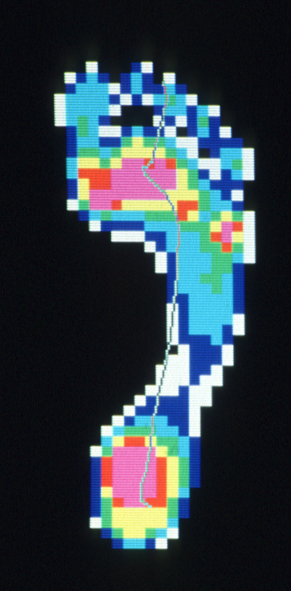
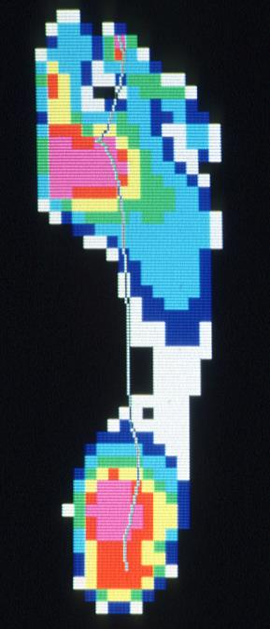
Pedobarographic findings
1 year after correction
Preoperative
Normalized pressure pattern of the sole
Load shift from lateral to medial in homolateral fracture dislocations
Improved roll-over and push-off (first and second toe)

Slide 7
Take-home messages
Overlooked purely ligamentous Lisfranc injuries can lead to 3-D deformity and arthritis
Corrective fusion restores function and alignment
Restrict fusion to the 1st, 2nd, and 3rd TMT joints if possible (ie, avoid fusion of 4th and 5th TMT joints)
Faciszewski et al. J Bone Joint Surg Am. 1990;72:1519–1522

