Slide 1
Teaching methods
Presenter’s name (Arial 20 pt)
Meeting (Arial 20 pt)
Presenter’s title (Arial 20 pt)
City, Month, Year (Arial 20 pt)

Slide 2
Learning outcomes
Select appropriate teaching methods
Ensure continuity in your curriclum
Sequence the teaching methods in your curriculum appropriately
Integrate the teaching methods in your curriculum appropriately

Slide 3
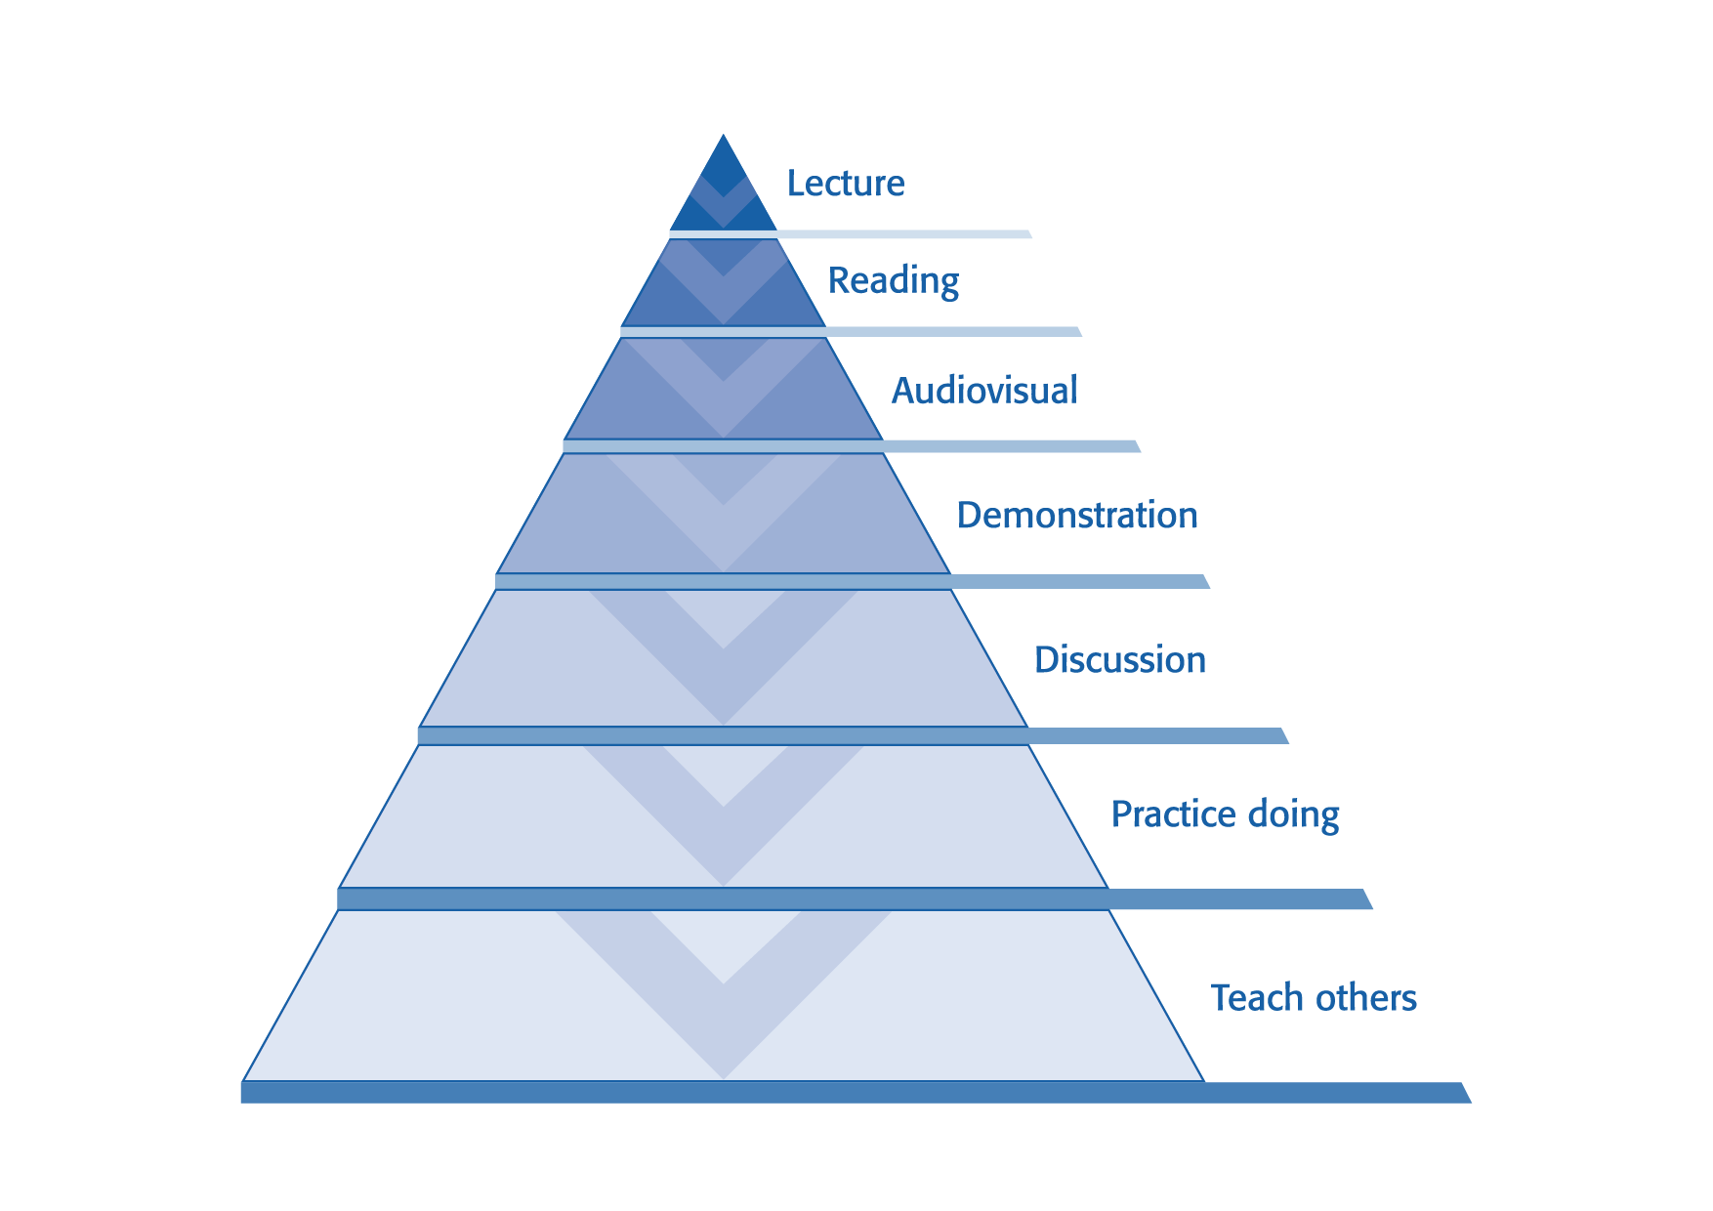

Slide 4
Select a teaching method for a defined audience
Selecting teaching methods…
requires good knowledge of the target audience
is dependent on the targeted level of outcome
respects the situation at the venue and the skills/experience of the faculty

Slide 5
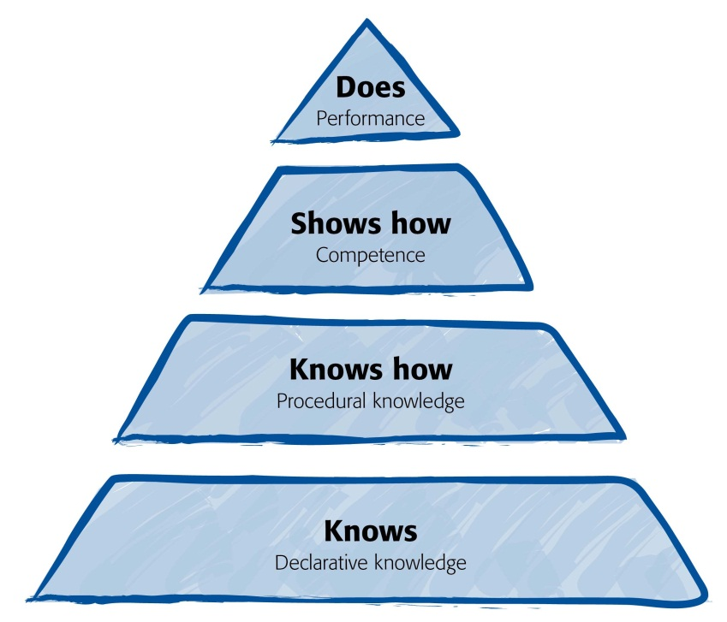
Targeted levels of outcomes
Successful application of knowledge and skills in clinical practice
Demonstration of skills (manual or decision making) in educational environment
Know how to do or achieve something
Facts/evidence, concepts, and the relationships between them

Slide 6
Which teaching method supports which level of outcome?
Successful application of knowledge & skills in clinical practice
Demonstration of skills (manual or decision making) in educational environment
Know how to do/achieve something
Facts/evidence, concepts, and the relationships between them
Not covered in AOT courses
Practical exercises, wet labs, ARS, case discussions, simulations
Case discussions, demon-strations, (case-based) lectures, eLearning
Presentations, lectures, eLearning, readings

Slide 7
CSI

Slide 8
Structure and flow of the curriculum
C: Continuity ─ Continuity provides learners the opportunity to revisit knowledge and skills in more depth as they progress through an educational activity.
S: Sequence ─ The sequence in an educational plan focuses on the order in which things occur: from simple to complex learning, from known to unknown.
I: Integration ─ Integration is concerned with the linkages of information to enable learners to develop a holistic overview.
Notes:
Geraldine O’Neill: Programme Design. Coherence, Sequence, and Integration in a Programme. UCD Teaching and Learning (www.ucd.ie/teaching).
“Most curricula are unfocused…There is a notable absence of structure and coherence”. Gardiner, 1996 (cited in Diamond, RM (1998) Designing and and Assessing Courses and Curricula: A practical guide. San Francisco: Jossey-Bass.

Slide 9
Continuity—example: fracture reduction
Continuity provides learners the opportunity to revisit knowledge and skills in more depth as they progress through an educational activity.
Fracture reduction is included in the AOTrauma Advances course in the following activities as a recurrent (but varied) topic:
Precourse eLearning or lecture on fracture reduction at the beginning of the course
All lectures on the management of articular and diaphyseal fractures
Case discussions in small groups
Practical exercises

Slide 10
Sequence—example: preoperative planning
The sequence in a curriculum focuses on the order in which things occur: from simple to complex learning, from known to unknown.
Example: “Preoperative planning” in the AOTrauma Principles course:
Basic concept is introduced and explained in a lecture
Secondly, participants develop a preop plan for a forearm fracture in the templating exercise
3) Subsequently, the preop plan established in the templating exercise is implemented in a practical exercise and feedback on the plan and the fixation is provided by table instructors

Slide 11
Integration
Integration is concerned with the linkages of information to enable learners to develop a holistic overview.
Examples:
Demonstrating, highlighting, and pointing out where the discussed topic or concept is also of relevance.
Referring to other faculty members’ lectures, evidence in the literature, related topics, concepts, or skills.
Summaries at the end of a module that convey “the big picture”.

Slide 12
Summary
Levels of outcomes
CSI

