Slide 1
AOTrauma Masters Course—Current Concepts
Module 3, Case 1: Lesser arc perilunate dislocation (purely ligamental injury)
Davos Courses
December 2018

Slide 2
Case description
28-year-old male merchandiser
Rolled over by a wave at the beach
He had a glenohumeral dislocation of the right shoulder treated by closed reduction and immobilization
Was seen 1 month after initial trauma
Wrist injury went unnoticed initially
Wrist pain, limitation of range of motion

Slide 3
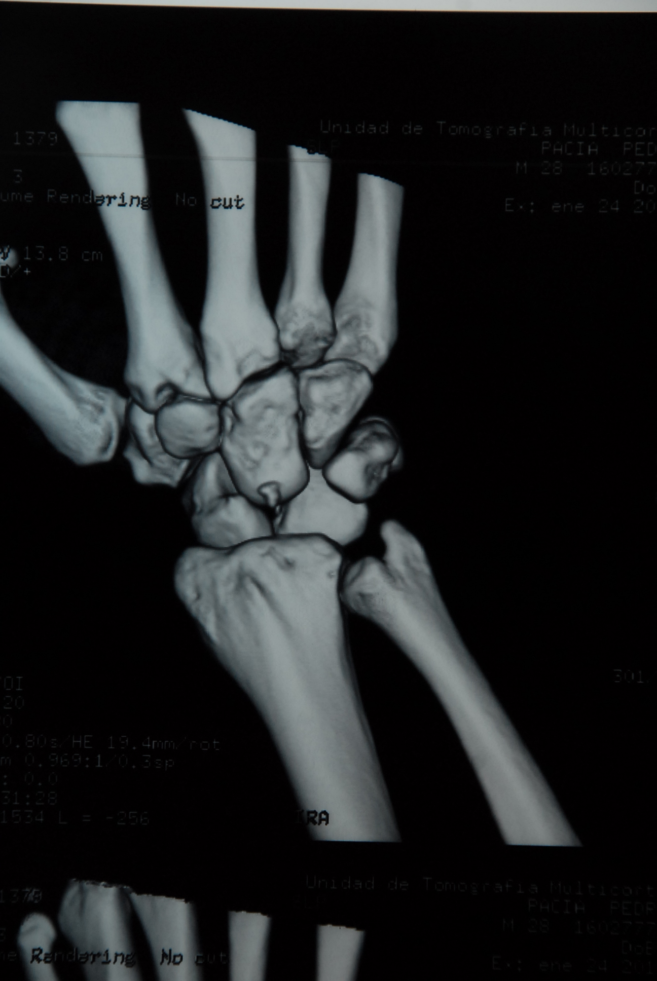

Slide 5
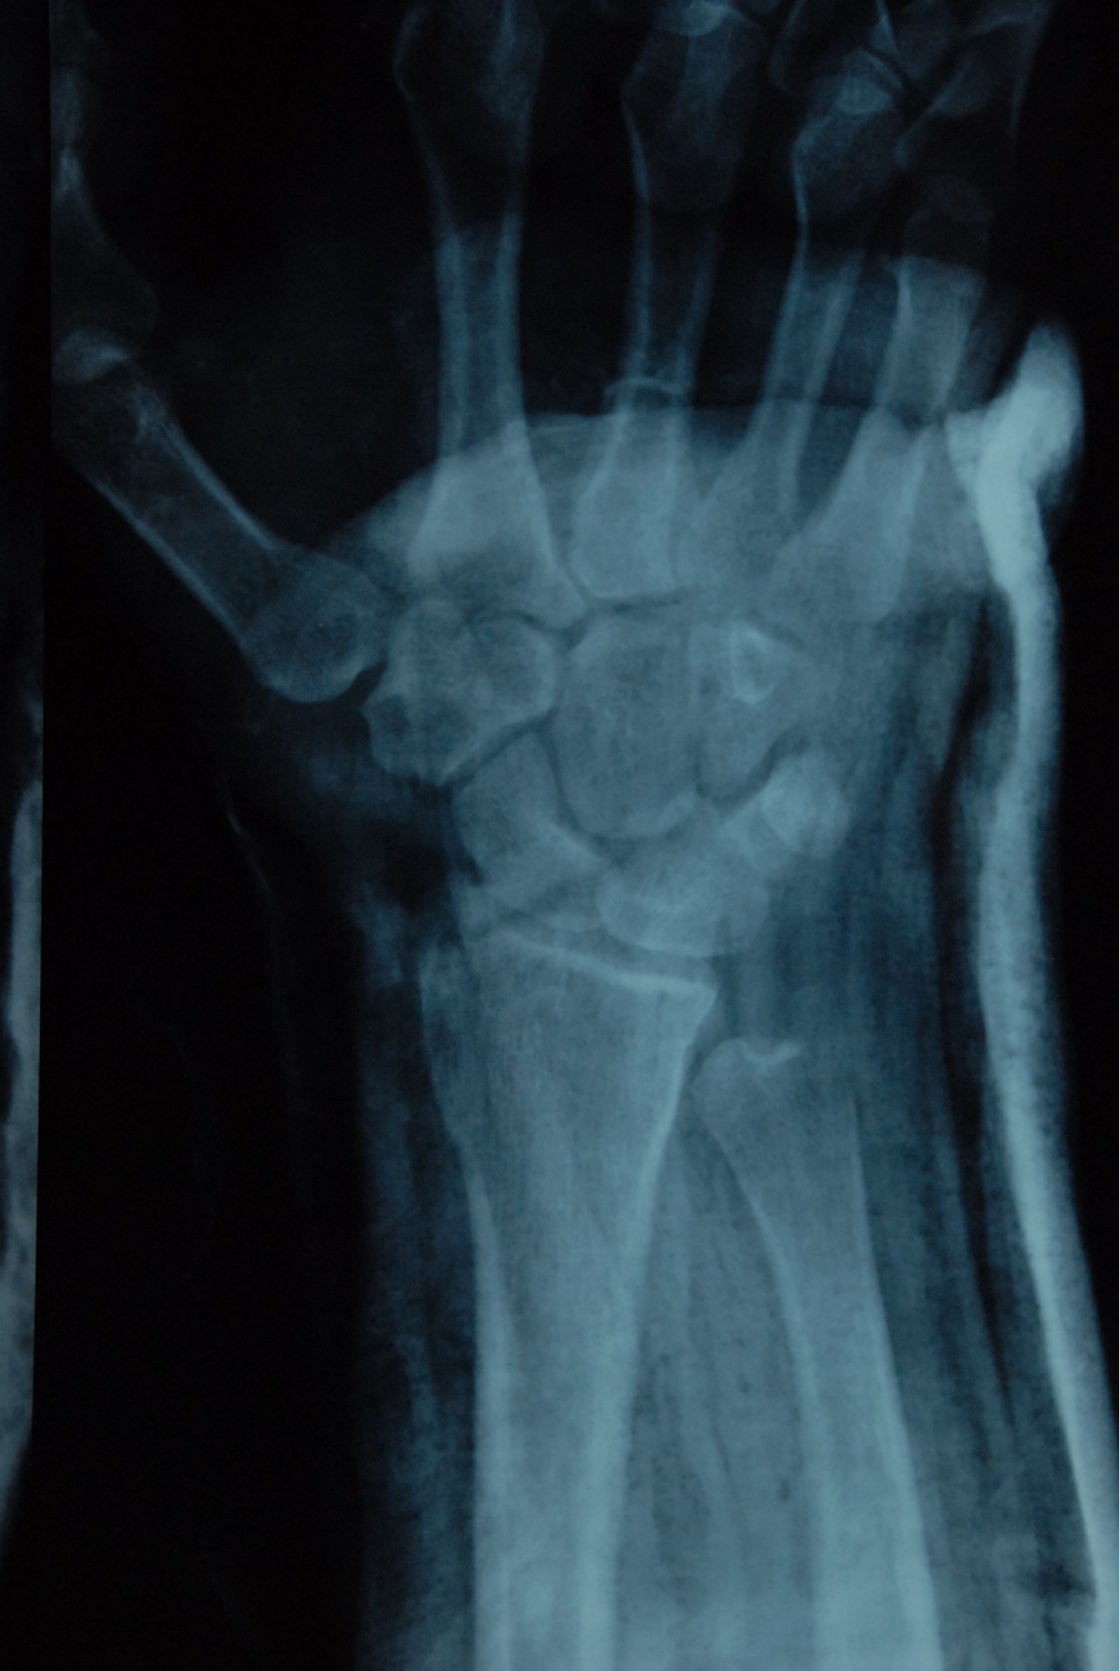

Slide 8
Discuss
Describe the injury
Treatment options
Approach
Method of fixation
Possible complications
Rehabilitation

Slide 9
Perilunate injuries
Johnson RP. The acutely injured wrist and its residuals. Clin Orthop Relat Res. 1980 Jun;(149):33‒44.
Palmar
3%
Greater arc dislocations
Dorsal
97%
Lesser arc
dislocations

Slide 10
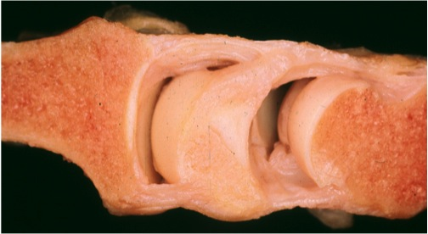
Two rows of matching concave and convex gliding surfaces
Notes:
The carpal bones are aligned in two rows of matching concave and convex gliding surfaces.

Slide 11
Endless varieties of injury patterns can be identified
Greater arc
Variants
Transscaphoid
perilunate fracture dislocation
Transscaphoid
transcapitate perilunate
fracture dislocation
Transstyloid perilunate fracture dislocation
Transstyloid transscaphoid
perilunate fracture dislocation
Notes:
Endless varieties of injury patterns can be identify depending on where the carpus is dislocated, what direction it is displaced and if there are any associated fractures.
In clinical practice, the prefix trans is used to refer to fractures and the prefix peri is used to describe a dislocation.

Slide 12
When should we operate? Timing of surgery
Herzberg G, Comtet JJ, Linscheid RL, et al. Perilunate dislocations and fracture-dislocations: a multicenter study. J Hand Surg Am. 1993 Sep;18(5):768–779
Patients treated after a delay of more than 45 days had significantly worse clinical outcomes
Komurcu M, Kürklü M, Ozturan KE, et al. Early and delayed treatment of dorsal transscaphoid perilunate fracture-dislocations. J Orthrop Trauma. 2008 Sep;22:535–540
Compared six patients treated acutely with six patients for whom treatment was delayed an average of 26 days
Follow-up after 45 months
Patients in the early treatment group had better wrist range of motion, grip strength, and clinical scores

Slide 13
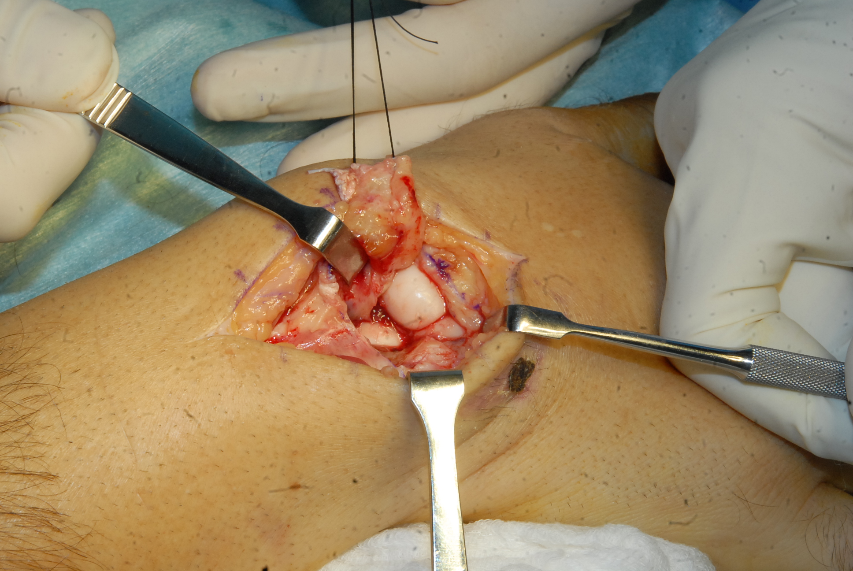

Slide 14
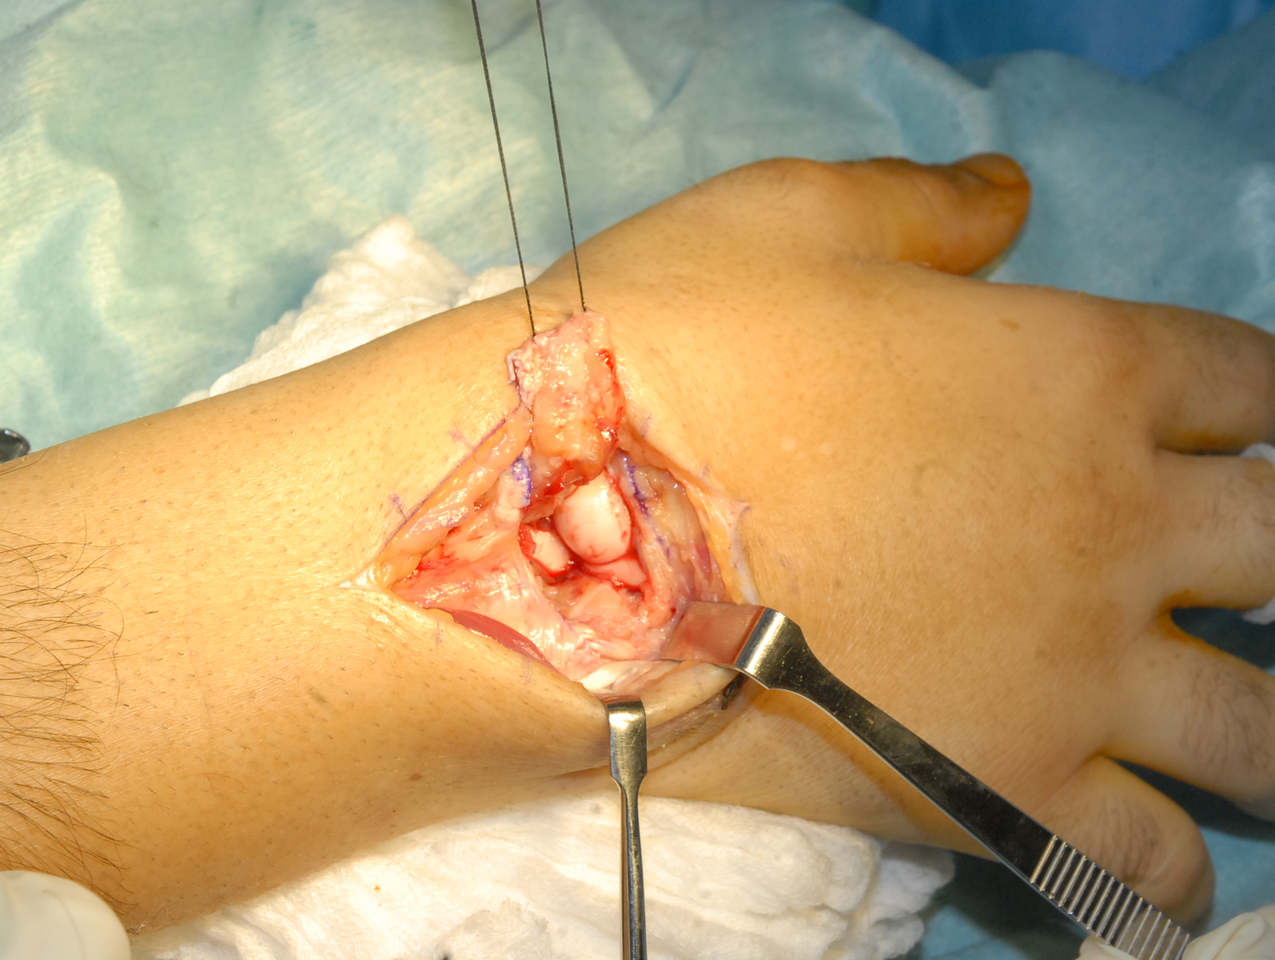

Slide 15
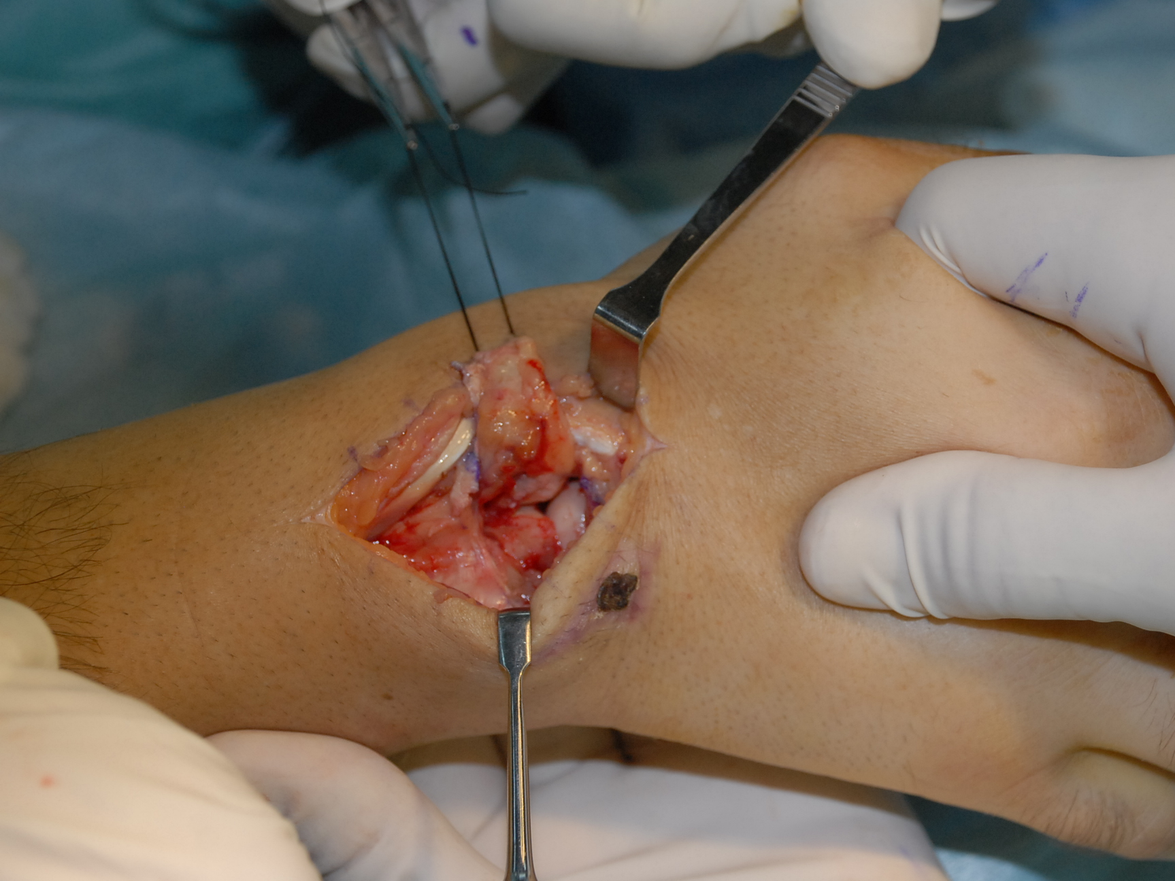

Slide 16
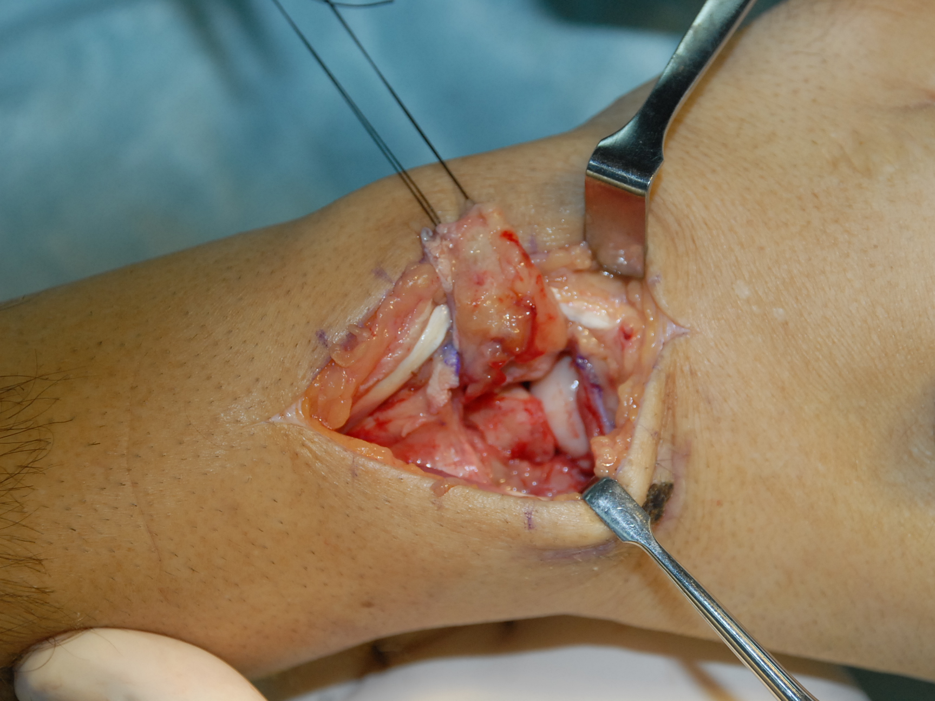

Slide 17
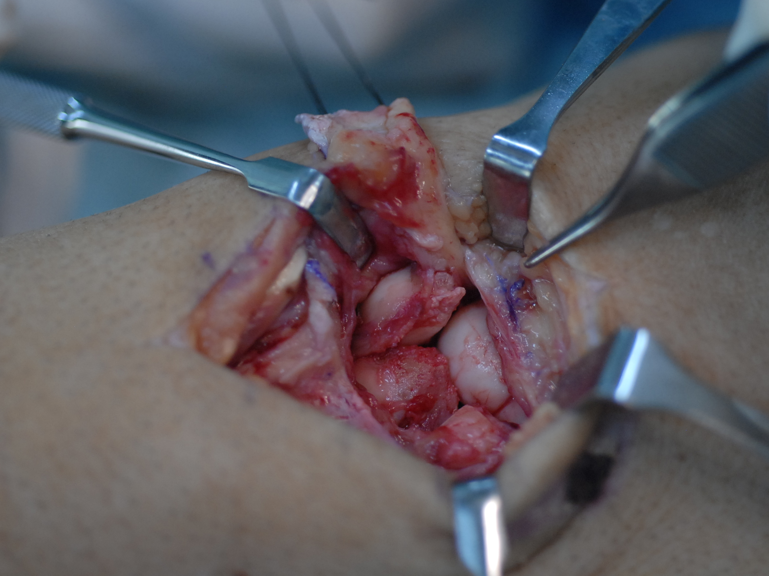

Slide 18
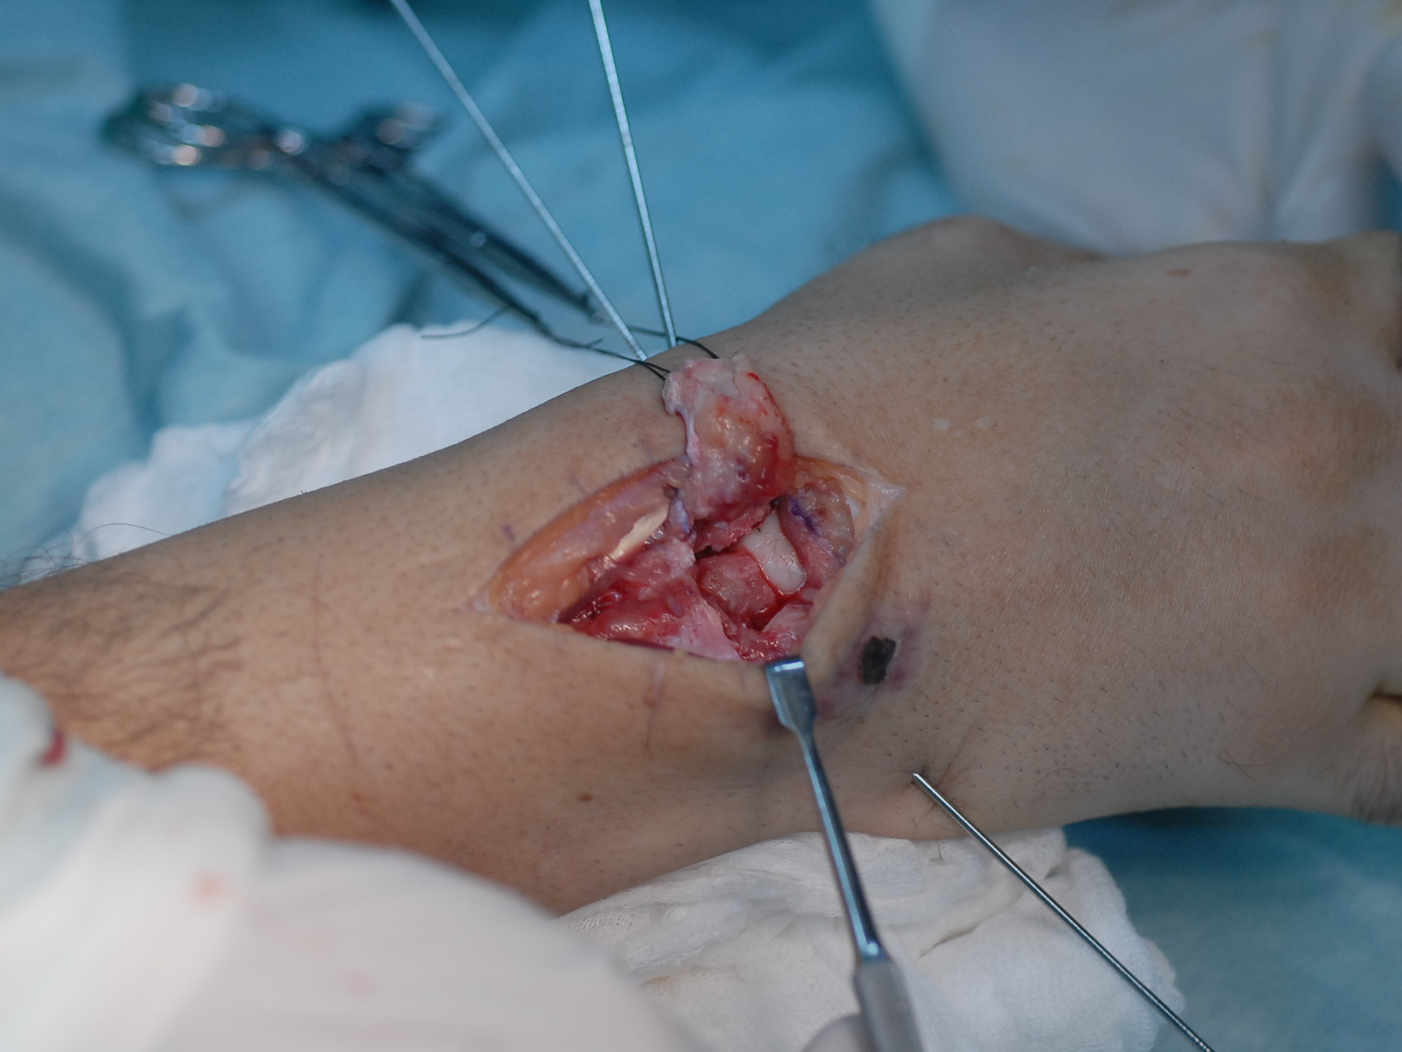

Slide 19
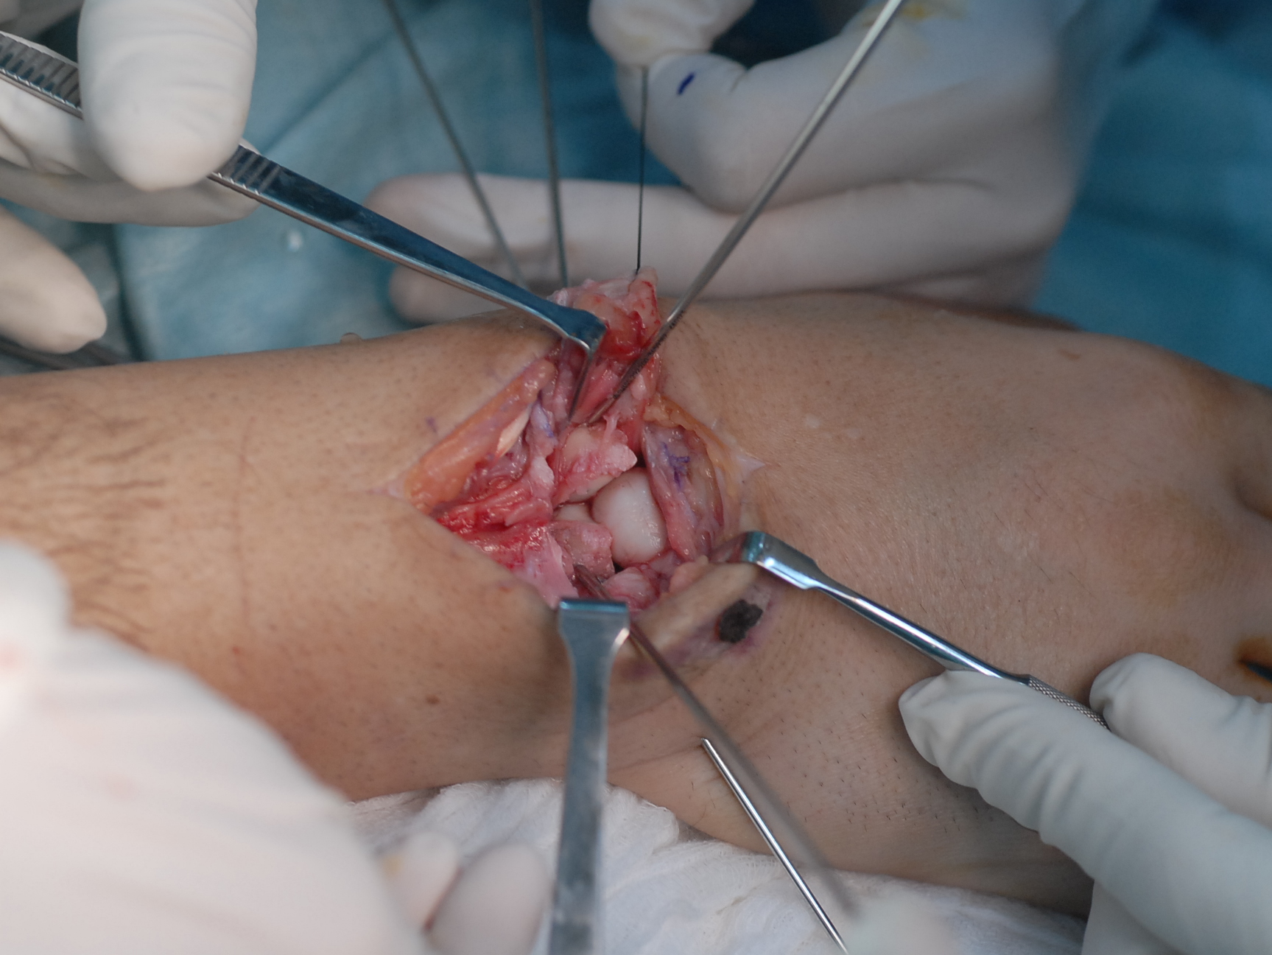

Slide 20
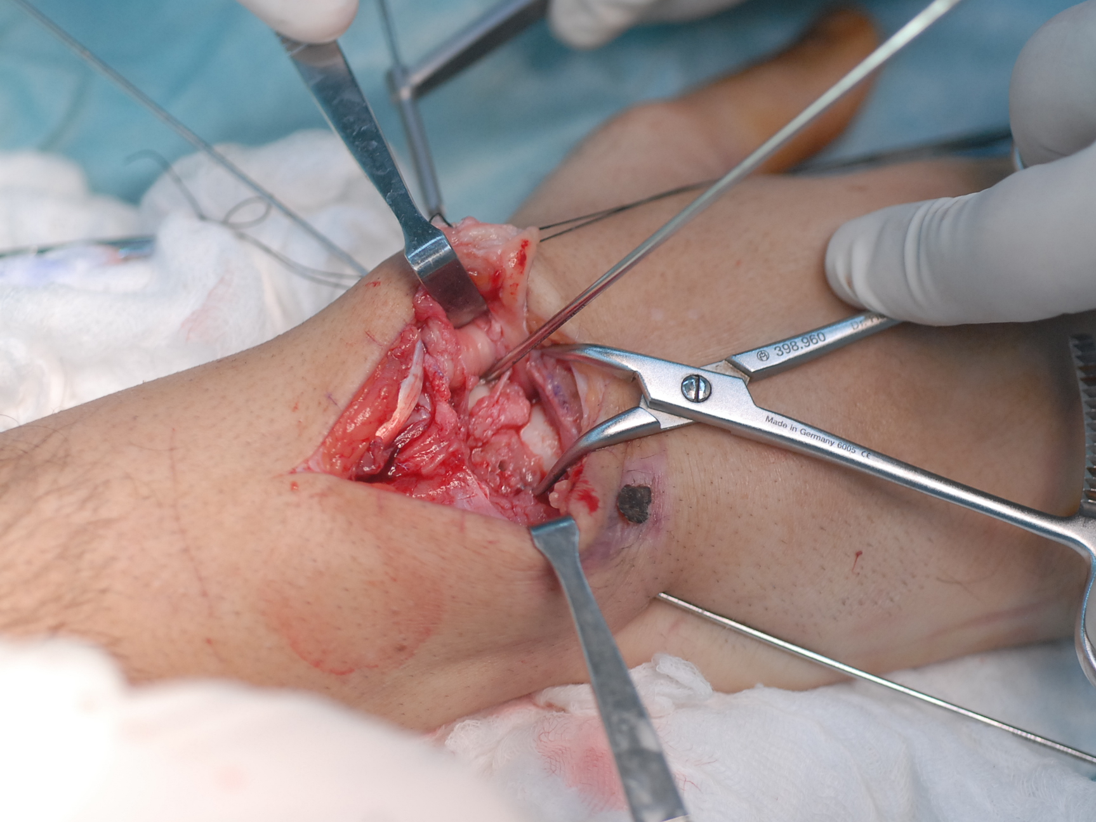

Slide 21
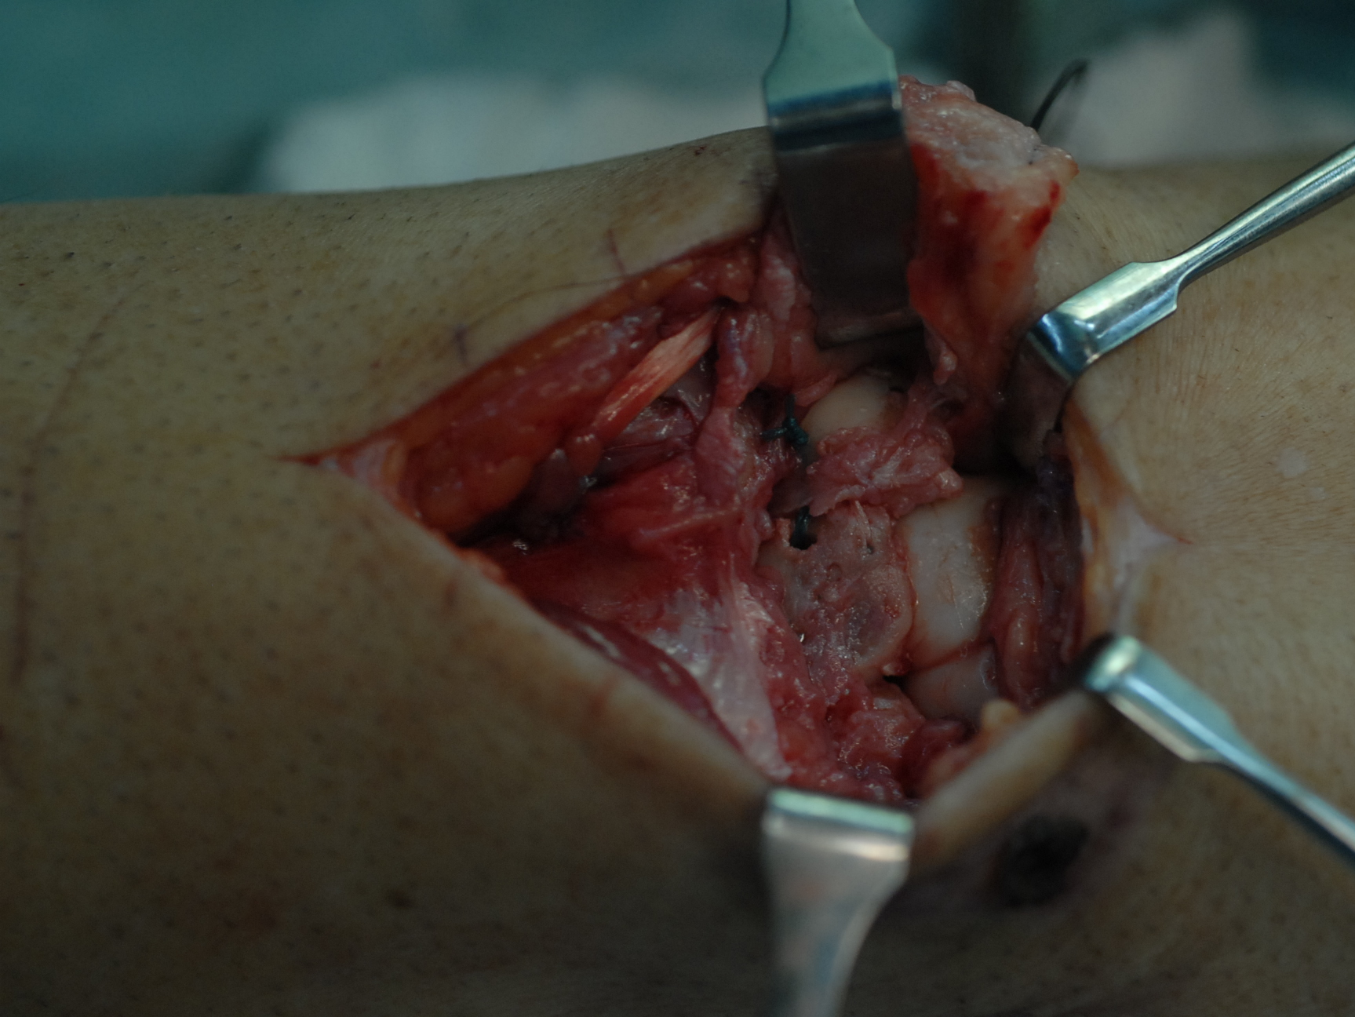

Slide 22
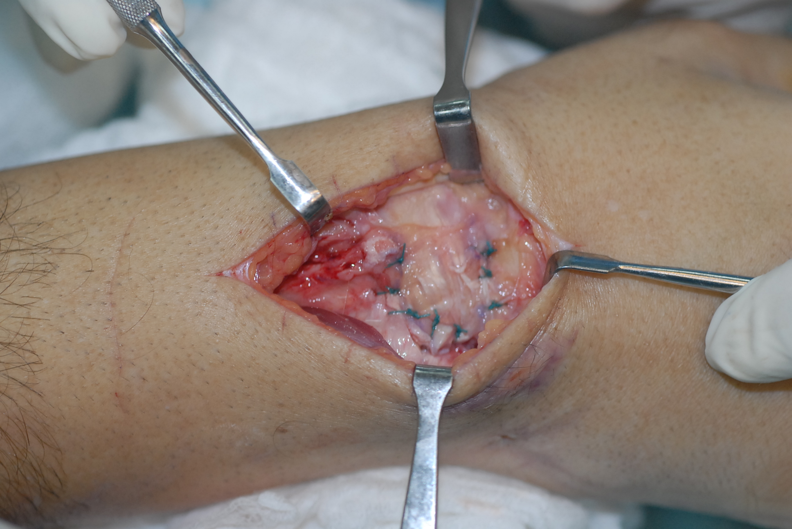

Slide 23
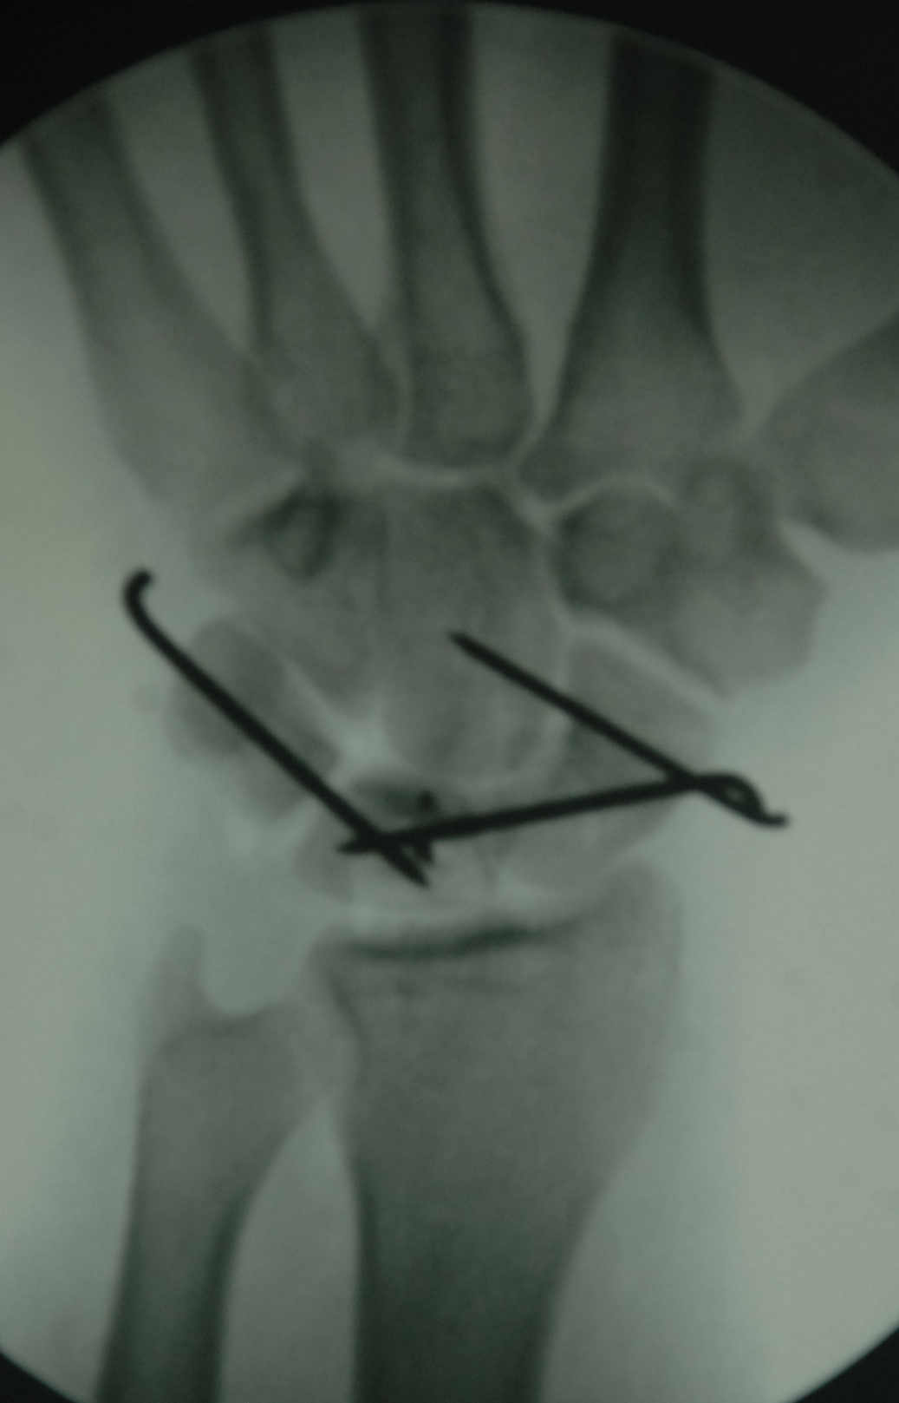
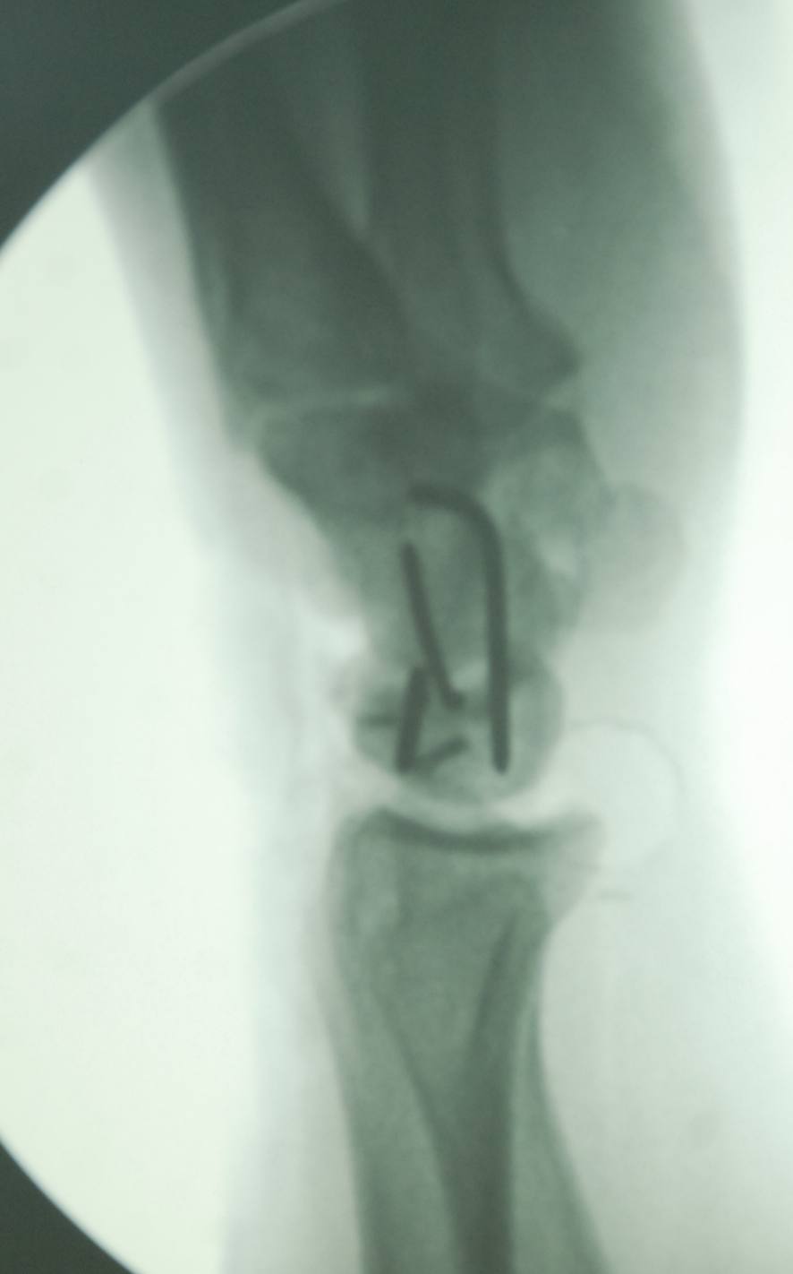

Slide 24
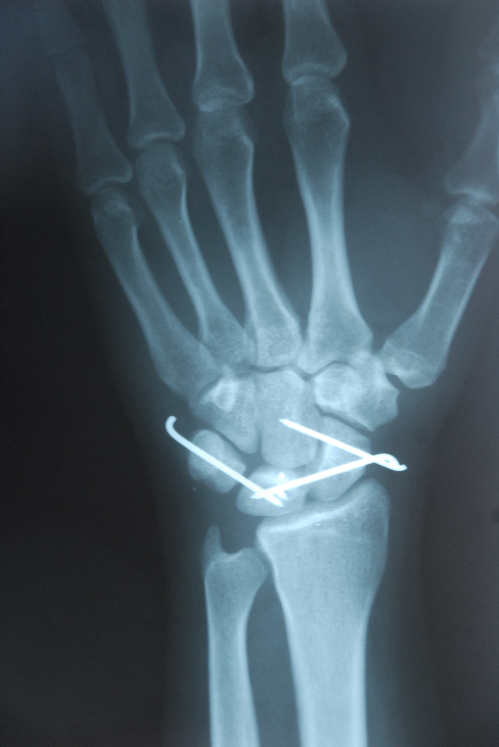
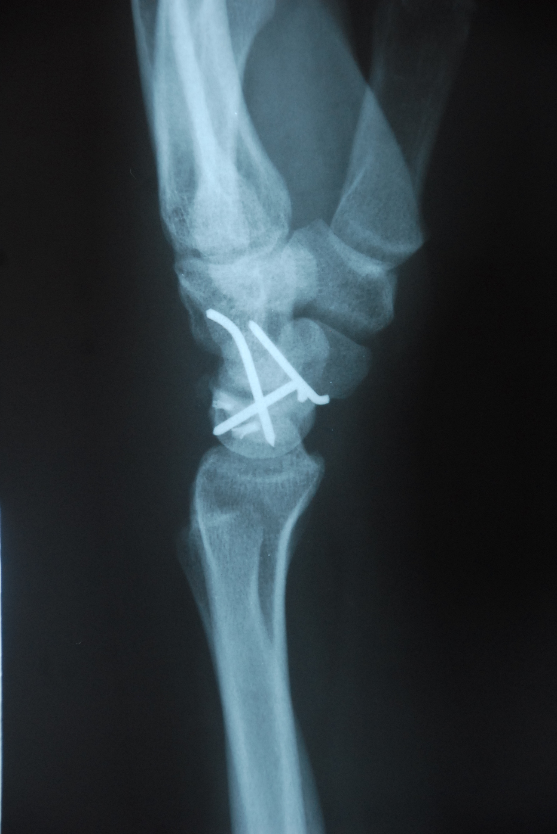

Slide 25
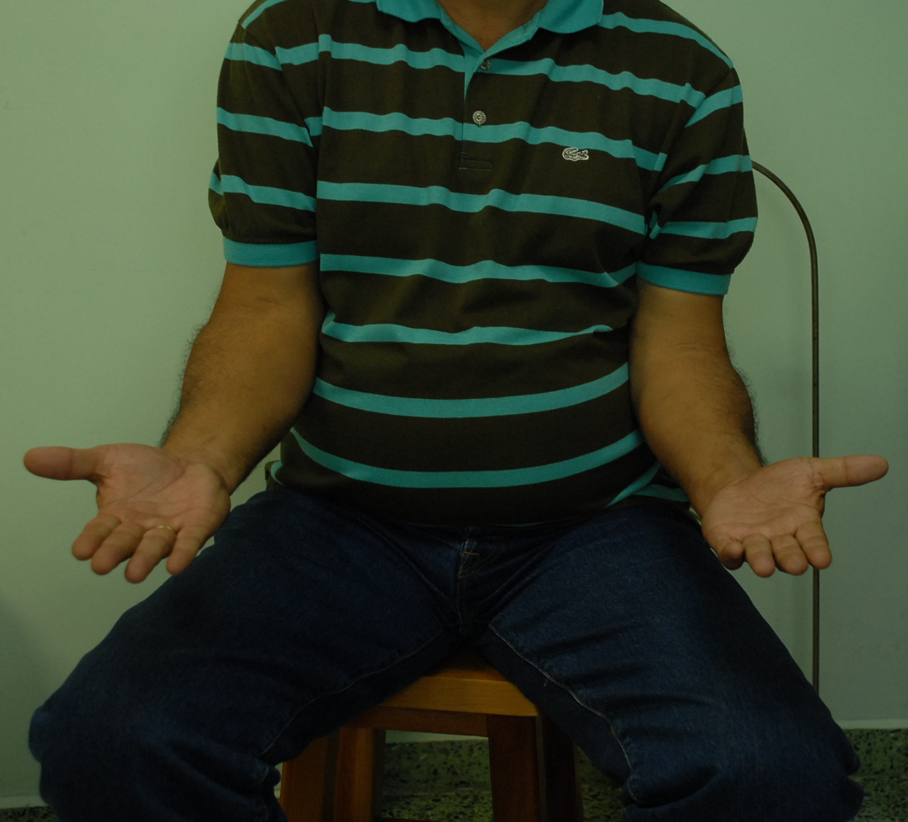
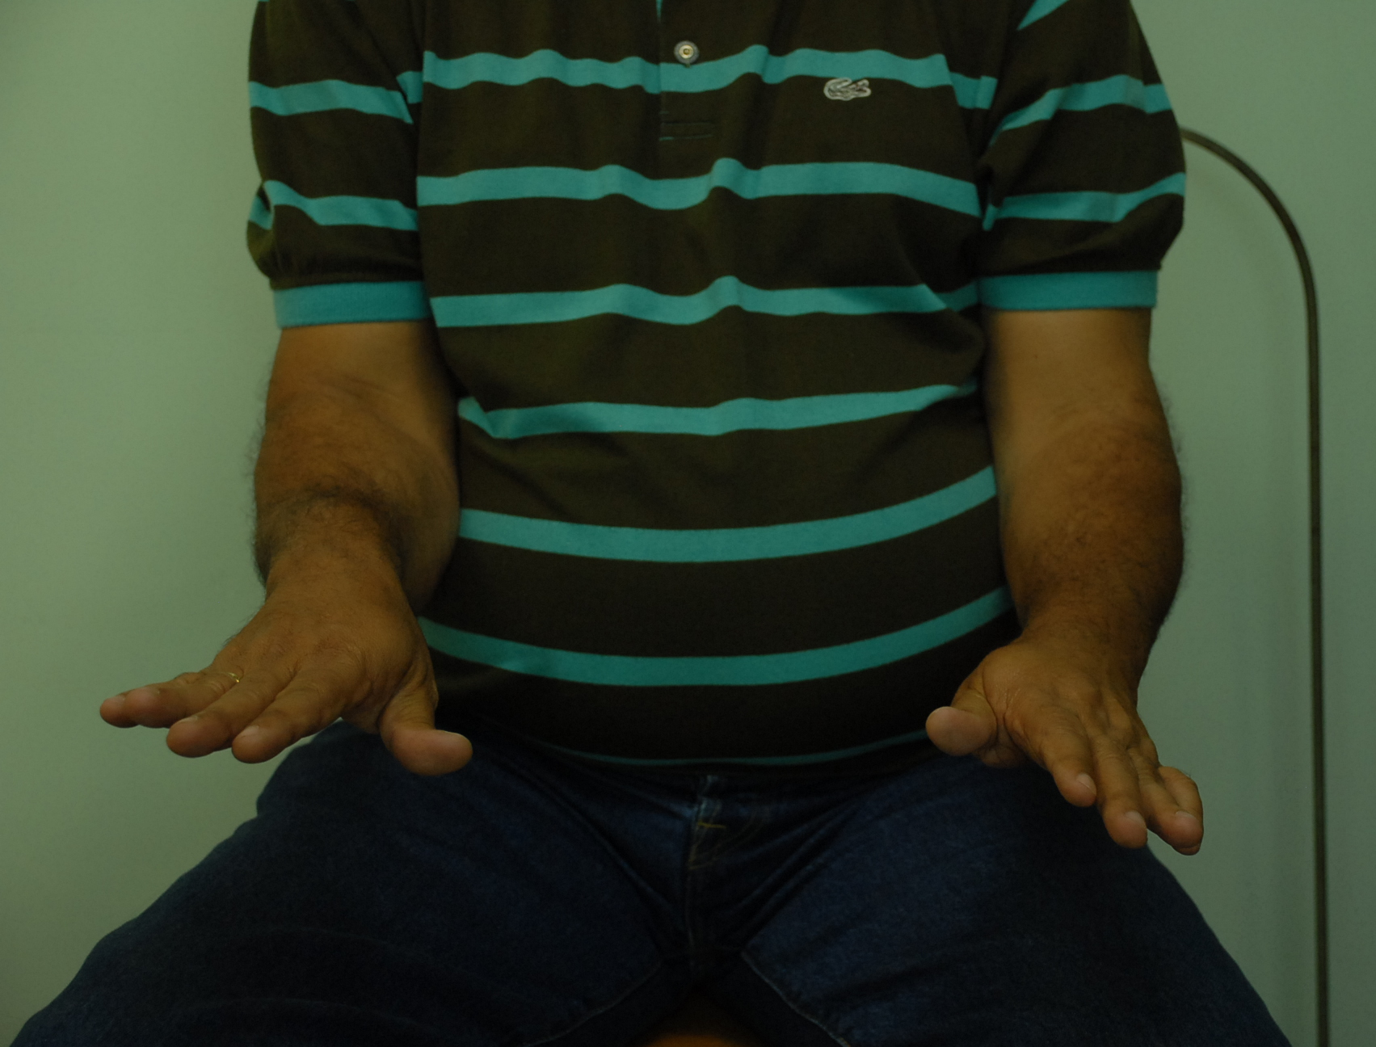

Slide 26
What happens in the long term? Study
Herzberg G, Forissier D. Acute dorsal trans-scaphoid perilunate fracture-dislocations: medium-term results. J Hand Surg Br. 2002; 27(6):498–502:
14 patients; follow-up after 8 years
11 dorsal approaches
3 combined
All fixed scaphoids healed
The Mayo wrist score: 5 excellent, 3 good, 5 fair, and 1 poor
Carpal alignment was satisfactory in most cases
Posttraumatic radiological arthritis occurred almost always but did not correlate with the Mayo wrist score
Notes:
Herzberg and Forissier investigated the medium-term results (mean follow-up: 8 years) of a series of 14 transscaphoid dorsal perilunate fracture dislocations treated operatively at an average of 6 days following injury. Eleven underwent open reduction and internal fixation through a dorsal approach. Combined palmar and dorsal approaches were used in three cases—in two cases, open reduction and internal fixation, and in one case, proximal row carpectomy. All internally fixed scaphoids healed, and no carpal avascular necrosis or collapse was observed. Carpal alignment was satisfactory in most cases. Posttraumatic radiologic midcarpal arthritis, radiocarpal arthritis, or both were almost always observed.
Reference:
Herzberg G, Forissier D. Acute dorsal trans-scaphoid perilunate fracture-dislocations: medium-term results. J Hand Surg Br. 2002;27(6):498–502.

Slide 27
Learning objectives
Explain the mechanism of production of these injuries
Discuss treatment options, advantages and disadvantages
Select appropriate treatment

