Slide 1
AOTrauma Masters Course—Current Concepts
Module 3, Case 2: Transscaphoid perilunate fracture dislocation
Davos Courses
December 2018

Slide 2
Case description
19-year-old man
Student
Fell during a motocross competition
Patient was admitted to the emergency department 3 hours after injury
Severe pain
Deformity of the wrist
Numbness in the index, ring, and middle fingers

Slide 3
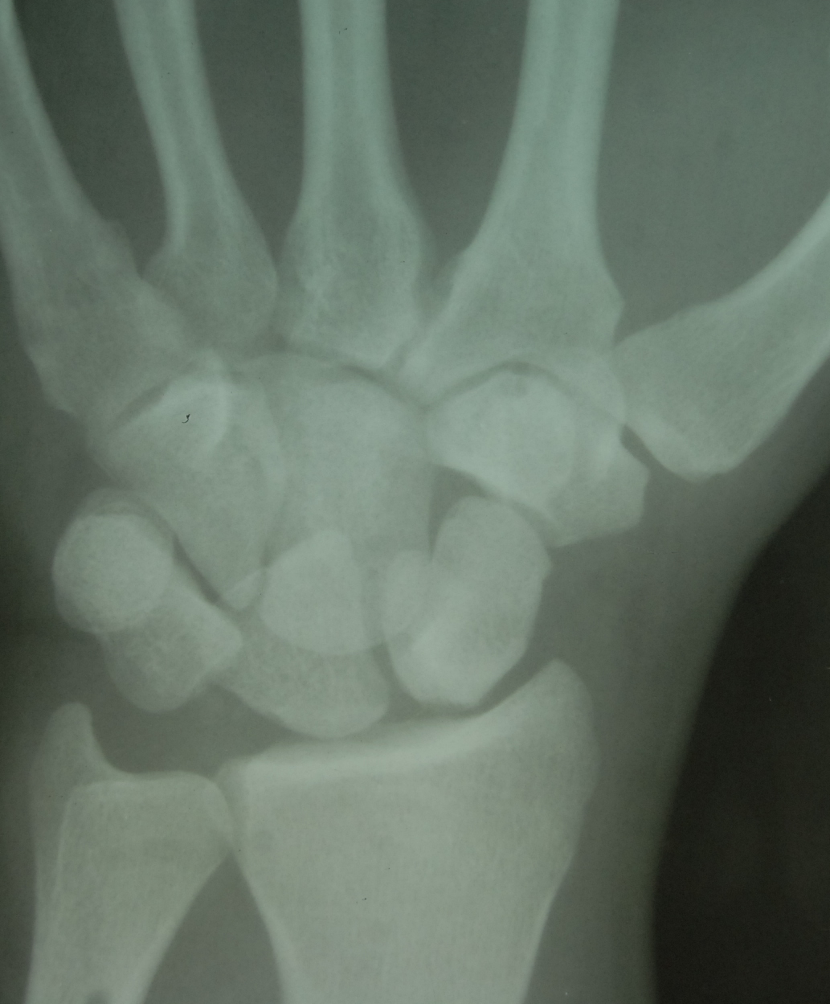

Slide 4
Discuss
Describe the injury
Mechanism of production
The more frequent acute complications
How to proceed in the emergency department

Slide 5
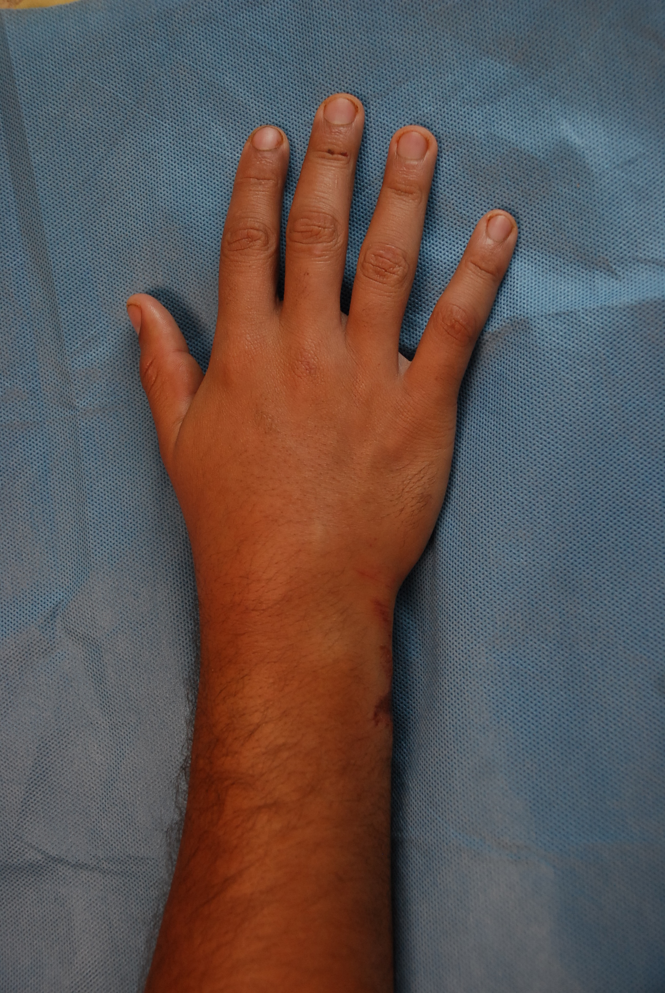
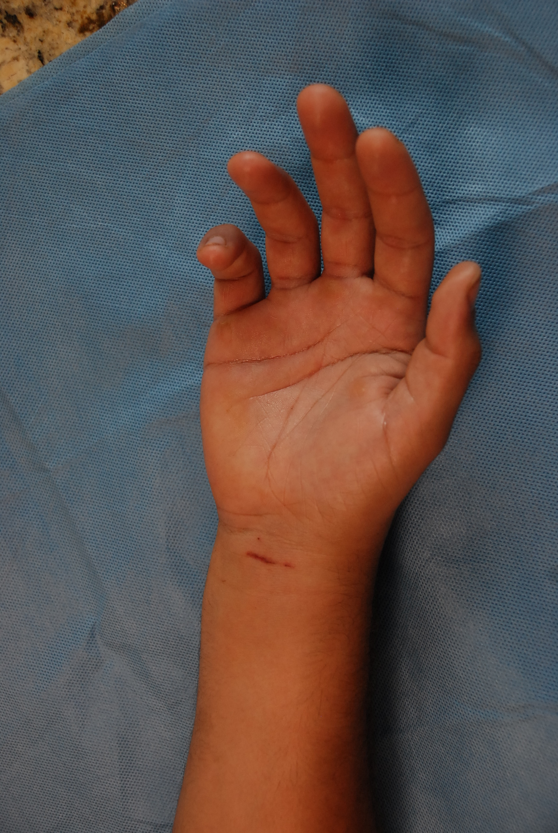

Slide 8
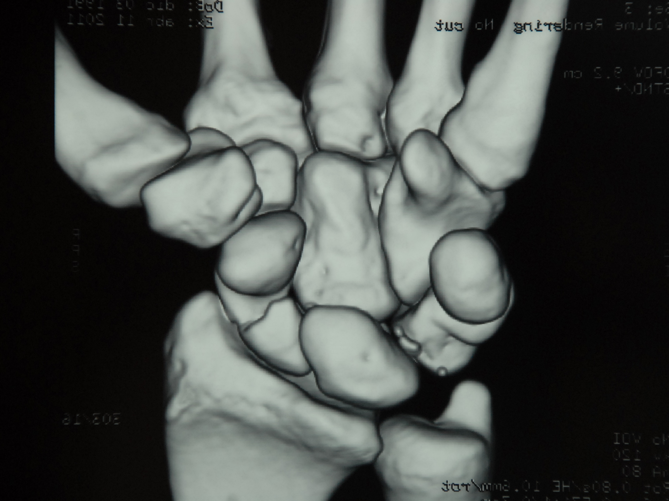

Slide 9
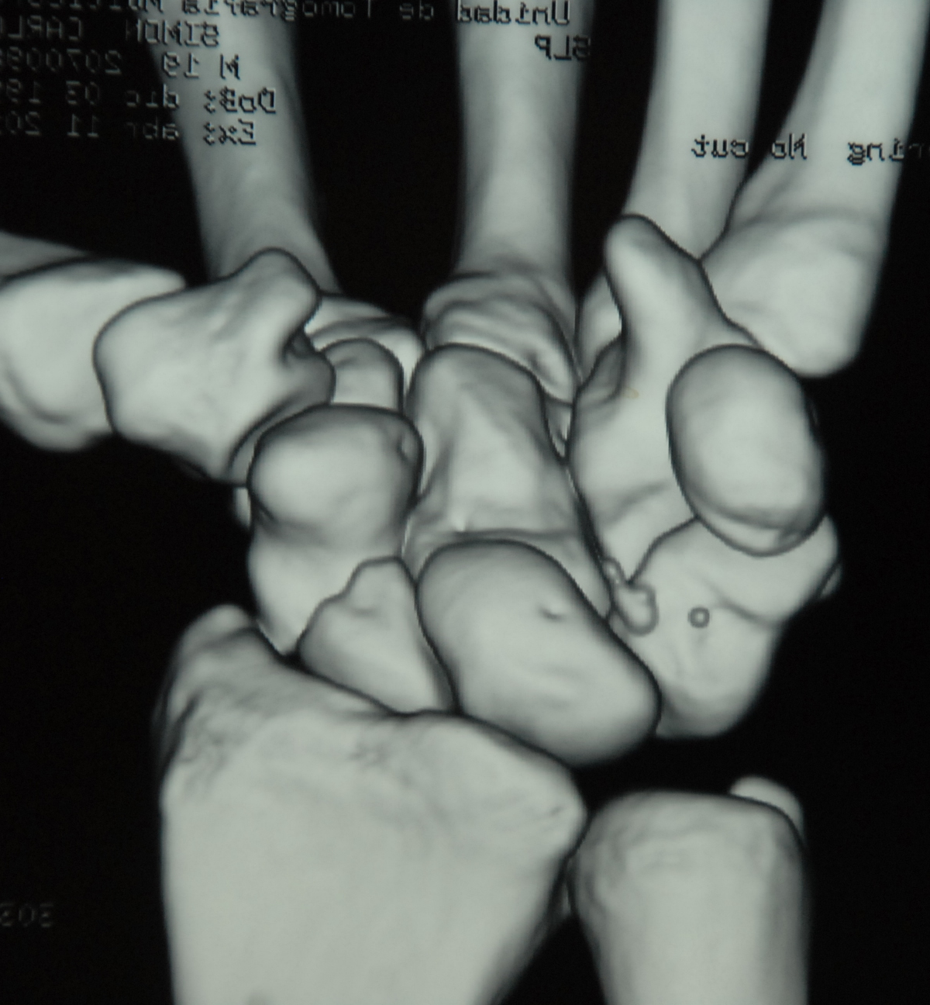

Slide 10
Discuss
Describe the injury
Treatment options
Approach
Method of fixation
Possible complications
Rehabilitation

Slide 11
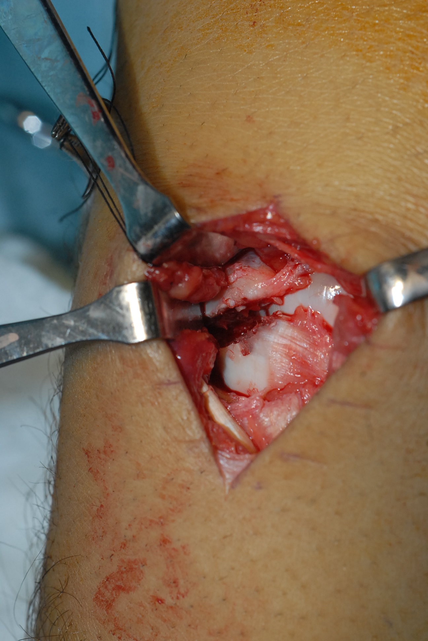

Slide 12
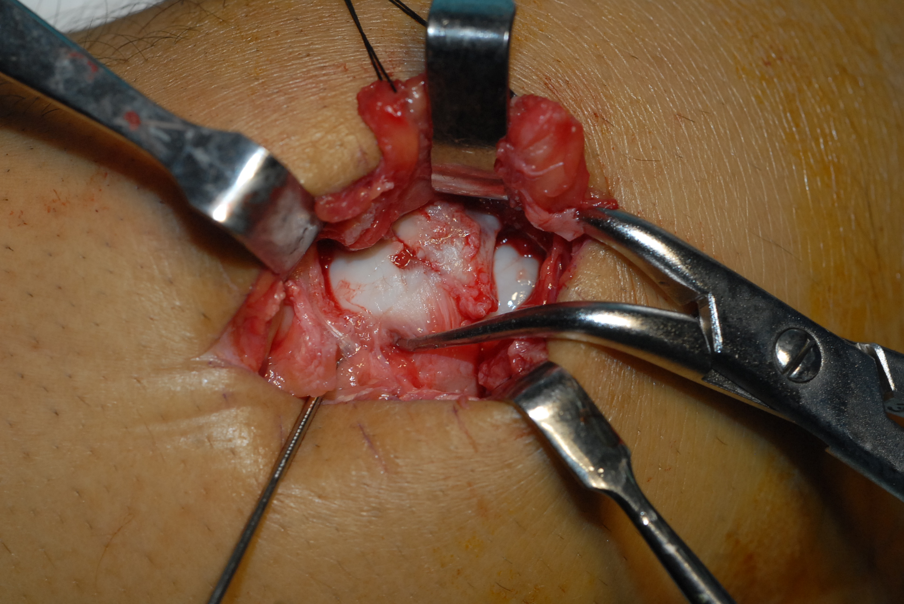

Slide 13
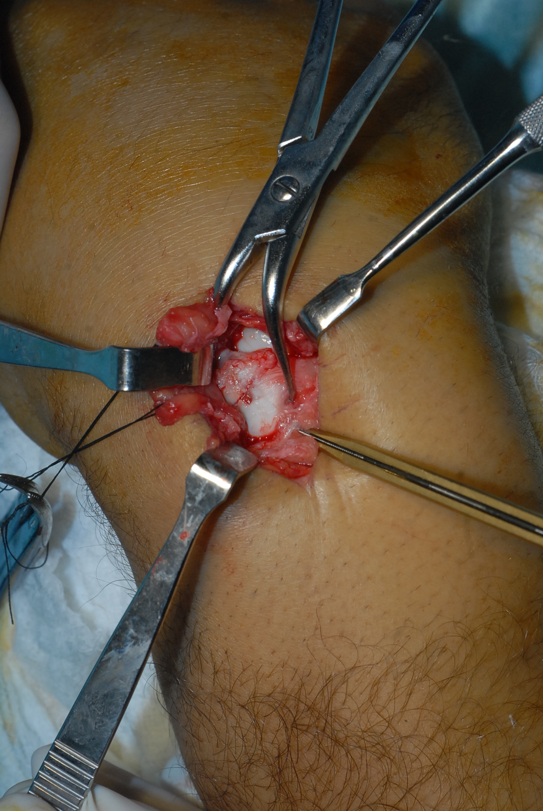

Slide 14
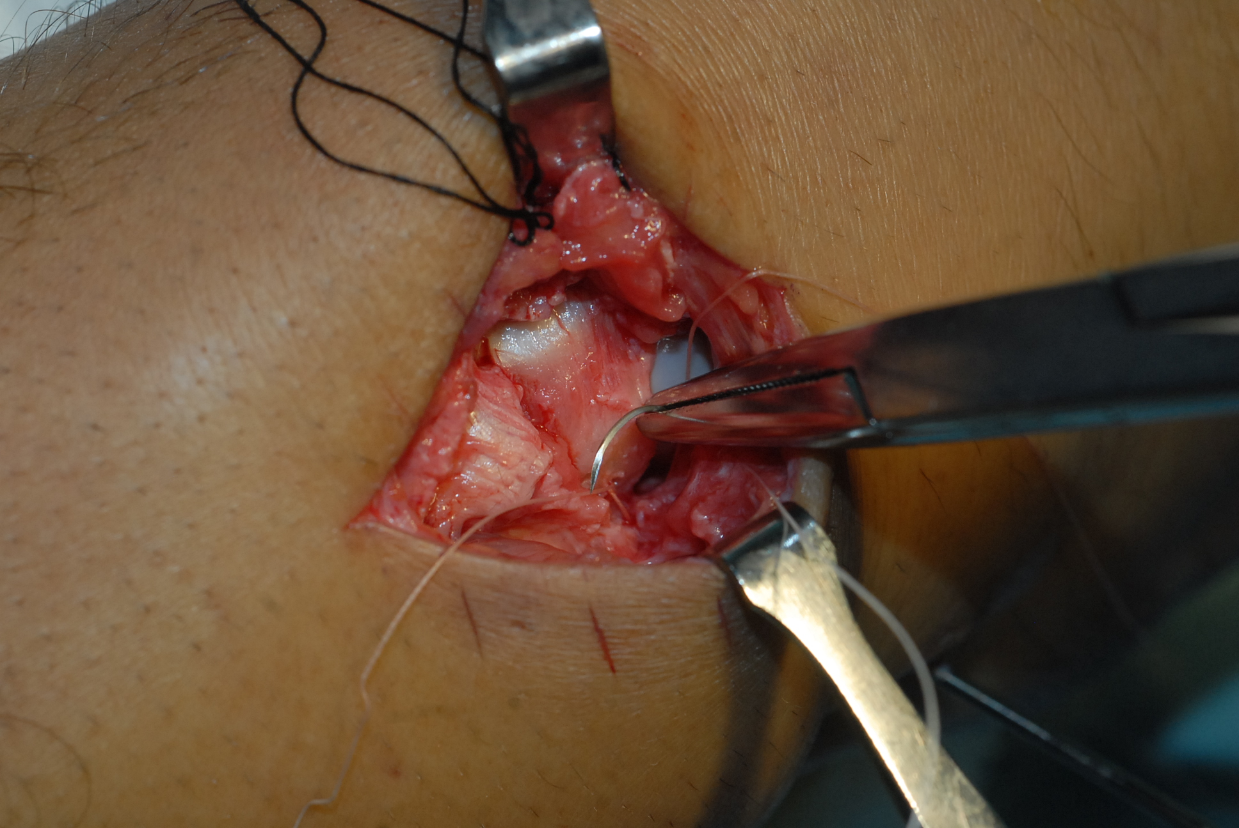

Slide 15
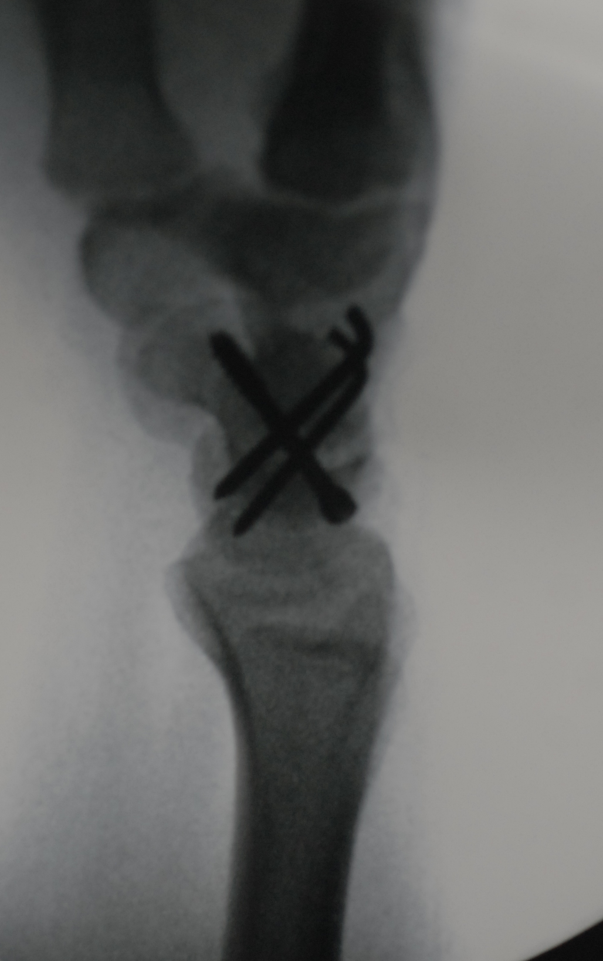

Slide 16
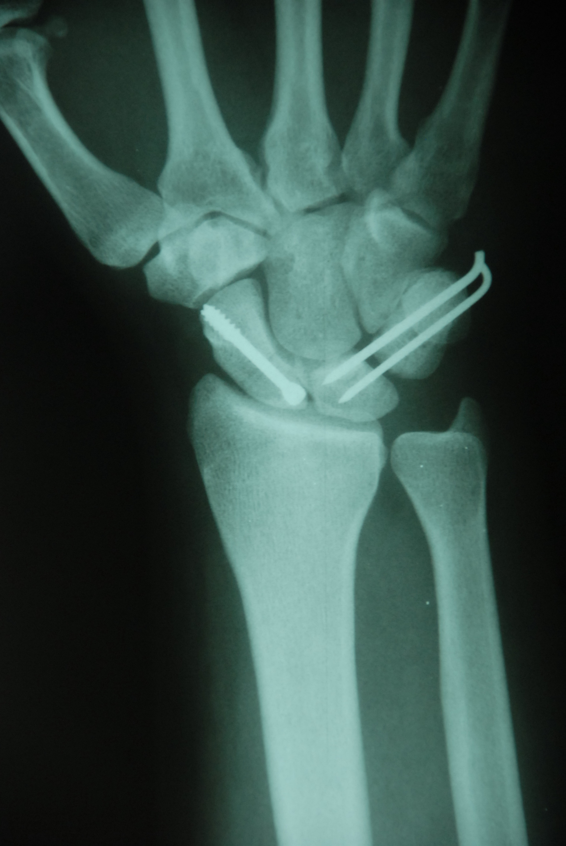
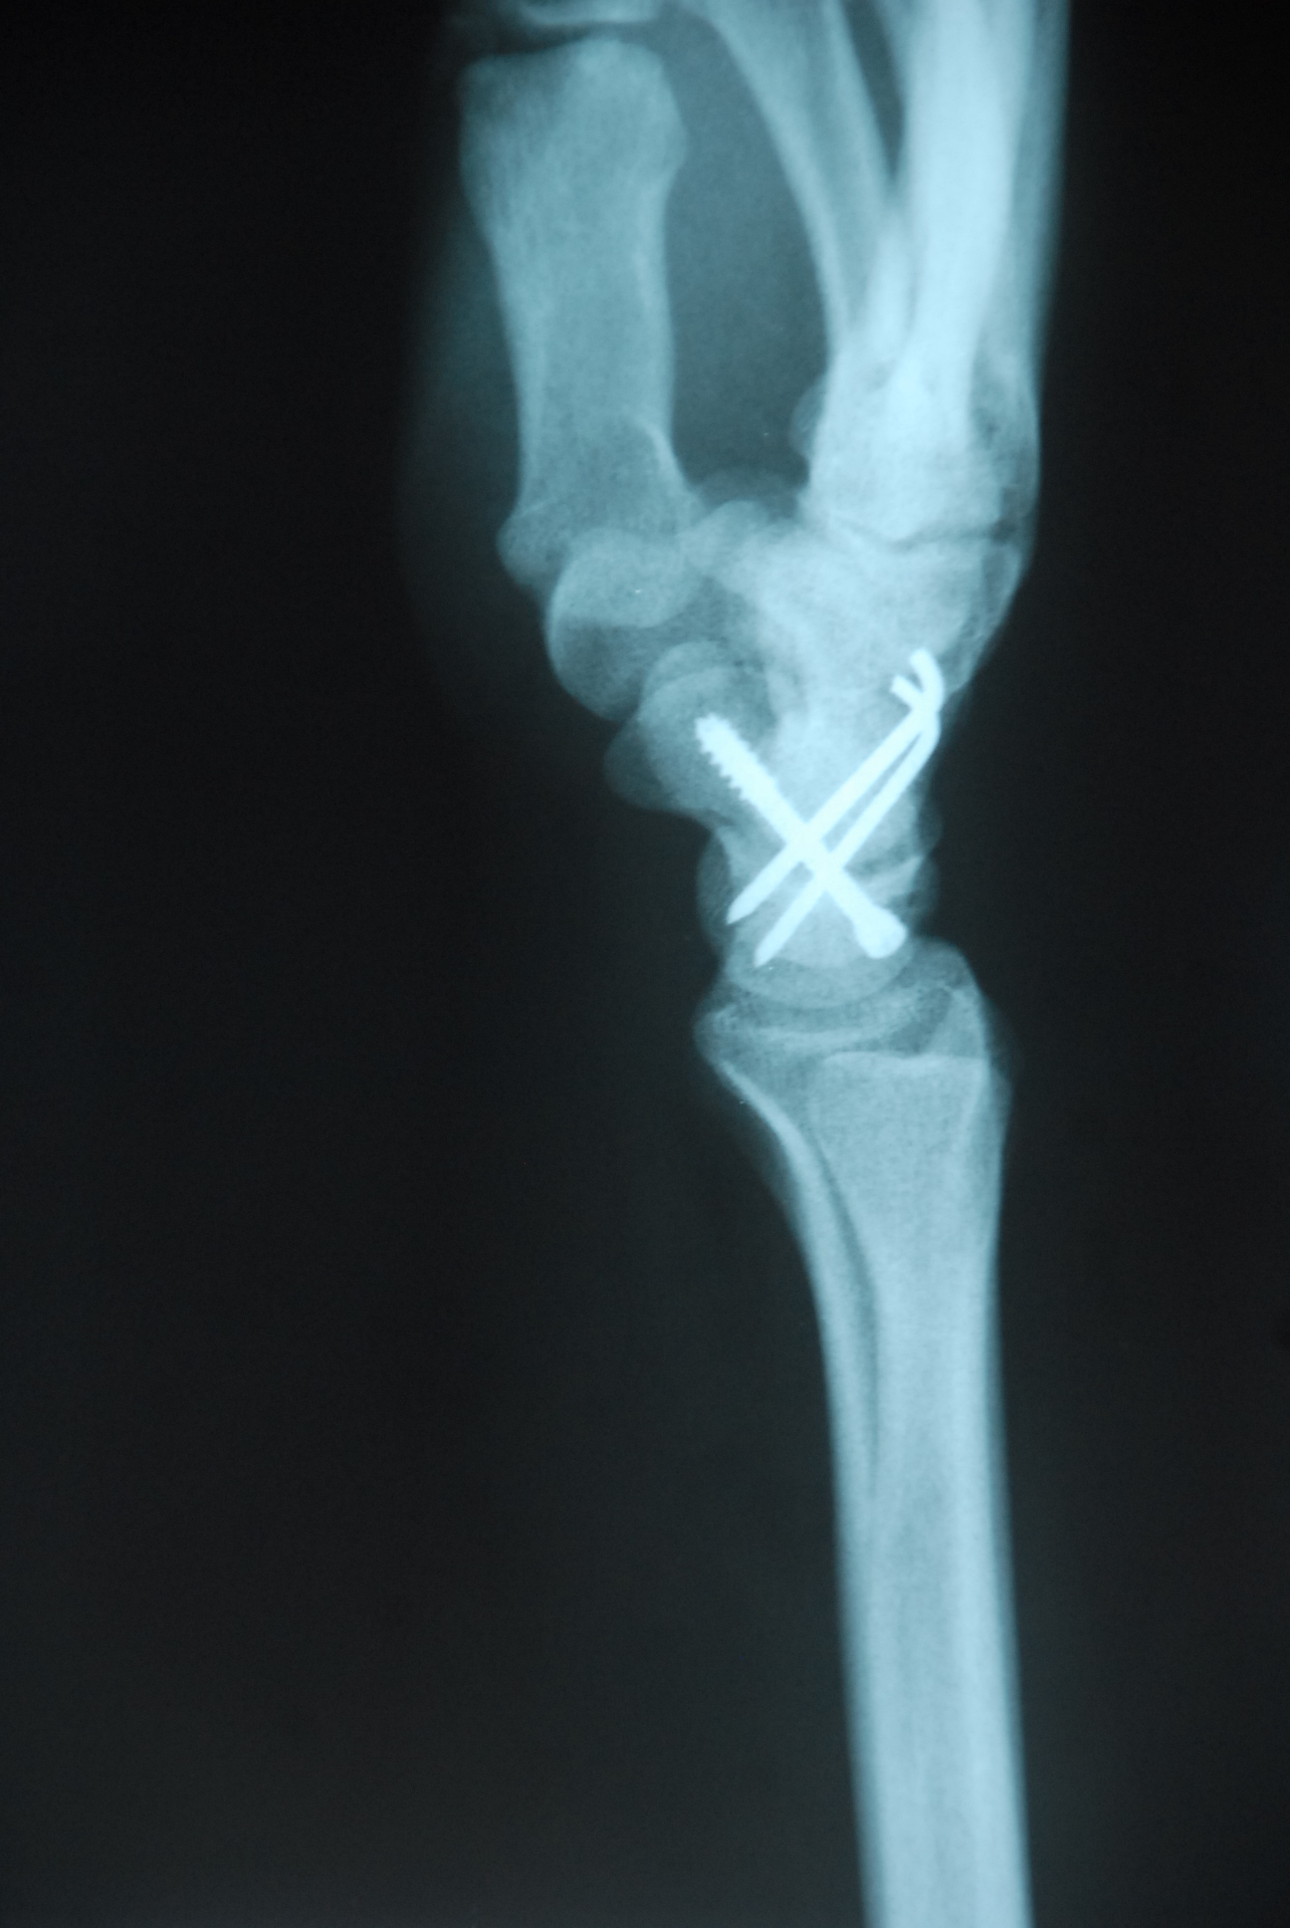

Slide 18
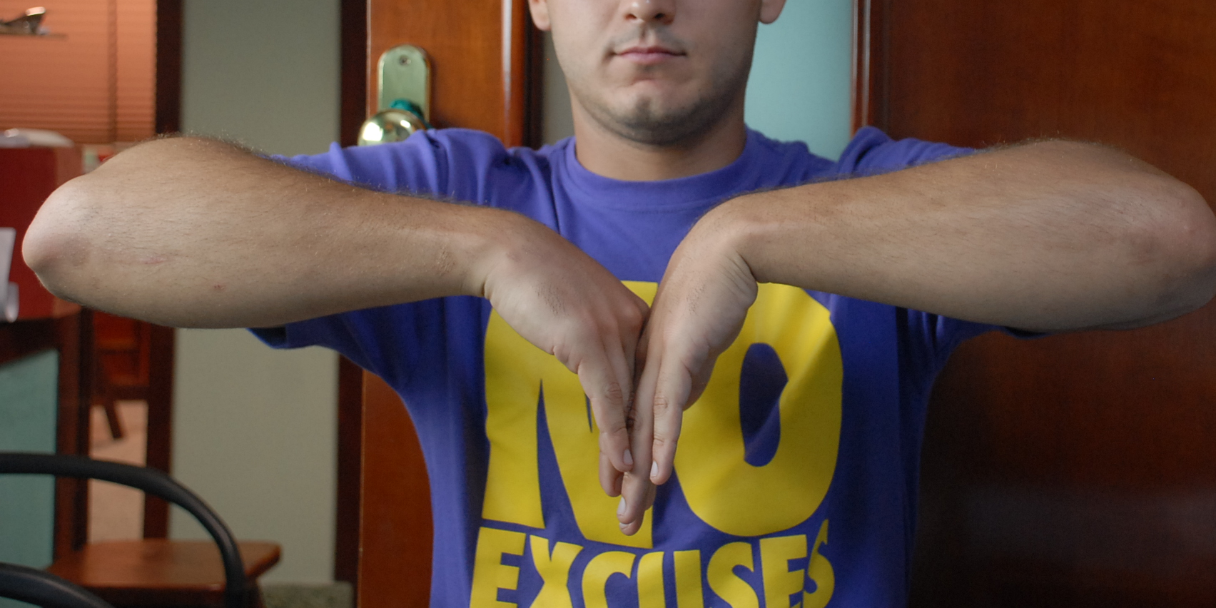
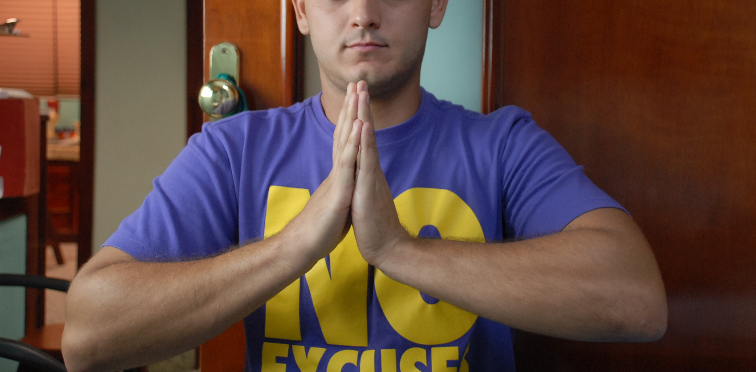
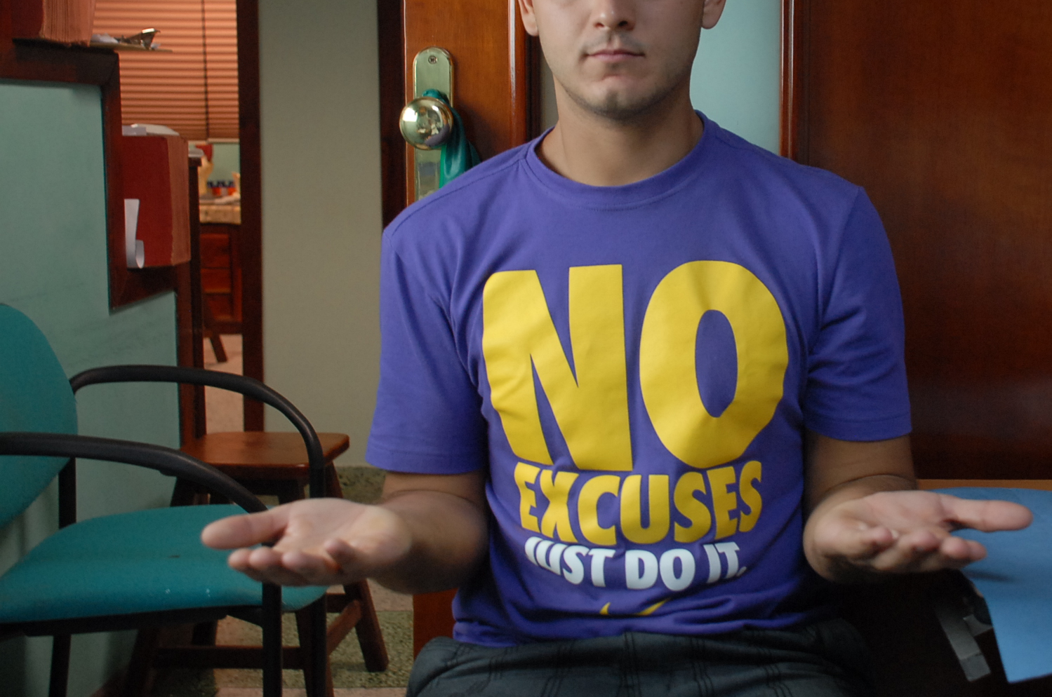

Slide 19
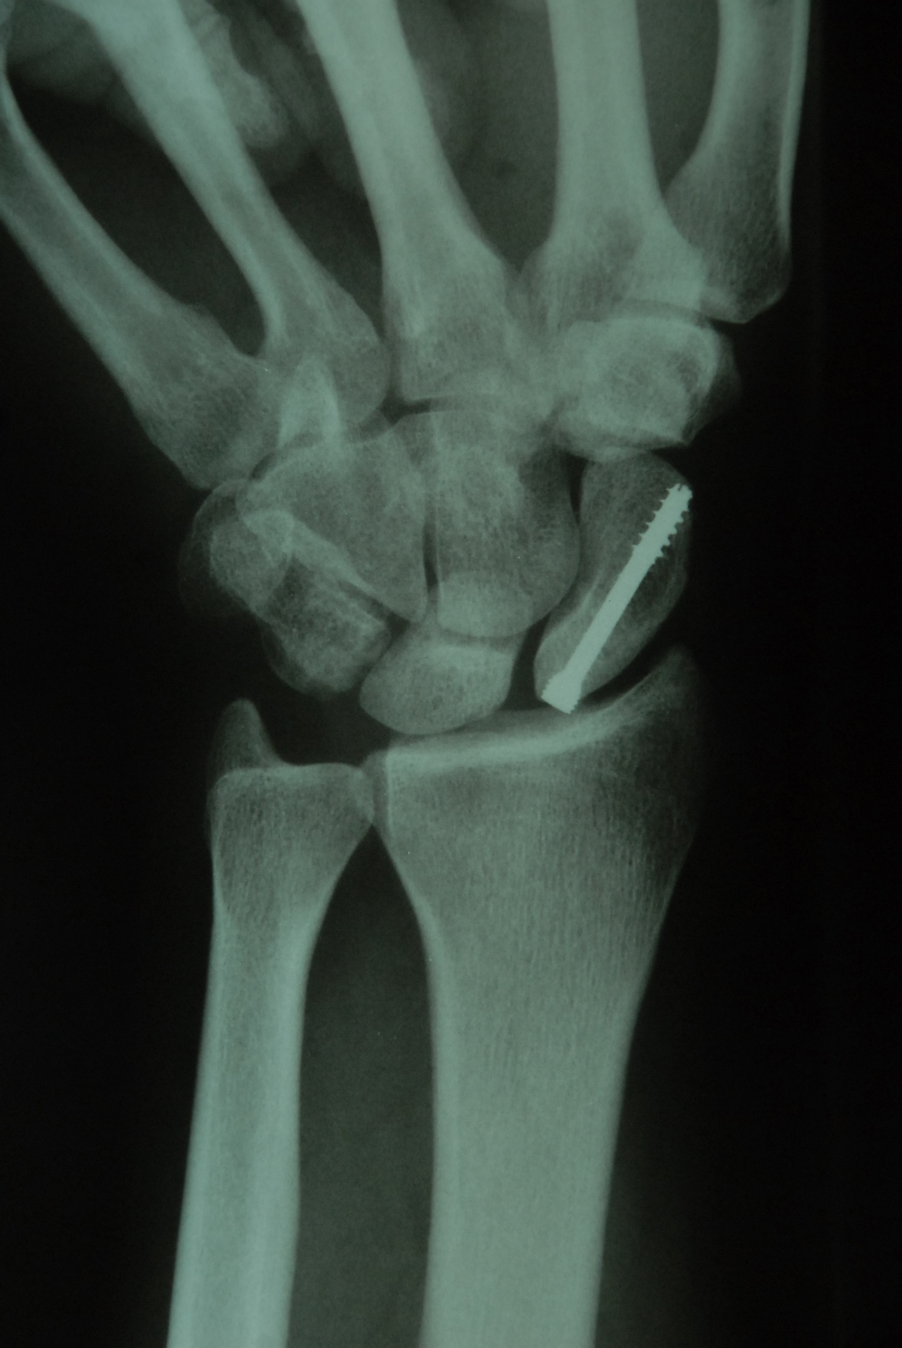
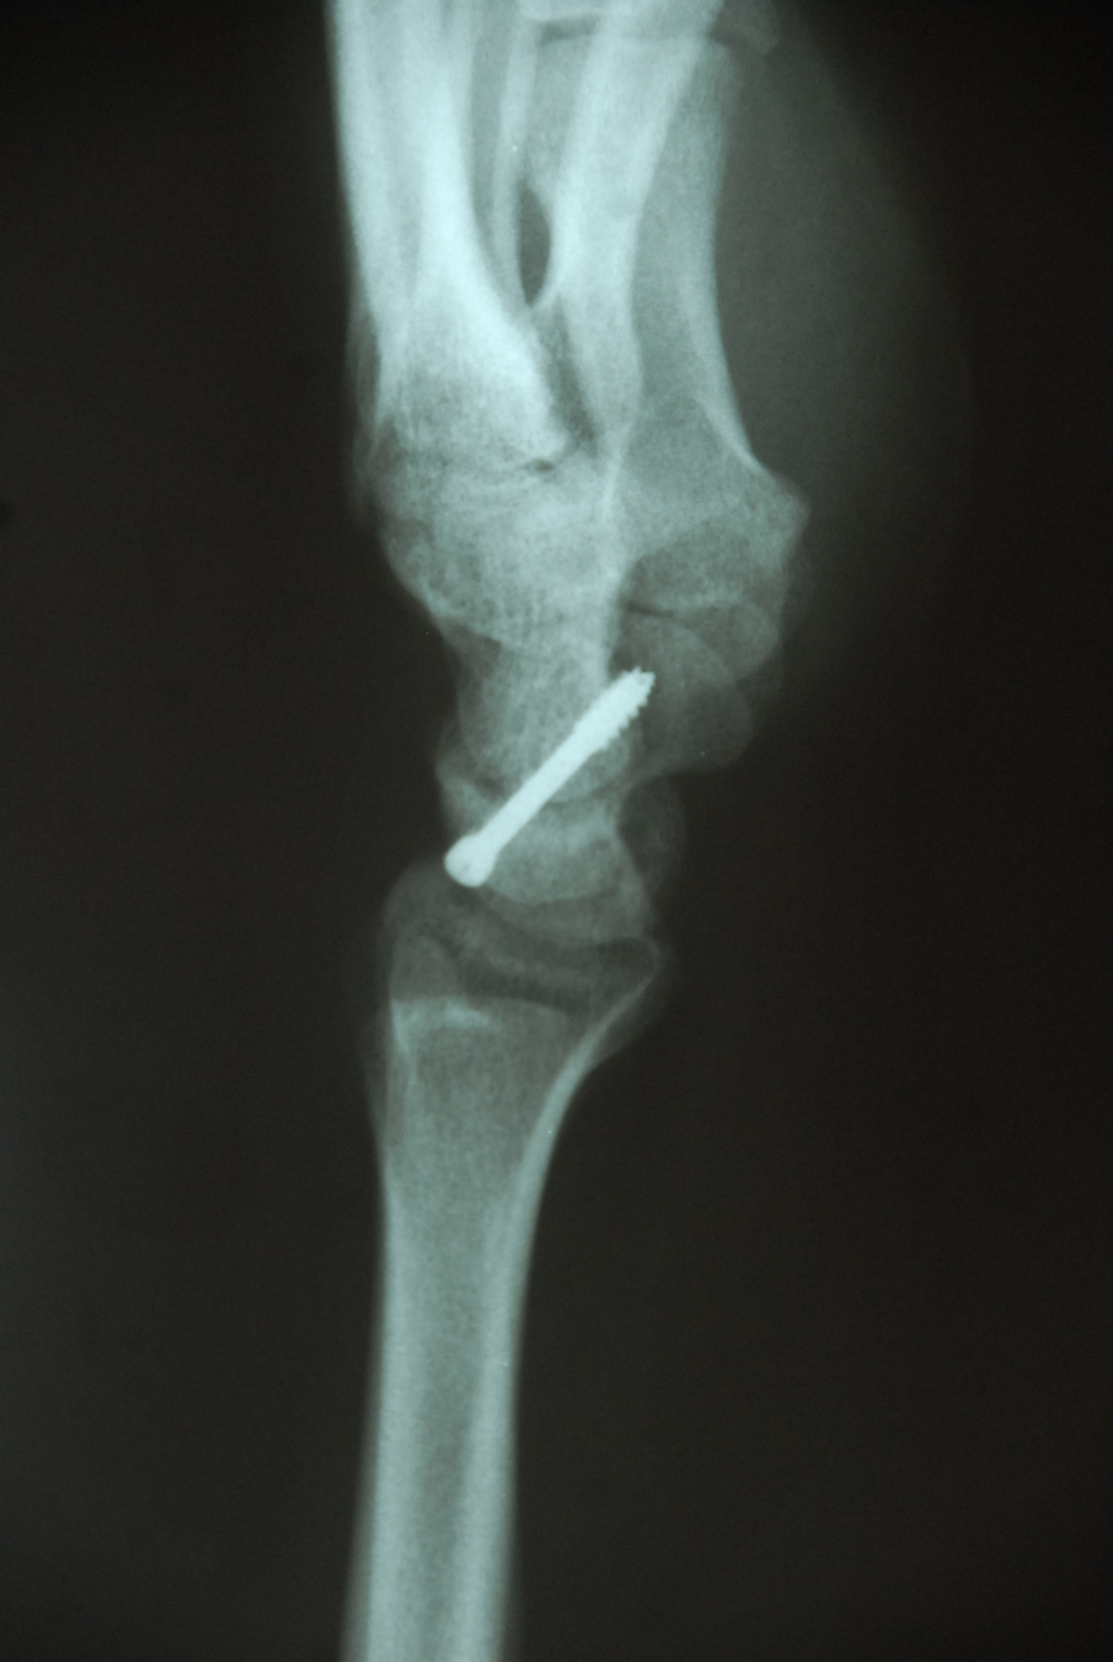

Slide 20
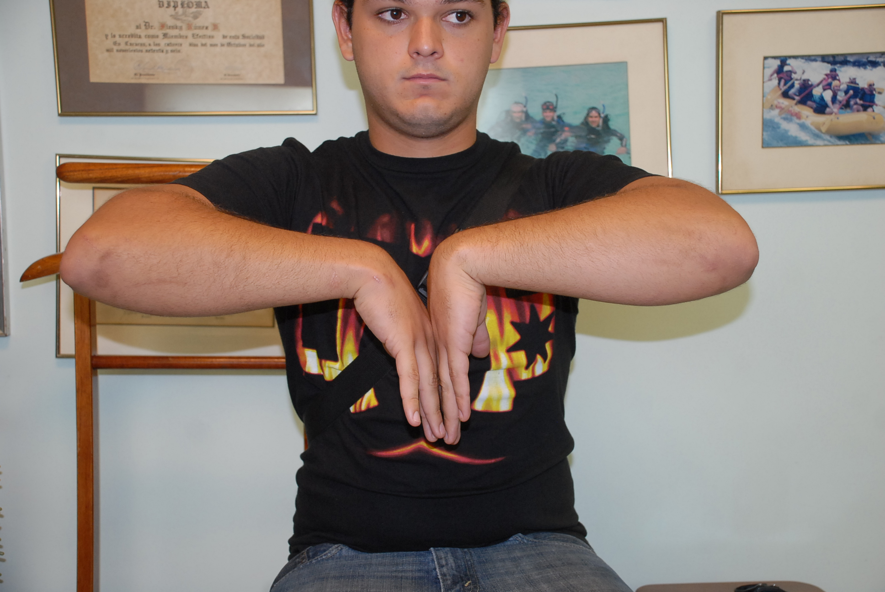
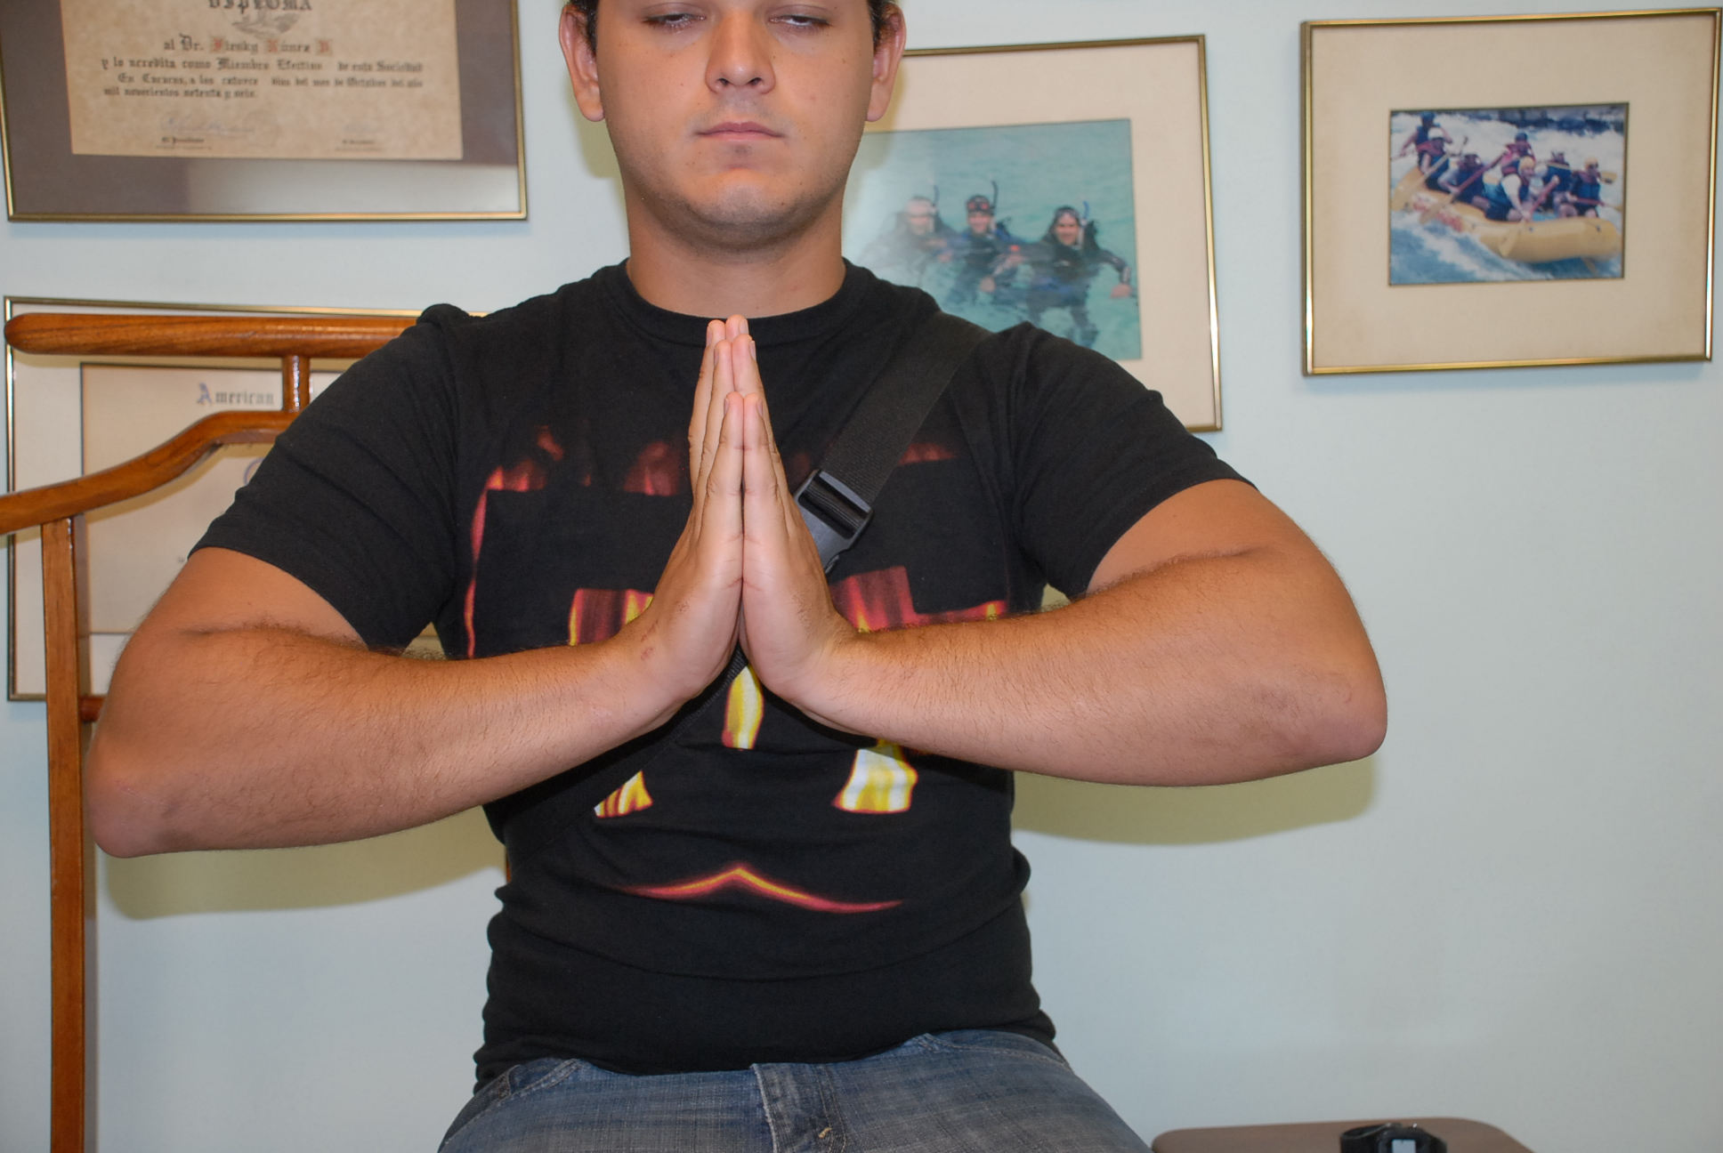
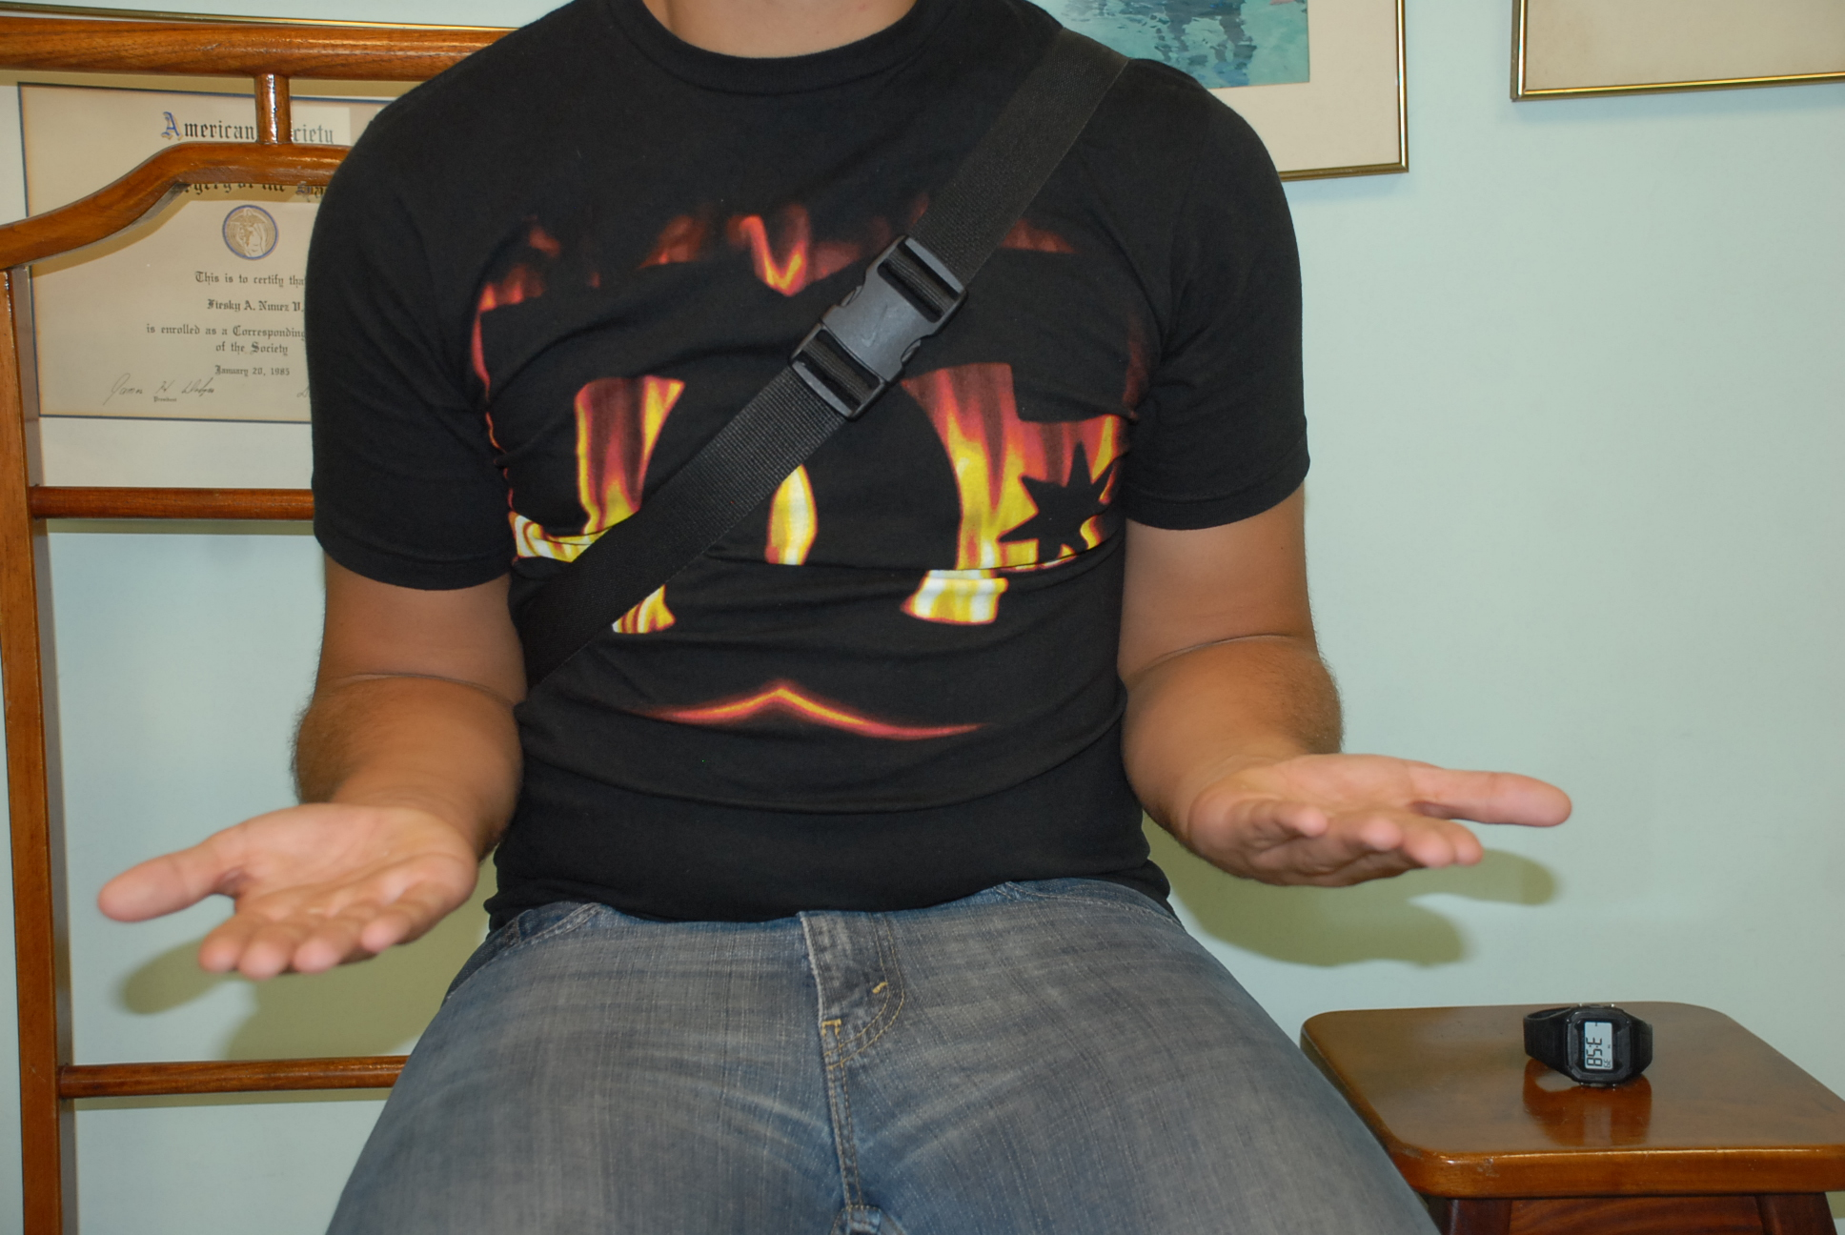
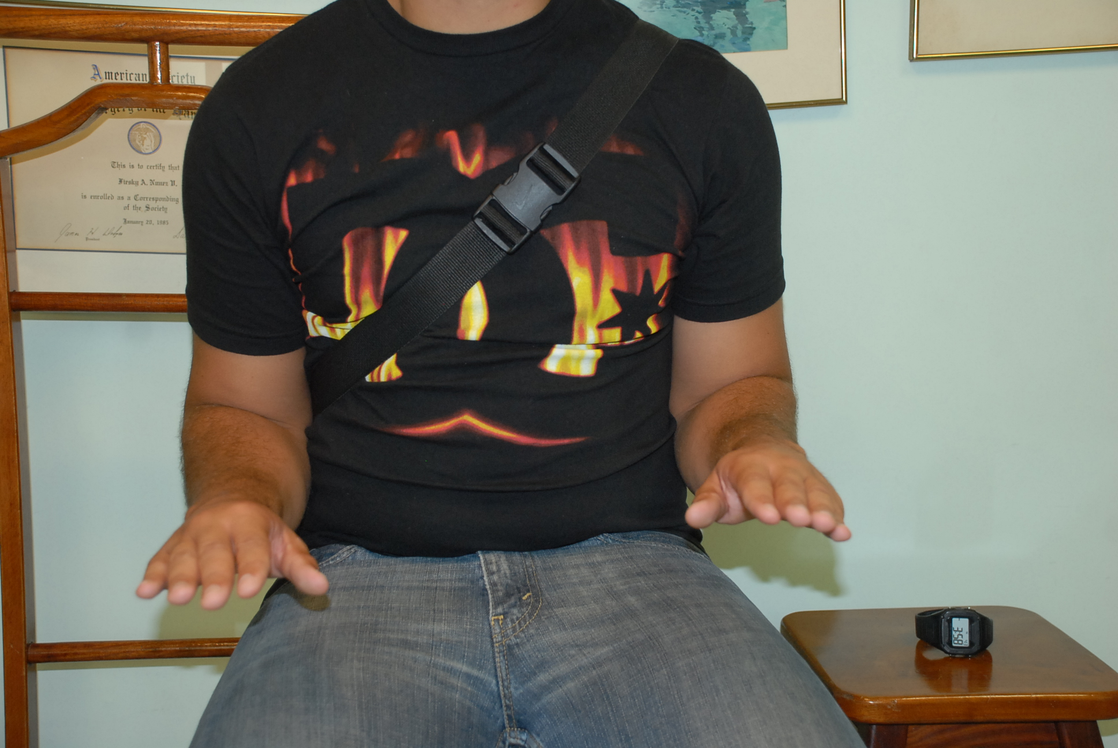

Slide 21
Learning objectives
Diagnose those injuries
List potential complications and how to avoid them
Discuss advantages and disadvantages of treatment options
Select appropriate treatment

