Slide 1
AOTrauma Masters Course—Current Concepts
Module 4, Discussion 3, Case 3: Intraarticular and extraarticular malunited fracture of distal radius
Davos Courses
December 2018

Slide 2
Case description
27-year-old woman
Housekeeping
Left, nondominant hand
Fell while skating
Intraarticular distal radial fracture treated conservatively
elsewhere

Slide 3
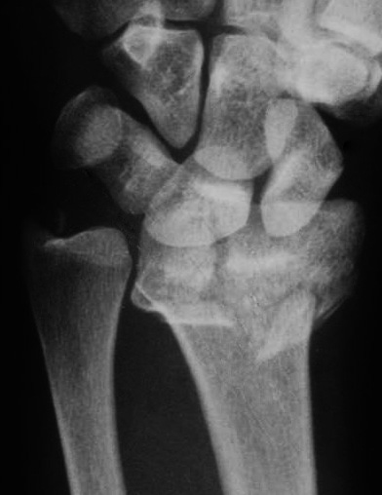
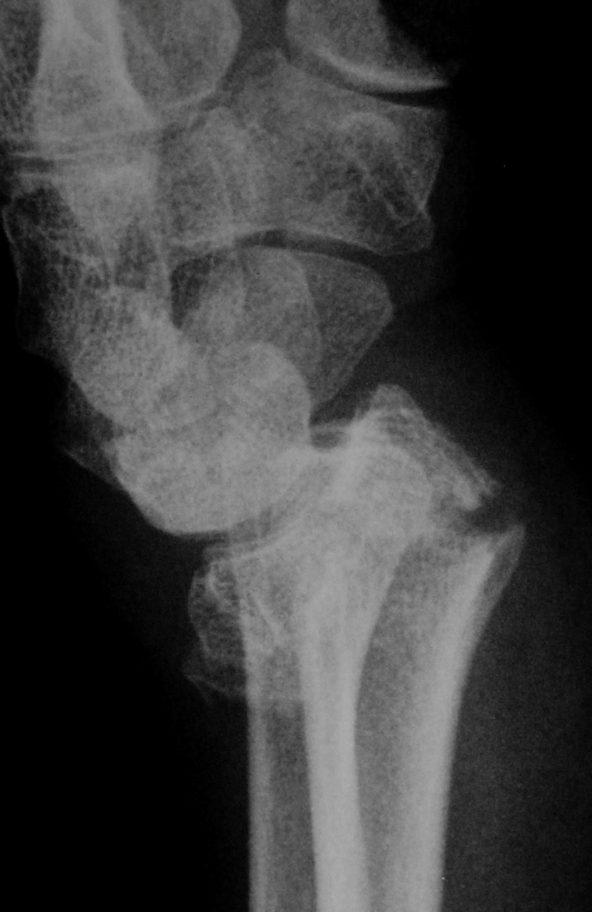
Initial x-ray after the fall
Notes:
Fracture pattern: 23.C2.1 fracture
The intraarticular component is a simple split, but the metaphyseal component is multifragmentary.
A large dorsoulnar fragment or sagittal split of the articular surface between the scaphoid and lunate facet is present.
Type III, compression fracture, of Fernandez classification

Slide 4
Discuss (briefly)
Fracture pattern
Initial treatment options
Notes:
Straight dorsal longitudinal incision
Approach between 3rd and 4th extensor compartments
Posterior interosseous nerve coagulation
Transverse radiocarpal capsulotomy to check reduction accuracy of the lunate and scaphoid fossas
Metaphyseal, transverse osteotomy parallel to the joint surface
Both lunate and scaphoid fossae are splinted in 2 parts through the former fracture sagittal line

Slide 5
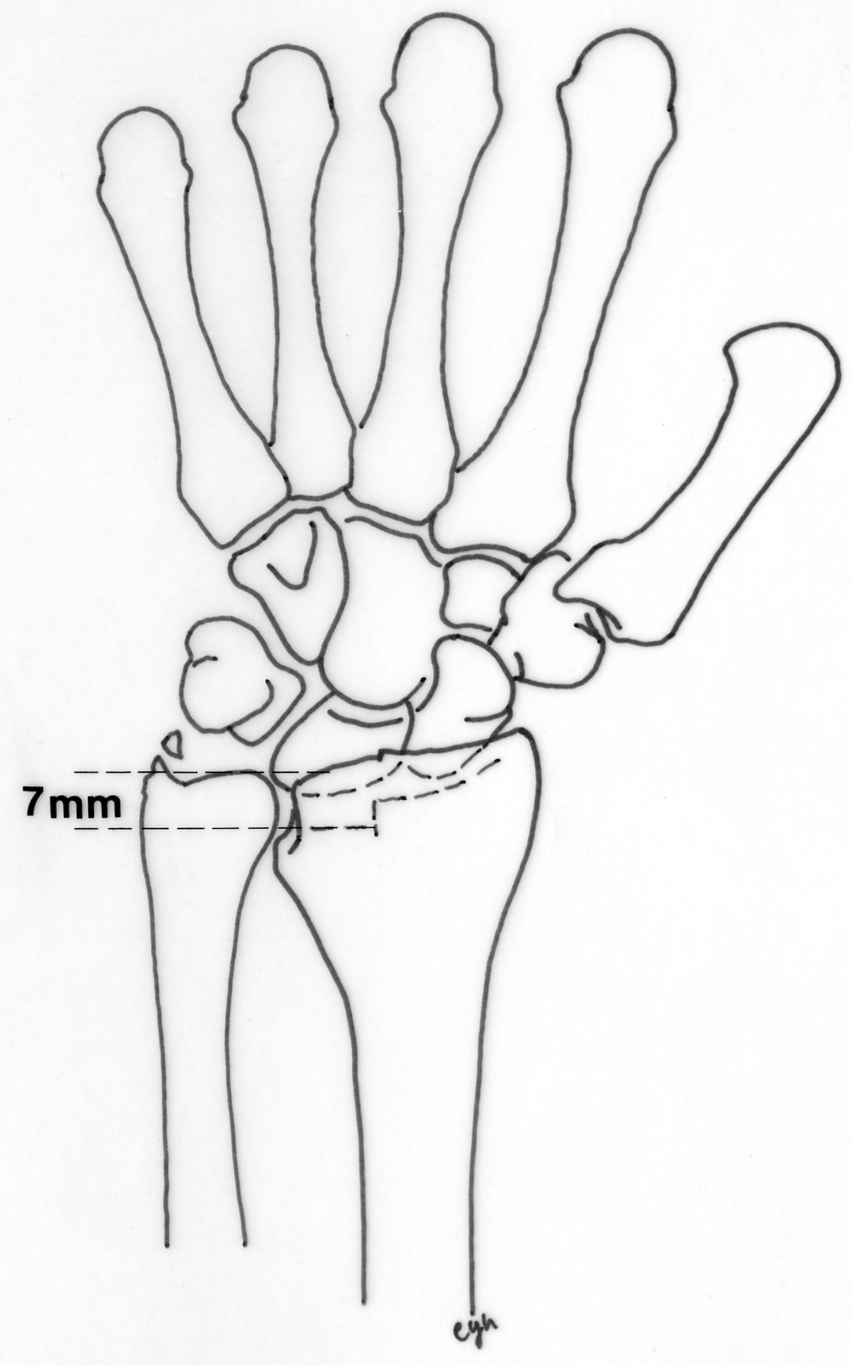
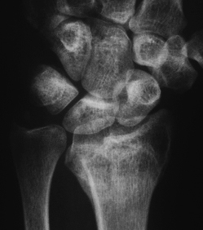
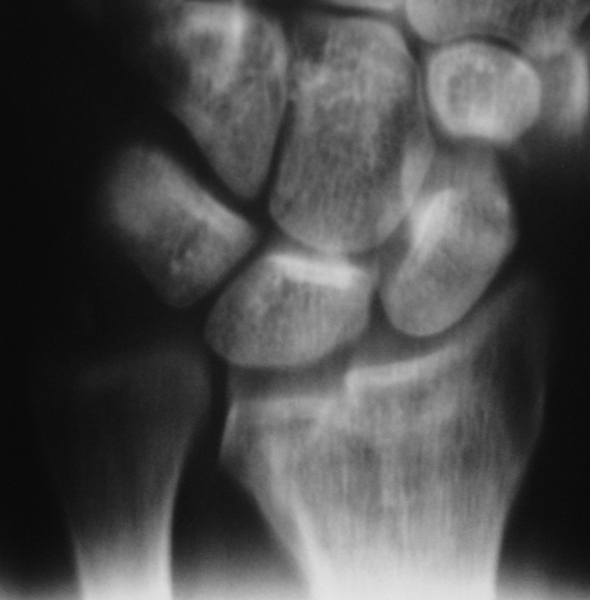
Imaging 5 months after fracture
Notes:
Imaging 5 months after fracture
Distal radial malunion, with both extraarticular and intraarticular components
Frontal view showing a 7 mm step-off at the lunate fossa

Slide 6
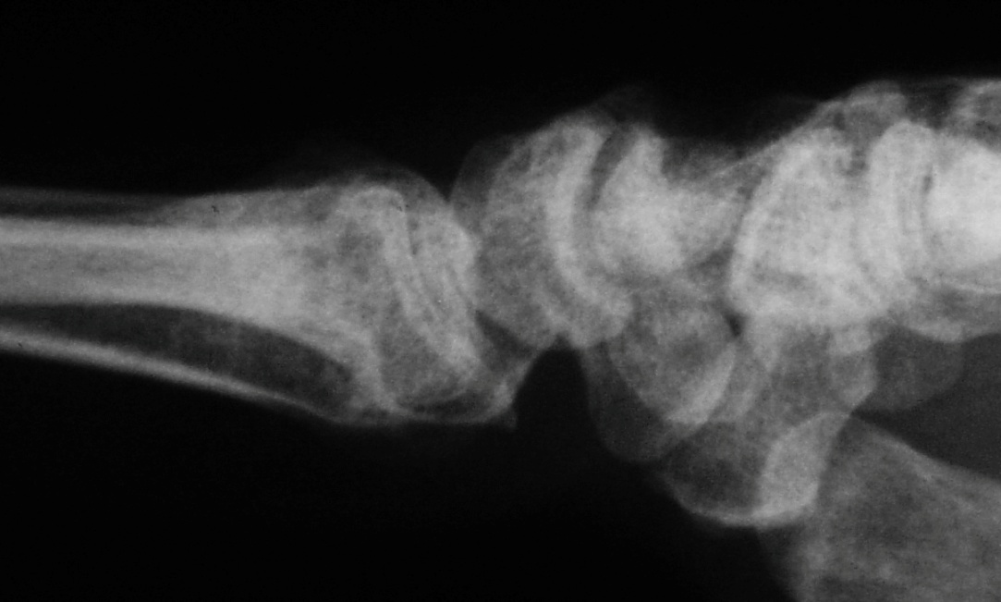
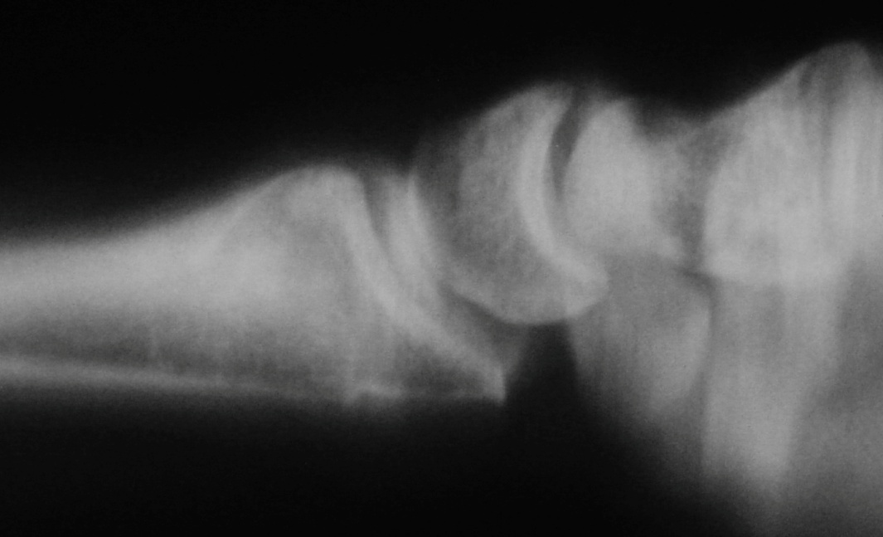
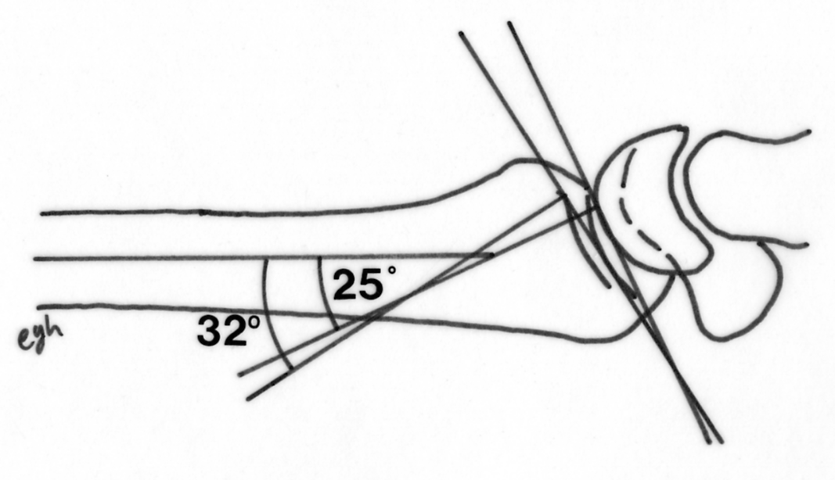
Notes:
Sagittal view showing the metaphyseal malunion and the different dorsal tilts of both lunate (32°) and scaphoid (25°) fossae

Slide 7
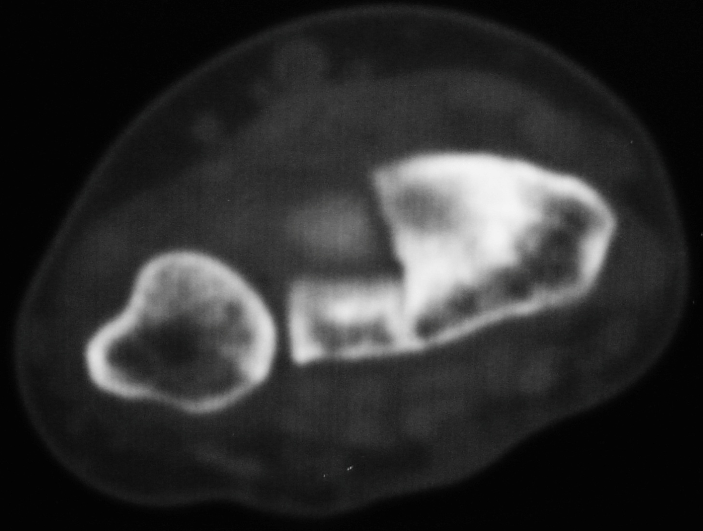
Clinical examination
Painful wrist with any
movement
Wrist motion
- 40° extension
- 35° flexion
- 15° radial deviation
- 20° ulnar deviation
- 60° supination
- 65° pronation
Grip strength: 28 kg
Contralateral: 35 kg
Notes:
Axial view showing the lunate fossa is more dorsally tilted than the scaphoid fossa

Slide 8
Discuss
Describe the complication
Treatment options
Approach
Possible bone graft
Method of fixation
Rehabilitation
Notes:
Straight dorsal longitudinal incision
Approach between 3rd and 4th extensor compartments
Posterior interosseous nerve coagulation
Transverse radiocarpal capsulotomy to check reduction accuracy of the lunate and scaphoid fossae
Metaphyseal, transverse osteotomy parallel to the joint surface
Both lunate and scaphoid fossae are splinted in 2 parts through the former fracture sagittal line

Slide 9
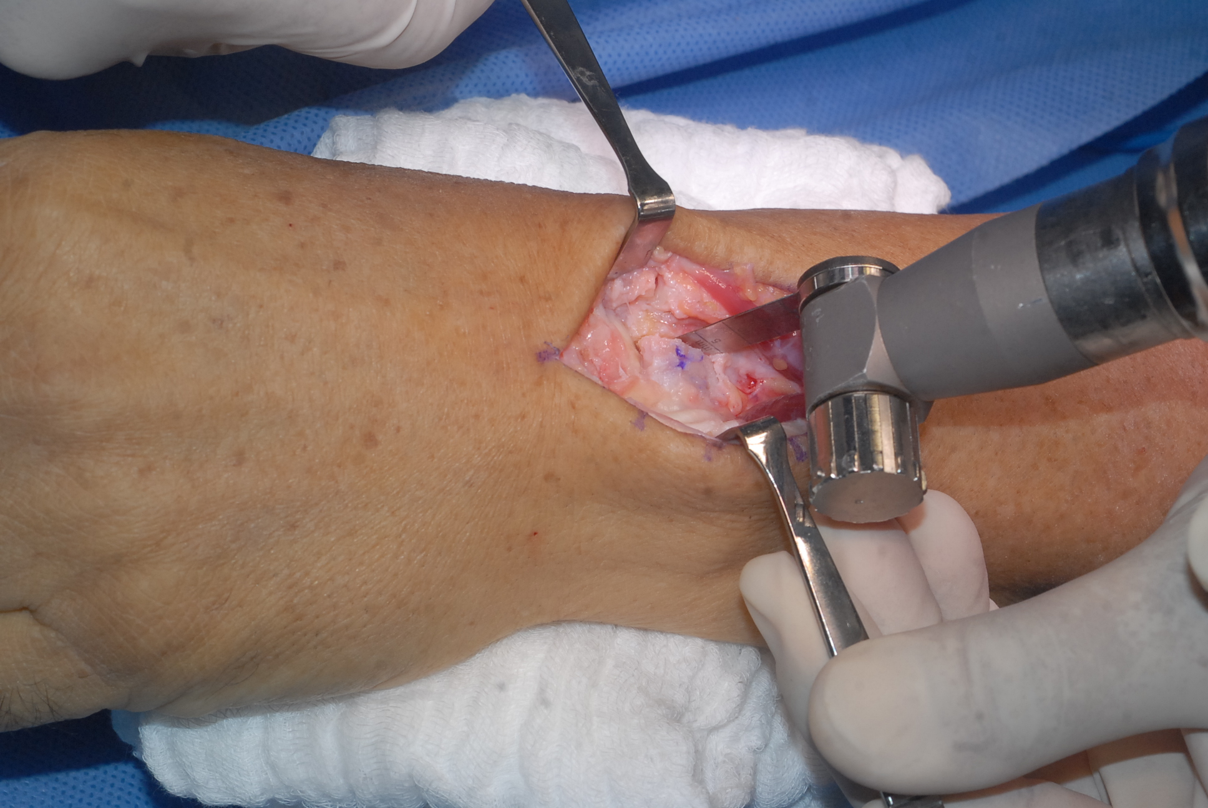
Notes:
Oscillating saw was used to make the cuts on the extraarticular areas of the malunion, first on the sagittal plane

Slide 10
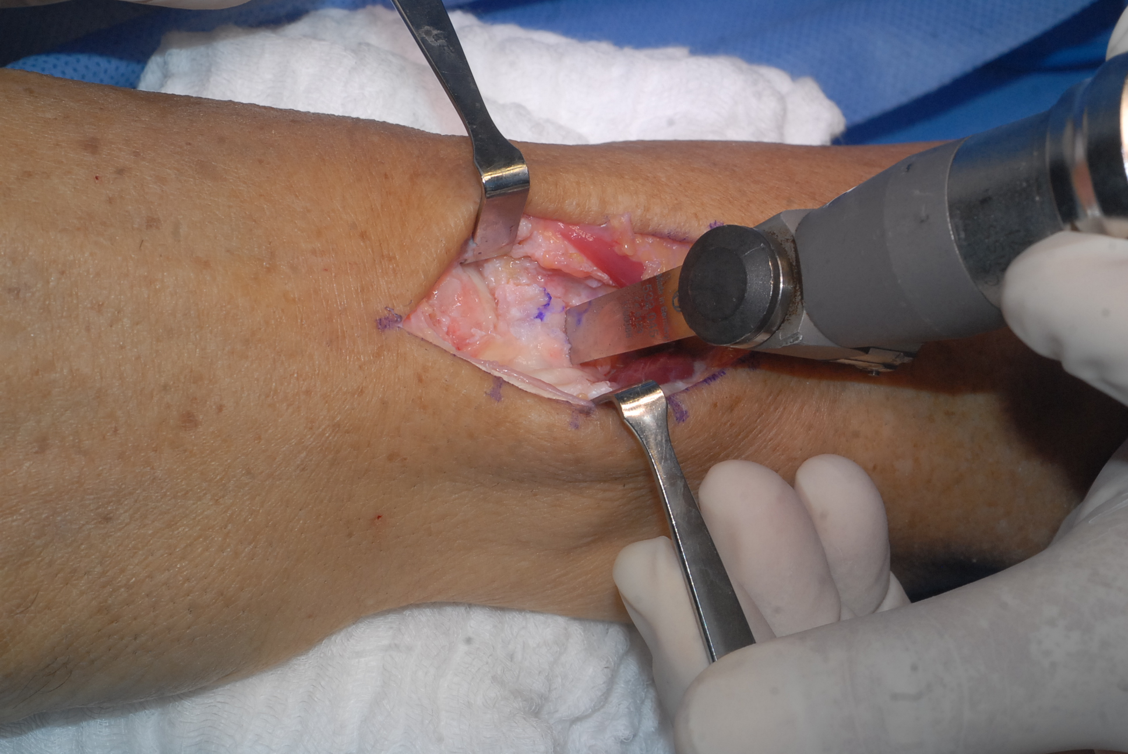
Notes:
Using the same device, a second cut was performed in the transverse plane.

Slide 11
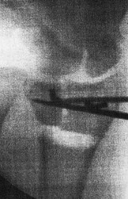
Intraoperative image intensification
Notes:
The intraarticular components were reduced using two K-wires as joysticks and fixed temporarily by K-wire. Step-off at the articular surface are reduced. The accuracy of the articular congruity reduction was checked through the capsulotomy by direct visual control.

Slide 12
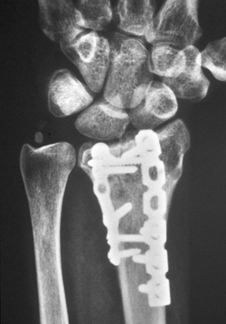
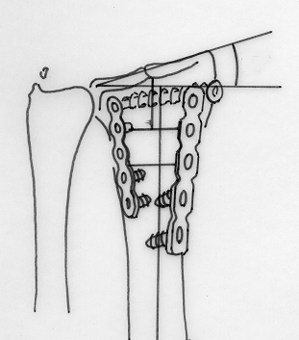
Fixation
21º
Notes:
First of all: fxation of the intraarticular components using a cannulated 3.0 screw
Iliac crest bone graft for the metaphyseal defect
Double plating dorsal fixation for the radial and intermediate distal radial columns

Slide 13
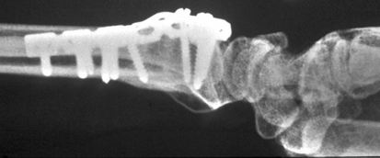
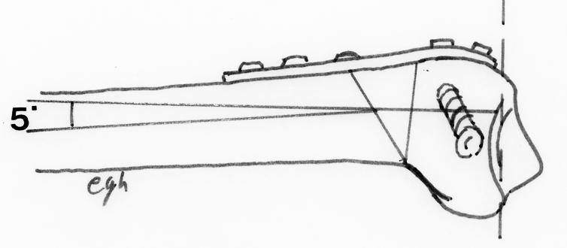

Slide 14
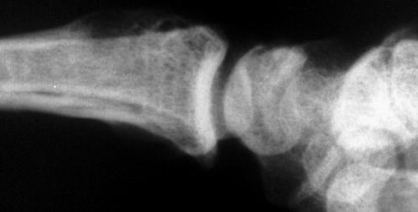
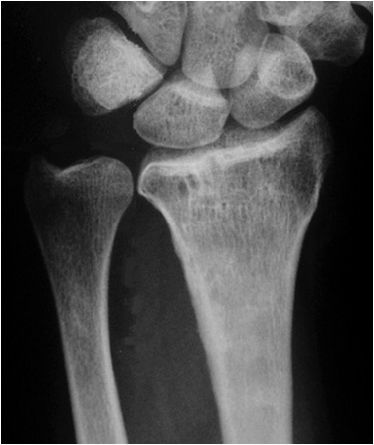
EDC II and EIP tendons rupture at 7 months Hardware removal EDC III tendon transfer with excellent results Carpal tunnel release at 8 years

Slide 15
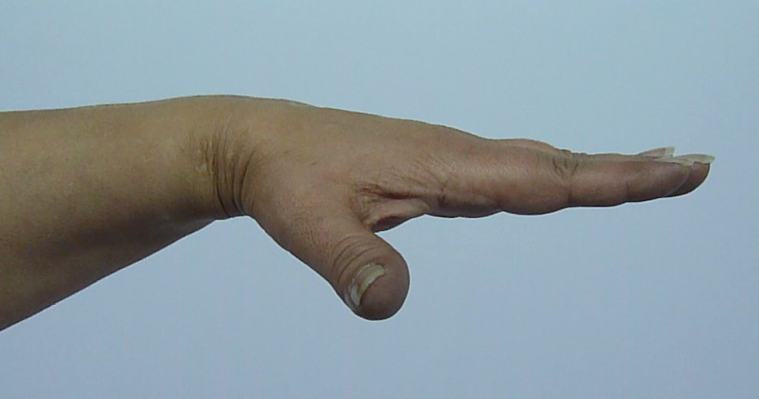
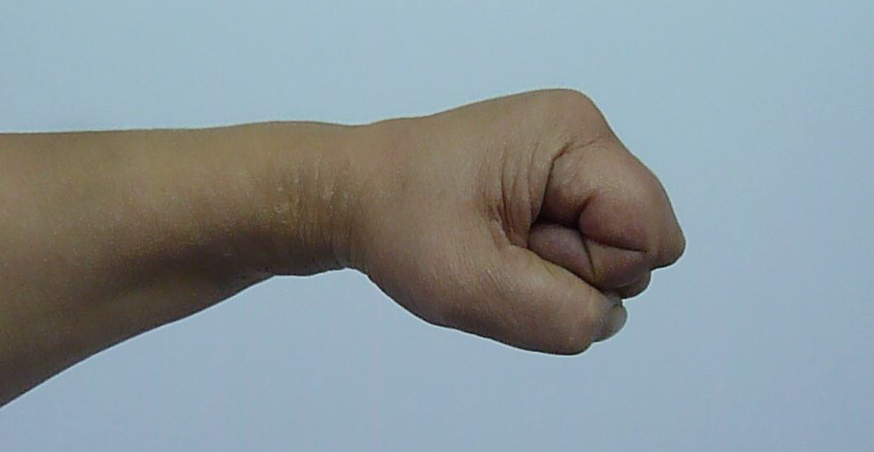
Follow-up 16 years

Slide 16
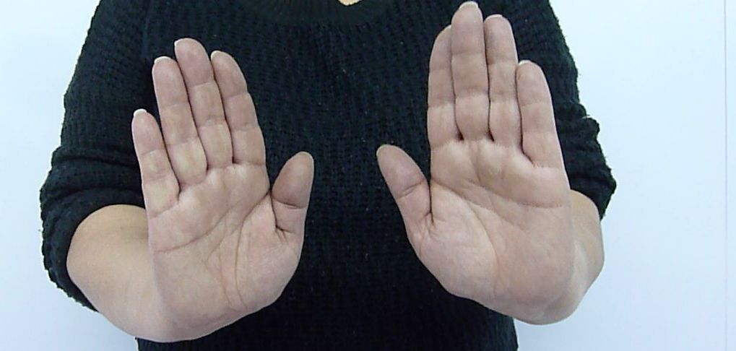
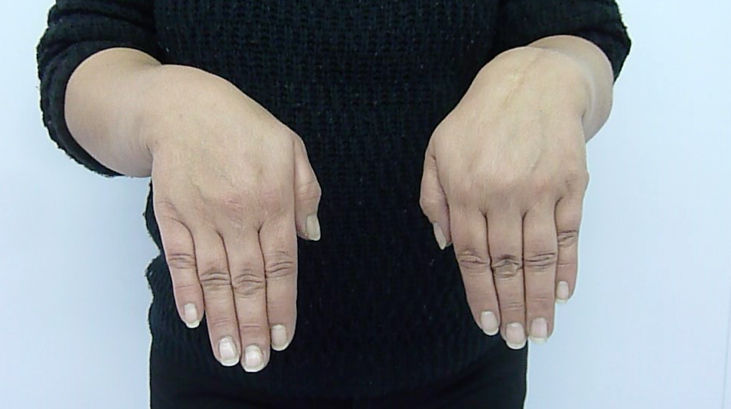
Follow-up 16 years

Slide 17
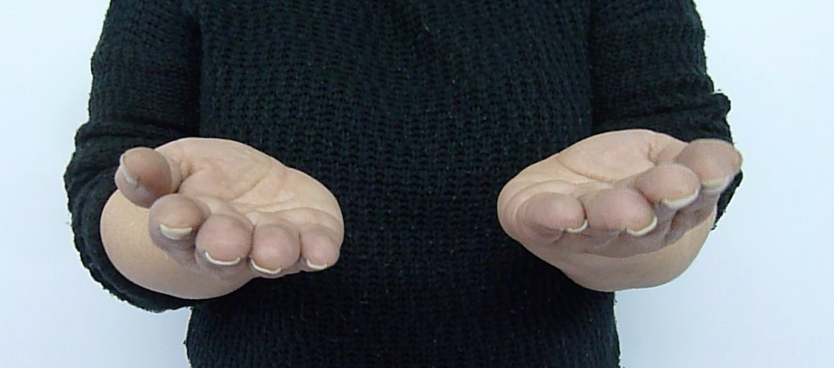
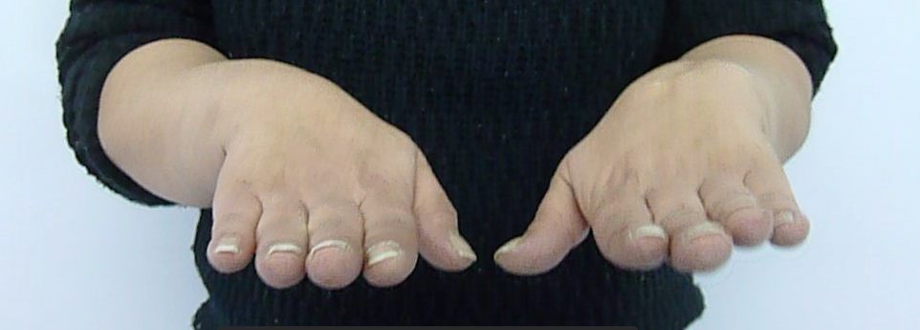
Follow-up 16 years

Slide 18
Learning objectives
Describe injury
Outline principles of treatment for malunited distal radial fracture
Explain benefits of early correction of intraarticular and extraarticular malunited fracture of the distal radius
Discuss treatment options
Select appropriate treatment

