Slide 1
AOTrauma Masters Course―Current Concepts
Complex elbow injuries
Module 1, Case 7: Complicated Monteggia injury with associated radial head comminuted fracture
Davos Courses
5 December 2018

Slide 2
Case description
32-year-old woman
Fall from bike
Has Ehlers-Danlos

Slide 4
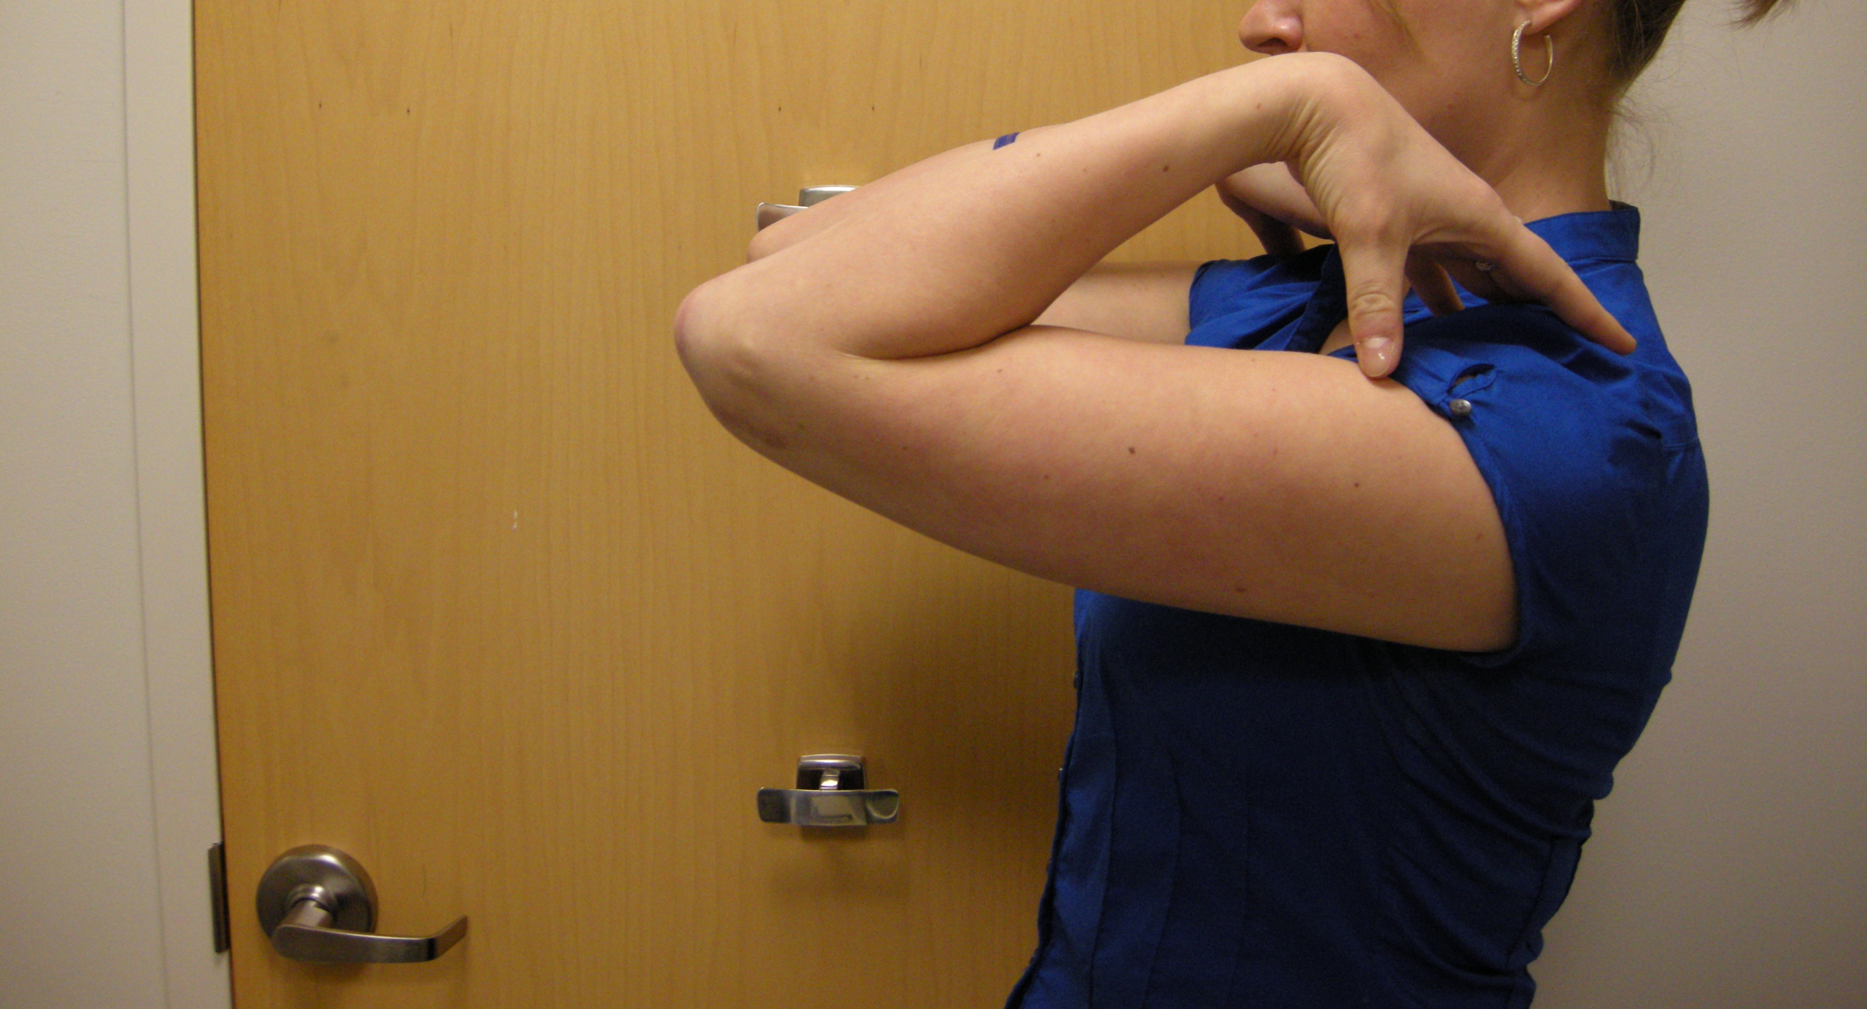
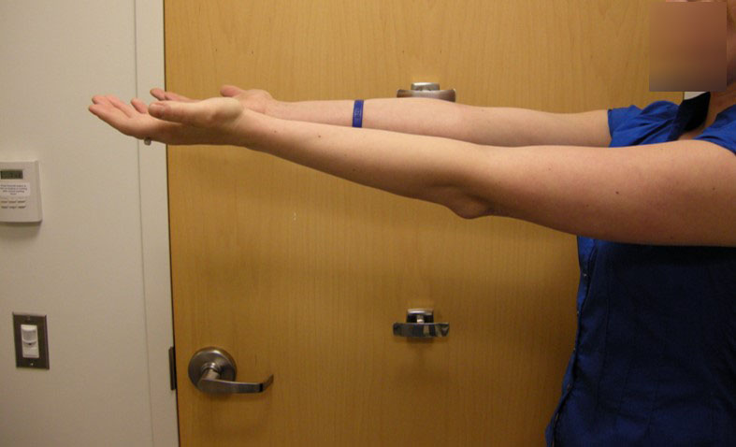
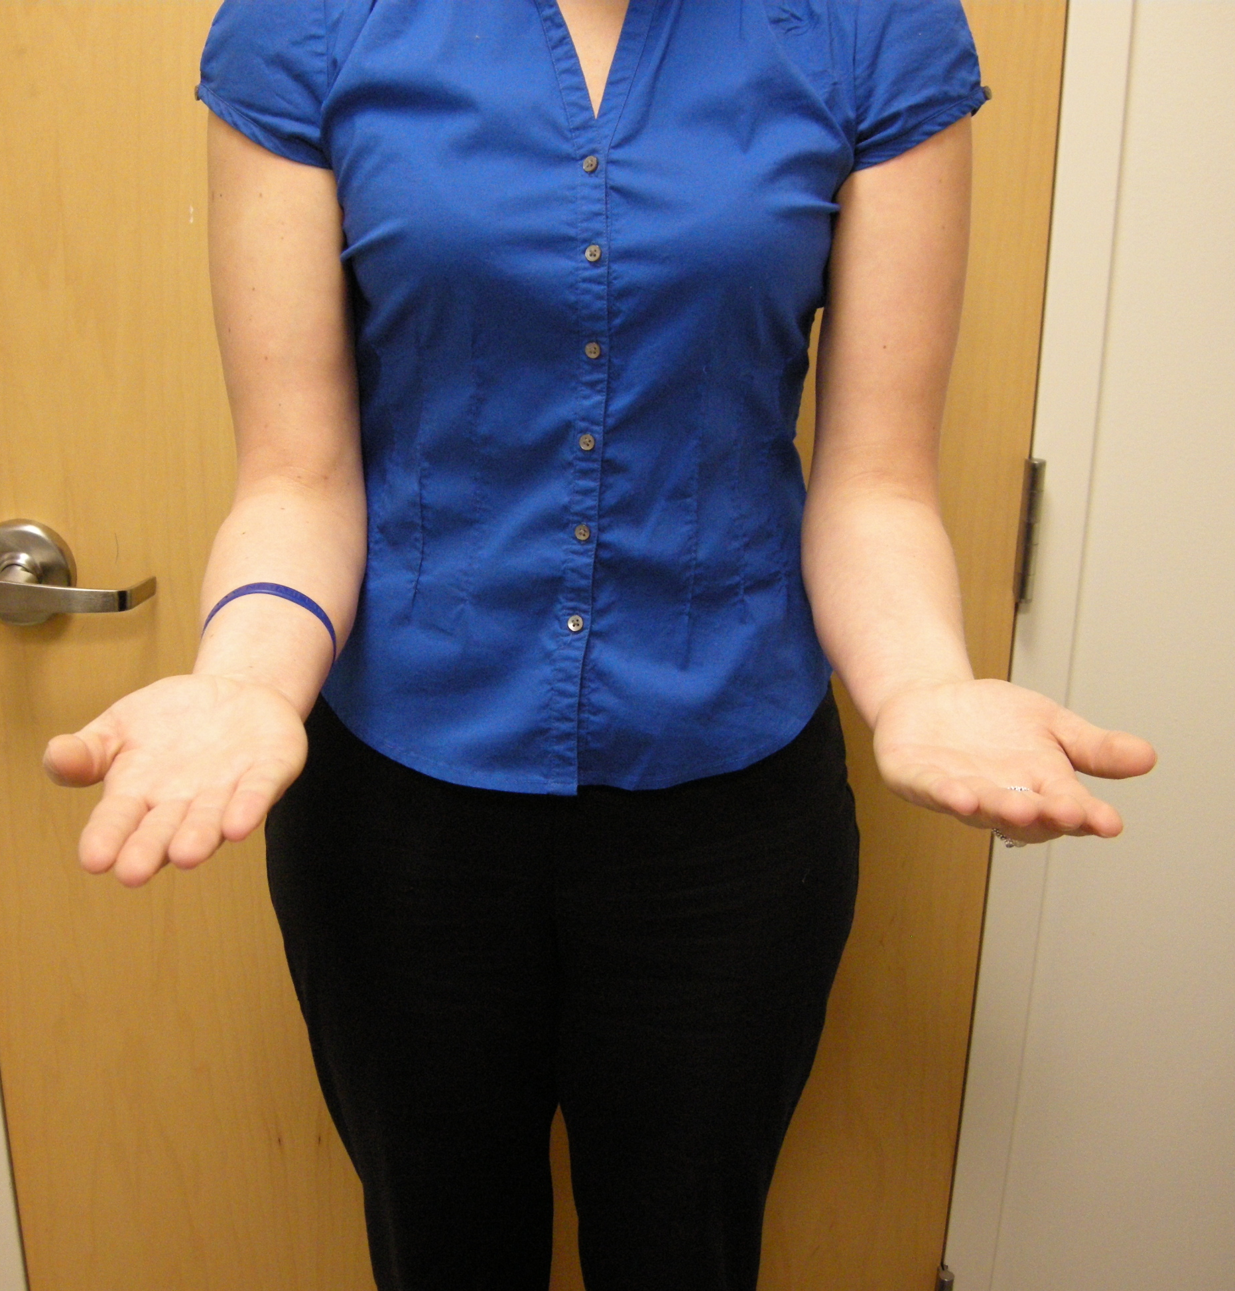
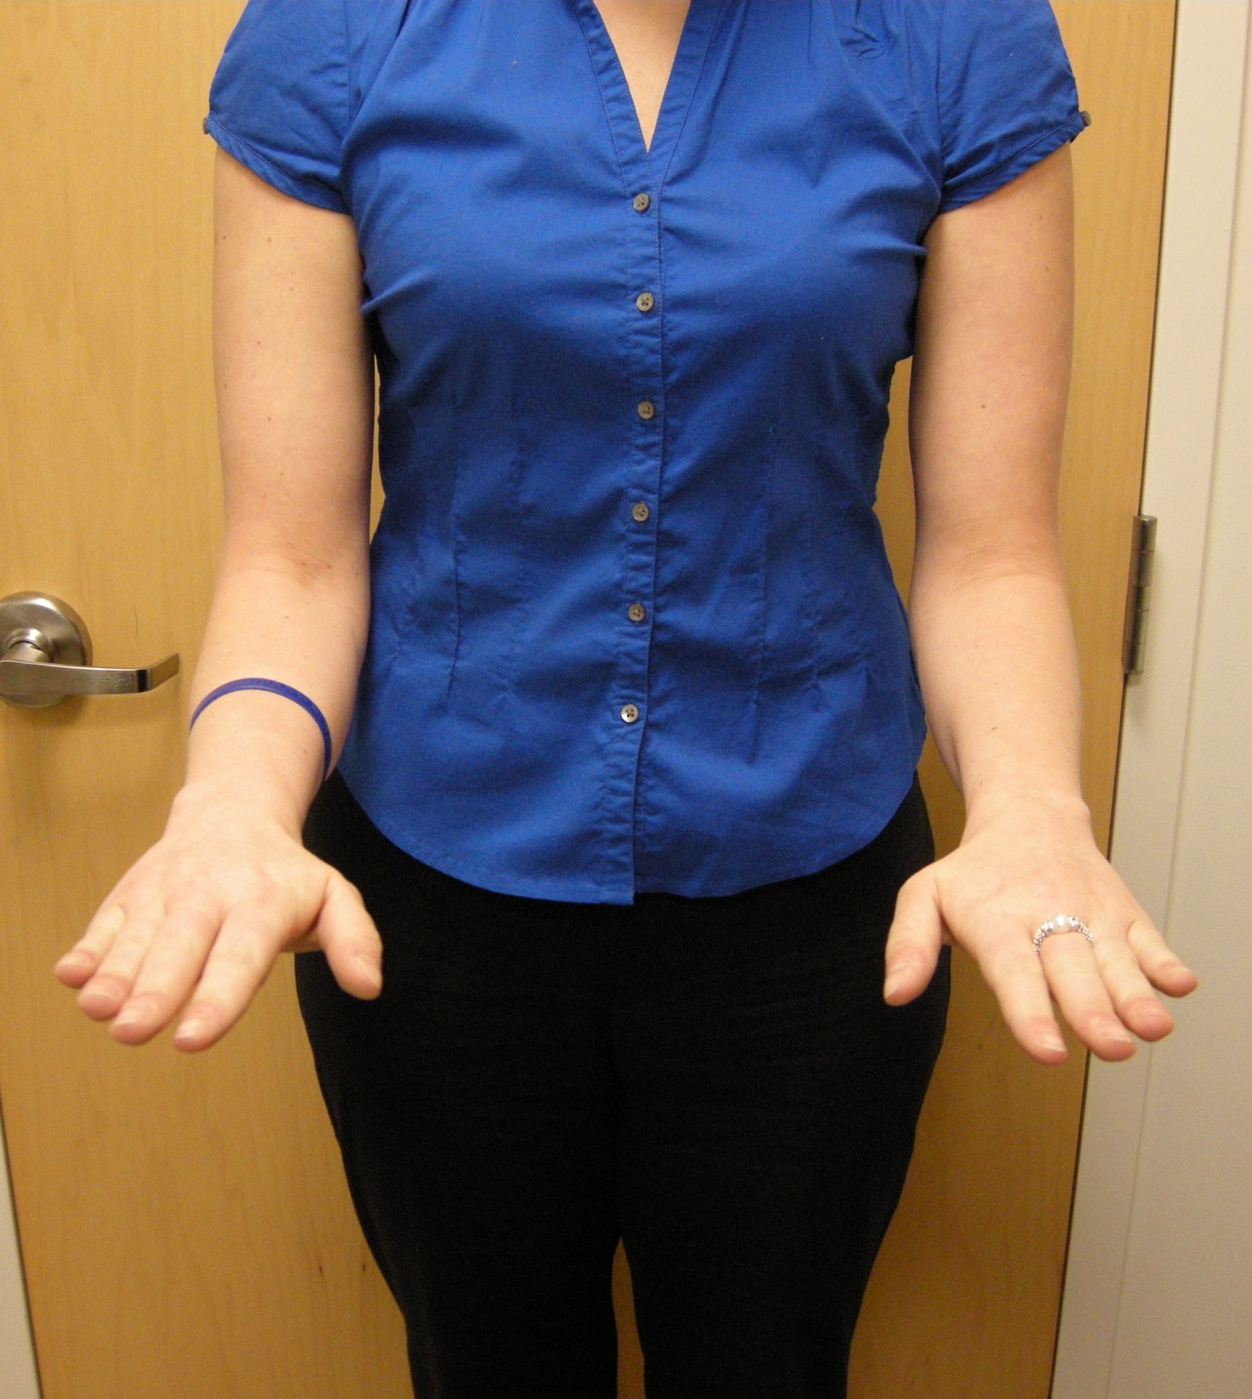

Slide 5
Learning objectives
Evaluate injury and identify the different damaged anatomical structures
Emphasize importance of repair or reconstruct damaged structures
Discuss treatment options
Select appropriate treatment based on the best evidence published

