Slide 1
AOTrauma Masters Course―Current Concepts
Module 3, Case 4: Oblique tip amputation of the small finger with bone exposure
Davos Courses
December 2018

Slide 2
Learning objectives
Evaluate injury and identify the exposed anatomical structures
Emphasize importance of the functional requirements of the patient
Explain usefulness and benefits to provide the fingertip with sensitive well-padded reconstruction as early as possible
Select in the reconstructive ladder of soft-tissue coverage the adequate procedure considering the injury presented

Slide 3
Case description
25-year-old man
Sustained a palmar oblique tip amputation of the small finger of his nondominant hand
Injury with an operating table saw
Patient was seen in the emergency department 2 hours after injury

Slide 4
Discuss
Describe the injury and patient requirements
Plan of reconstruction
The question of reconstruction versus early amputation

Slide 6
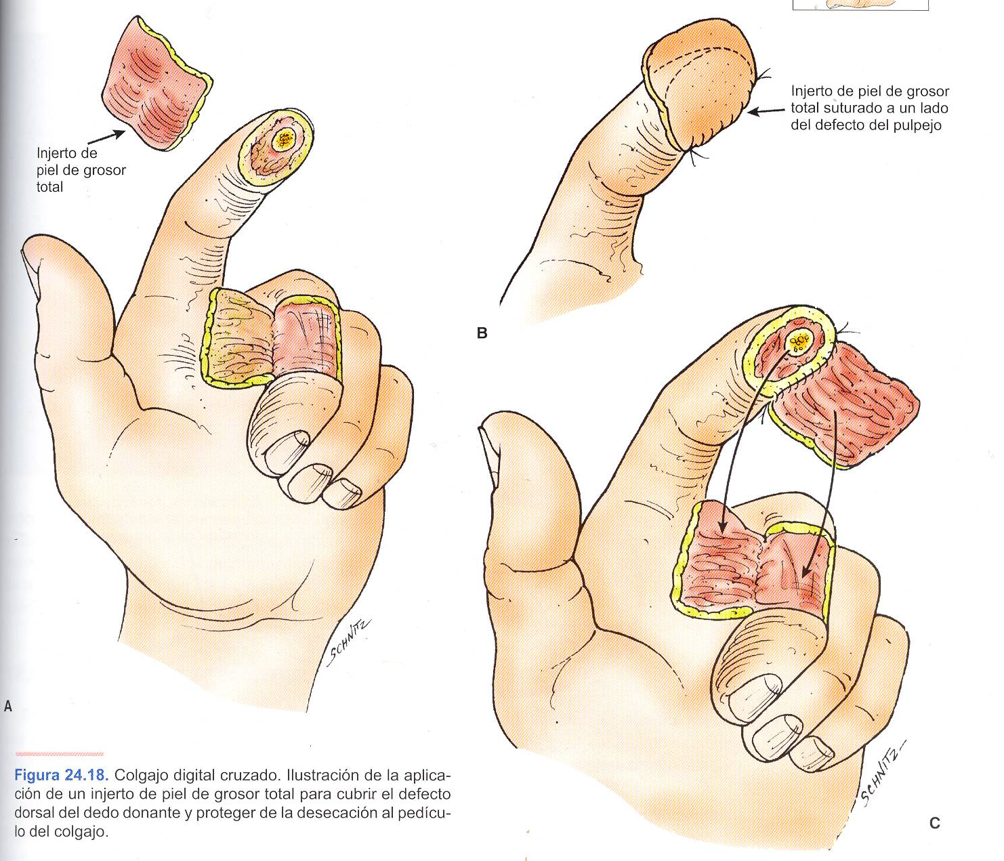
Cross-finger pedicle flap

Slide 10
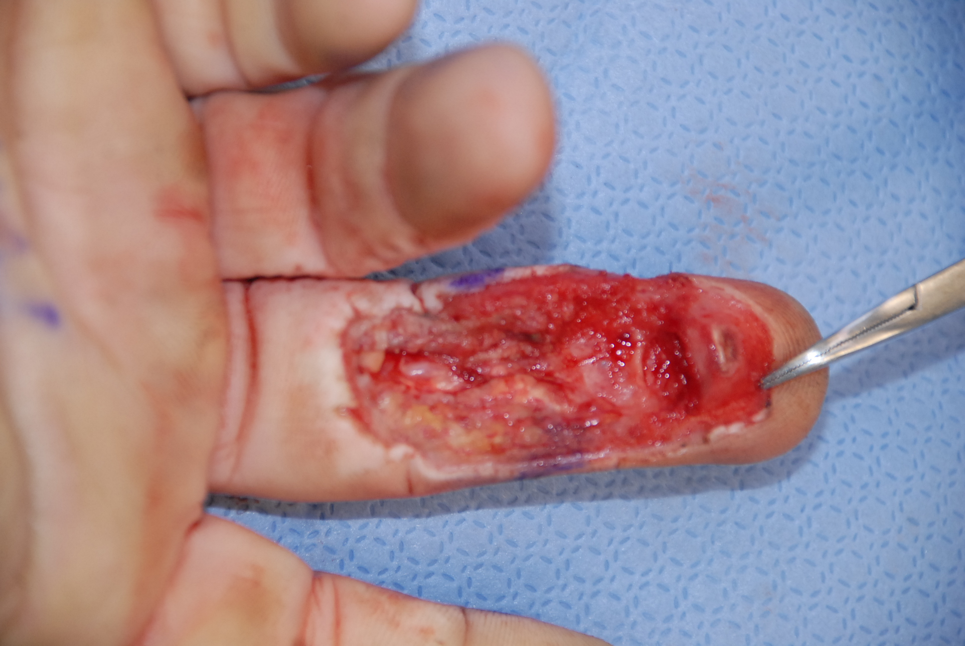

Slide 11
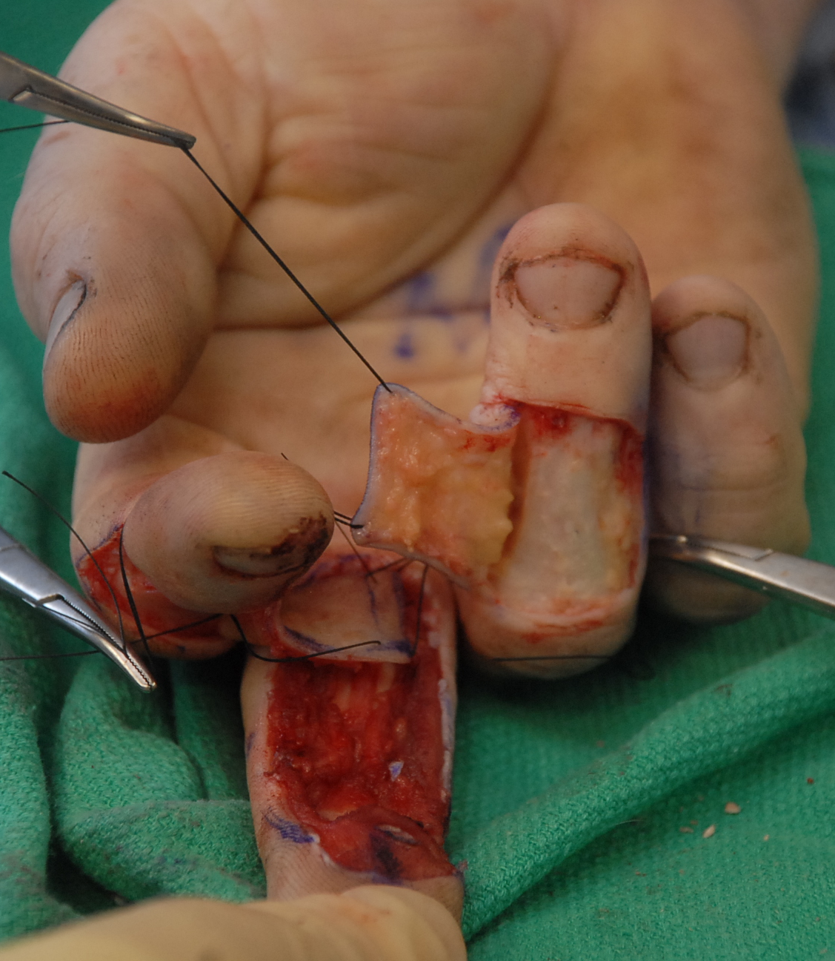
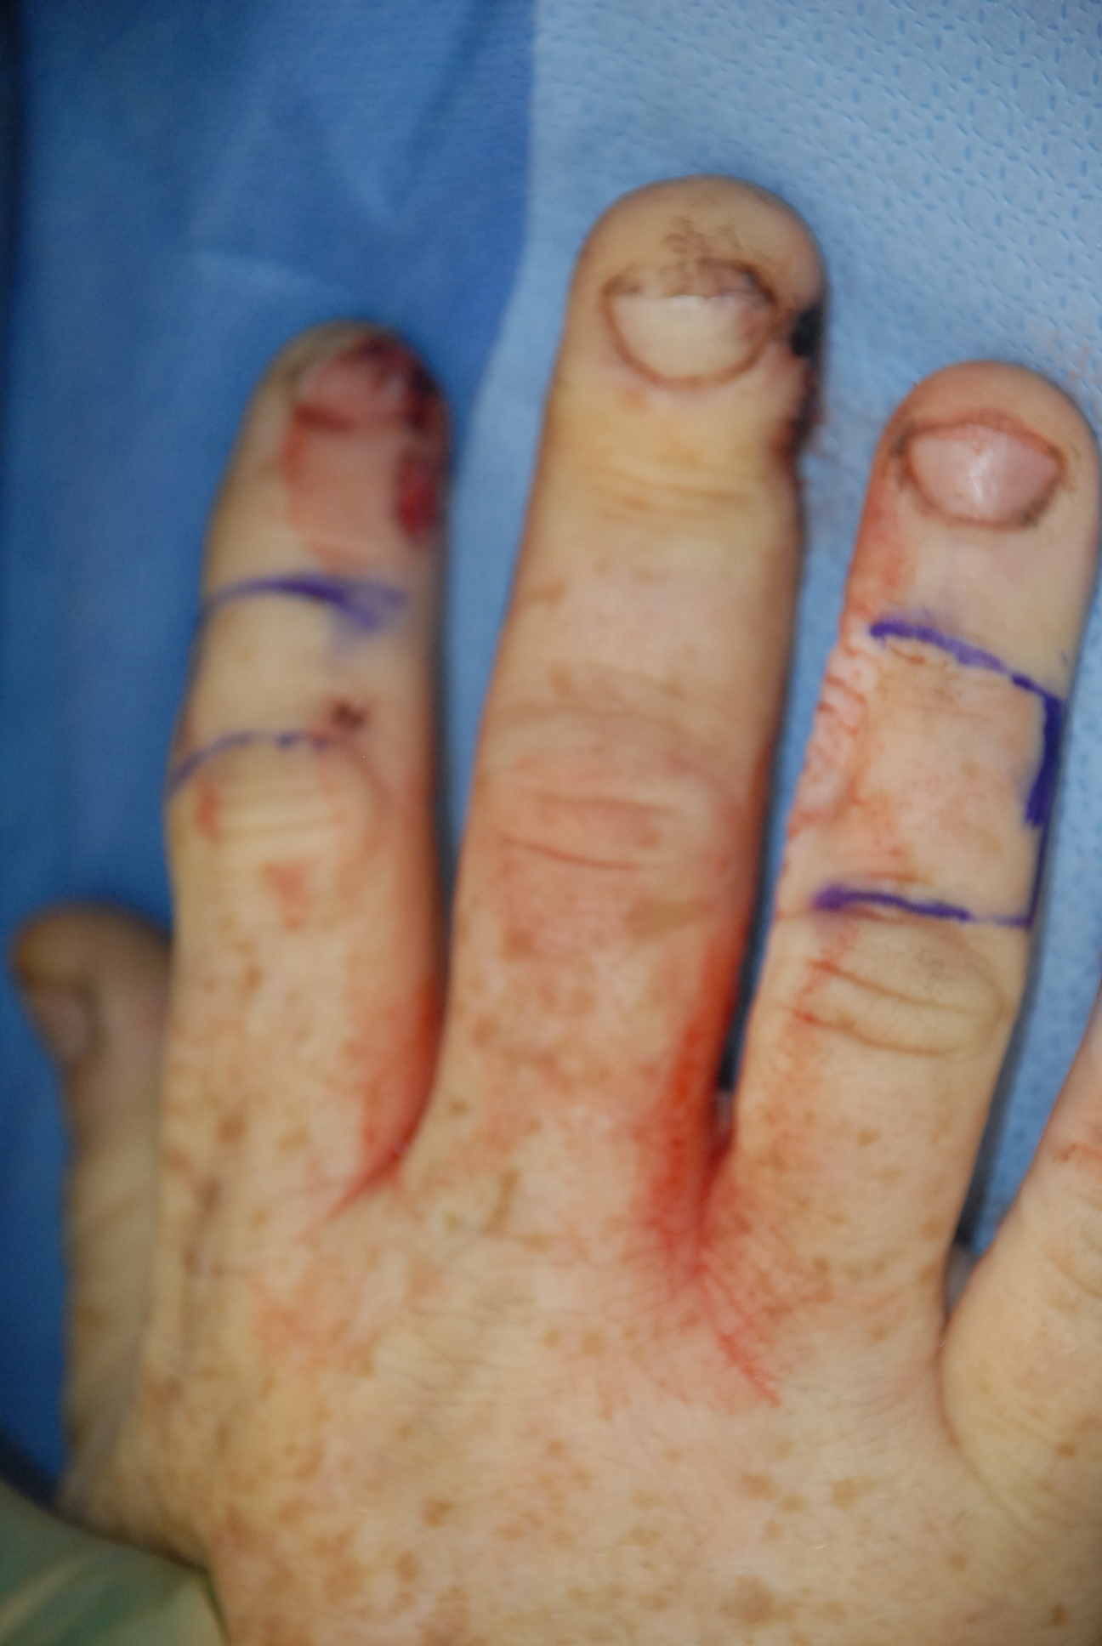
Double cross-finger flap

Slide 12
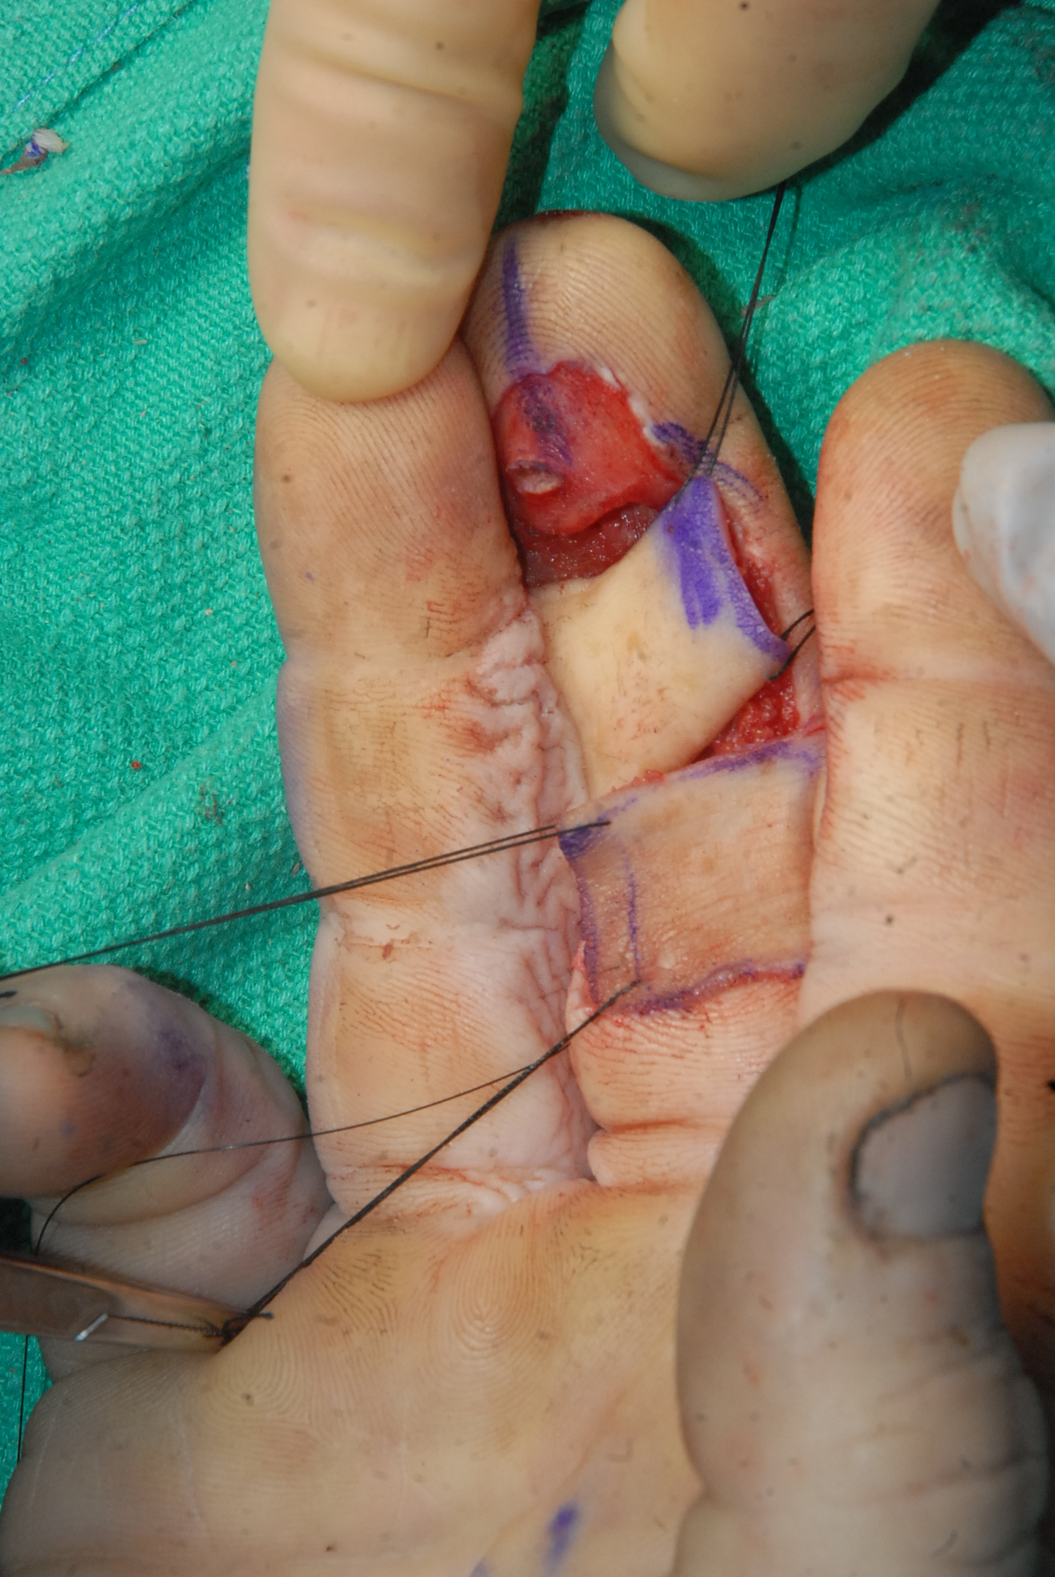
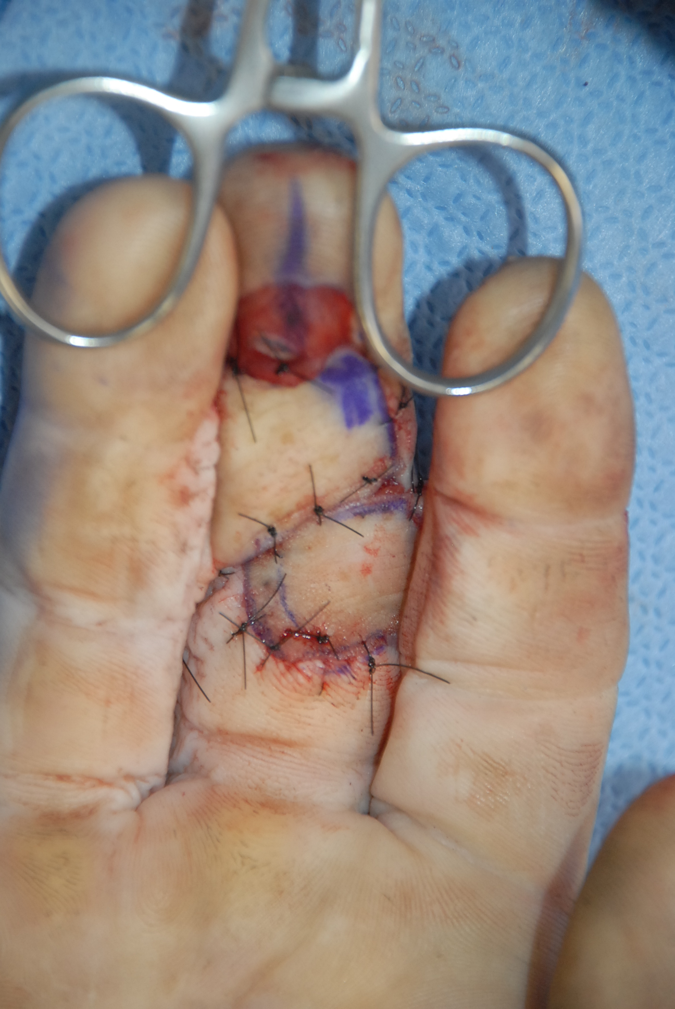

Slide 13
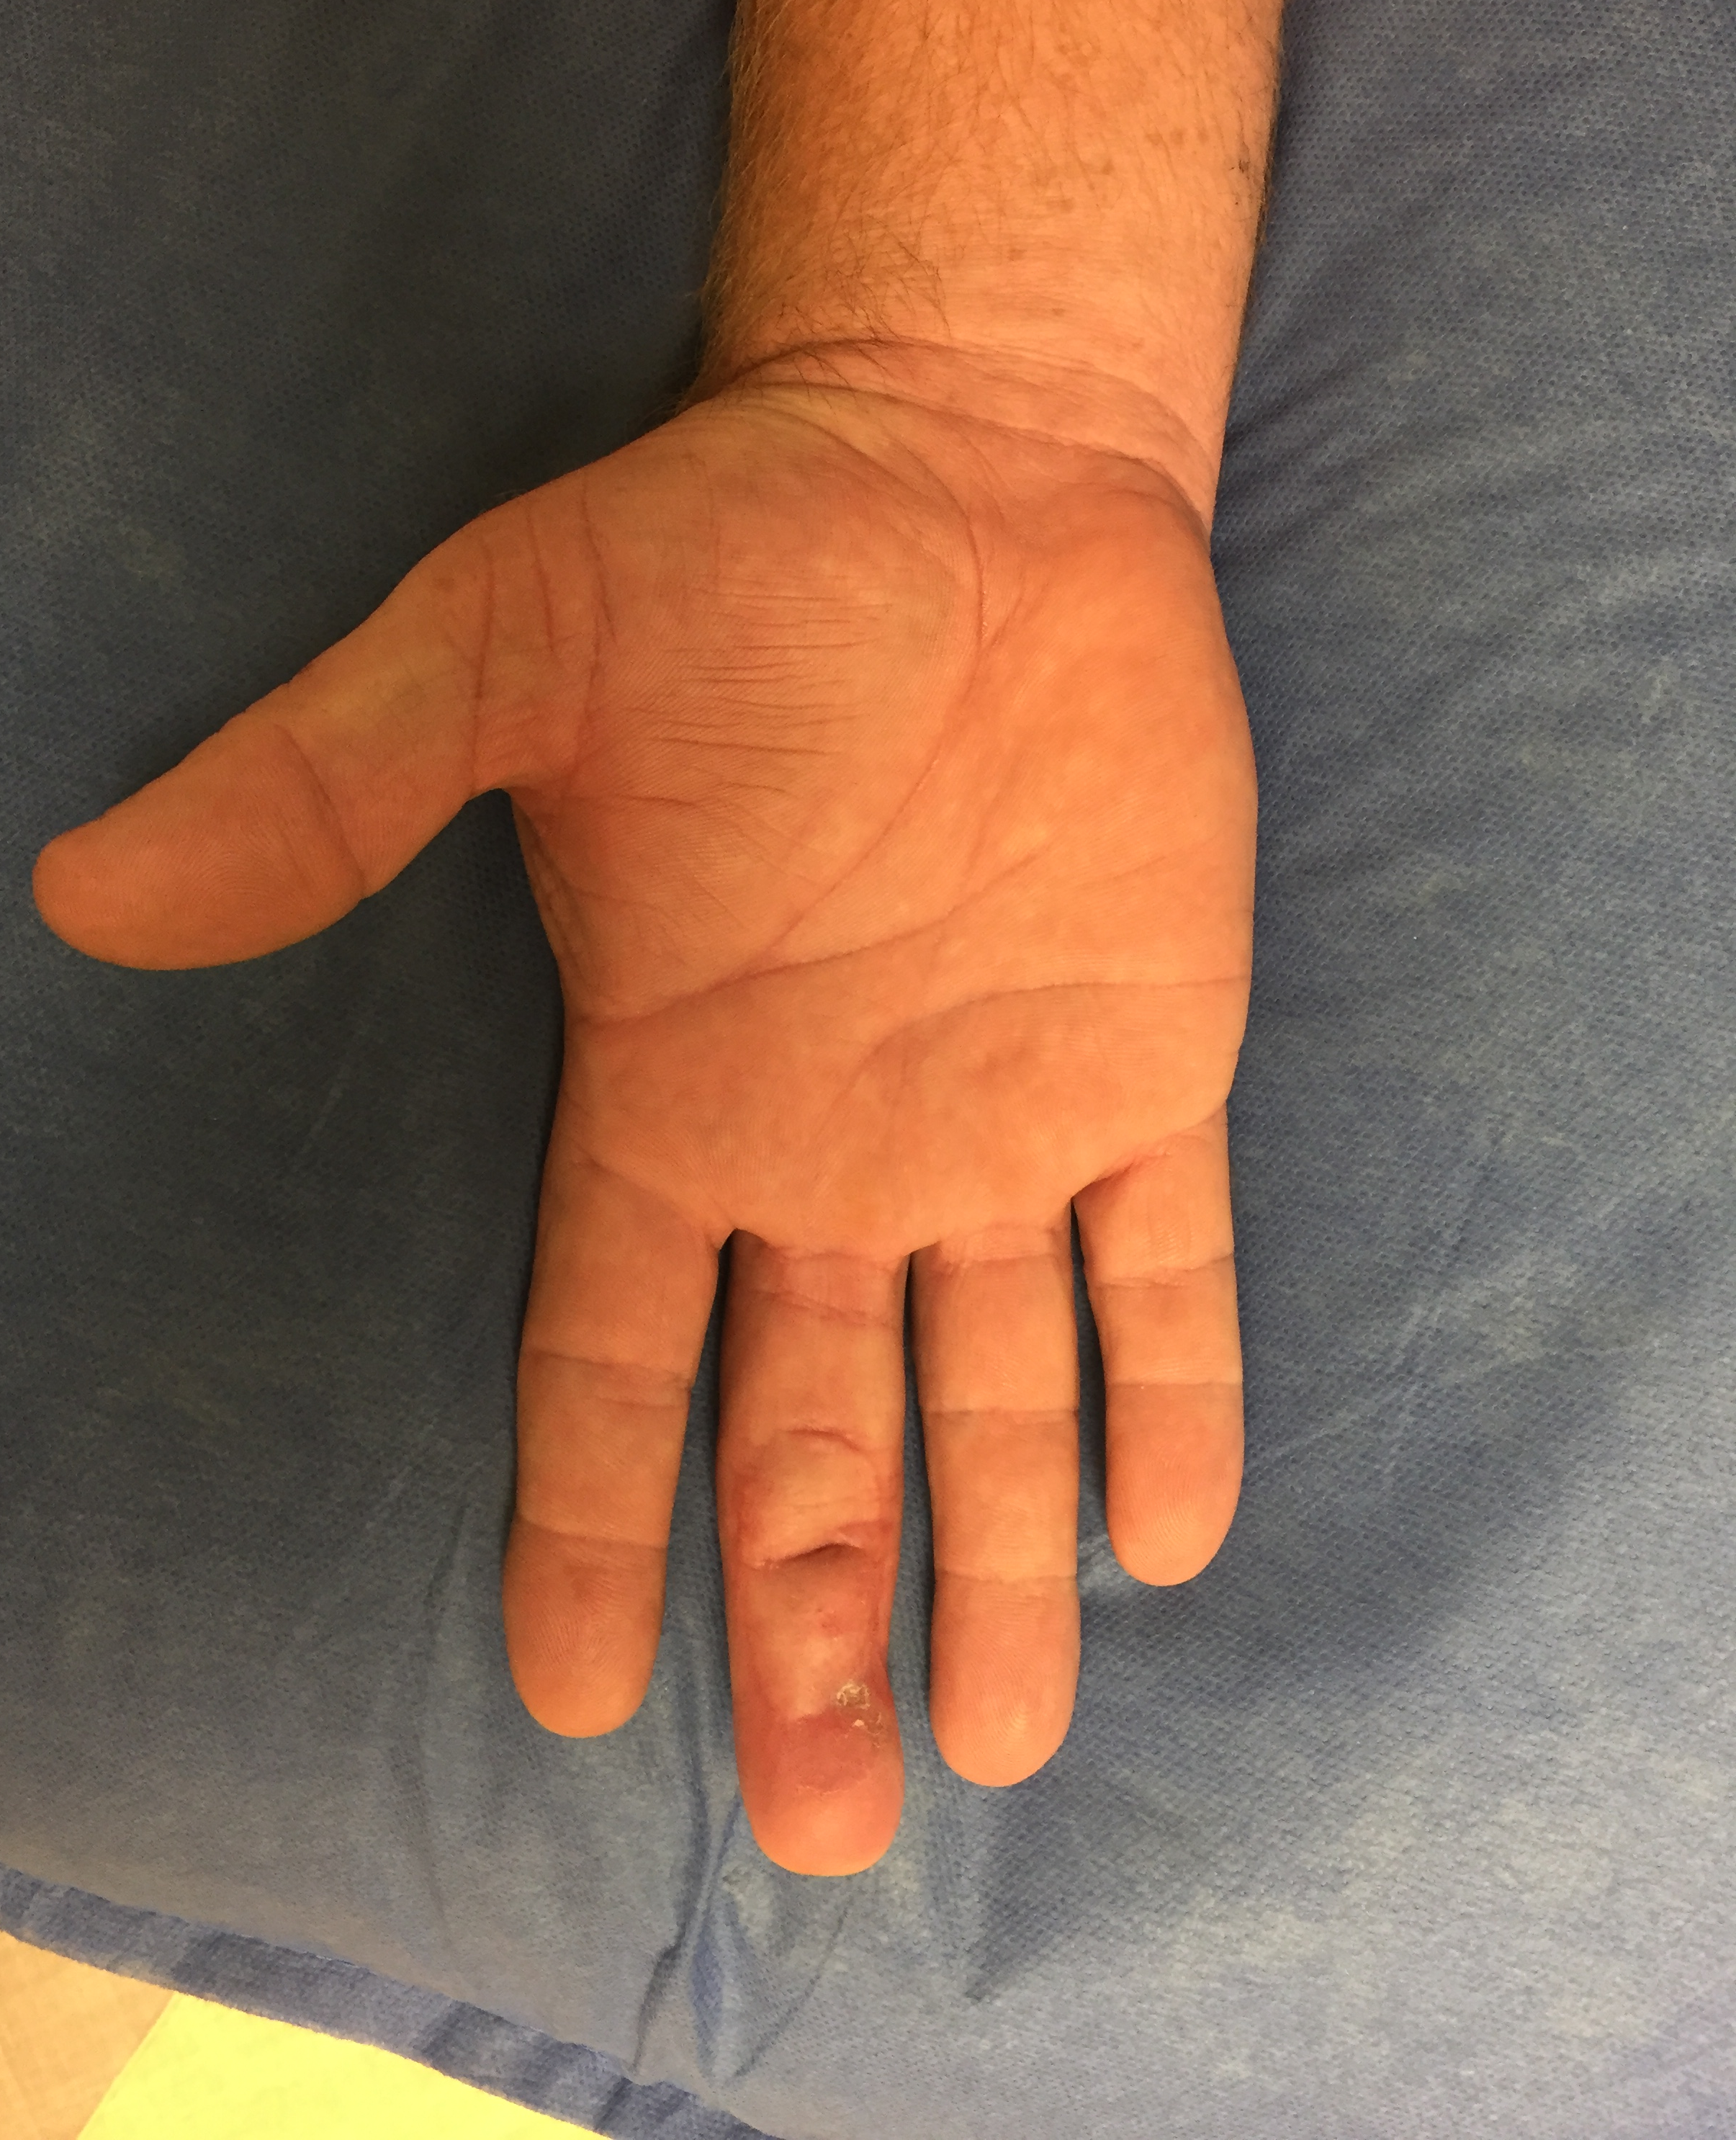
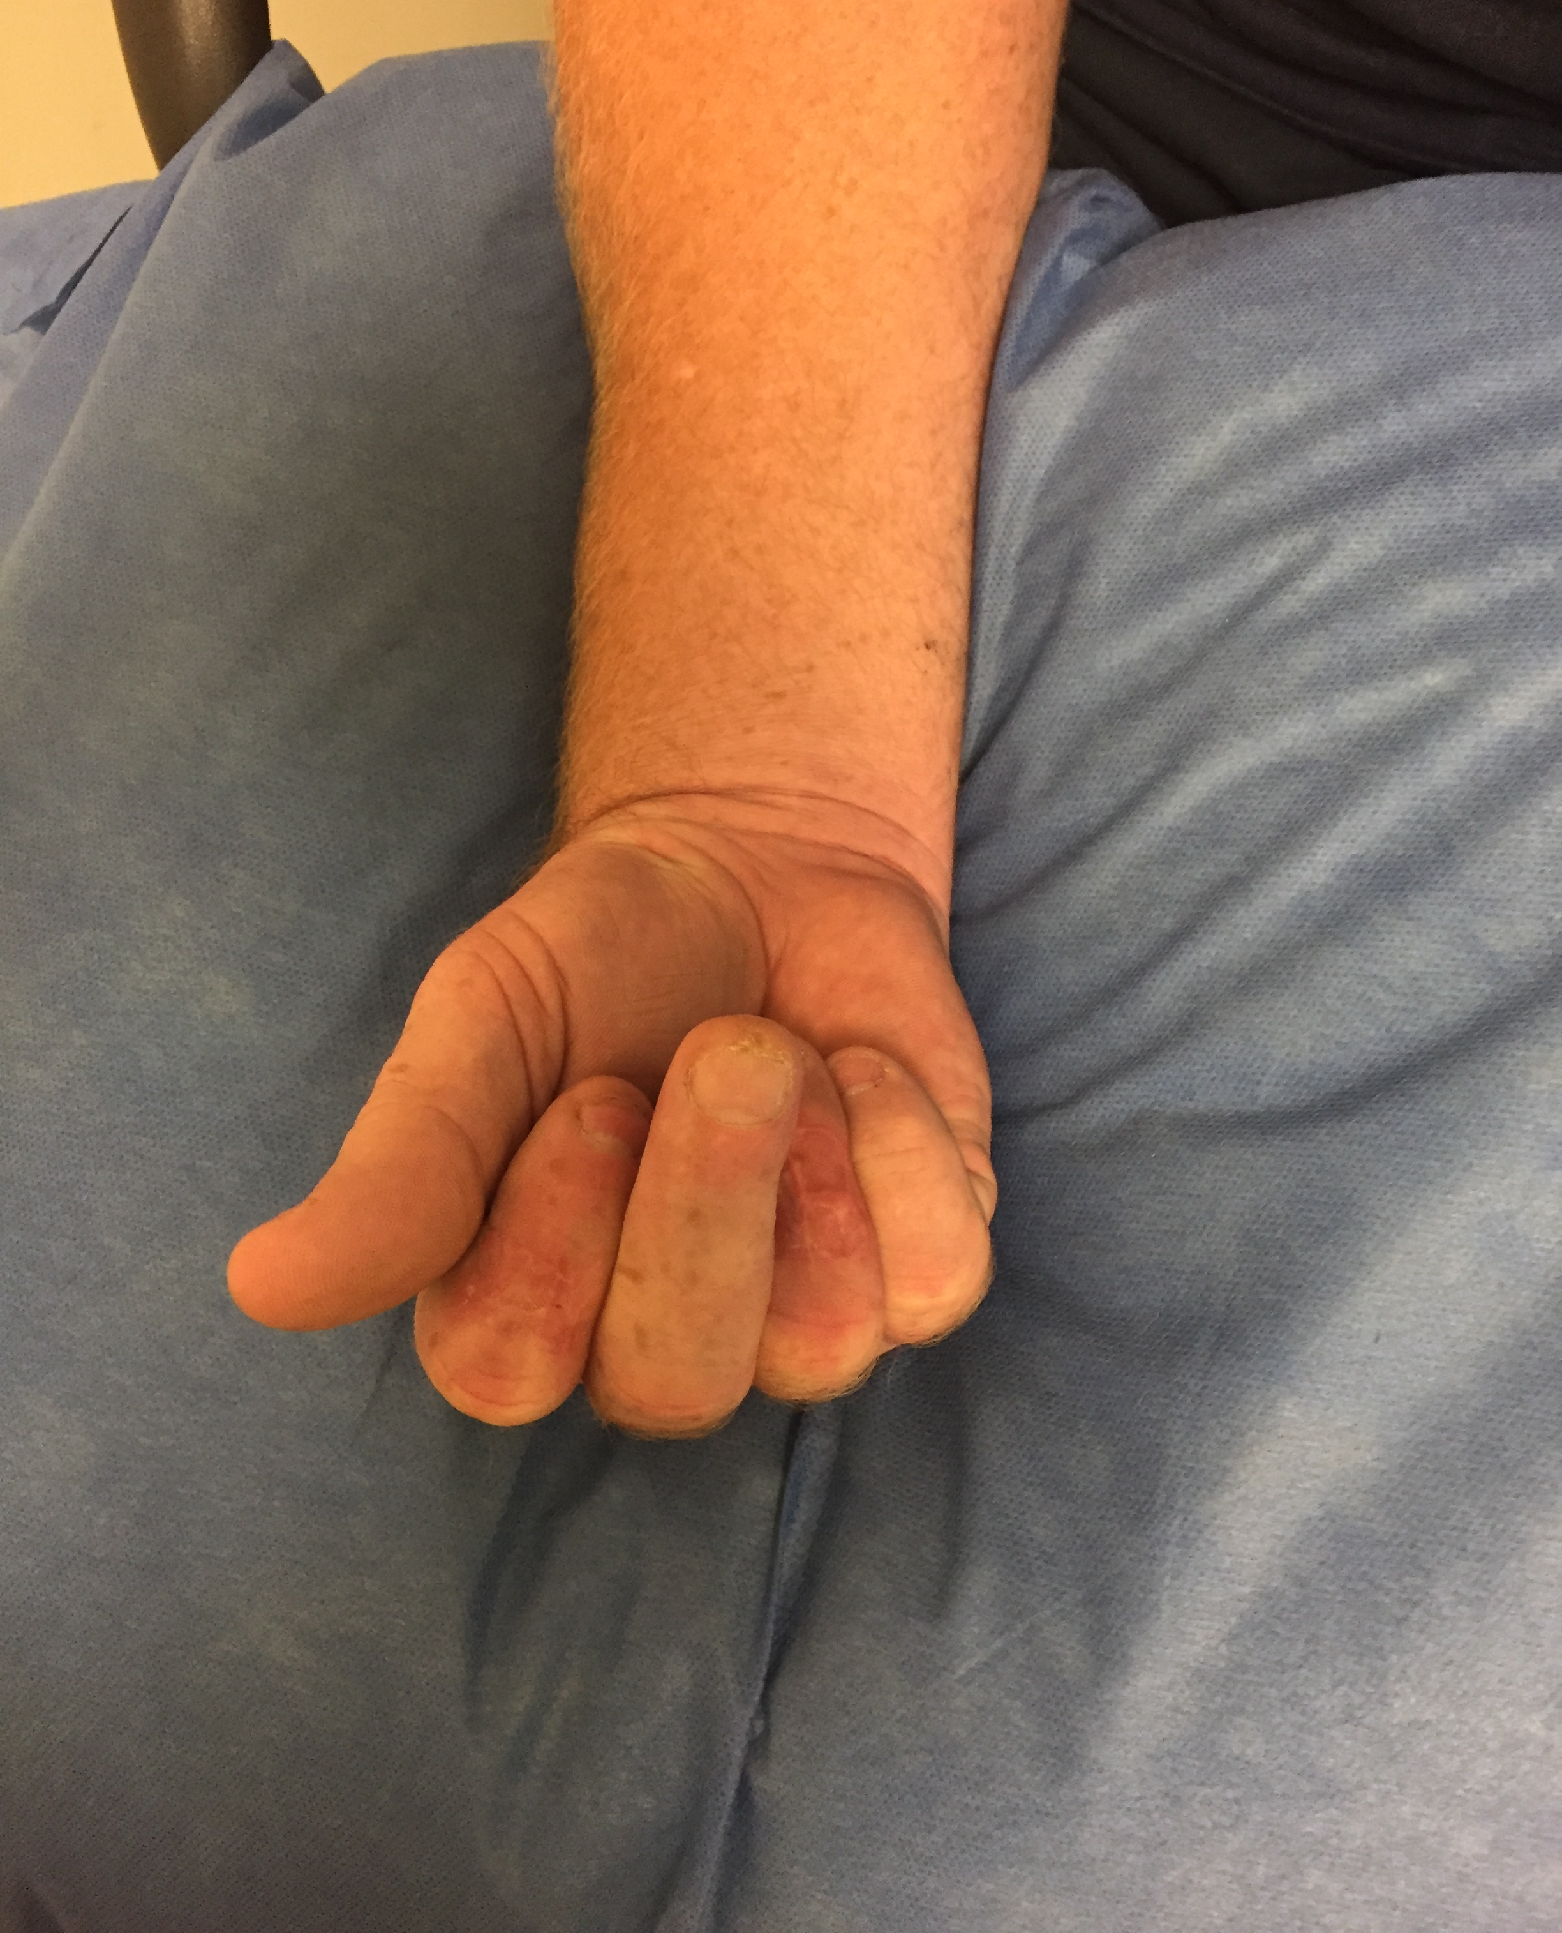

Slide 15
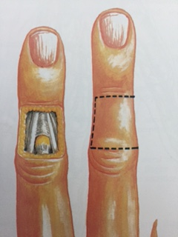
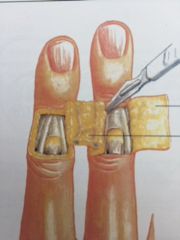
Reverse cross-finger flap

Slide 16
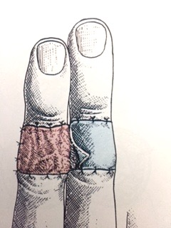

Slide 17
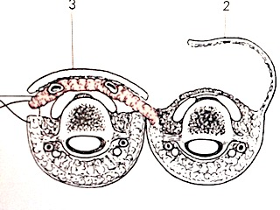

Slide 18
