Slide 1
AOTrauma Masters Course―Current Concepts
Module 3, Case 1: A wide loss of skin coverage of the hand and wrist with exposure of arteries, nerves and bone, sequelae of crush injury
Davos Courses
December 2018

Slide 2
Case description
38-year-old metallurgical industry worker
Sustained a crush injury to his dominant hand
Injury while using a hydropneumatic press
Patient was seen in the emergency room 1 hour after injury

Slide 3
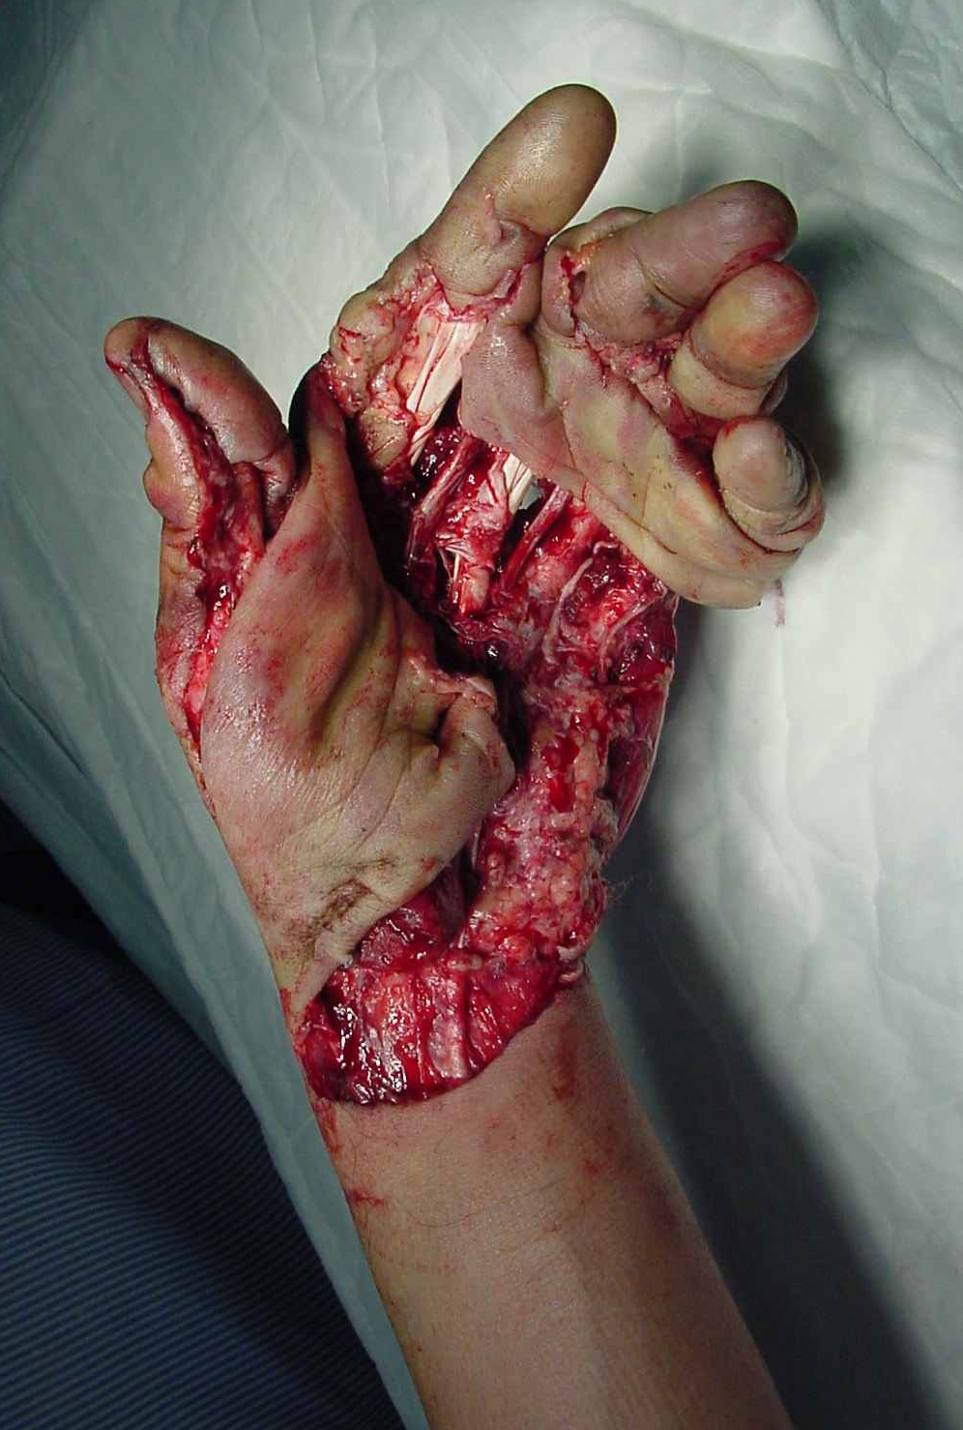

Slide 4
Discuss (briefly)
Describe the injury
Possible complications
Plan of immediate treatment

Slide 5
After two surgical debridement and revascularization of the thumb

Slide 6
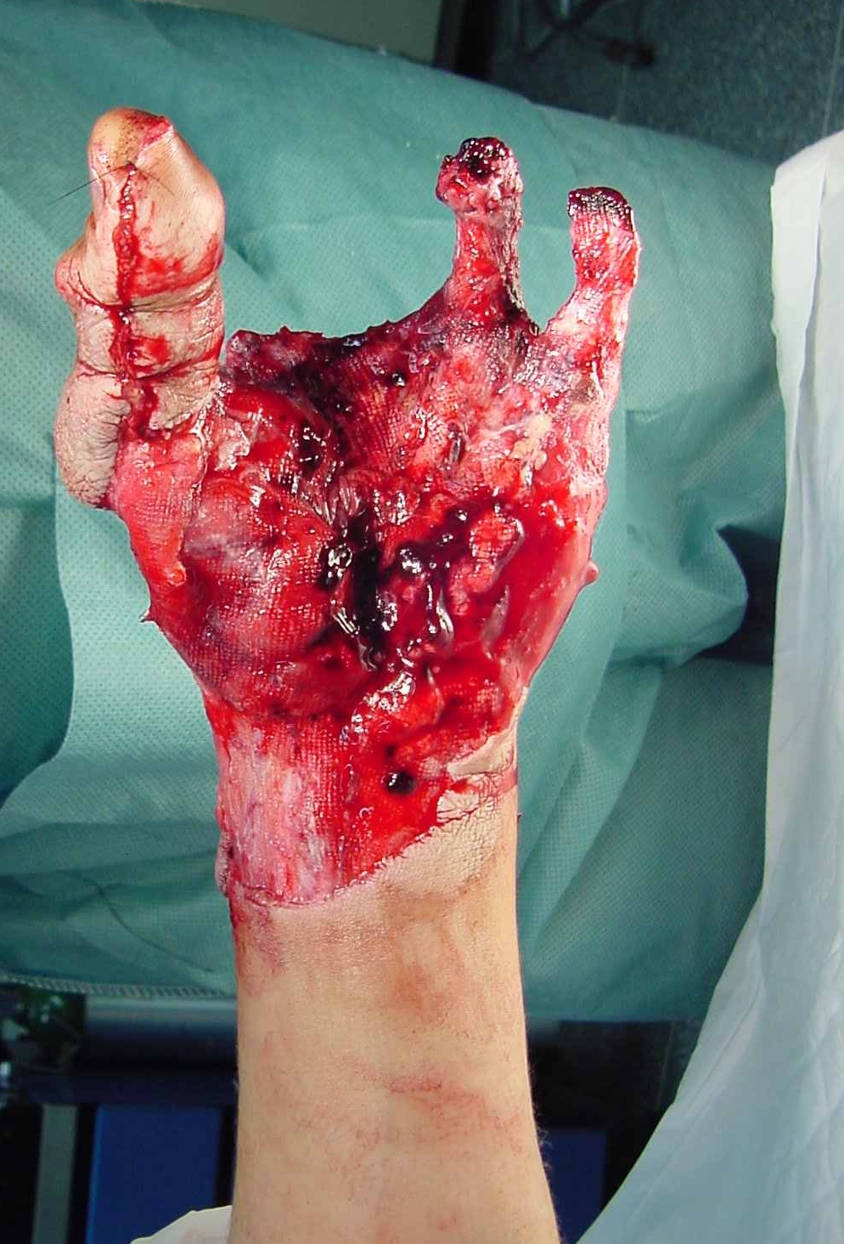
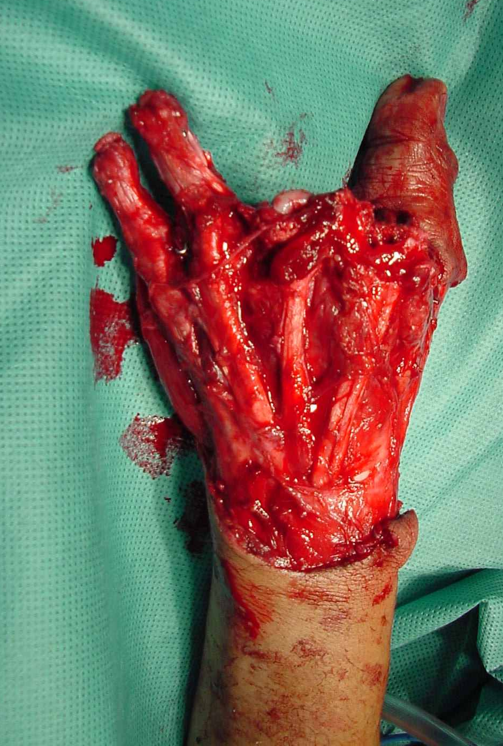

Slide 7
Discuss
Describe the present situation and patient requirements
The tiers and standardized applicability of the reconstructive ladder of soft-tissue injury
Plan of reconstruction
The question of complex reconstruction versus early amputation and prosthesis
The question of early or late reconstruction

Slide 8
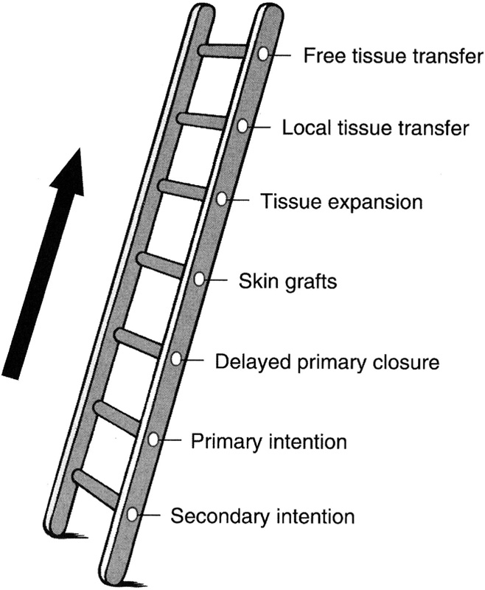
Reconstructive ladder of soft-tissue injury

Slide 9
Radial forearm flap was elevated from the contralateral forearm

Slide 10
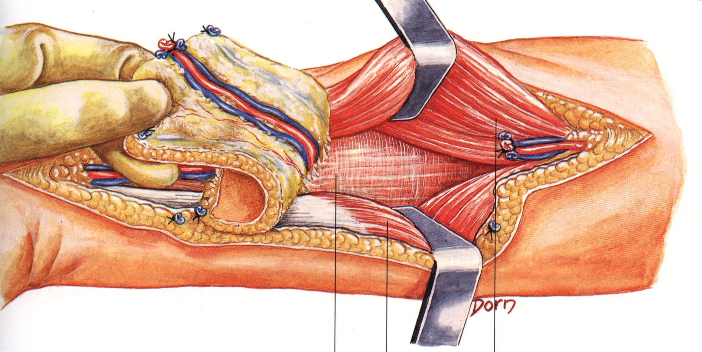
Free radial forearm flap

Slide 11
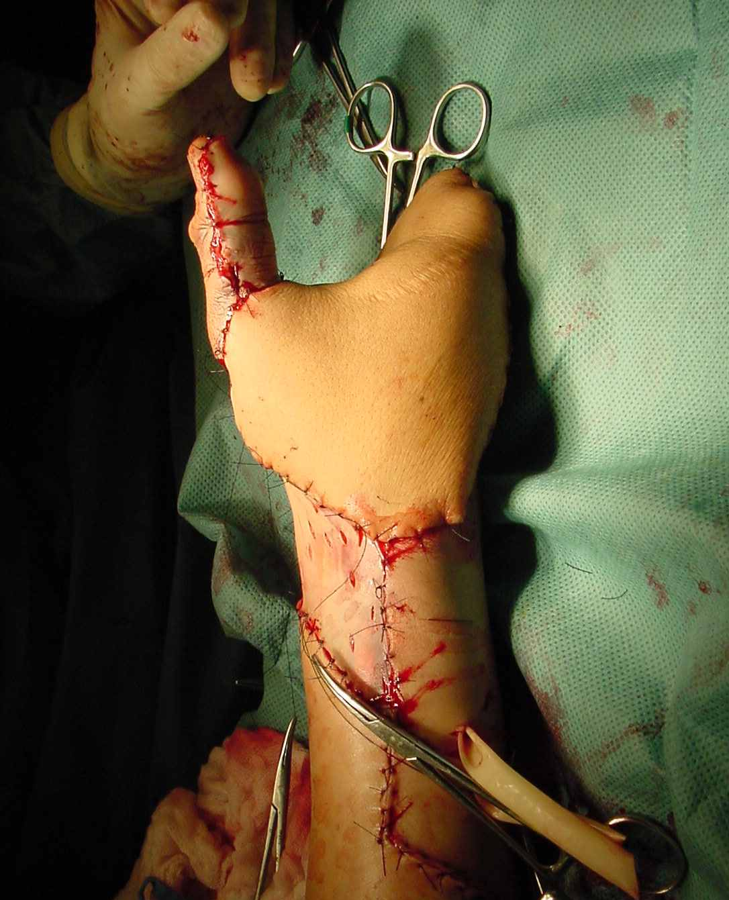
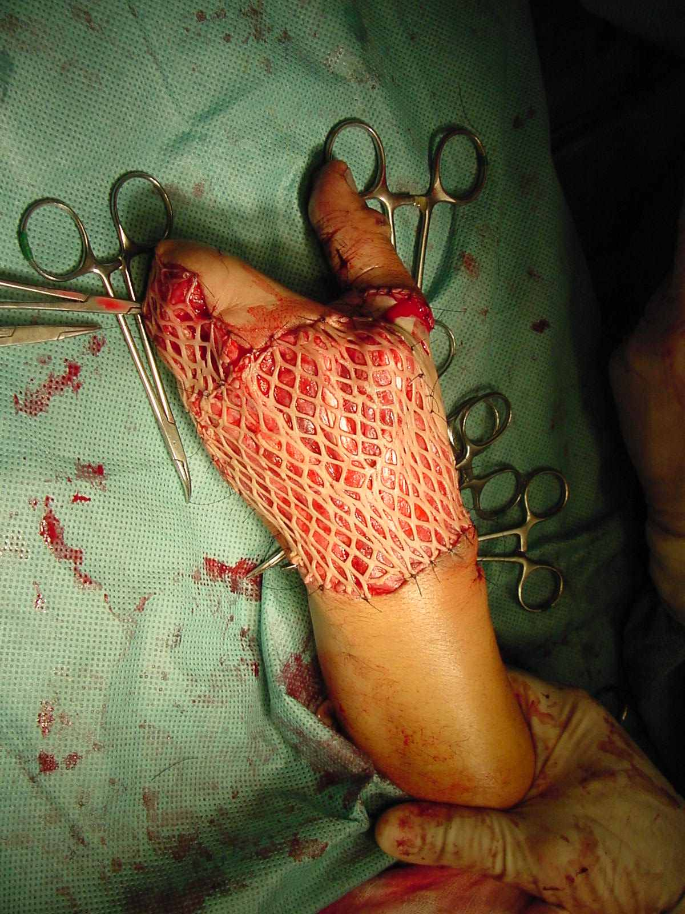
Free radial forearm flap was used to reconstruct the ulnar and palmar aspect of the hand
Skin graft was used to cover the dorsal aspect of the hand and radial aspect of the wrist

Slide 12
Early microsurgical reconstruction of complex trauma of the extremities
Godina M. Early microsurgical reconstruction of complex trauma of the extremities. Plast Reconstr Surg. 1986 Sep;78:285–292
Godina's work showed that with a radical debridement and early microsurgical soft-tissue reconstruction within 72 hours, infection risk, morbidity, and time to healing were all dramatically improved

Slide 13
Emergency free flap (publications)
The concept of emergency complete reconstruction proposed by Godina (soft-tissue reconstruction with free tissue transfer) was reinforced by other published series
Lister G, Scheker L. Emergency free flaps to the upper extremity. J Hand Surg Am. 1988 Jan;13:22‒28
Chen SH, Wei FC, Chen HC, et al. Emergency free flap transfer for reconstructions of acute complex extremity wounds. Plast Reconst Surg. 1992 May;89:882‒888
Notes:
Included in Godina's series and reinforced by other centers was the concept of complete reconstruction, including soft-tissue reconstruction with free tissue transfer in a single emergent setting.

Slide 14
15 days

Slide 15
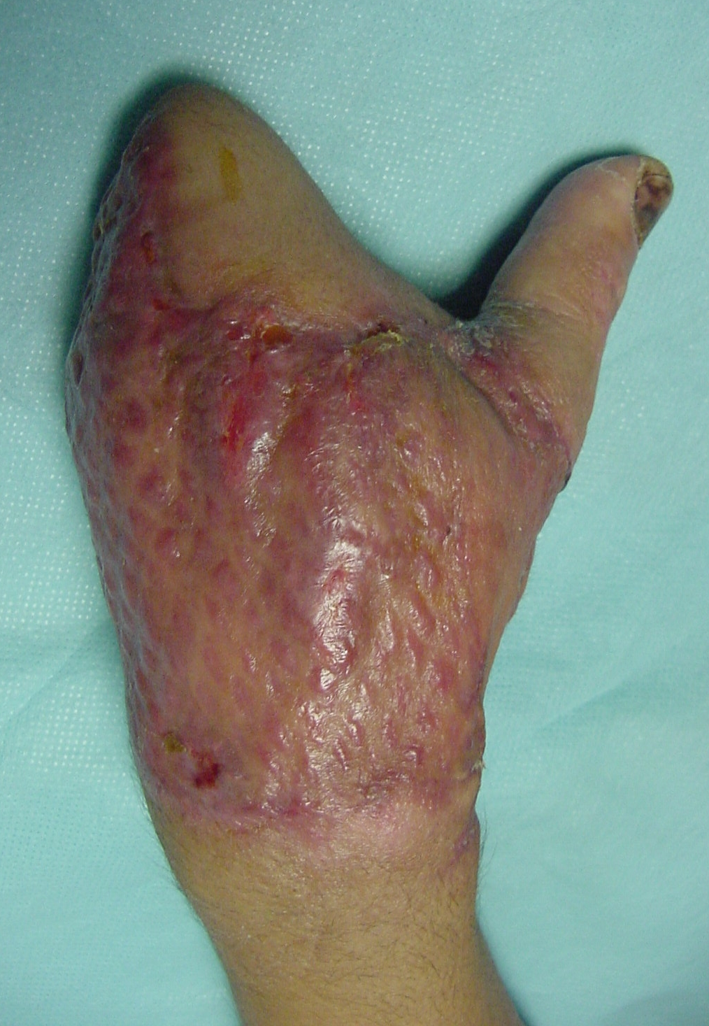
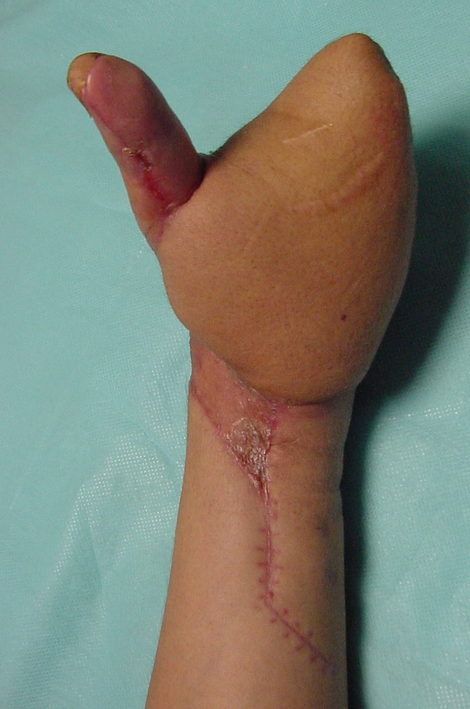
2 months

Slide 16
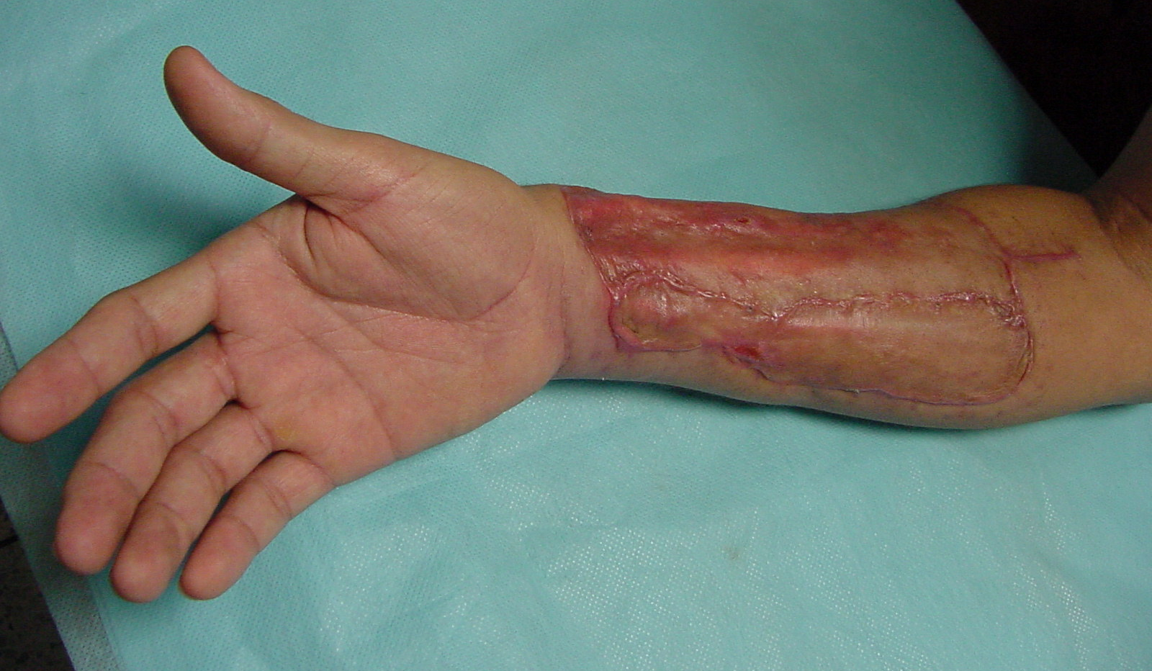
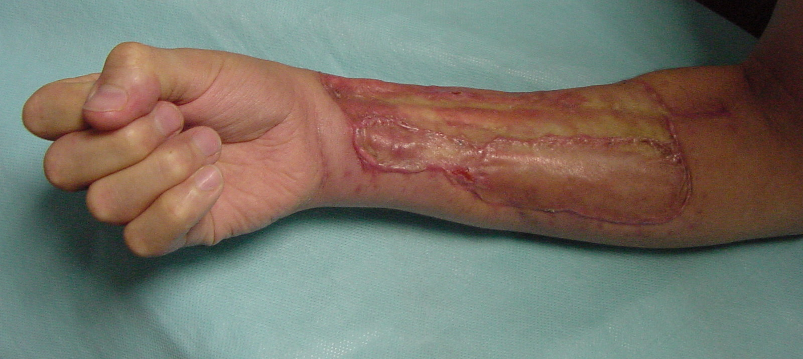

Slide 17
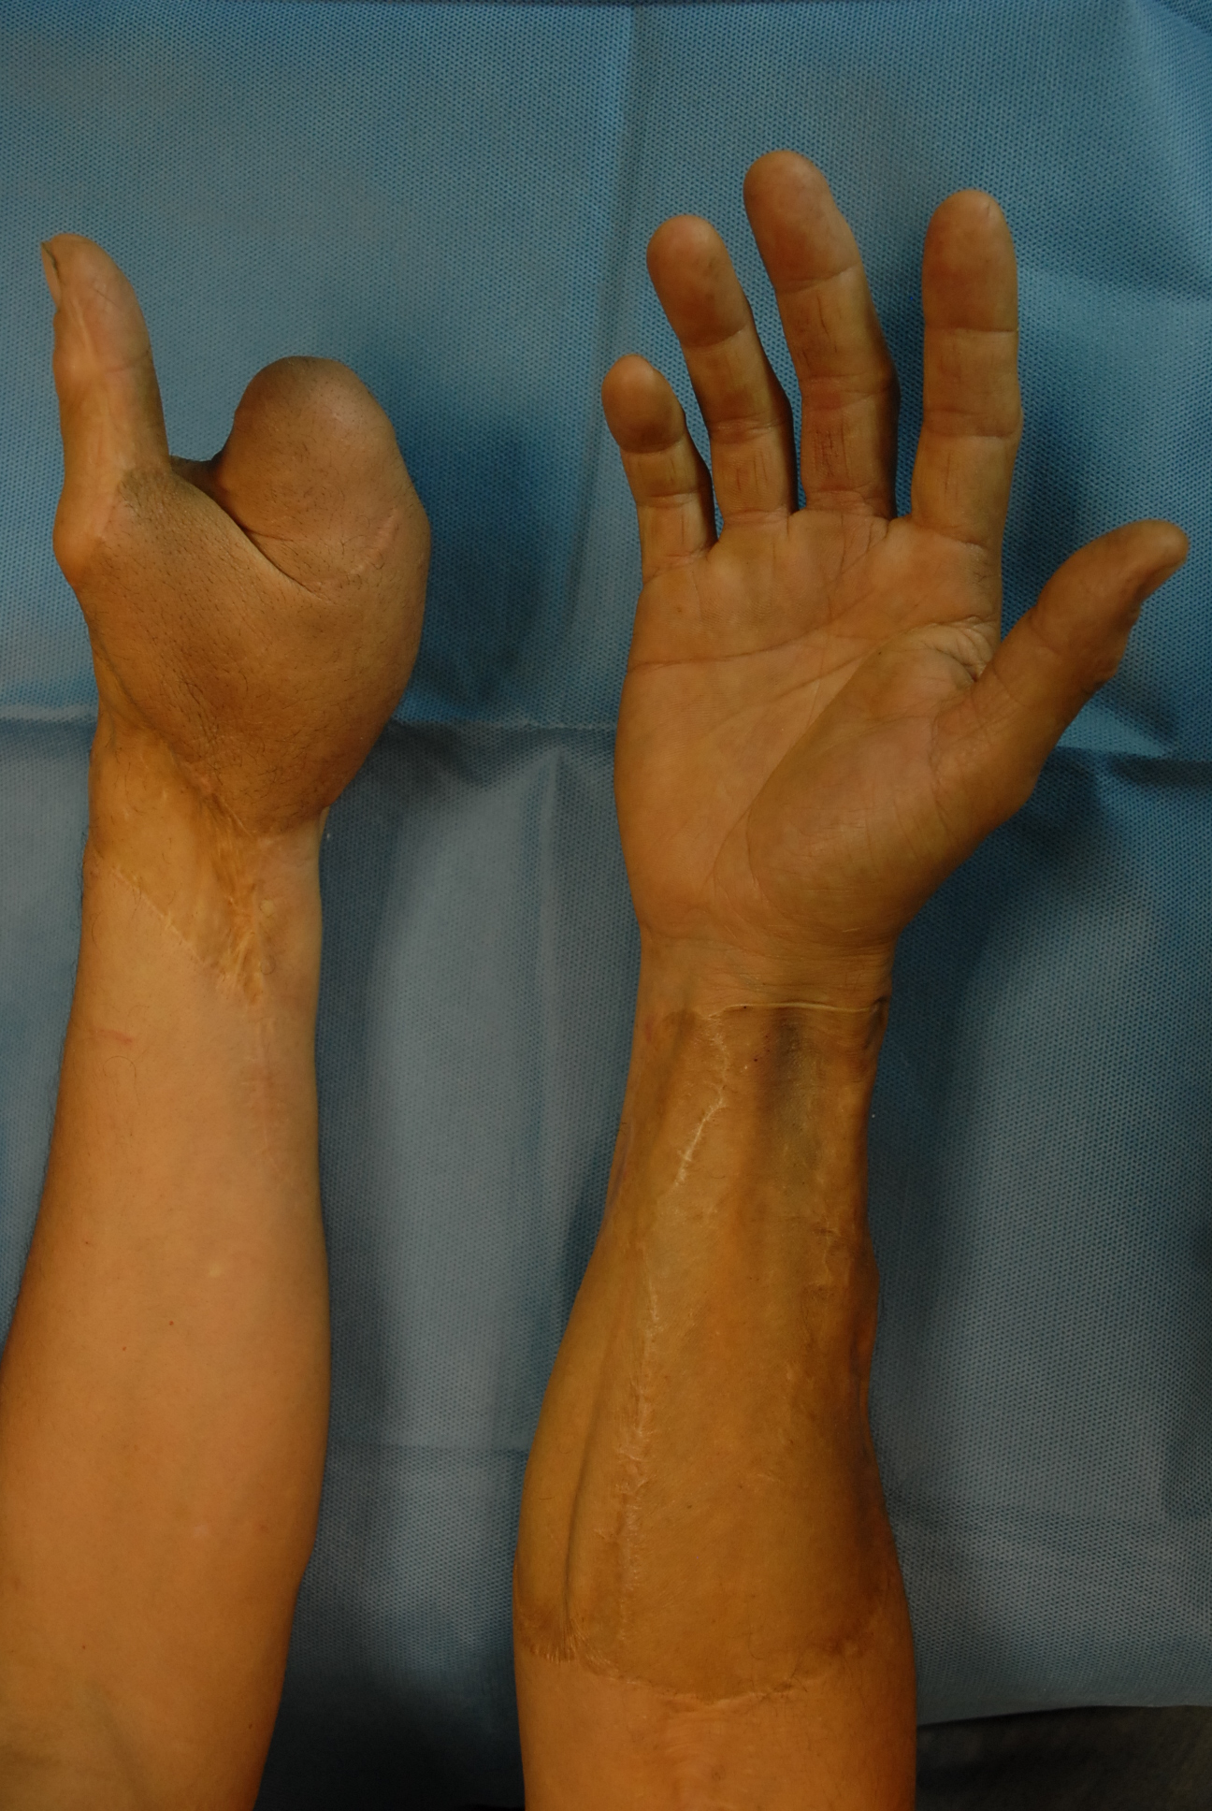
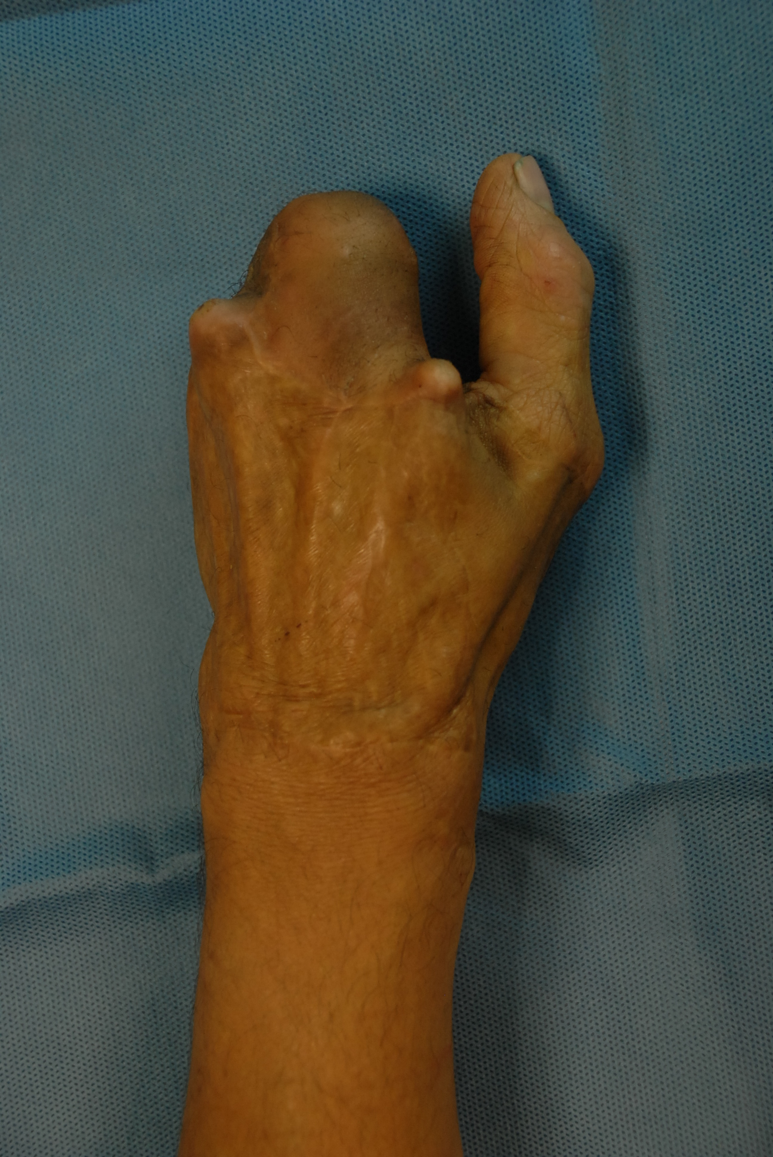
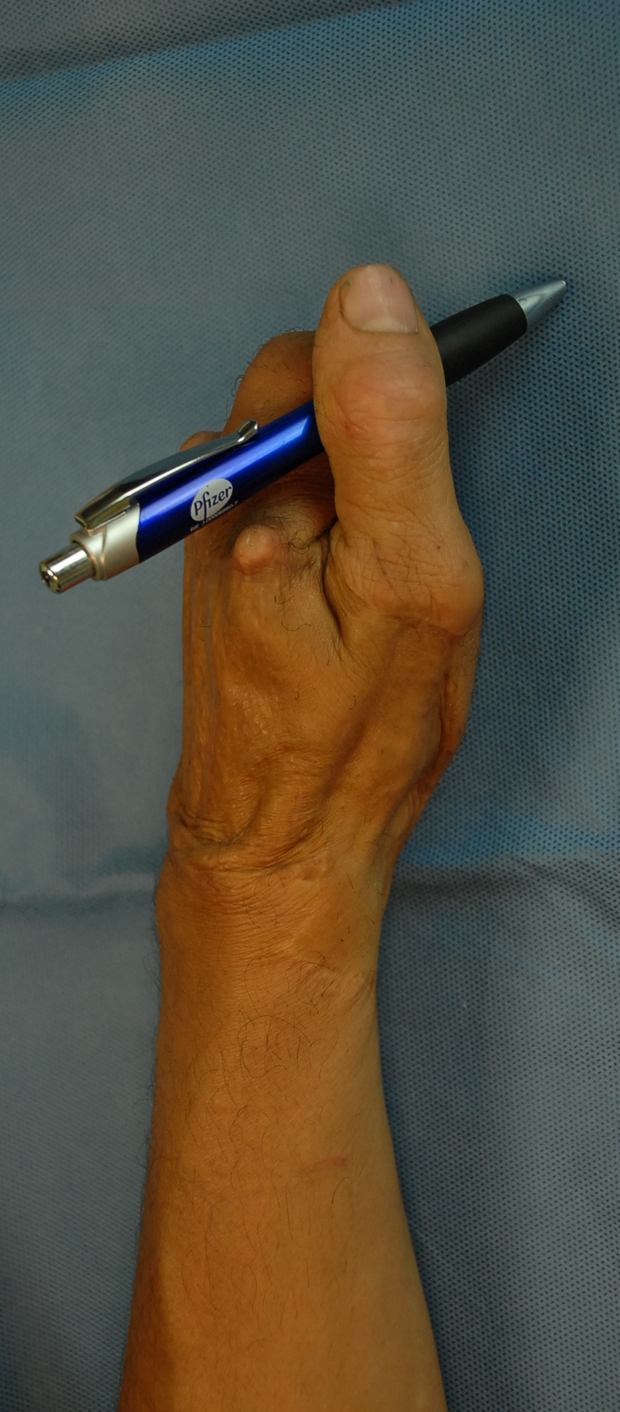
8 years

Slide 18
Outcomes
Although outcome studies of lower extremity salvage have shown equivocal benefit for complex reconstruction versus amputation and prosthesis, it has long been believed that because of the complex mechanical and sensory functions of the hand, nearly any sensate function is preferable to a prosthesis

Slide 19
Outcomes
Brown HC, Williams HB, Woolhouse FM. Principles of salvage in mutilating hand injuries. J Trauma. 1968 May;8:319‒332.
Bueno RA Jr , Neumeister MW. Outcomes after mutilating hand injuries: review of the literature and recommendations for assessment. J Hand Clin. 2003 Feb;19:193‒204.
Graham B, Adkins P, Tsai TM, et al. Major replantation versus revision amputation and prosthetic fitting in the upper extremity: a late functional outcomes study. J Hand Surg Am. 1998 Sep;23:783‒791.
Peacock K, Tsai TM. Comparison of functional results of replantation versus prosthesis in a patient with bilateral arm amputation. Clin Orthop. 1987 Jan;(214):153‒159

Slide 20
Learning objectives
Evaluate injury and identify the anatomical structures exposed and damaged
Emphasize importance of the functional requirements of the patient
Explain usefulness and benefits of early microsurgical reconstruction (emergency free flaps) in this kind of injury based on the published evidence
Select in the reconstructive ladder of soft-tissue coverage the adequate procedure considering the injury presented

