Slide 1
Case discussion Infection
Case 5
AOTrauma Masters Course—SDL Infection course

Slide 2
Case description
Retired 60-year-old patient
Fell down elevator shaft
Bilateral pilon fractures

Slide 3
Injury imaging

Slide 5
Postexternal fixator

Slide 6
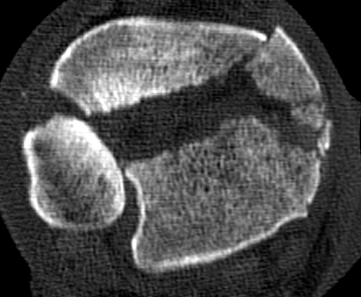

Slide 7
Intraoperative images

Slide 8
Postoperative images

Slide 9
6 months postoperatively

Slide 10
6 months postoperatively
Weight bearing as tolerated
No pain
Able to walk two blocks

Slide 11
7 months postoperatively
Increasing pain
Cannot bear wait
Wound drainage
Computed tomographic scan shows abscess
Erythrocyte sedimentation rate: 50
C-reactive protein: 48

Slide 12
Treatment plan?

Slide 13
Infected nonunion
Taken to operating room
Hardware removal
Cultured
Enterococcus faecalis
Nonunion

Slide 14
Options
Debridement and...
External fixation, delayed reconstruction
Ring?
Refixation
Splint
Amputation

Slide 16
Infected nonunion
Treatment plan at this point?

Slide 17
Infected nonunion
Patient requested amputation
Did not want to undergo multiple operations to eradicate infection and gain union

Slide 18
Intraoperative images

Slide 19
Take-home messages
You must talk to your patients
Amputation is an answer to infected nonunions

