Slide 1
Case discussion Infection—infected nonunion
Case
Chang-Wug Oh
South Korea
AOTrauma Masters Course—SDL Infection course

Slide 2
Case description
A 45-year-old man
Several operations after tibial fractures (4 years ago)

Slide 3
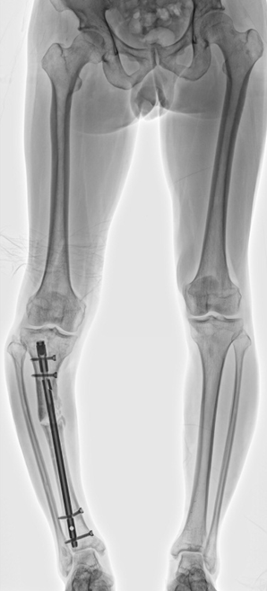
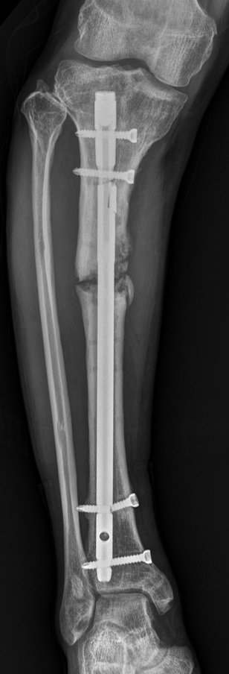

Slide 4
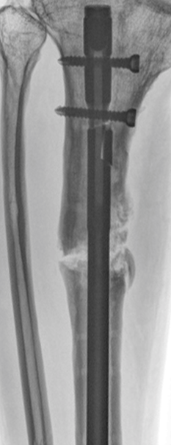
Intermittent wound discharge

Slide 5
What’s next?

Slide 6
Exploration with nail removal
Dirty granulation

Slide 7
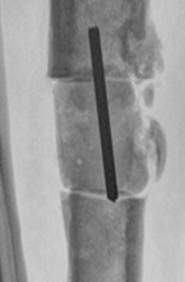
Resect 3 cm and cement block

Slide 8
At 4 weeks normalized lab, no growth of previous S/C
Your treatment?

Slide 9
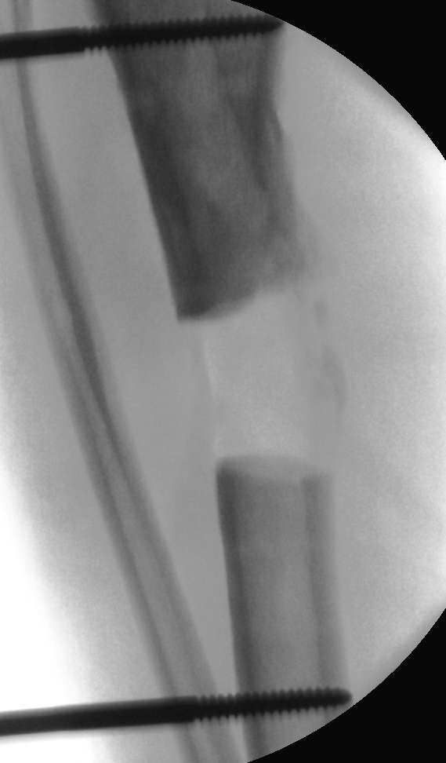
Correct the deformity
Good induced membrane

Slide 10
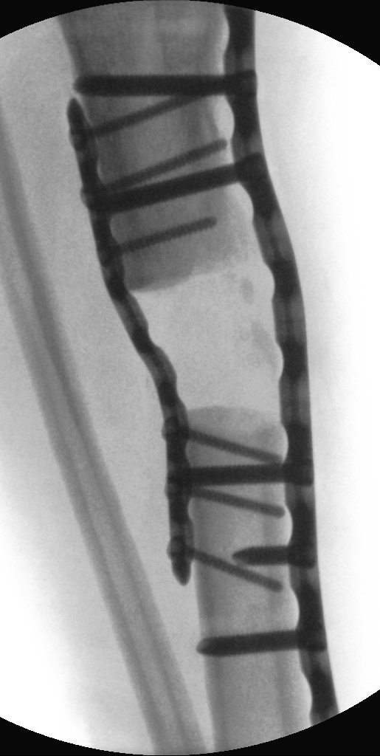
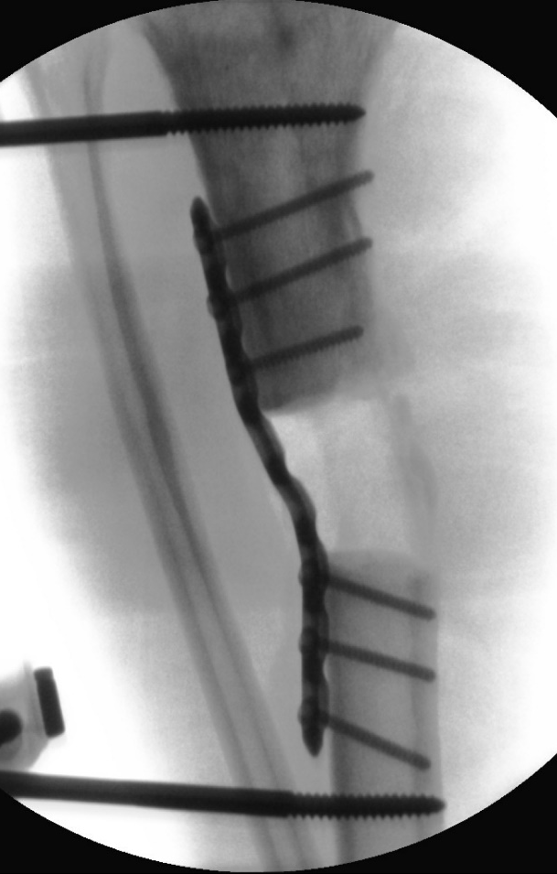
Additional medial plate
Lateral plate

Slide 11
Autogenous iliac bone graft

Slide 12
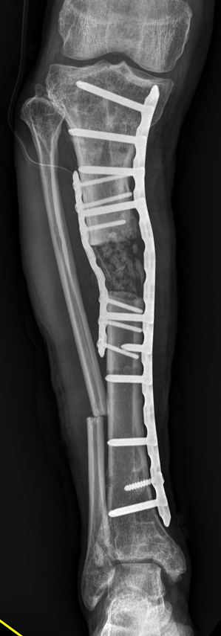
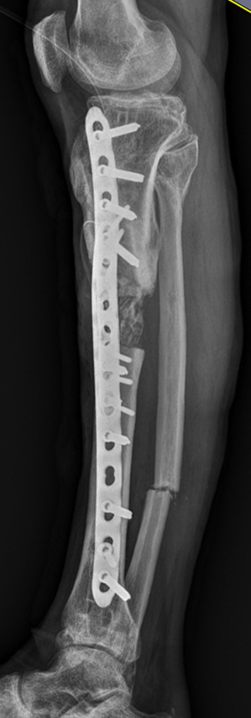
Postoperative images

Slide 13
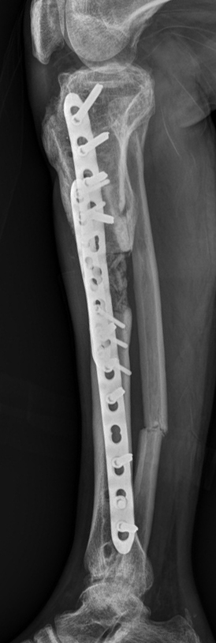
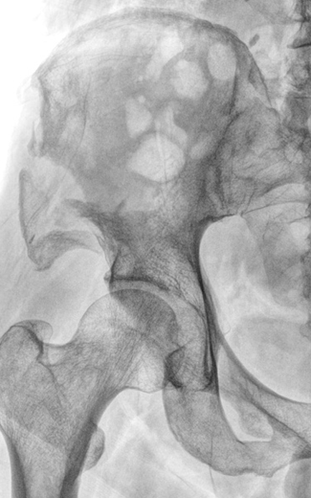
At 3 months
Fracture of donor site

Slide 14
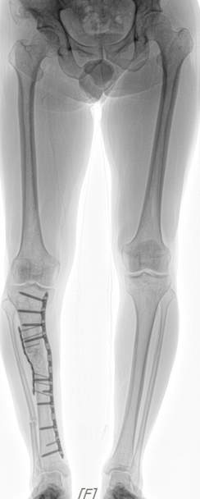
After 1.5 years

Slide 15
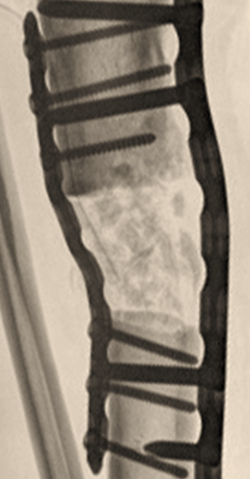
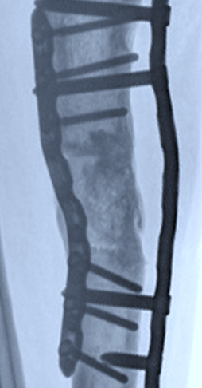
Before After

