Slide 1
Case discussion Infection—open tibial fracture
Case
Chang-Wug Oh
South Korea
AOTrauma Masters Course—SDL Infection course

Slide 2
Case description
12-year-old boy
Motorbike injury
Arrived at emergency department 2 hours after injury
Tibial open fracture IIIb
Neurovascular status intact
No other injuries

Slide 3
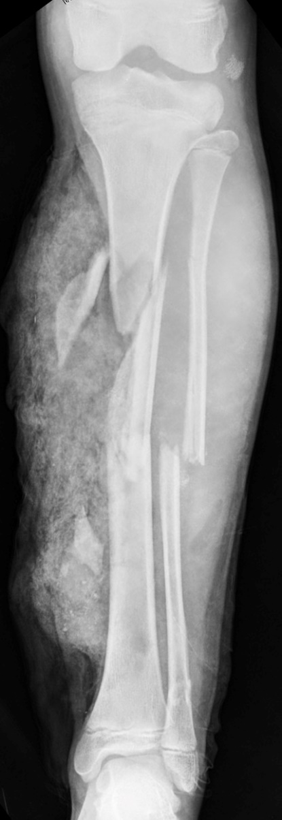
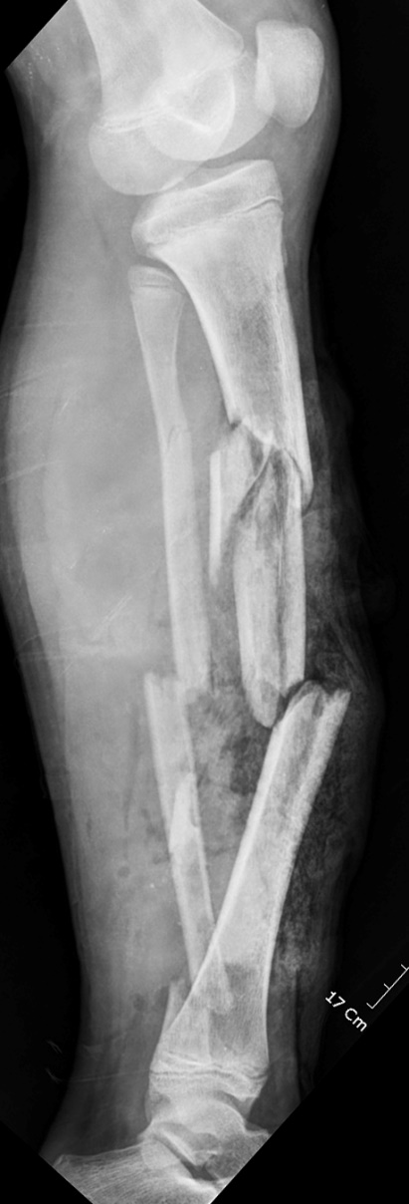
Preoperative images

Slide 4
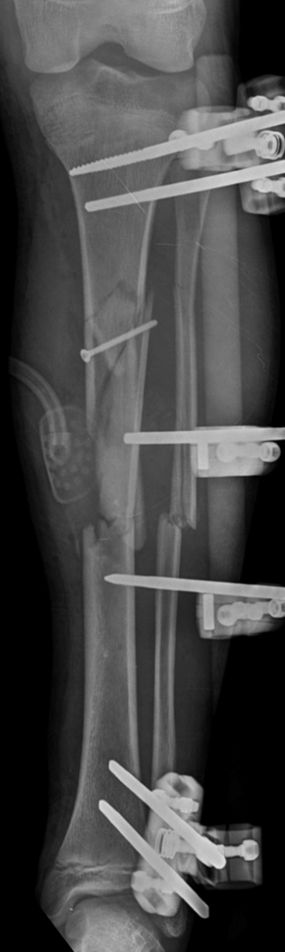
Day 0: debridement and negative pressure wound therapy

Slide 5
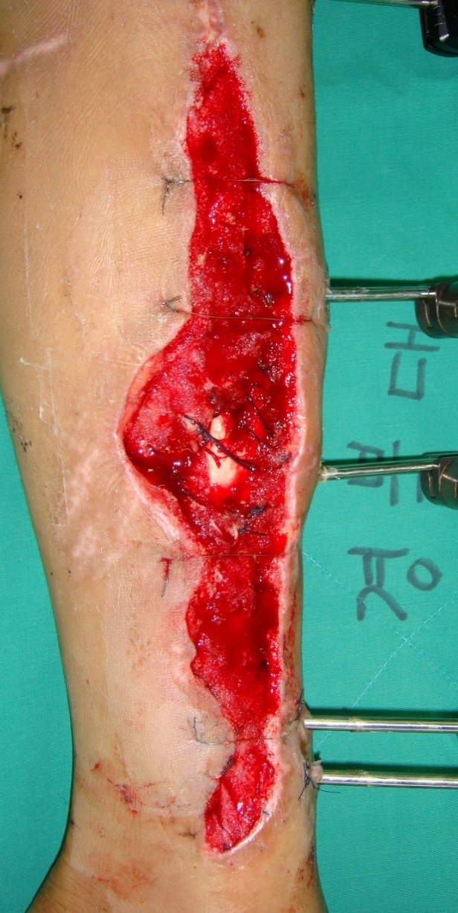
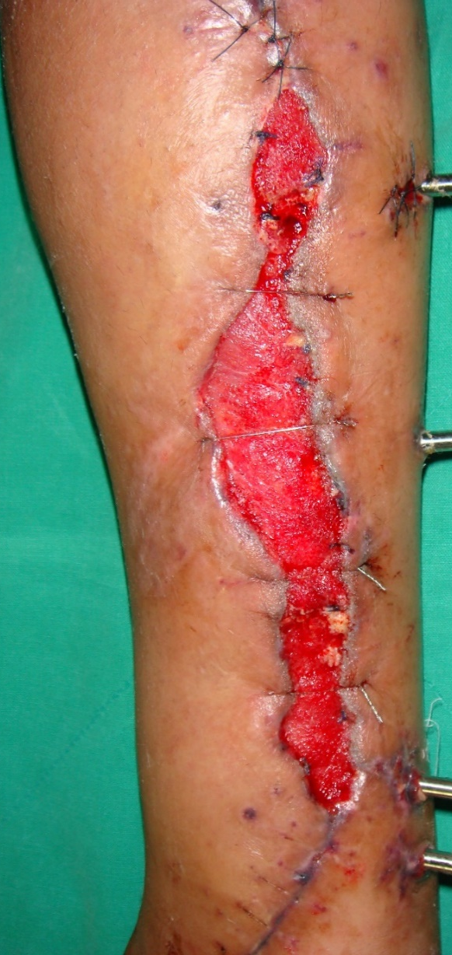
Day 4 Day 15 Day 30

Slide 6
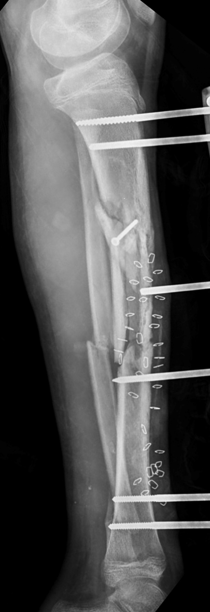
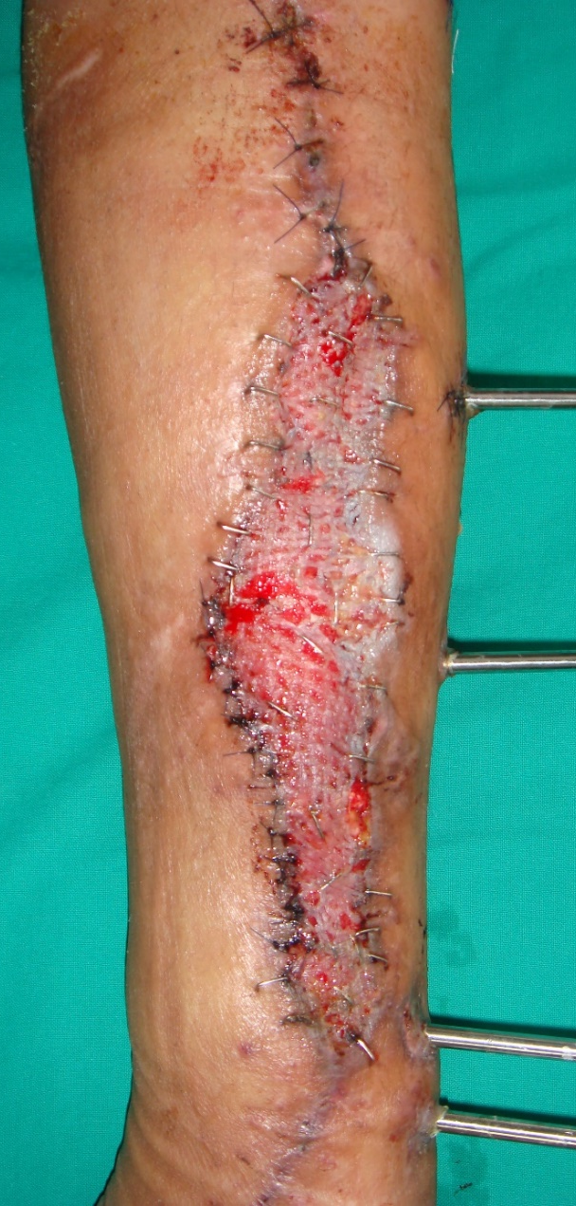
Day 40: skin graft

Slide 7
Day 55: localized (?) infection

Slide 8
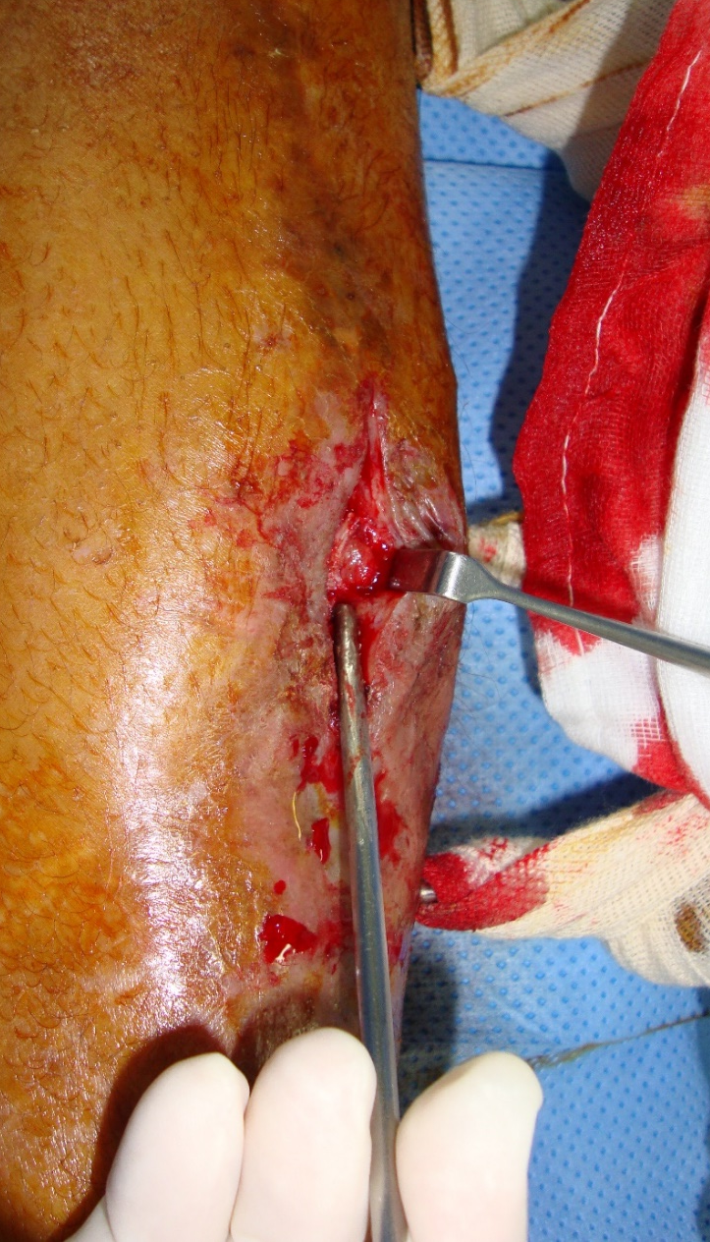
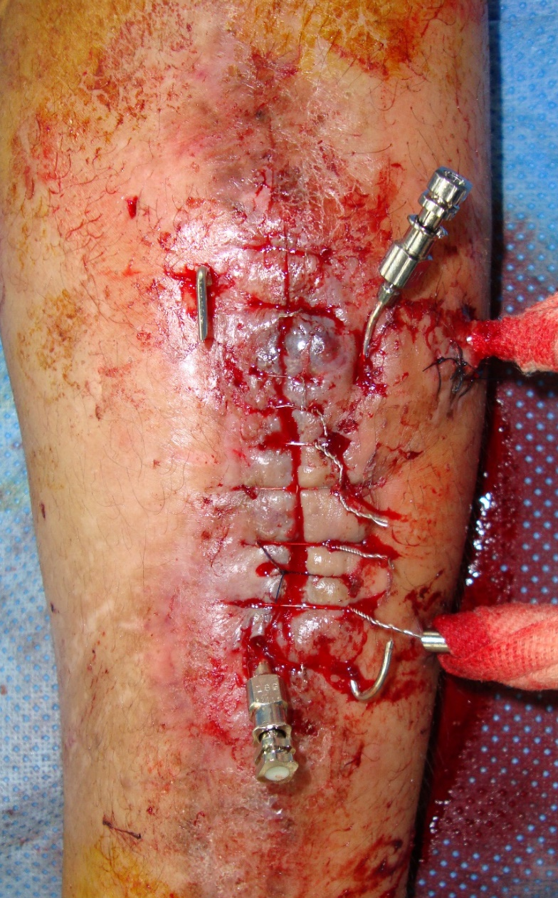
Irrigation and drainage

Slide 9
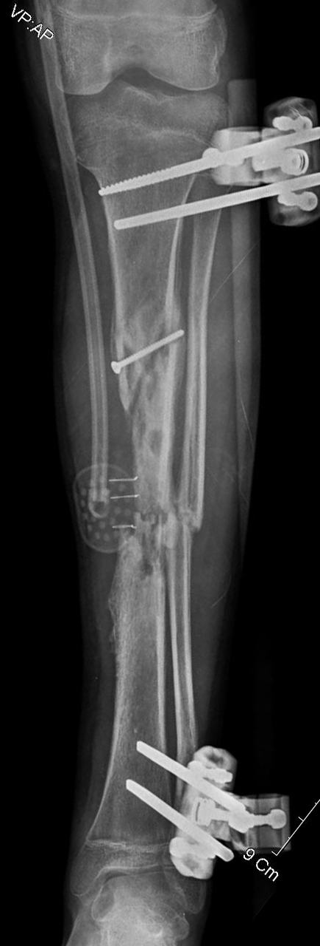
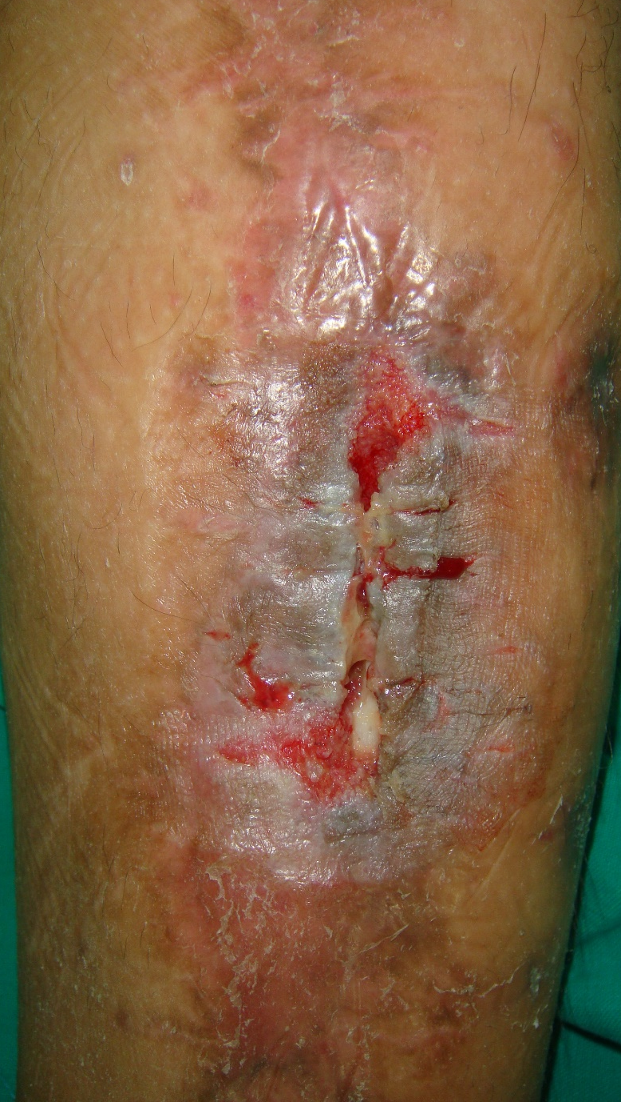
Day 80: osteomyelitis

Slide 10
Day 80: osteomyelitis
Your treatment?
Infection eradication

Slide 11
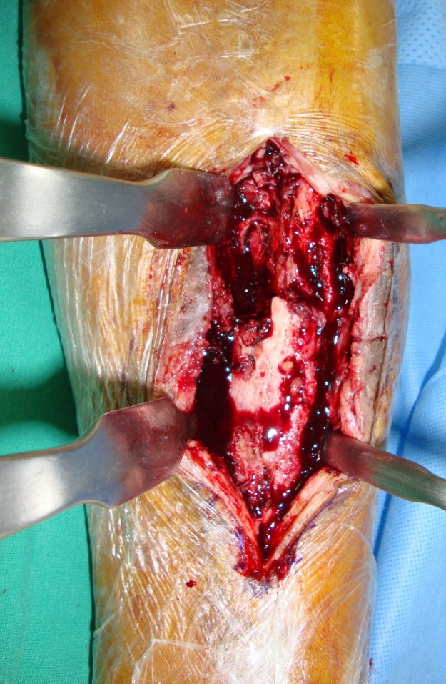

Slide 12
Resect the dead bone and debridement (x4)

Slide 13
Normalized infection lab
Your treatment?
Soft tissue
Bone
Stabilization
??
?
Yes
Yes

Slide 14
Bone transport with plate

Slide 15
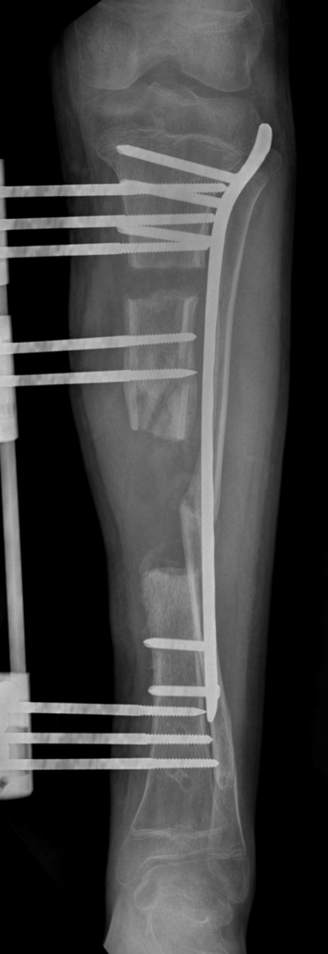
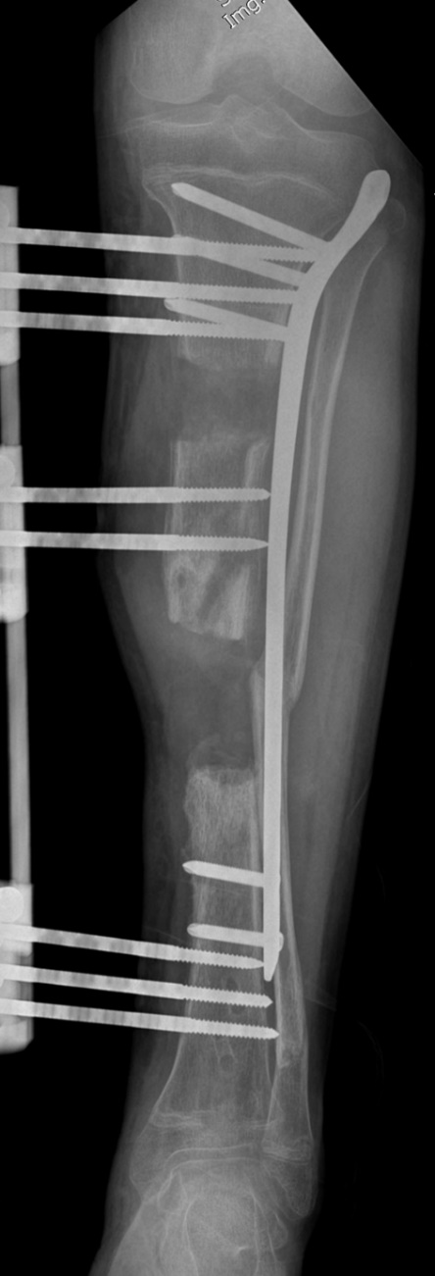

Slide 16
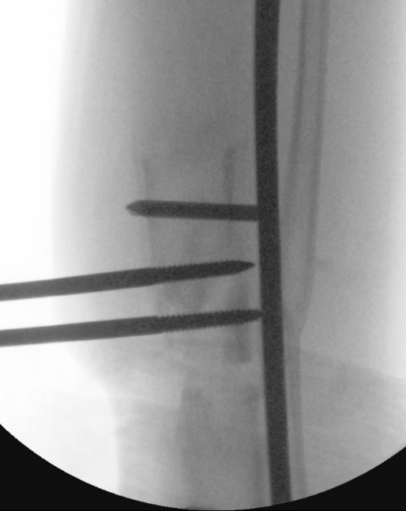
Screwing and docking site bone graft and external fixator removal

Slide 17
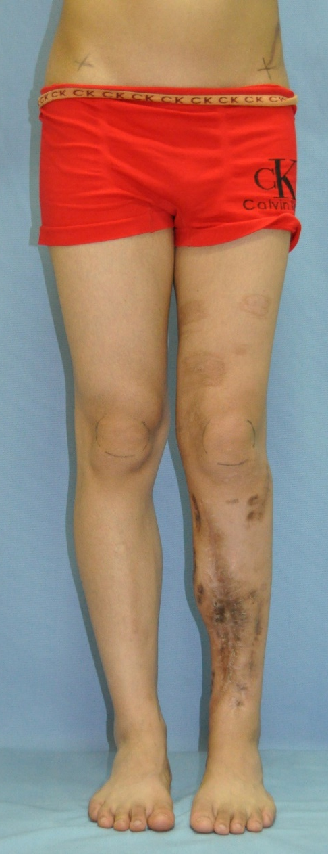
2 months later

Slide 18
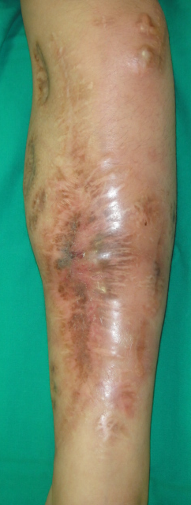
5 months later, nonuinon of docking site, redness/heat

Slide 19
Removal of plate

Slide 20
Bone graft and plating

Slide 21
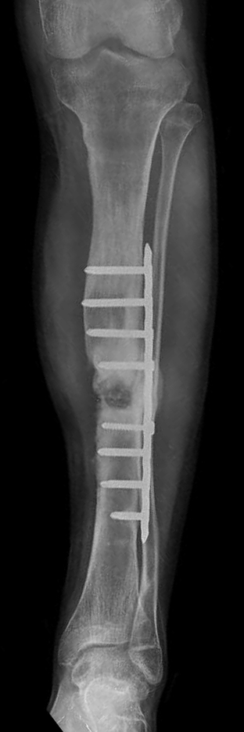
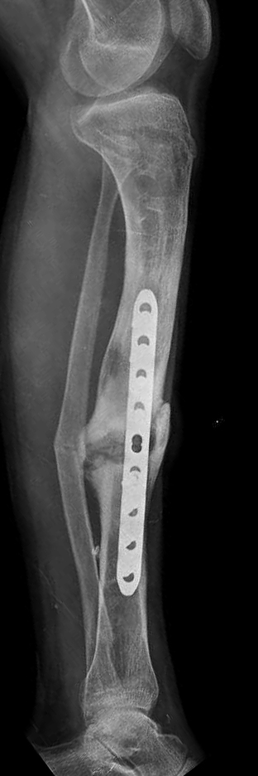
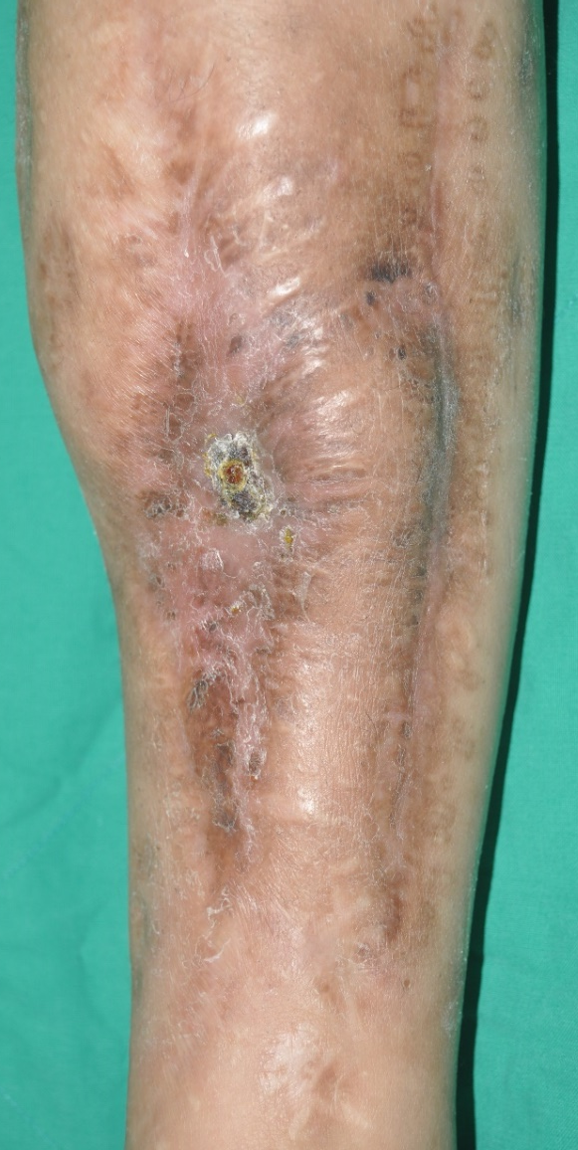
Another 5 months, still nonunion, infection remains?

Slide 22
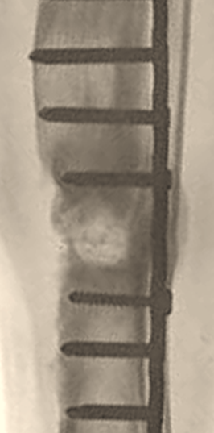
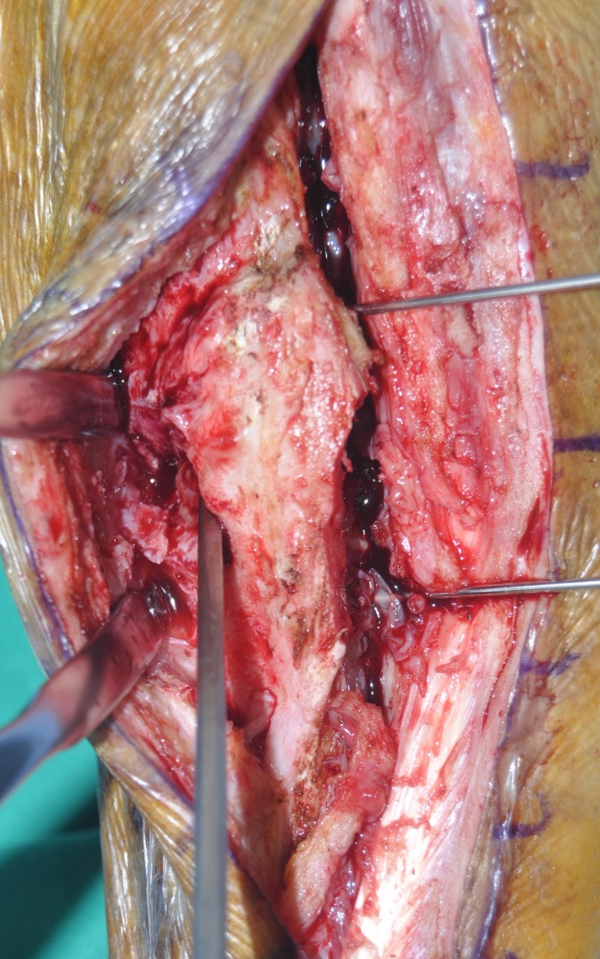
Resect the infected bone (3.5 cm)

Slide 23
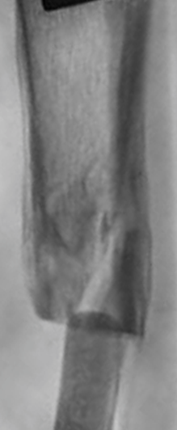
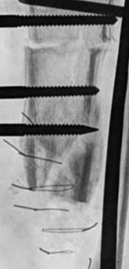
Incomplete resection of infected bone
Back to the past

Slide 24
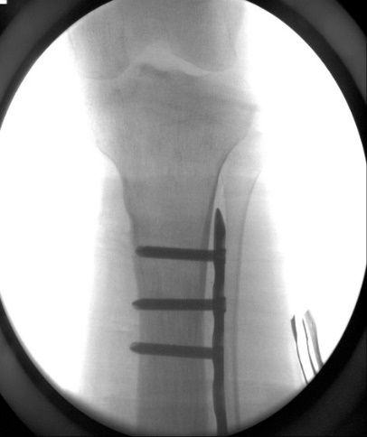
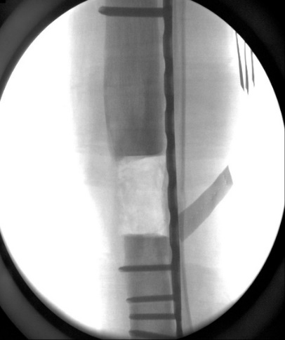
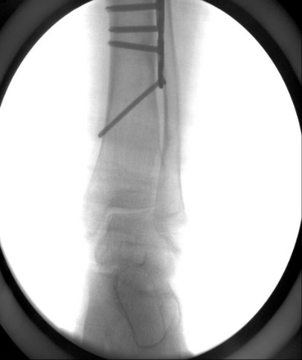
Bone transport with plate

Slide 25
Second operation: screws at middle segment and bone graft at docking

Slide 26
1 year later

