Slide 1
Discussion groups: Complications in clavicular fracture treatment

Slide 2
Case 1

Slide 3
Case description
Police officer with gun shot wound to chest
Open clavicle fracture
Minimally displaced
Associated with subclavian artery injury
Vascular surgery needs access
Does it need open reduction and internal fixation (ORIF)?

Slide 5
Does this need ORIF?

Slide 6
Post subclavian artery repair

Slide 7
Comment on fixation
Which implant was used?
Looks good
Plate is too long
There are too many screws
The implant is not strong enough

Slide 8
Postoperative week 8

Slide 9
Next steps
Treat in a sling as all clavicle fractures will heal in a sling
Revise with a stronger plate
Revise with a stronger plate and bone graft
Revise with an intramedullary device

Slide 10
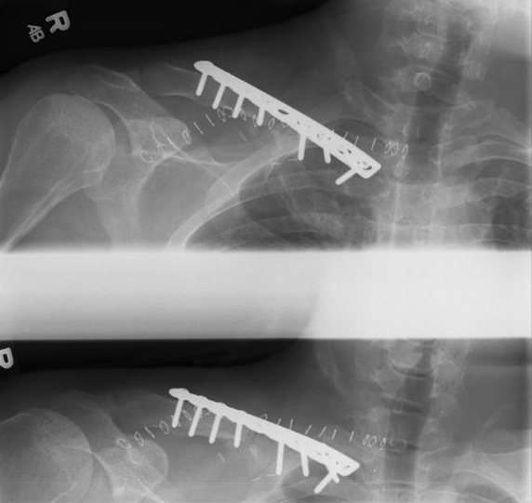
After revision

Slide 11
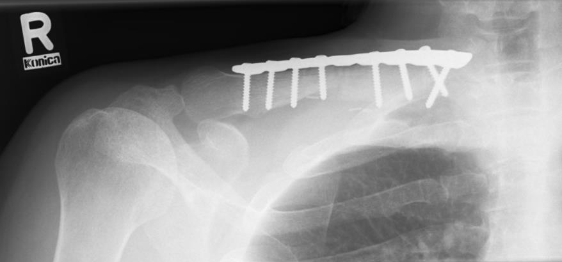
After revision, 3 months

Slide 12
Take-home messages
Plate post clavicle osteotomy for vascular access is a good idea
Need strong implant
Reconstruction plates 2.7 or 3.5 are not strong enough for most male patients
Revision with a thicker implant, plus or minus bone graft, when indicated

Slide 13
Case 2

Slide 14
Case description
20-year-old man
Fell while playing soccer
Landed on dominant right shoulder
Pain in right clavicle
Isolated, closed injury
Neurovascularly intact
Day 0

Slide 15
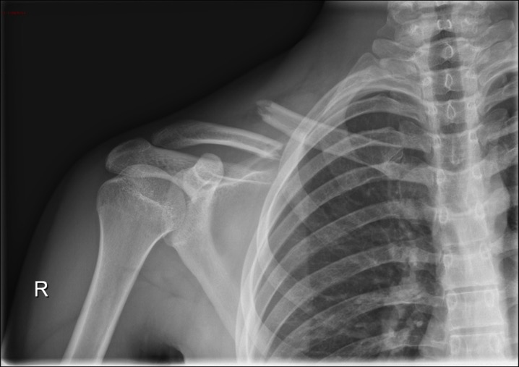
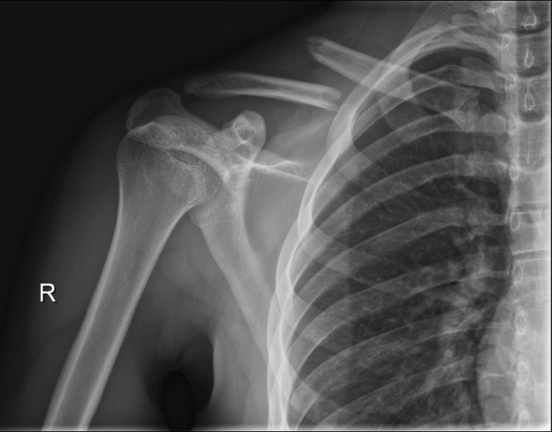
Initial x-rays
Day 0

Slide 16
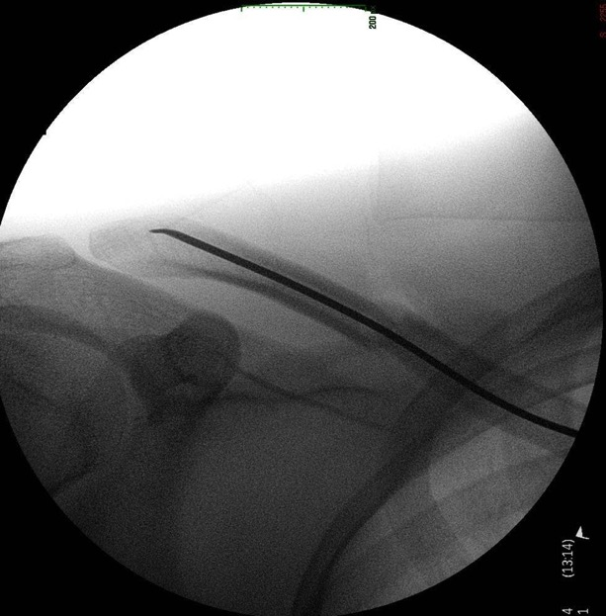
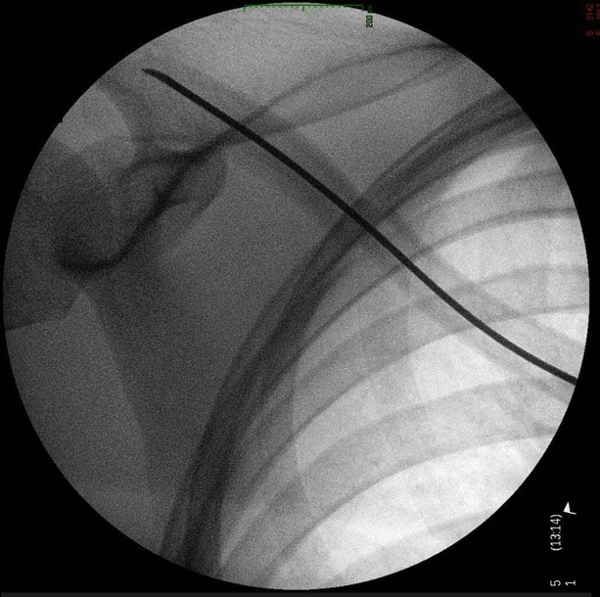
Operating room views
Day 3

Slide 17
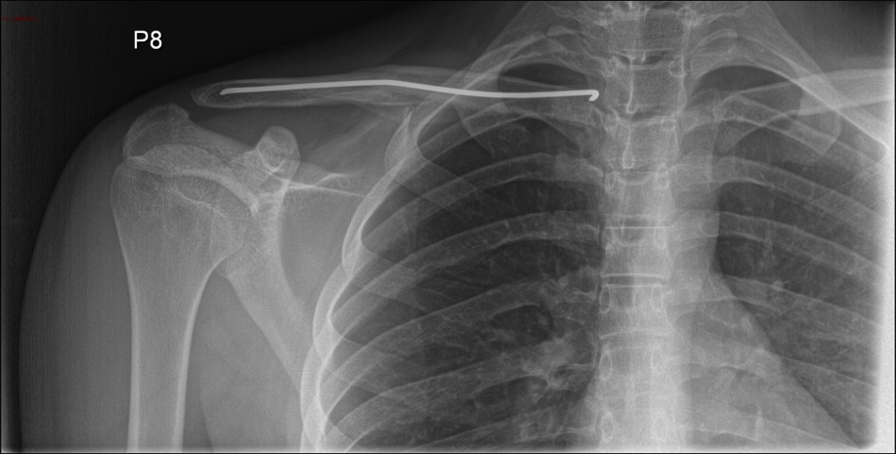
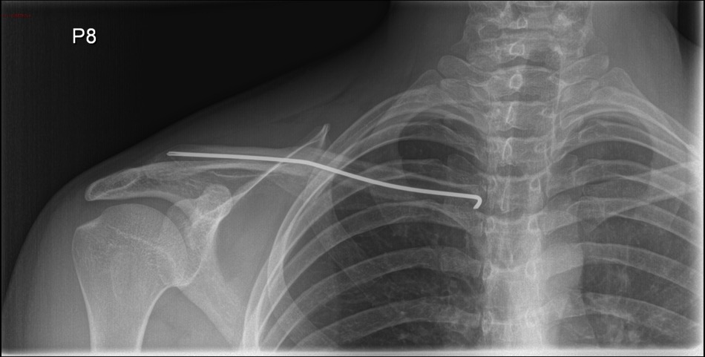
Follow-up
Month 2

Slide 18
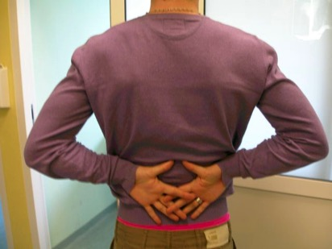
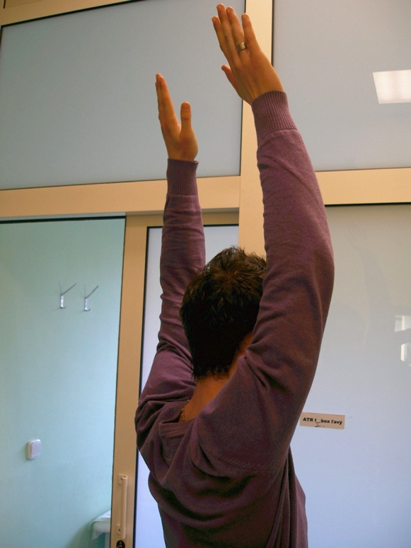
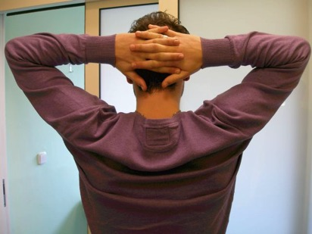
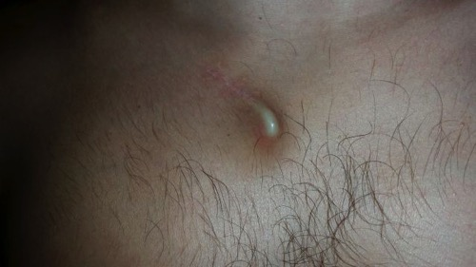

Slide 19
Take-home messages
Displaced clavicle fractures may benefit from reduction and stable fixation
Alternatives to open reduction and plating may have an evolving role in 2018
Flexible intramedullary nail is interesting concept

Slide 20
Case 3

Slide 21
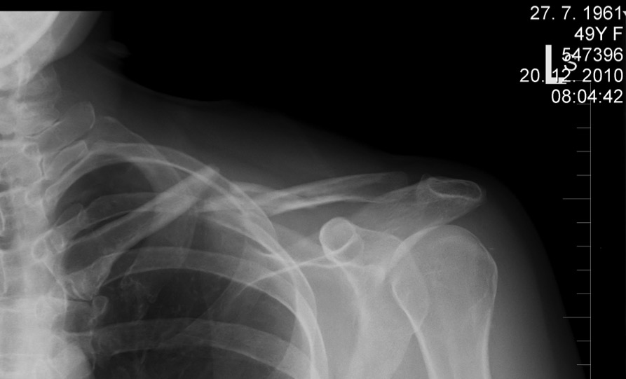
Case description
49-year-old woman
Simple fall
Monotrauma
Nondominant hand
Administrative work

Slide 22
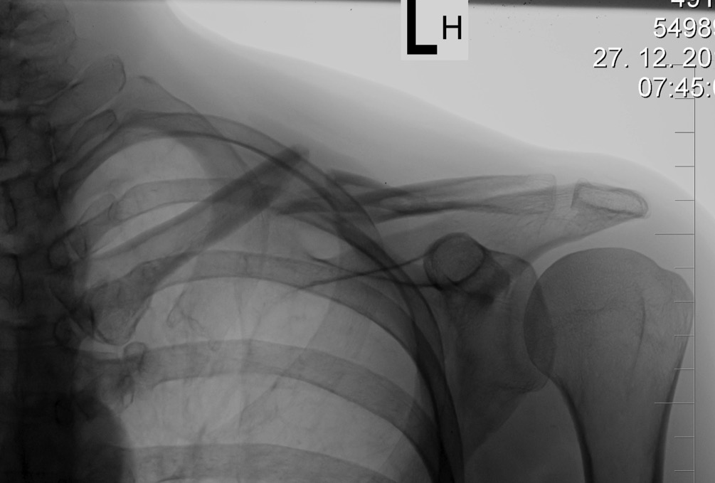
One week later, figure eight

Slide 23
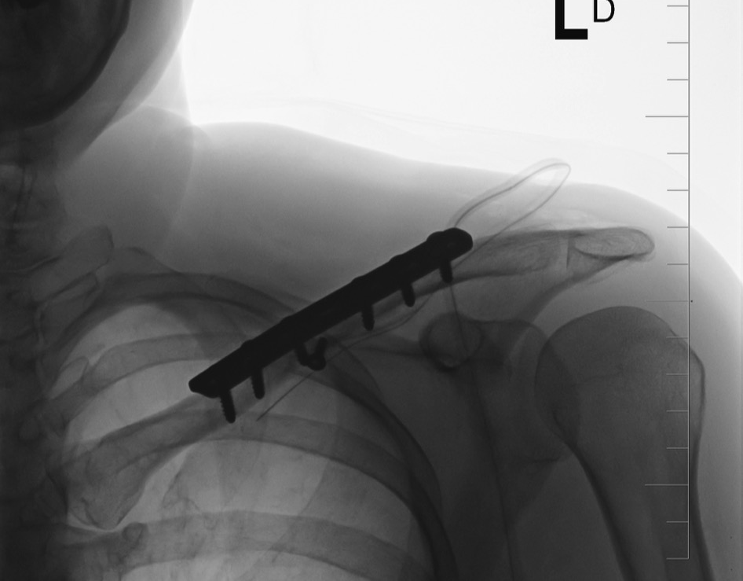
Notes:
Fixation sufficient
Stability

Slide 24
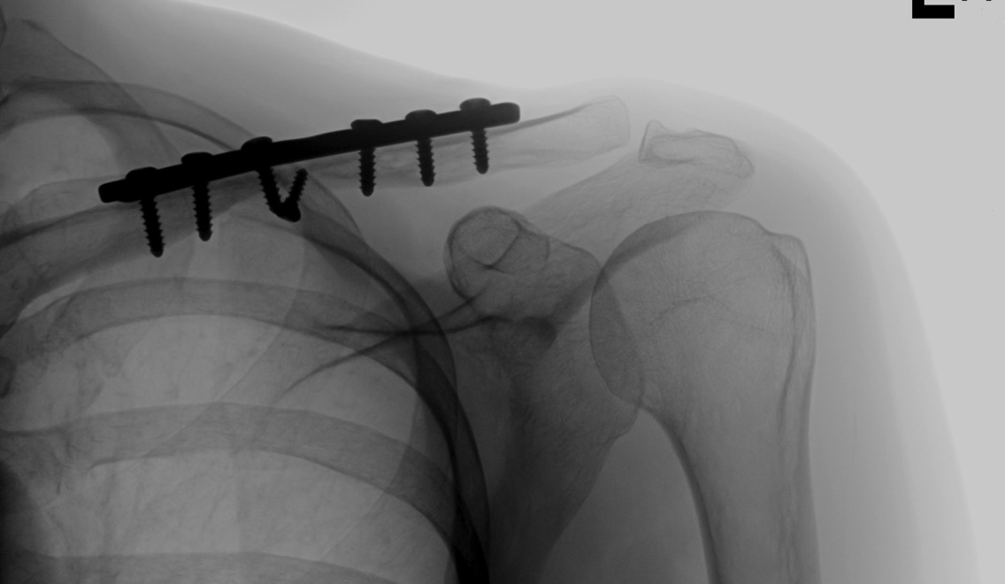
Postoperative, 6 months

Slide 25
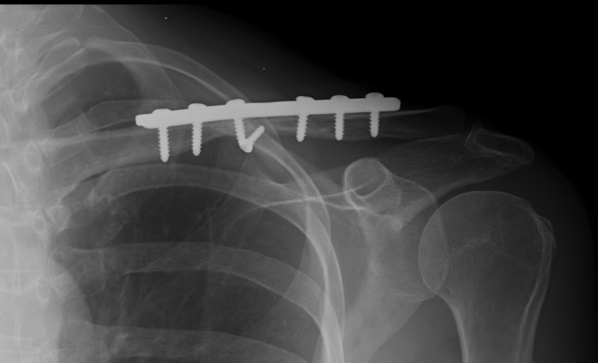
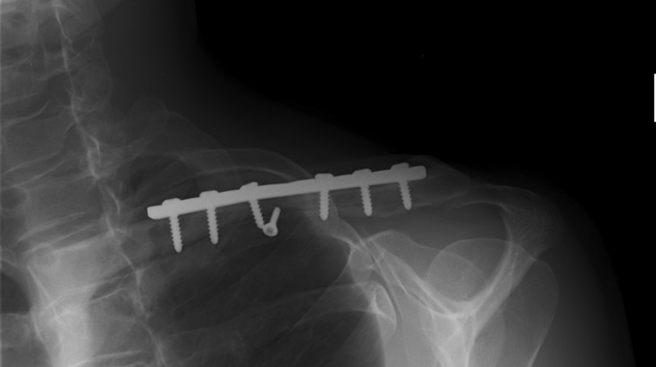
Postoperative, 1 year

Slide 26
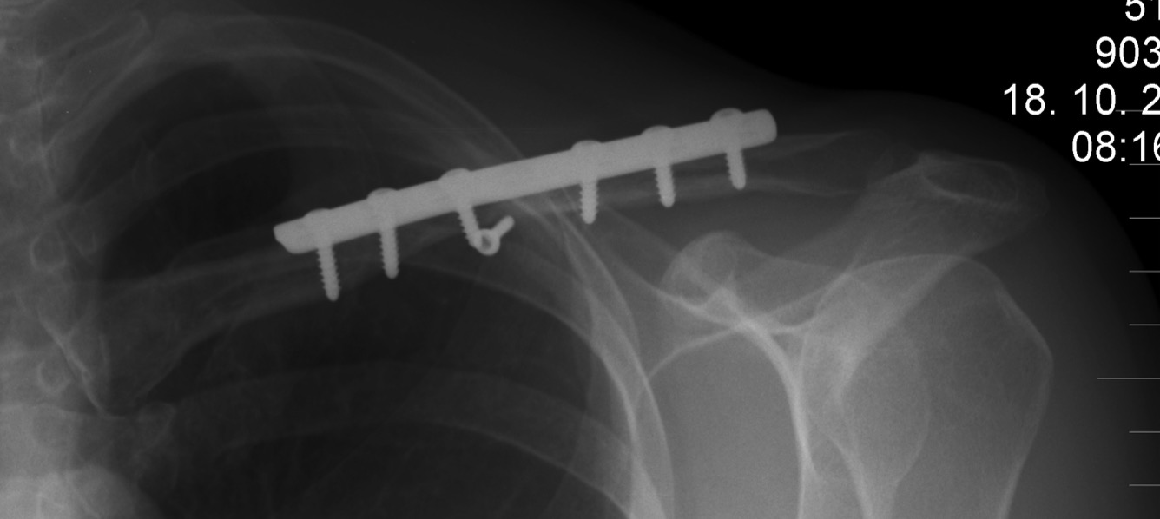
After 1.5 years, remove the plate

Slide 27
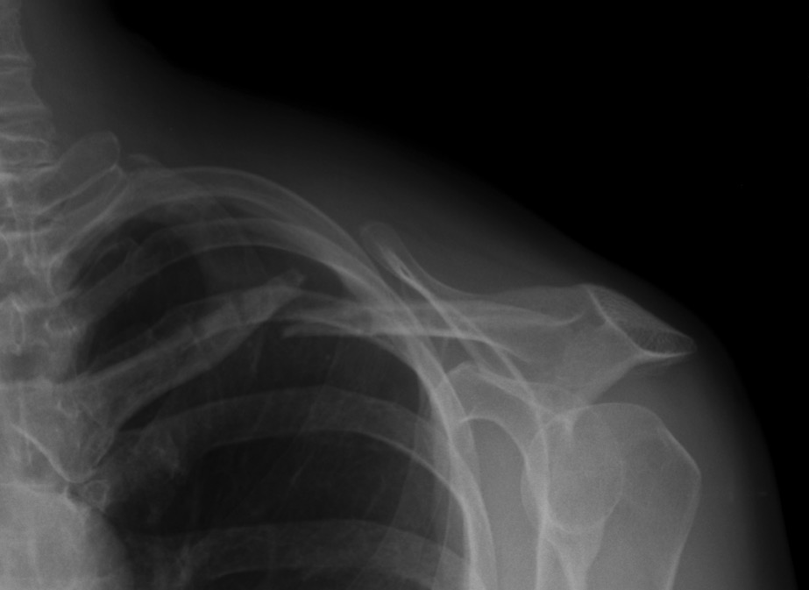
One month later

Slide 28
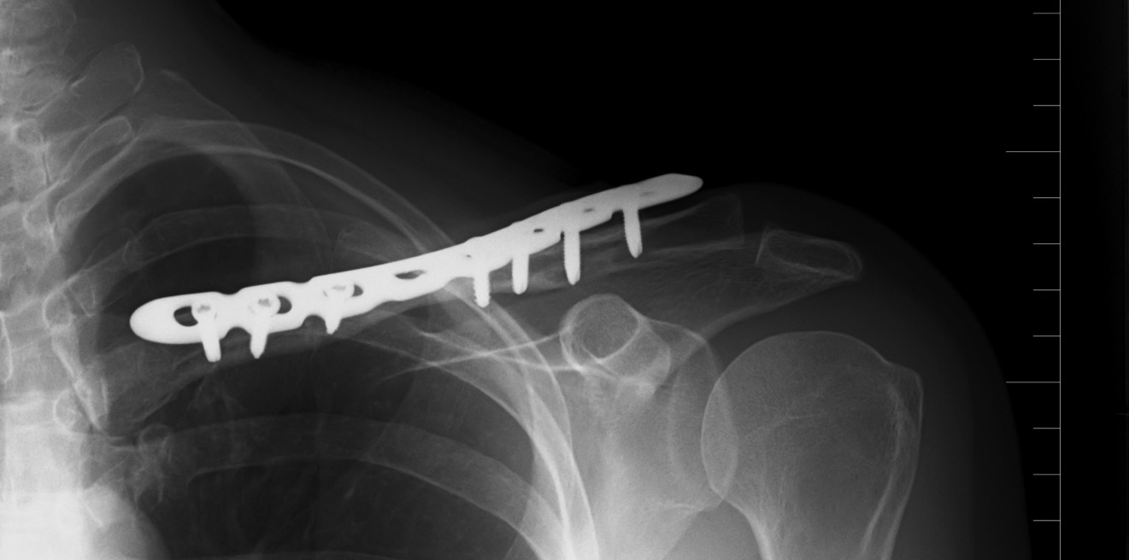
One year later

Slide 29
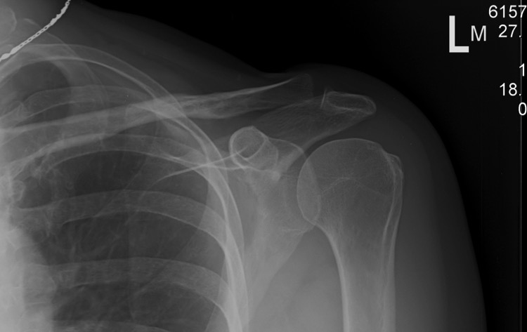
Take home messages
No pain is not always ready to play
Risks of implant removal—plates
It is not obligatory to remove implant

Slide 30
Case 4

Slide 31
Case description
24-year-old man
Fall in soccer
Landed on left dominant shoulder
Pain in left clavicle
Isolated, closed injury
Neurovascularly intact
Day 0
Notes:
31

Slide 32
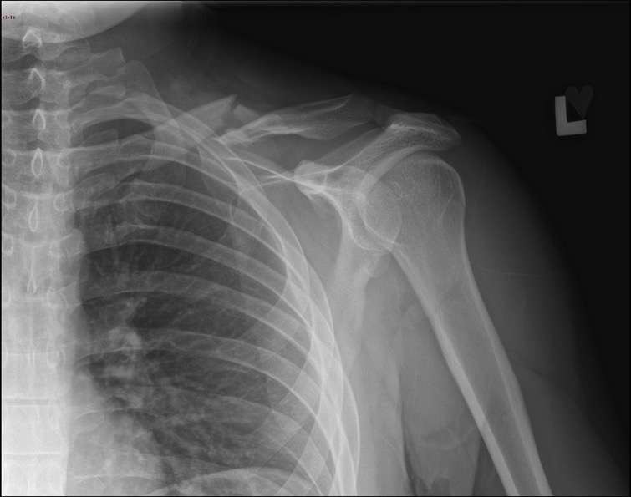
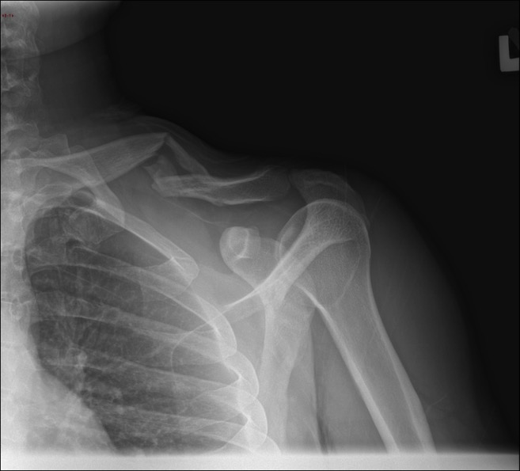
X-rays
Day 0
Notes:
Dispalced midshaft frx
32

Slide 33
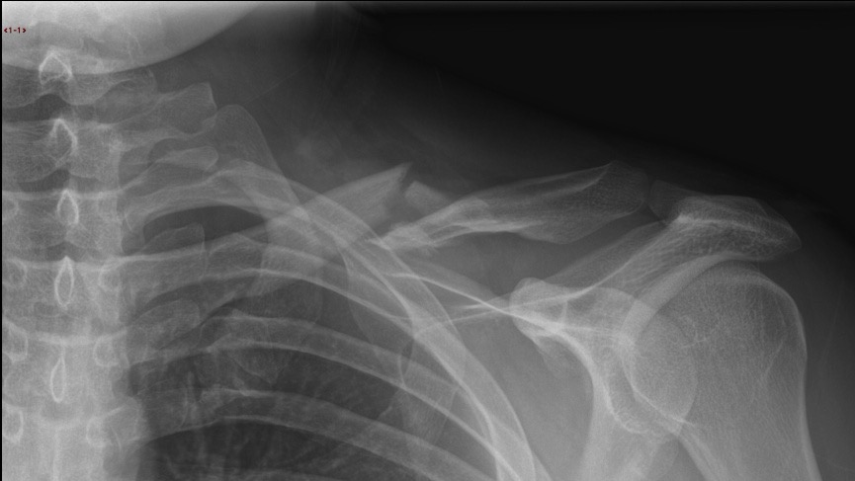

Slide 34
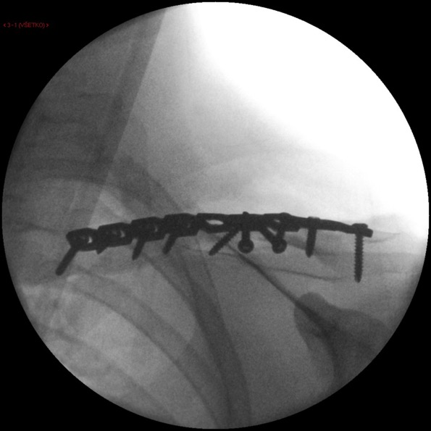
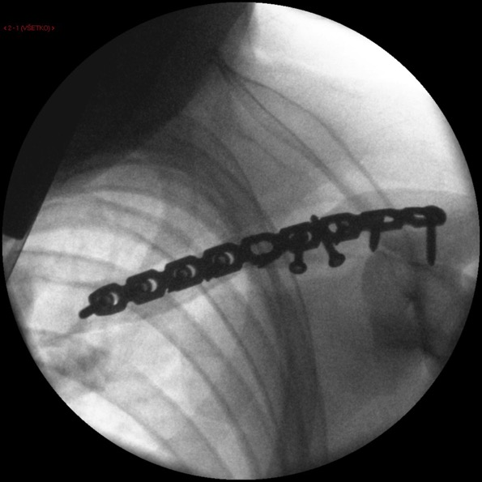
Day 3
Notes:
Reconstructive plate 3.5 synthes
Neutralisation/protective plate for 2 lag screws
Bridging is better option in comminuted fractures
34

Slide 35
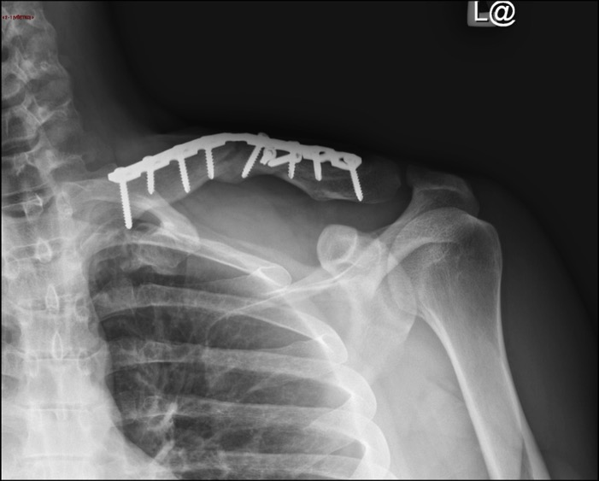
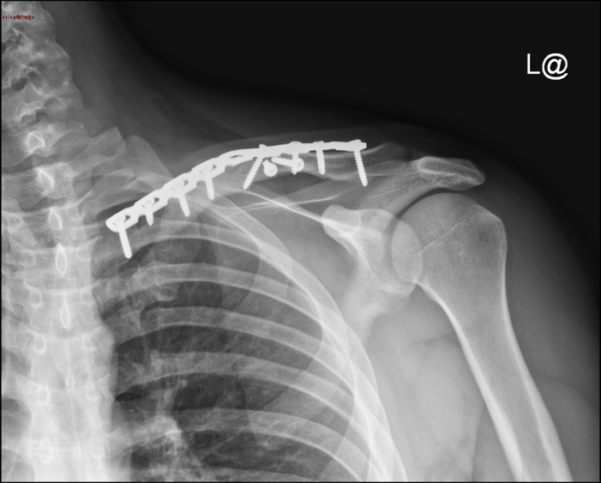
Month 2

Slide 36
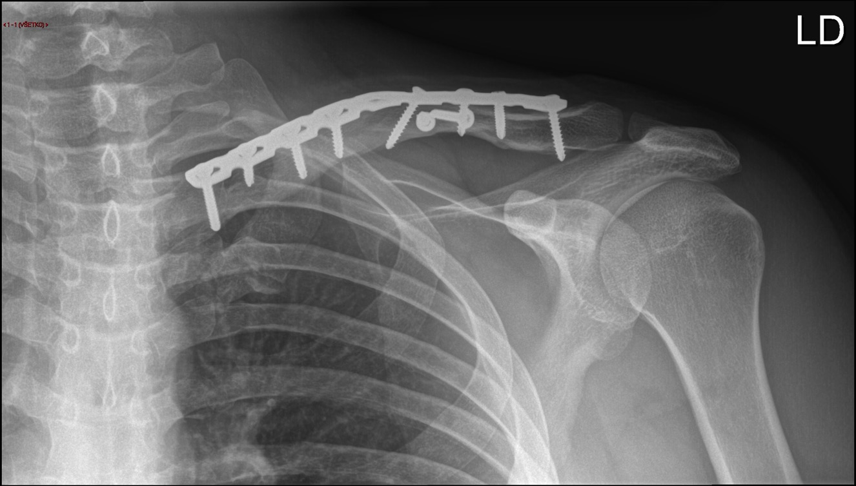
Month 4
What´s happened?

Slide 37
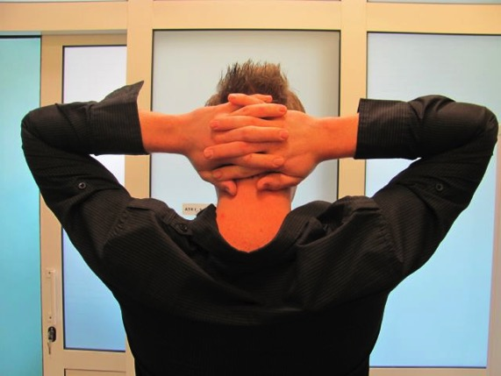
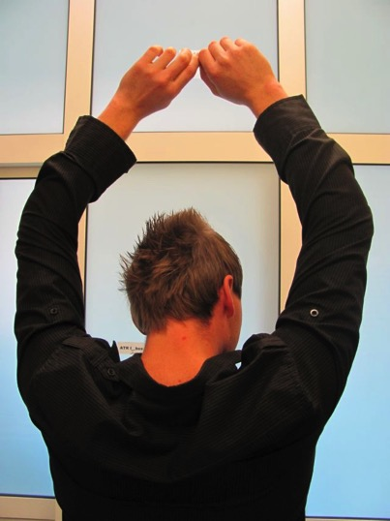
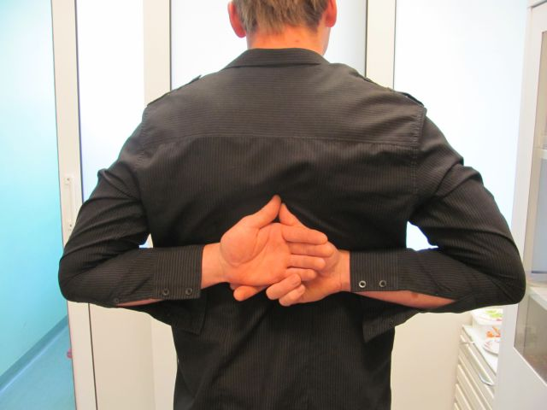
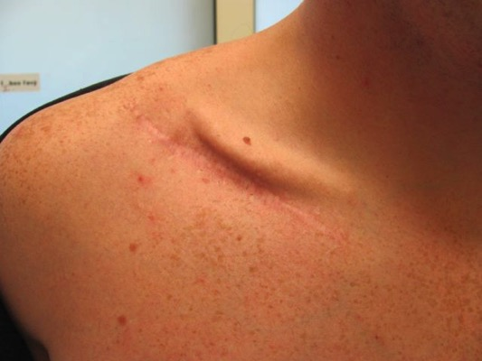
Postoperative, 5 months

Slide 38
Case 5

Slide 39
Case description
48-year-old man
Motorcycle accident, less than 30 kph
Low velocity, car pulled out of side road
Went over the car landing on left nondominant shoulder
Wearing protective clothing and helmet
Pain in left clavicle
Isolated, closed injury
Neurovascularly intact
Day 0

Slide 40
Initial x-rays
Open reduction and internal fixation (ORIF) or nonoperative treatment?
Absolute or relative stability?
Anatomical reduction with lag screw or bridge plating?
Day 0

Slide 41
Operating room
Which method of plating?
Which plate has been used?
What sort of screws?
Day 1

Slide 42
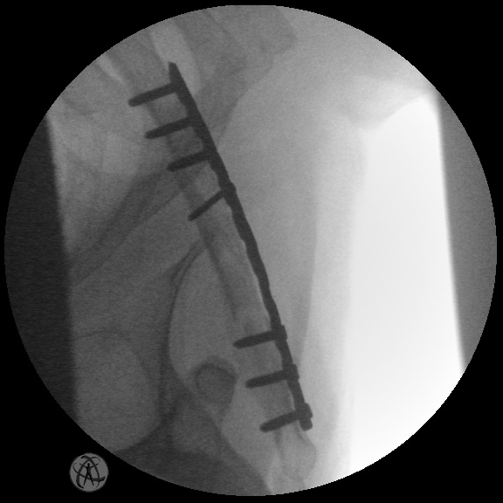
Fracture clinic follow-up
What has happened?
Could we have predicted it?
Why did it happen?
Could we have prevented it?
Week 6

Slide 43
Fracture clinic
Obvious deformity—patient not pleased with result!
Week 6

Slide 44
Take-home messages
Bridge plating is an option for comminuted fractures
Although in this case, it was a combination of bridge plating and reduction and lag fixation
Bridge plating is an option for comminuted fractures
Reconstruction plates
Not strong enough for bridging
“Neutralization/protection” plates with lag screws in wedge fractures
Precontoured anatomical plates 3.5 are much stronger

Slide 45
Case 6

Slide 46
Case description
46-year-old man
Direct hit while playing rugby
Pain in right clavicle
Isolated, closed injury
Neurovascularly intact
Day 0

Slide 47
Initial x-rays
Bony contact and shortening < 2 cm
Nonoperative treatment? Which fixation?
Operative treatment? Options?
Day 0

Slide 48
Initial x-rays
AC joint not painful
Type of injury?
Classification?
Treatment?
Day 0

Slide 49
Risks of nonoperative treatment
37-year-old man
Acceptable bony contact, no shortening, but still…

Slide 50
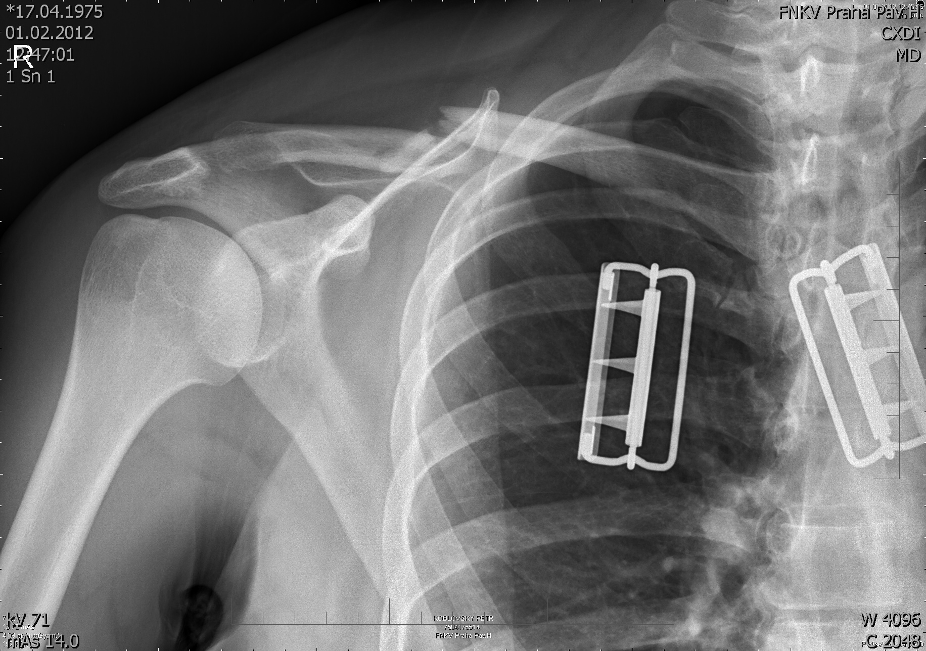
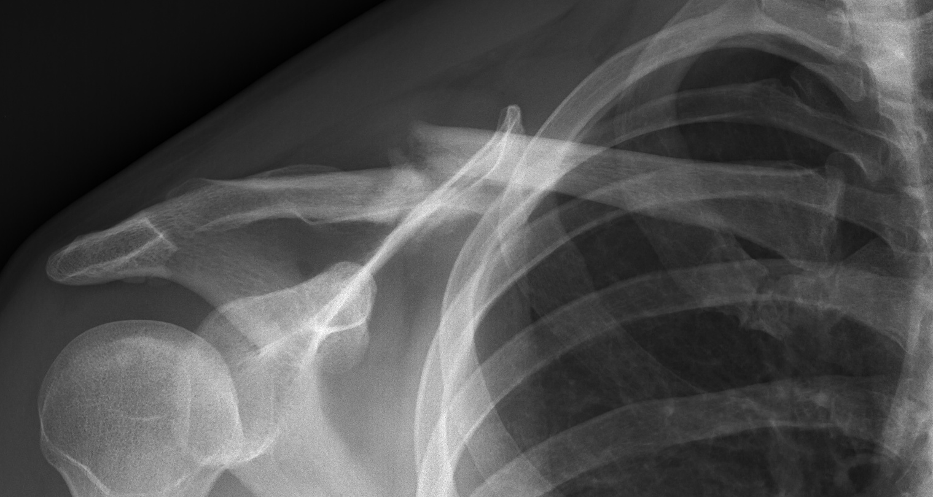
Risks of nonoperative treatment
1 month
5 months
1y
1 year
Notes:
Risks of nonoperative treatment continued

Slide 51
Operating room
Which approach was used?
Which method of plating?
Which plate has been used?
Is it stable enough?
Why was the acromioclavicular (AC) joint not addressed?
Day 2

Slide 52
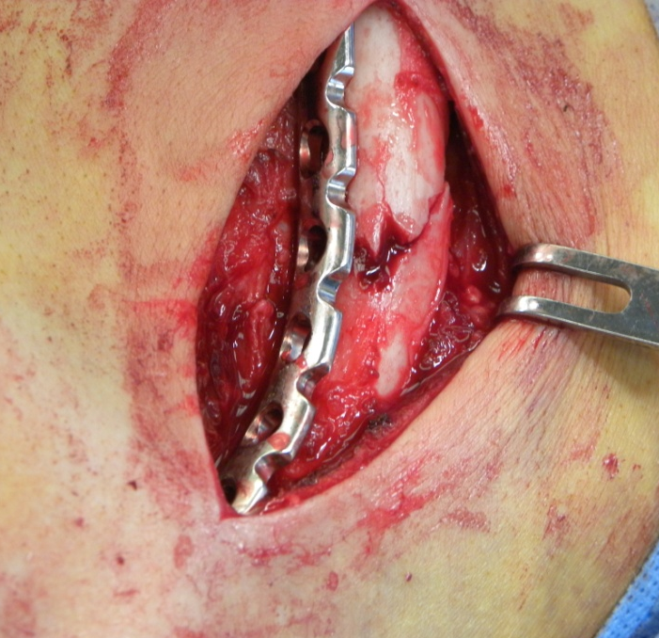
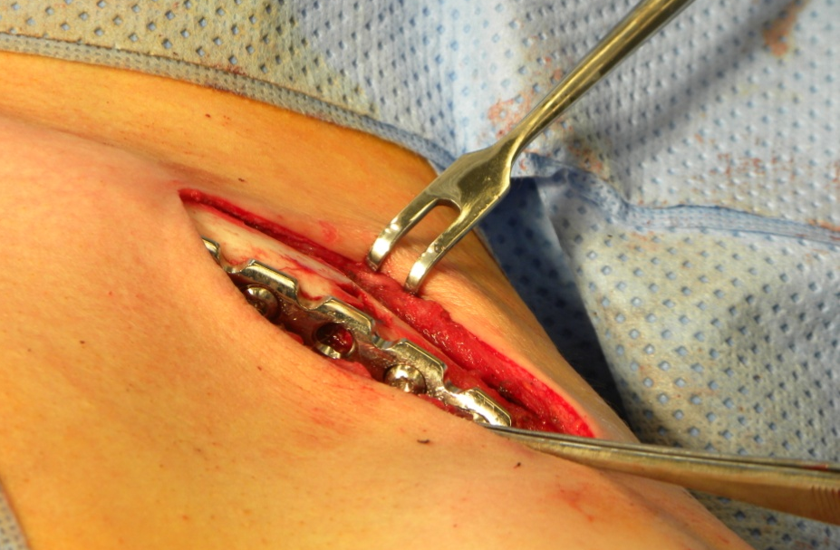
Advantages of anteroinferior plating

Slide 53
Follow-up at 6 weeks
No immobilization
Sleeping with his injured arm lifted
Sustained direct hit by door frame
Obvious deformity
Palpable bump
Tingly sensation
What has happened?
Could we have predicted it?
Why did it happen?
Could we have prevented it?
Wait? Revision surgery, how?
Week 6

Slide 54
Revision surgery
Locking compression plate—precontoured
Superior plating
No bone graft
Week 6

Slide 55
Follow-up at 1 year
Fracture healed
Full range of motion (ROM)
Medial plate irritation

Slide 56
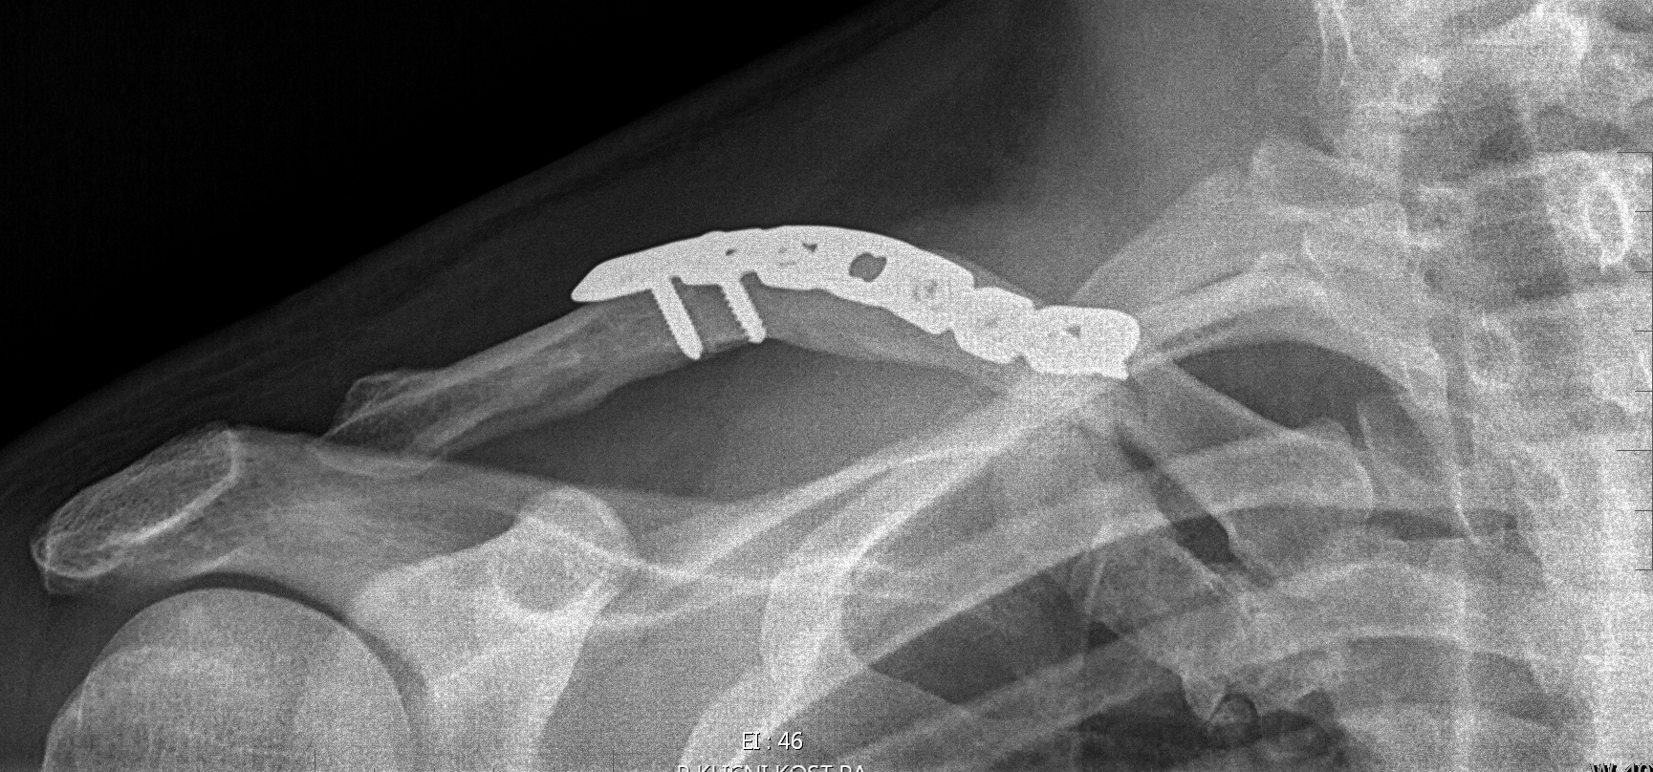
Postoperative, 18 months
Another direct hit while playing rugby
Initial fracture healed, but again slight deformity
Another fracture medial to the plate
Operative or nonoperative treatment?

Slide 57
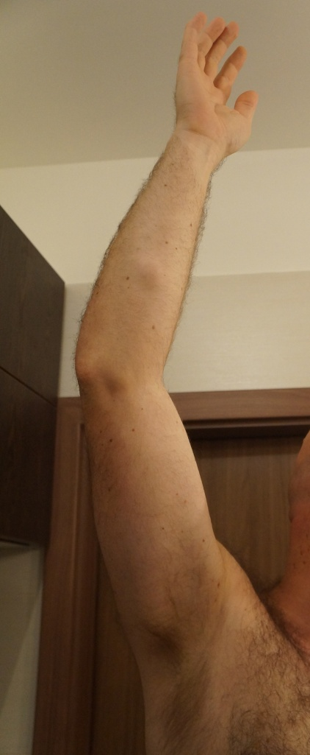
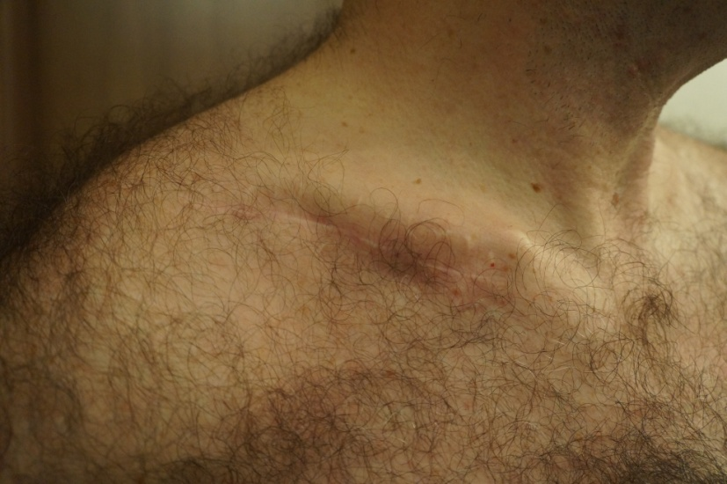
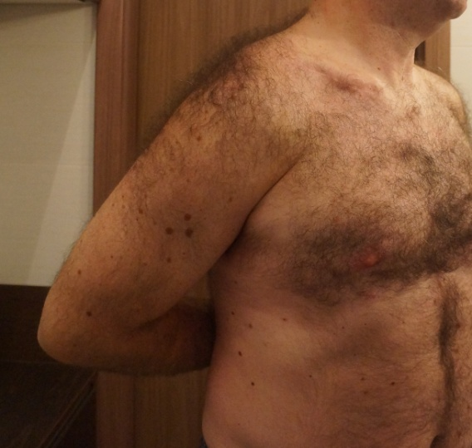
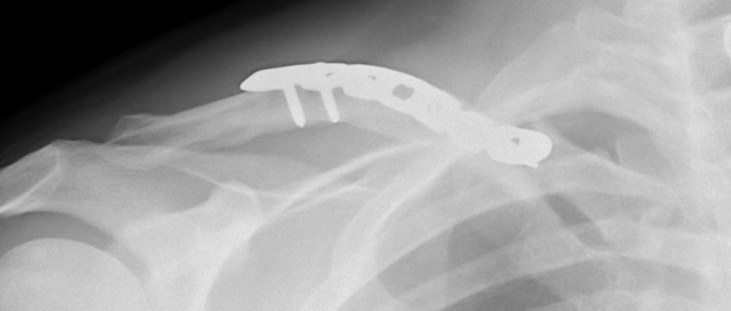
After 6 months
Sling and nonoperative treatment
Fracture healed with full ROM
Medial prominence irritated by safety belt
Requests plate removal

Slide 58
Take-home messages
False prejudice regarding operative treatment
Obtain correct length, alignment, and rotation
Reconstruction plates are rarely strong enough for bridging in superior plating
Biomechanically favourable anteroinferior plating, but…
Reconstruction plates work well as neutralization/protection plates
Newer precontoured anatomical plates are much stronger
(nonlocking or locking screws)

Slide 59
Case 7

Slide 60
Case description
21-year-old man
Fall off motorcycle at low speed
Pain in left clavicle
Isolated, closed injury
Neurovascularly intact
Day 0

Slide 61
Initial x-ray
Type of injury?
ORIF/CRIF or nonoperative treatment?
Absolute or relative stability?
Day 0

Slide 62
Pin fixation
Lateral entry point
Double-threaded pin
Mini-open reduction
Stability? Type of healing?
Medial or lateral entry point?
Risks of pin fixation?
Postoperative immobilization?
Day 1

Slide 63
Follow-up at 3 months postoperatively
Is it healed?
Any further restriction?

Slide 64
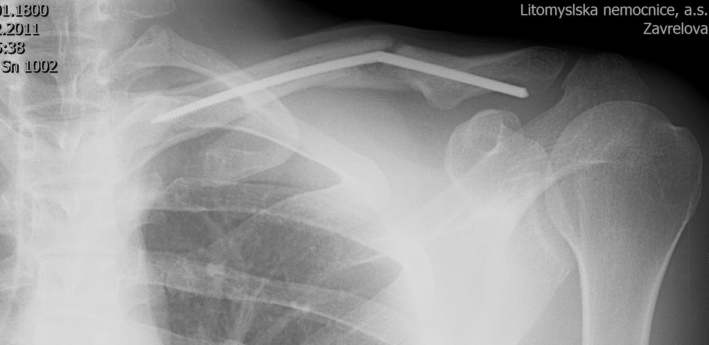
Postoperative, 4 months
Sudden pain and palpable bump
No history of previous fall or injury
Type of nonunion?
Reason?
Any other examination?

Slide 65
Nonunion
Can we treat this conservatively?
Any suggestion for operative treatment?
Decision made for nonoperarative treatment

Slide 66
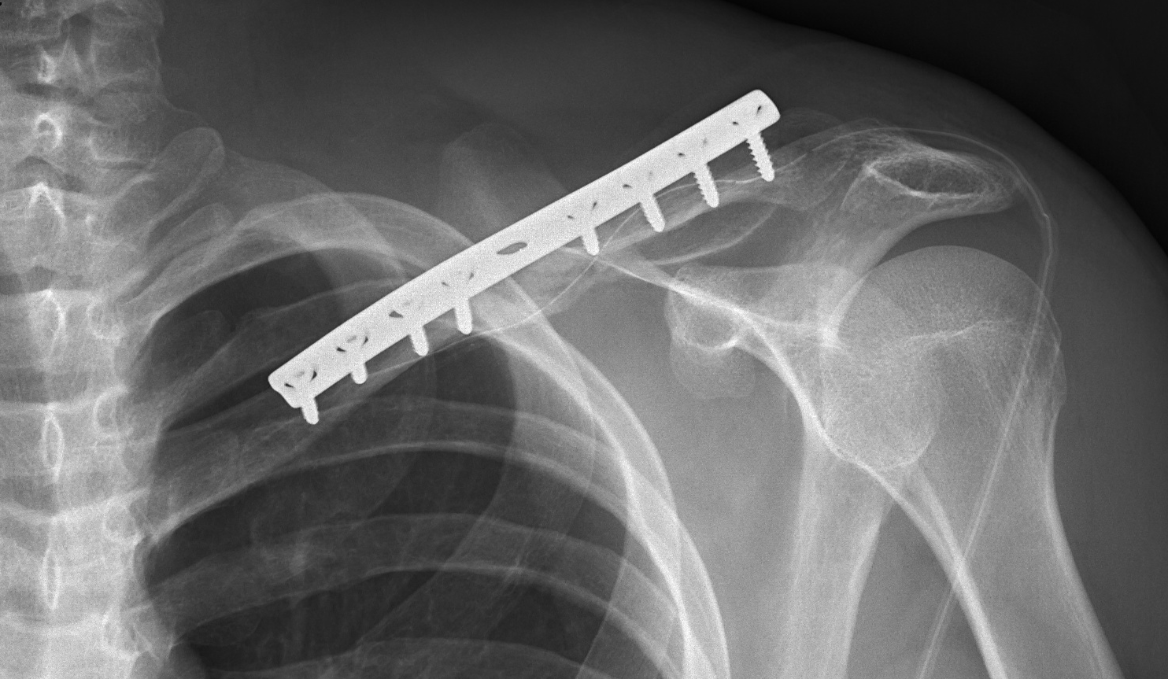
Four months later—revision surgery
Patient was referred for revision surgery due to persistant pain and limited range of motion (ROM)
Horizontal approach
Broken pin removal
Illiac crest bone graft
DCP fixation
Sling postoperatively

Slide 67
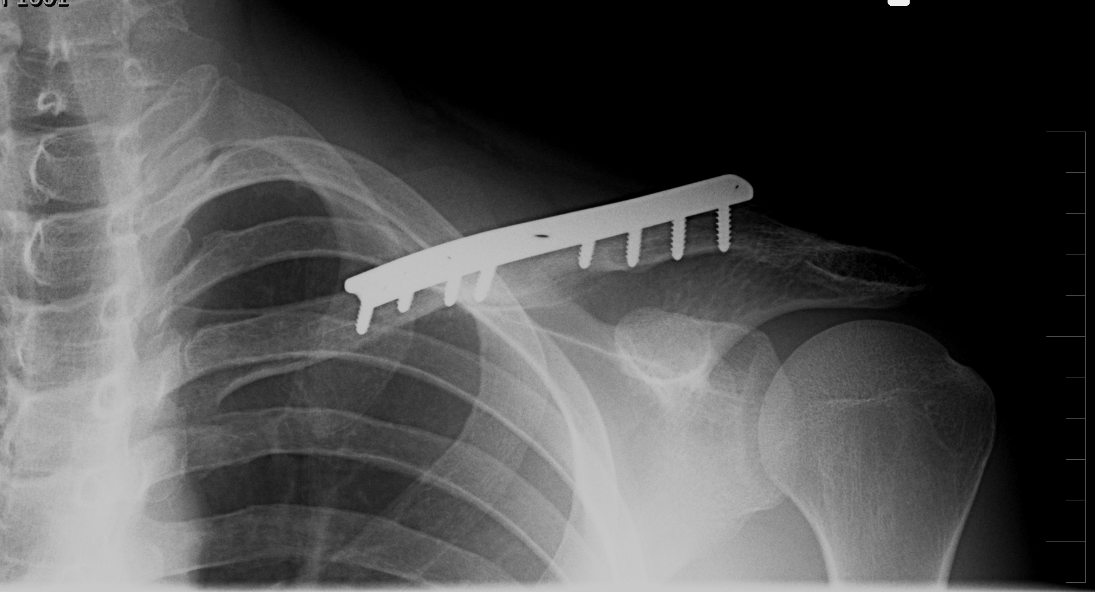
Follow-up 3 months after revision surgery
Healed nonunion
Full range of motion
Completely satisfied
One year after injury

Slide 68
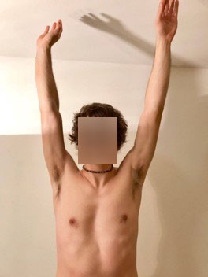
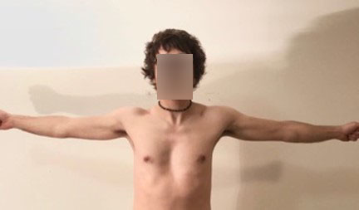
Take-home messages
Inferior stability of pin fixation
Complicated pin extraction
Absolute stability necessary for nonunion treatment—rigid plate fixation
Bone graft according to nonunion type and local defects

Slide 69
Case 8

Slide 70
Case description
56-year-old woman
Fell while hanging curtains
Pain, limited range of motion (ROM) of left arm and shoulder
Isolated, closed injury
Neurovascularly intact
Day 0

Slide 71
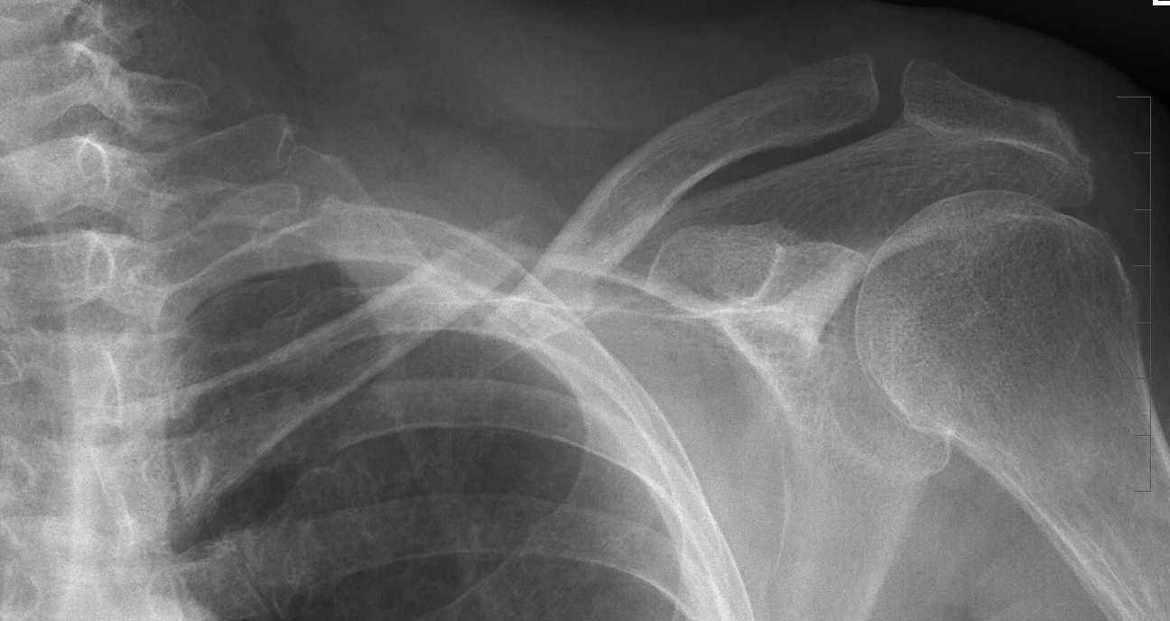
Initial x-rays
Other examination?
How many fragments?
Nonoperative treatment or surgery?
What type of fixation?
Day 0

Slide 72
Nonoperative treatment—figure-of-eight brace fixation not tolerated
Pain
Subcutaneous prominence
No bony contact
Acceptable length
Day 0
Sling?
Nonoperative treatment or surgery?

Slide 73
Nonoperative treatment—sling fixation
Pain
Subcutaneous prominence
No bony contact
Shortening
Day 12
Still nonoperative treatment?

Slide 74
Surgery
Lag screw and neutralization dynamic compression plate (DCP)
No bone graft
Postoperative sling
Uneventfull wound healing
Day 13
Stability?
Additional postoperative fixation? For how long?

Slide 75
Follow-up at 3 months postoperative—failure of fixation
Pain
Palpable screws
Loosened plate
Nonoperative treatment in any type of immobilization?
Revision surgery?
Type of plate?
Bone graft? Autograft/allograft/bone substitute?

Slide 76
Follow-up at 5 months—CT revealed nonunion
Nonoperative treatment? Any immobilization?
Revision surgery?
Type of plate?
Position of the plate?
Bone graft? Autograft/allograft/bone substitute?

Slide 77
Six months postoperative—revision surgery
Horizontal approach
Anteroinferior plating
Bone graft from illiac crest
Locking compression plate (LCP)
Type of stability?
Postoperative fixation?

Slide 78
Three months after revision surgery
Fracture healed
Almost full ROM
Any restrictions?
Is there an indication for plate removal? When?

Slide 79
Take-home messages
Limited stability in osteoporotic bone
Precontoured LCP plates can be placed superiorly or anteroinferiorly
Evaluate primary use of bone graft in indicated cases

