Slide 1
Discussion group 3: Scapular fractures
Cases for small group discussion
AOTrauma Masters course Upper extremity current concepts

Slide 2
Case 1
AOTrauma Masters course Upper extremity current concepts

Slide 3
Case description
57-year-old man
Multiple injuries:
Femoral fractures
Ipsilateral multiple rib fractures
Mild head injury

Slide 4
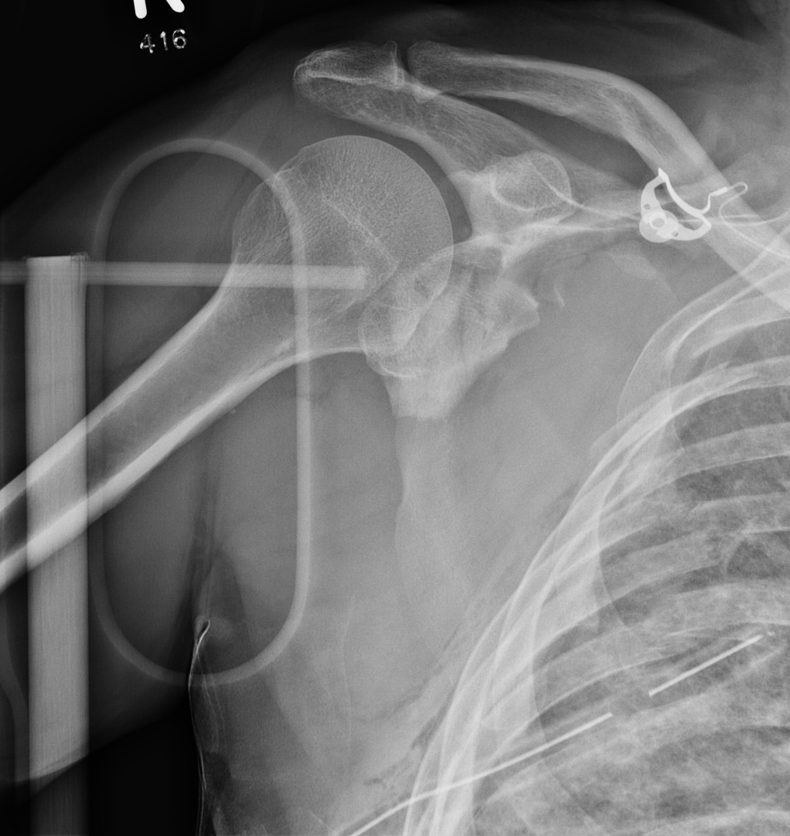
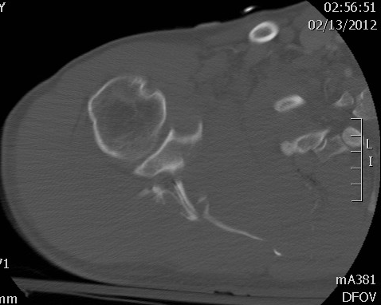

Slide 5
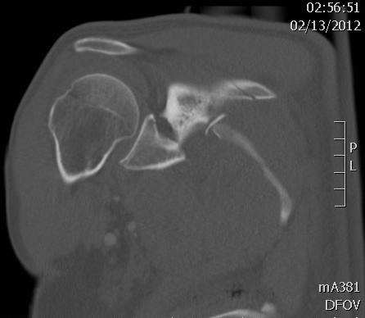
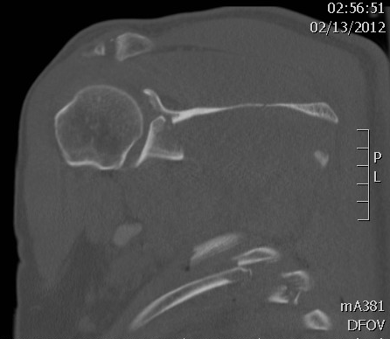

Slide 6
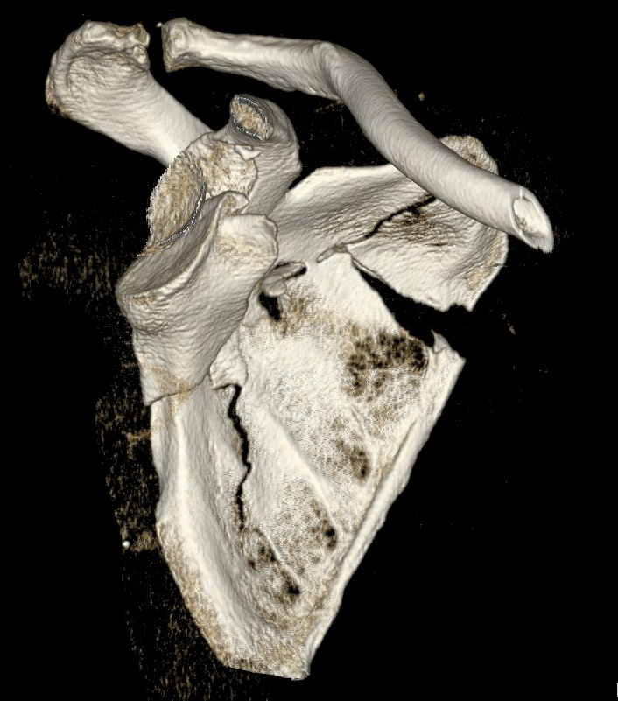
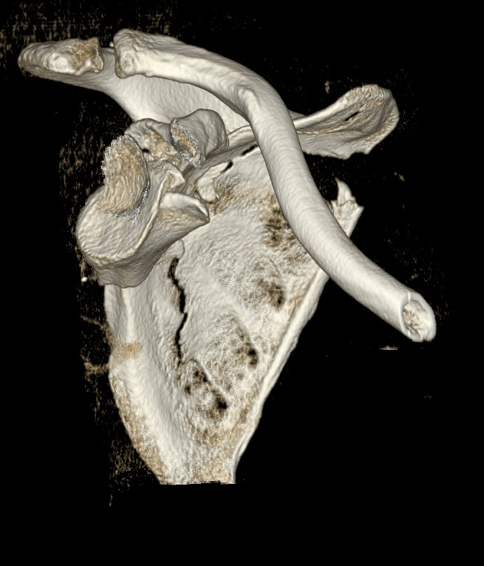

Slide 7
57-year-old man
Multiple injuries:
Femoral fractures
Ipsilateral multiple rib fractures
Mild head injury

Slide 8
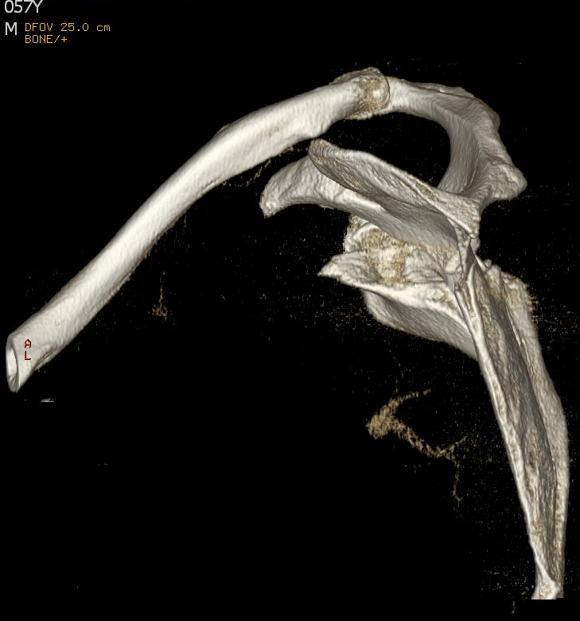
Options for management? Reasons

Slide 9
Management
Nonoperative
Closed reduction and percutaneous pinning
Open reduction and fixation (ORIF) with fixation of medial and lateral columns including joint surface
ORIF with fixation of lateral column and joint surface

Slide 10
If decision for surgery
What surgical exposure do you plan on using?
Patient positioning?
Type of table?
Image intensifier?
Implants needed?

Slide 11
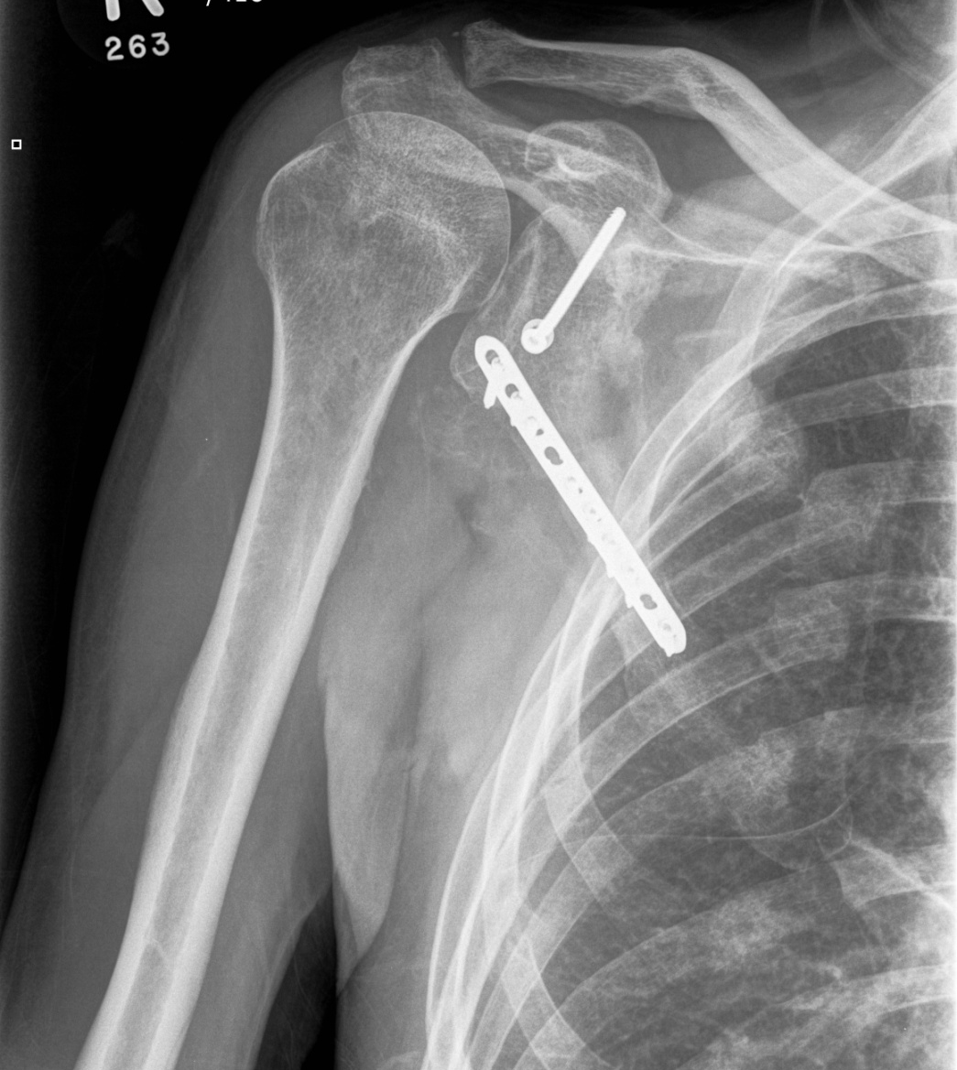
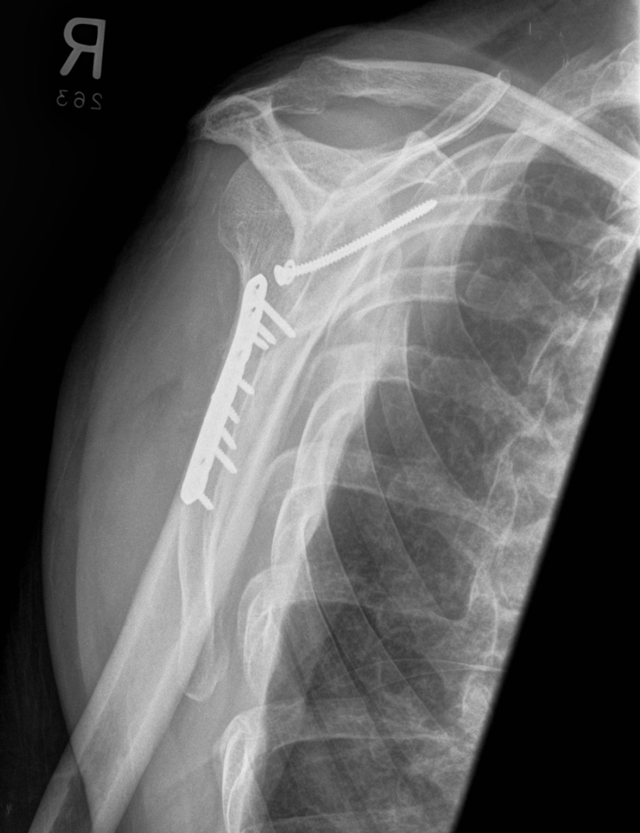
6 months postoperative
140 FF, 120 Abd, ER 60, IR L5
No pain

Slide 12
Case 2
AOTrauma Masters course Upper extremity current concepts

Slide 13
Case description
57-year-old man
Car accident
Partial brachial plexus palsy

Slide 14
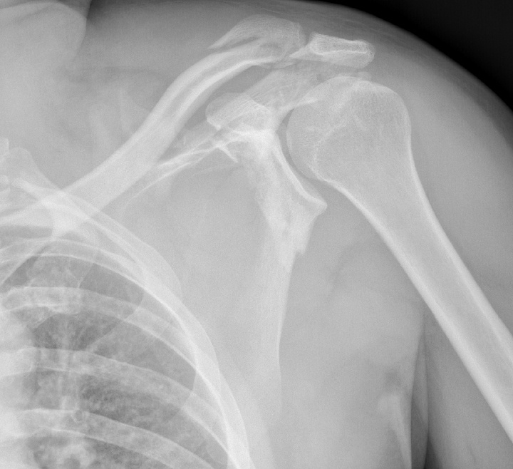
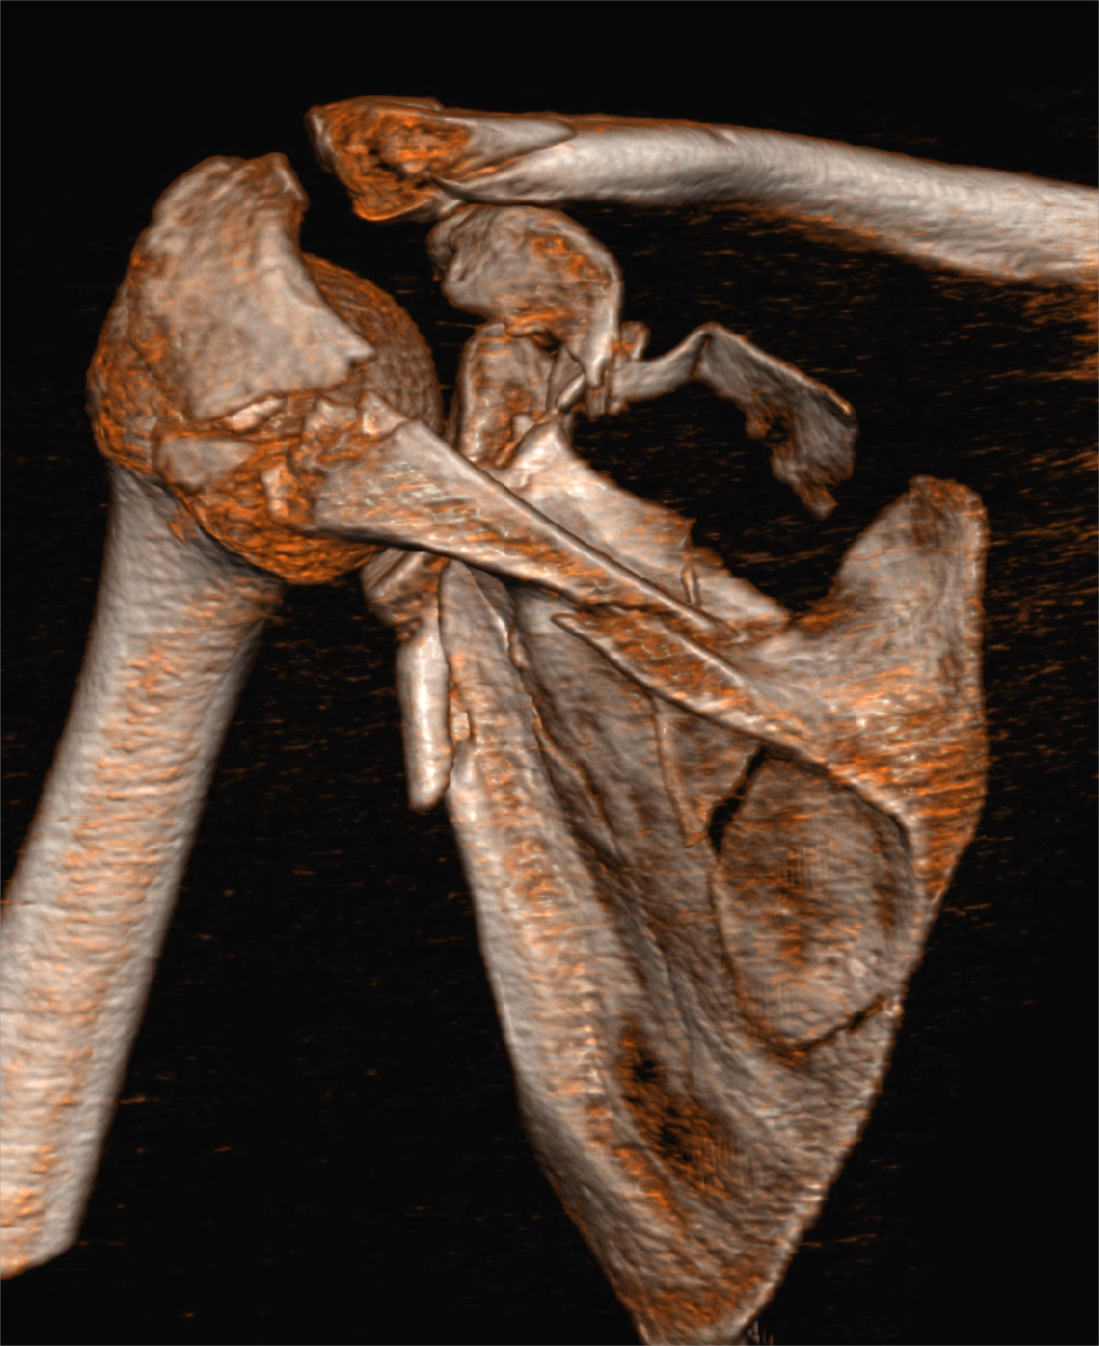
Imaging
Notes:
The type I fracture is in AP view.
The type II fracture shows transitional displacement in both AP and axillary view.
The type III fracture shows angulatory displacement in axillary view.

Slide 15
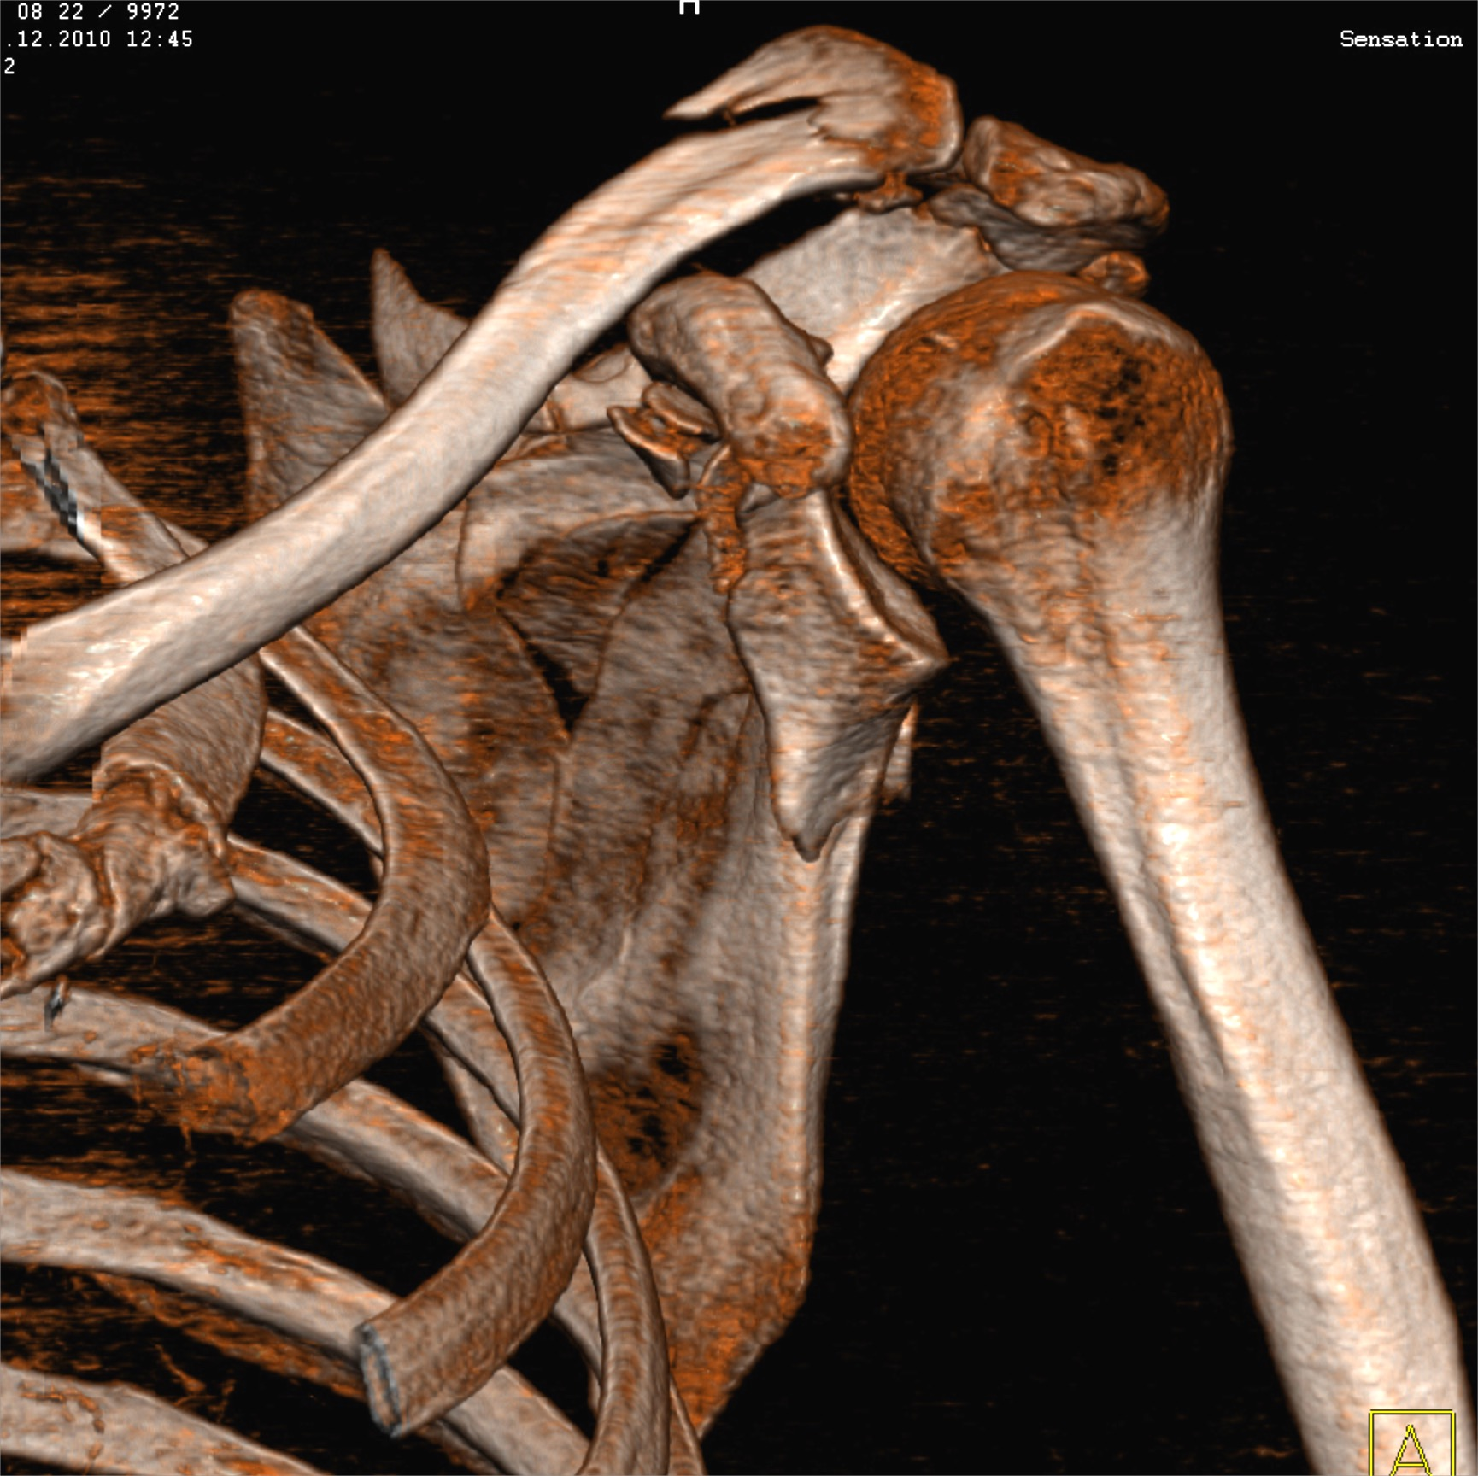
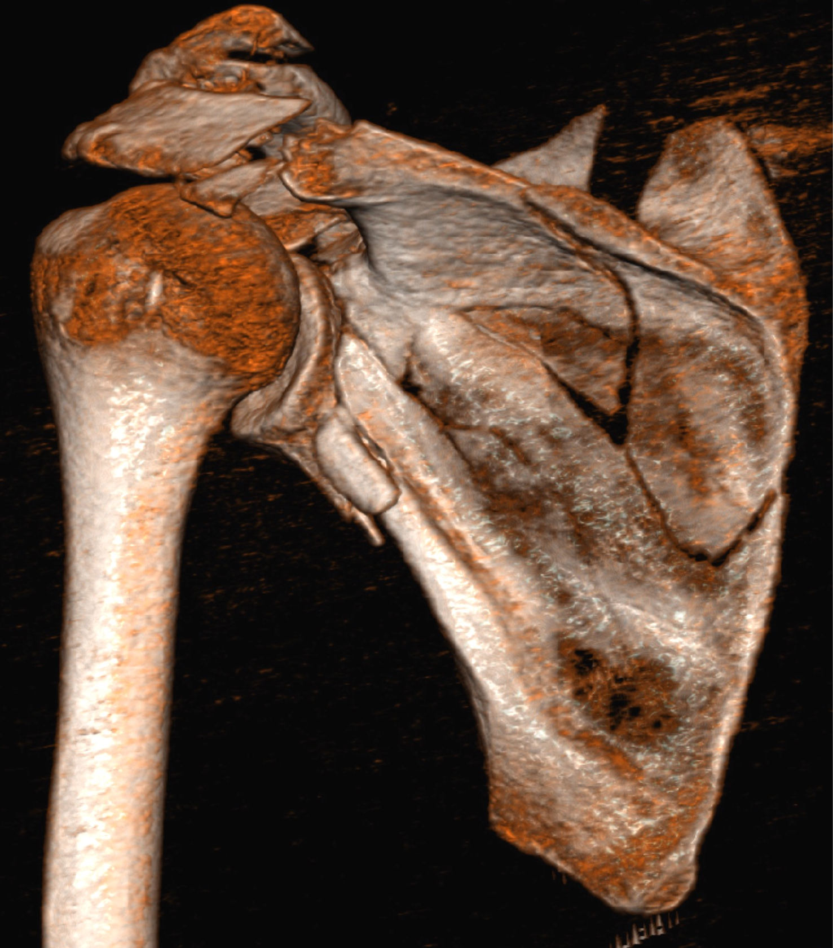
Imaging
3-D CT with possibility of rotation necessary, subtraction
Notes:
The type I fracture is in AP view.
The type II fracture shows transitional displacement in both AP and axillary view.
The type III fracture shows angulatory displacement in axillary view.

Slide 16
Which approach?
Posterior?
Anterior?
Combined?
What should be stabilized?
Notes:
The type I fracture is in AP view.
The type II fracture shows transitional displacement in both AP and axillary view.
The type III fracture shows angulatory displacement in axillary view.

Slide 17
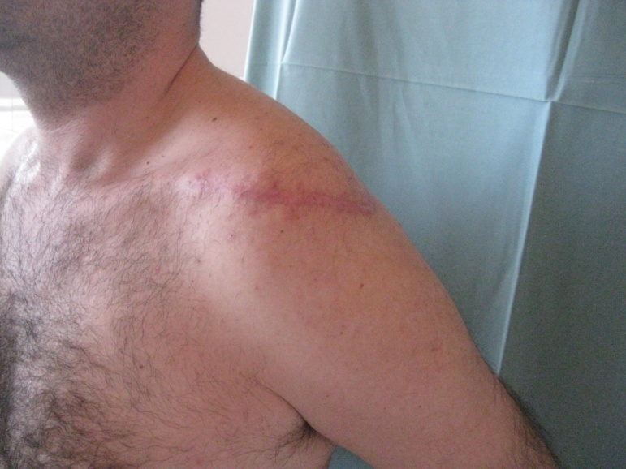
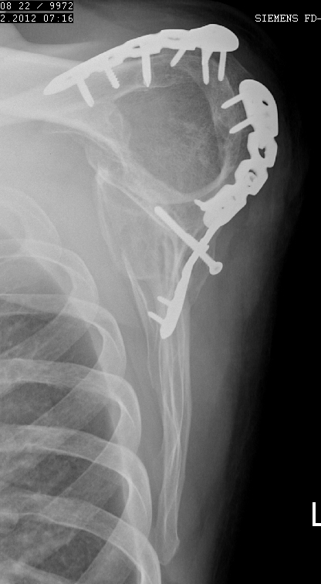
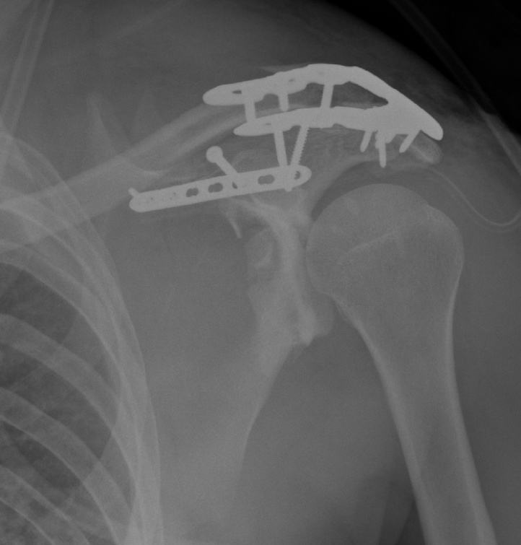
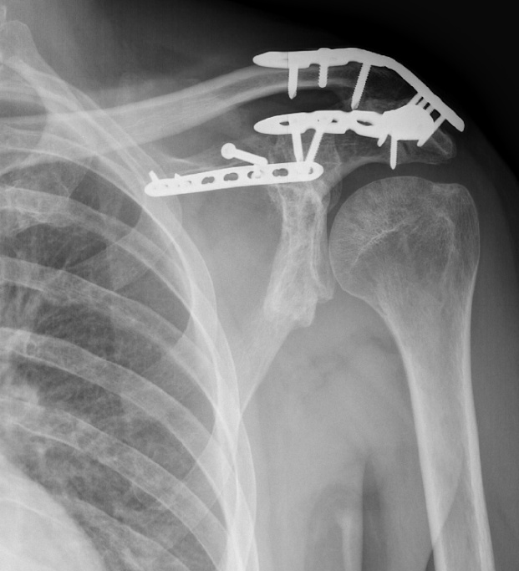

Slide 18
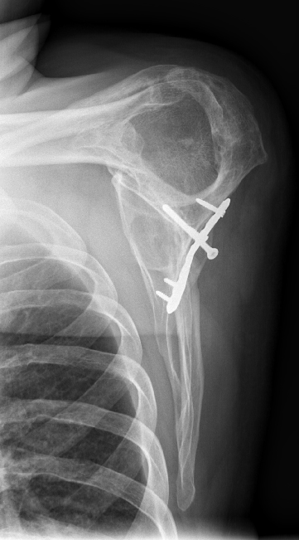
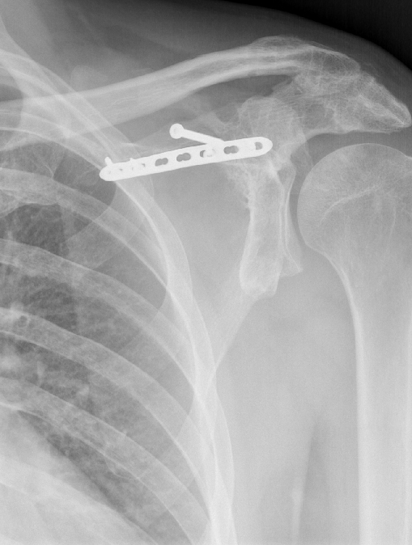

Slide 19
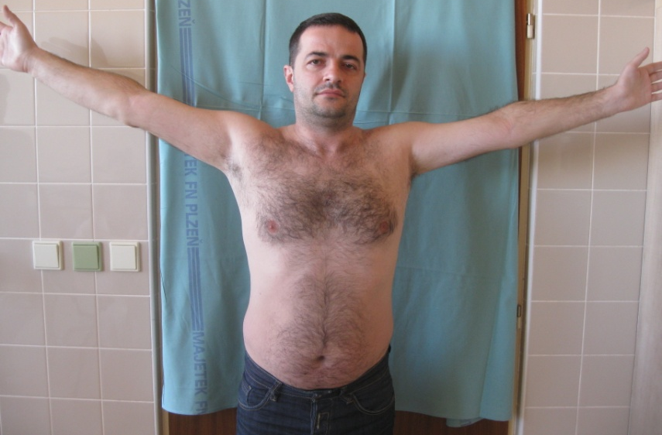
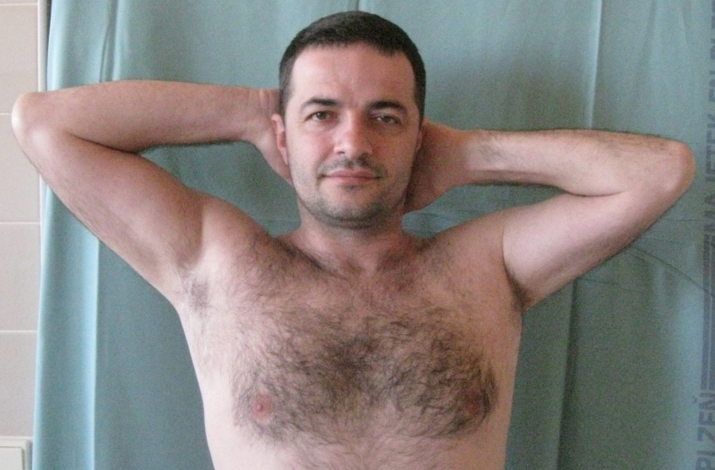
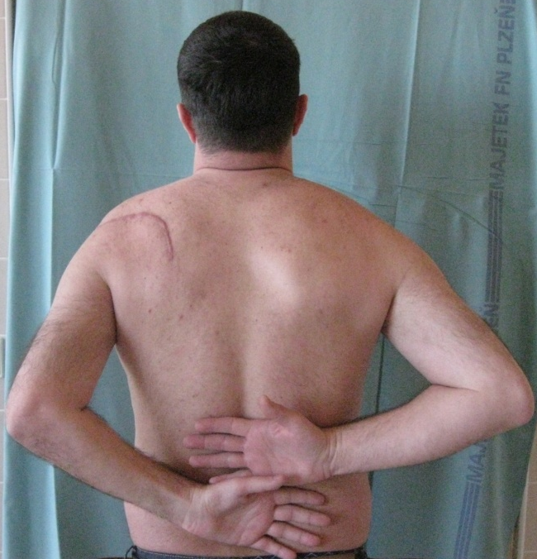
Follow-up, 18 months

Slide 20
Conclusions
Three-dimensional CT imaging is necessary for all understanding of all displaced scapula fractures
Experience with simple fractures and approaches necessary before complicated cases treatment

Slide 21
Case 3
AOTrauma Masters course Upper extremity current concepts

Slide 22
Case description
40-year-old man
High-speed bicycle accident
Multiple Rib fx
Questionable cervical spine injury
Abrasions around injured forequarter

Slide 23
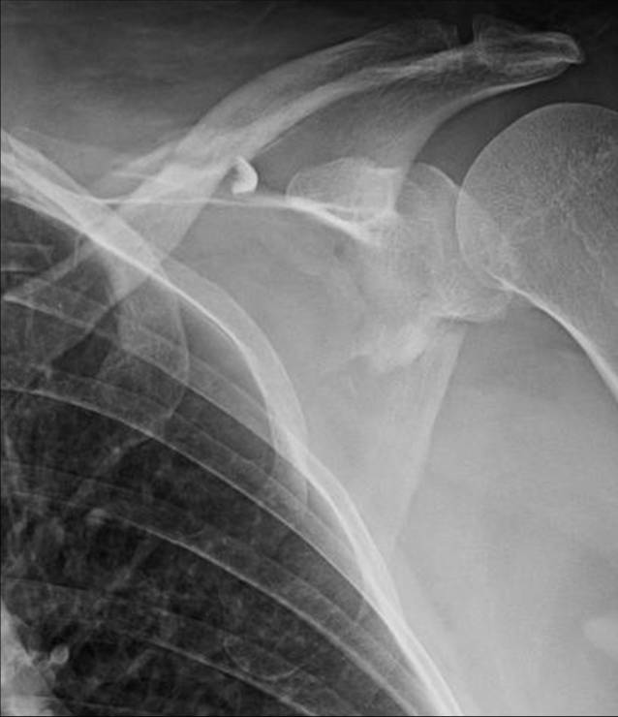
X-rays

Slide 24
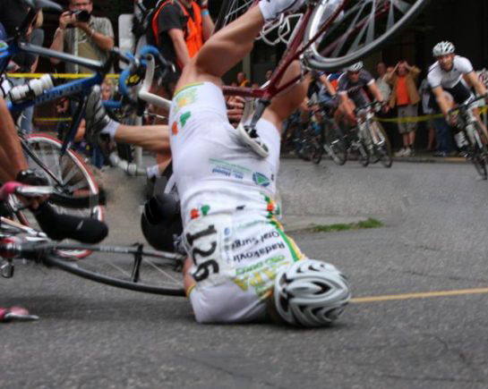
Bike collision

Slide 25
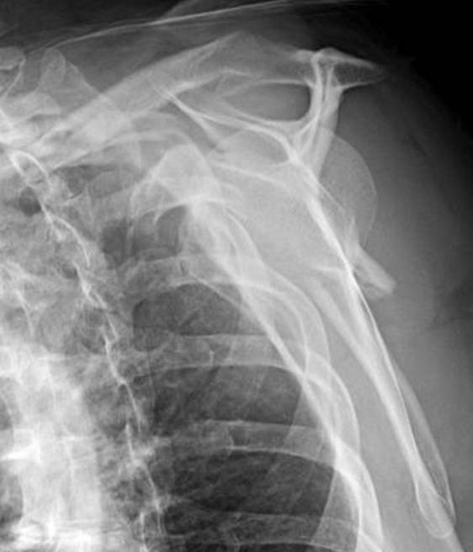
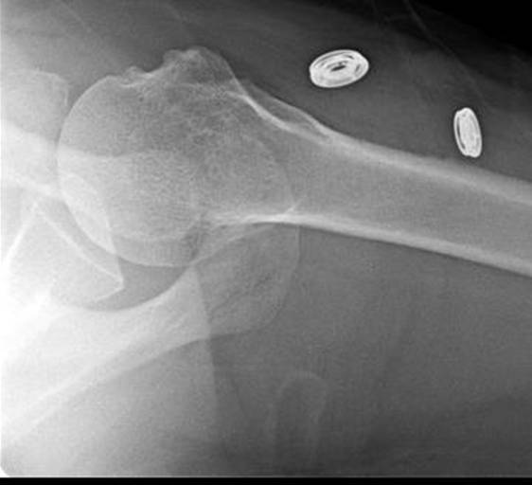

Slide 26
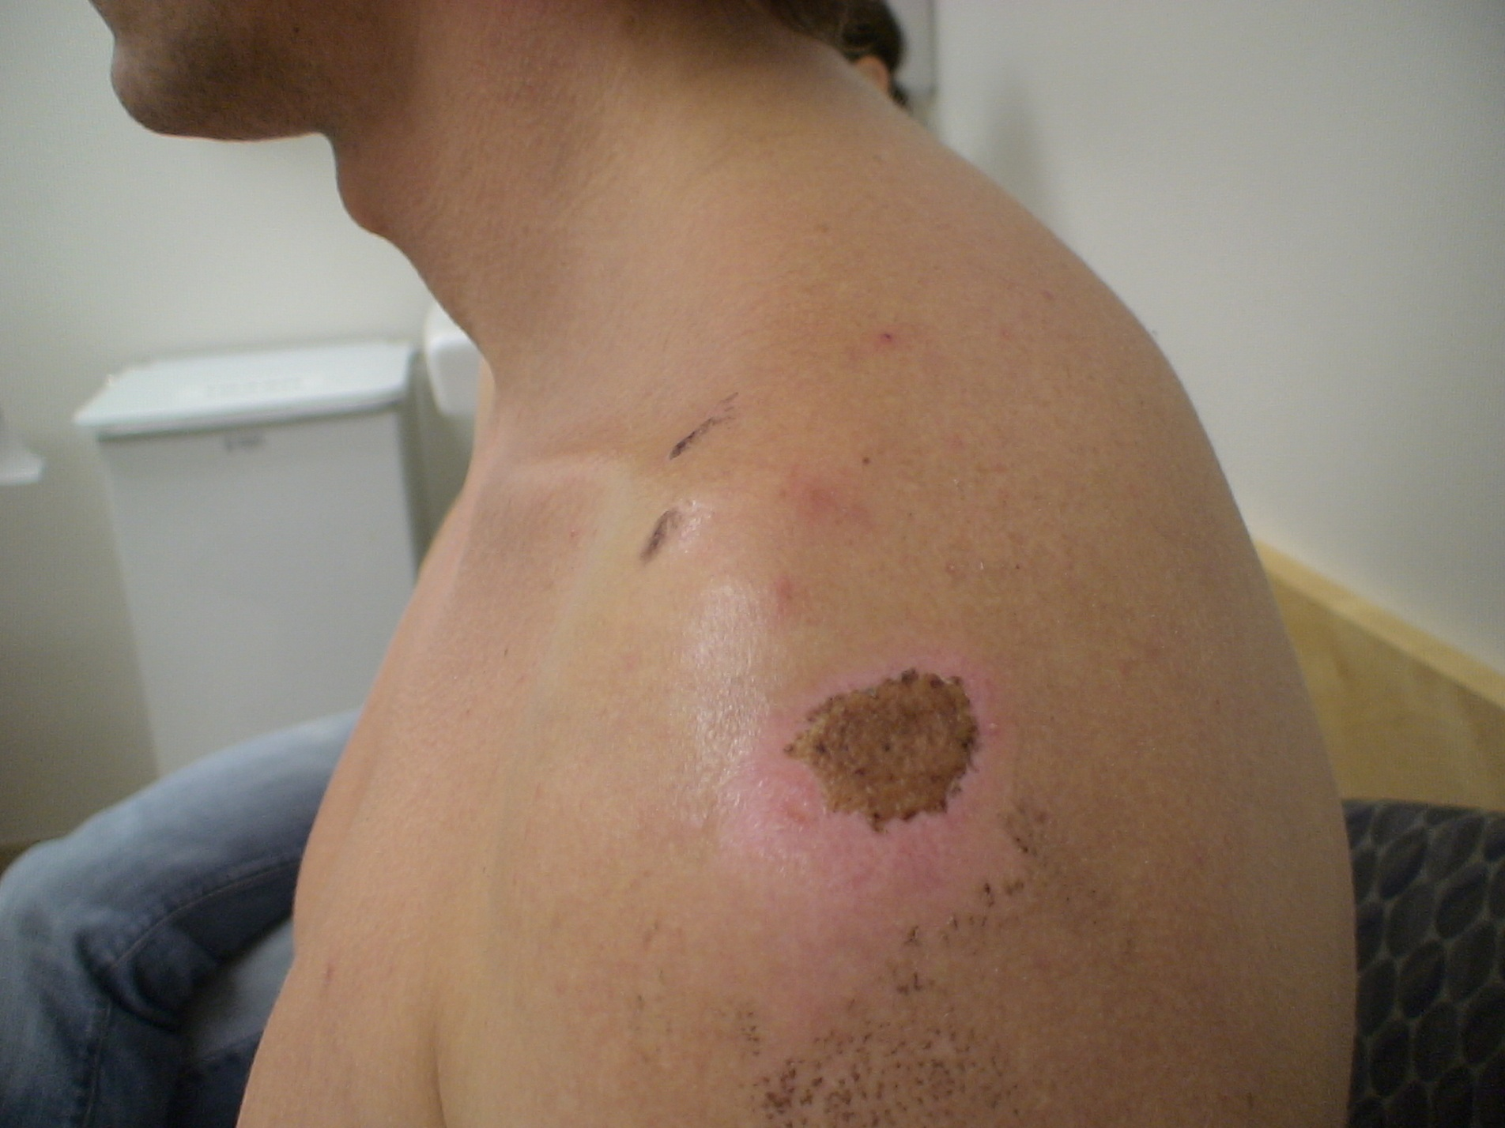
Abrasions

Slide 27
Double disruption of the superior shoulder suspensory complex
Operate clavicle only
Operate scapula and clavicle
Sling and follow up at three weeks
Operate once abrasions are healed

Slide 28
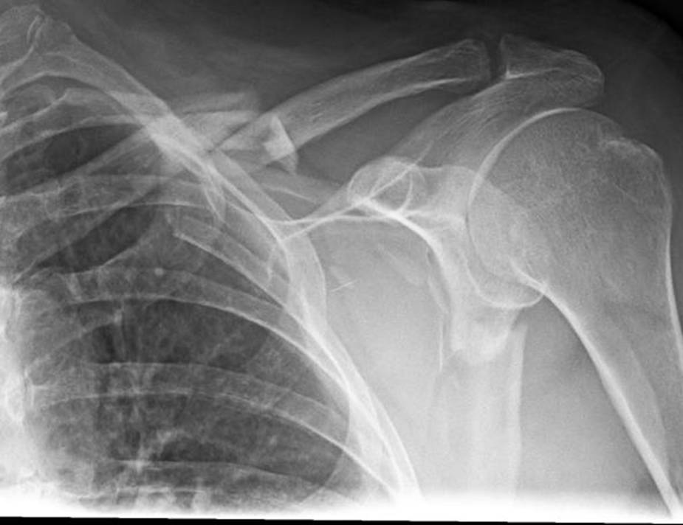
1 week later

Slide 29
What to do now?

Slide 30
Progressive displacement in clavicle fractures
Study by Anavian J, Khanna G, Plocher EK, et al. Progressive displacement of scapula fractures. J Trauma. 2010 Jul;69(1):156–161.
8/49 (16.3%) showed progressive fracture displacement in the early post-injury period
Notes:
Anavian J, Khanna G, Plocher EK, et al. Progressive displacement of scapula fractures. J Trauma. 2010 Jul;69(1):156–161.

Slide 31
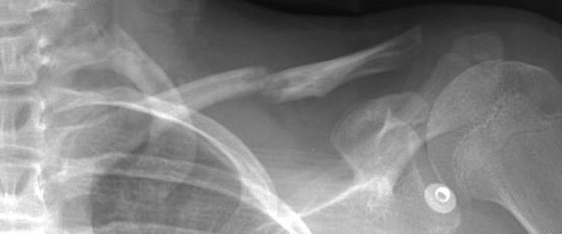
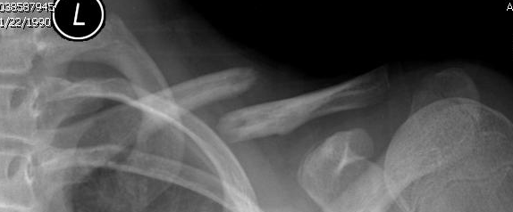
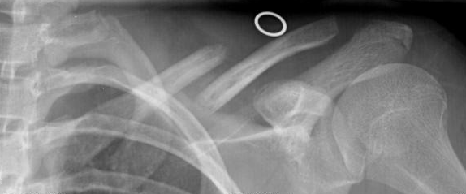
Progressive displacement in clavicle fractures
26% displacement to operative indications within 3 weeks
Anavian J, Khanna G, Plocher EK, et al. Progressive displacement of scapula fractures. J Trauma. 2010 Jul;69(1):156–161.
Notes:
Anavian J, Khanna G, Plocher EK, et al. Progressive displacement of scapula fractures. J Trauma. 2010 Jul;69(1):156–161.

Slide 34
What approach would you use for the scapula?
Posterior
Direct posterior straight incision
Judet incision, leave deltoid, work between infraspinatus and teres minor
Judet incision, take down deltoid, work between infraspinatus and teres minor
Judet incision, elevate infraspinatus, and teres minor
Other
Anterior with extension to clavicle
Anterior and posterior combined

Slide 35
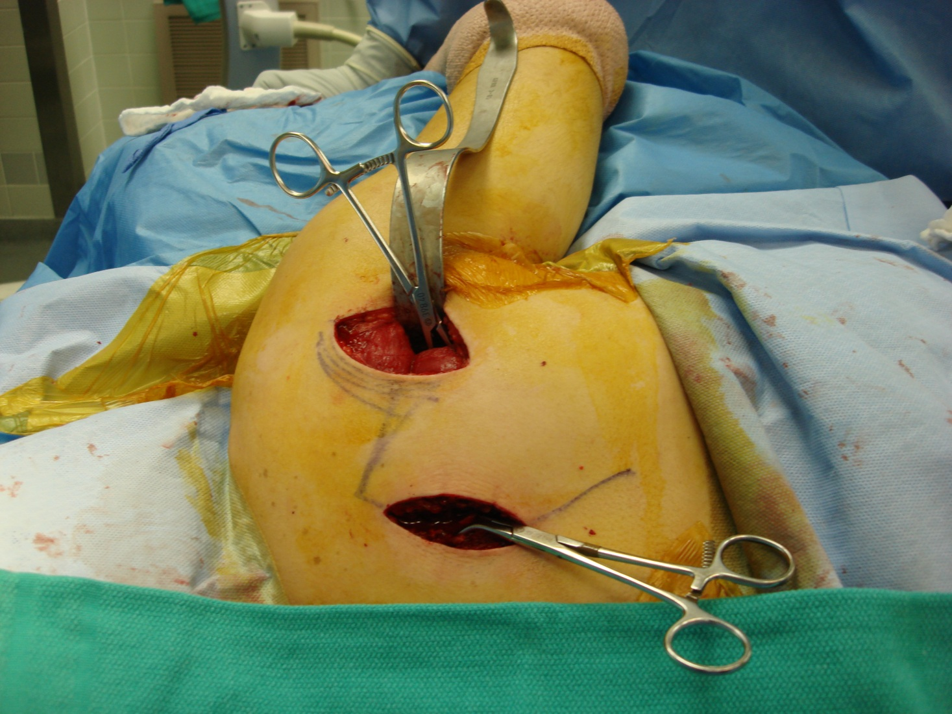
Two straight incisions (“MIO” approach)
To lateral pillar and vertebral border

Slide 36
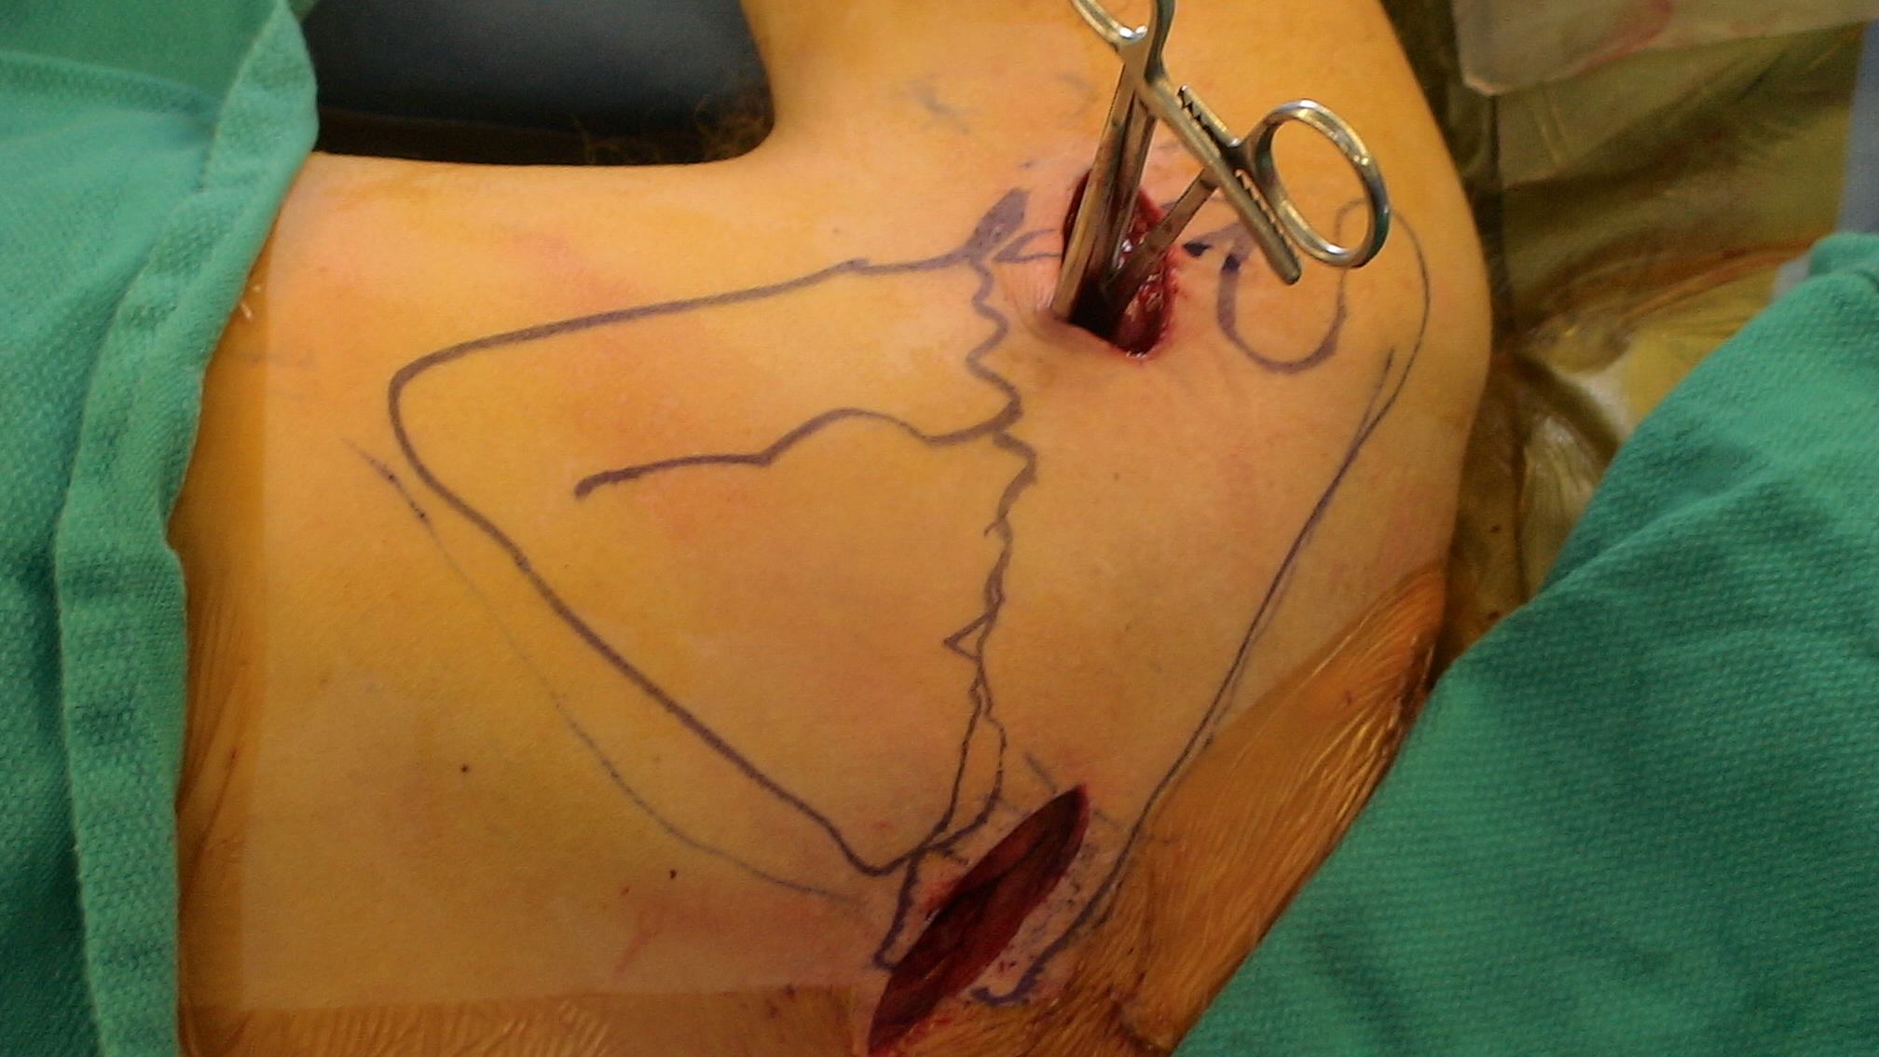
Alternate incision placement

Slide 37
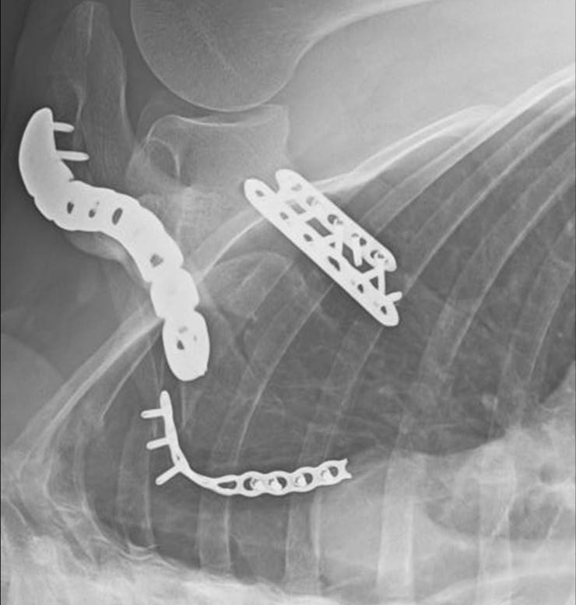
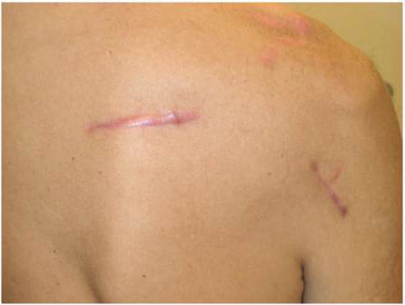

Slide 38
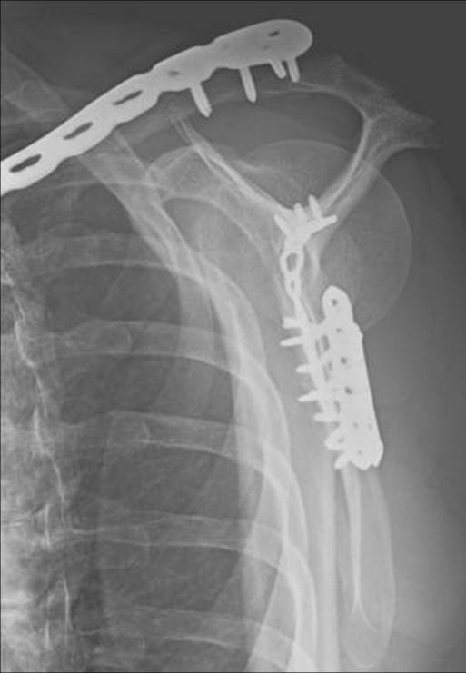
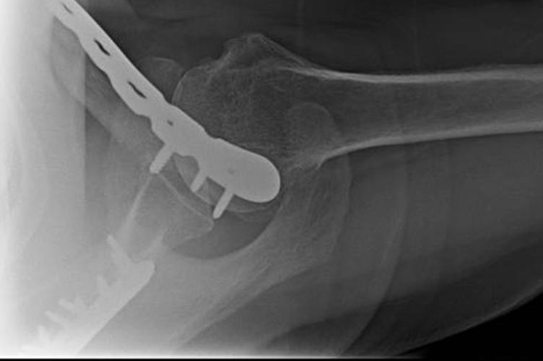

Slide 39
Case 4
AOTrauma Masters course Upper extremity current concepts

Slide 40
Case description
30-year-old man
Snowboarding accident
Deformed shoulder
No other injuries
History of bilateral clavicle fractures, twice treated nonoperatively

Slide 41
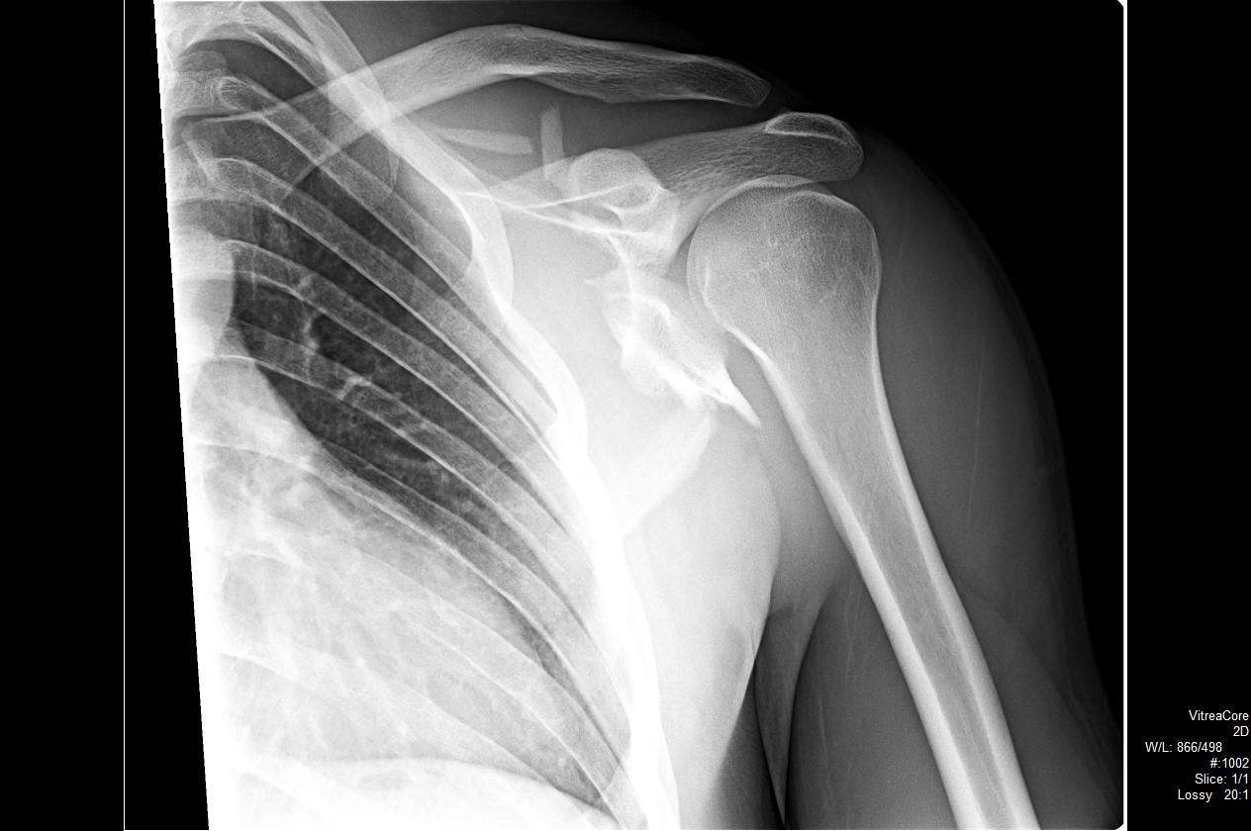
X-rays

Slide 42
Trauma images

Slide 43
Three-dimensional CT

Slide 44
70ᵒ angulation

Slide 45
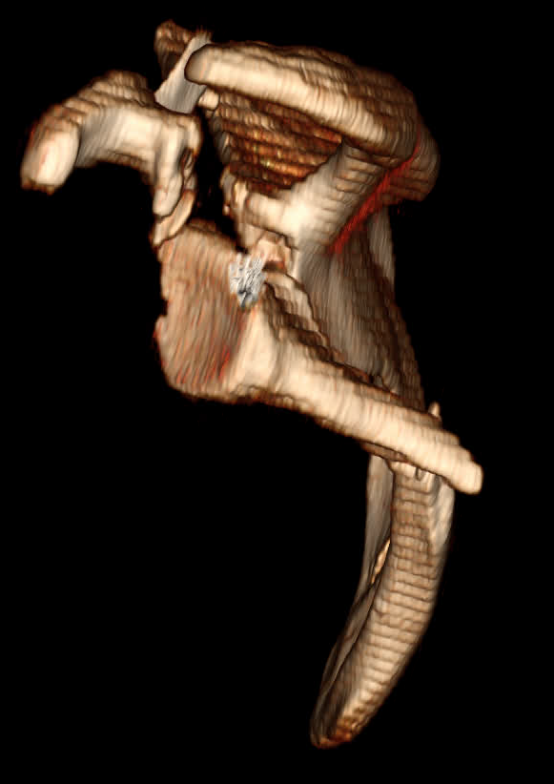
Coracoid displaced 2 cm

Slide 46
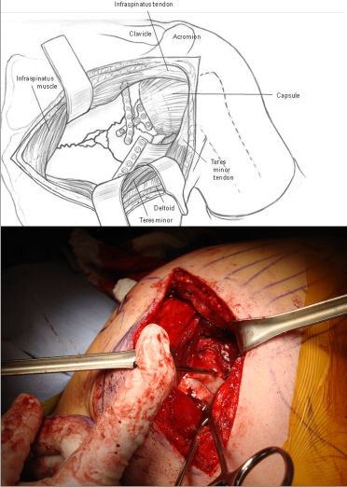
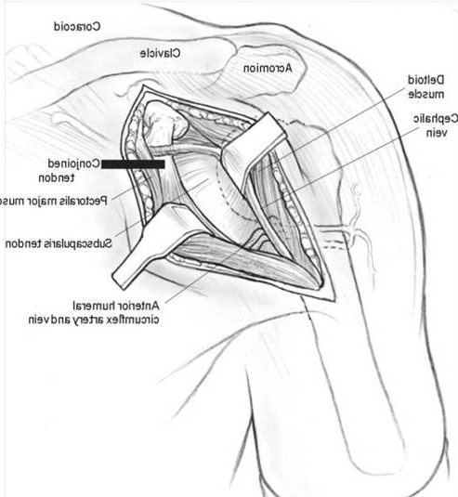
Intraoperative
Posterior incision straight over glenoid neck
Deltopectoral for coracoid

Slide 47
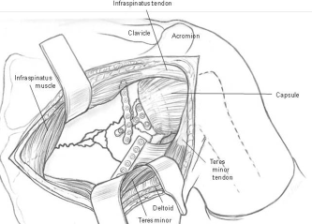
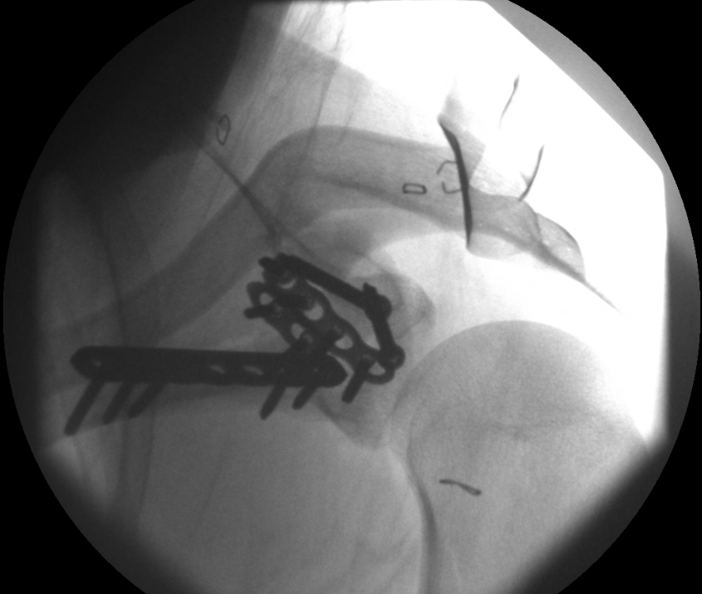
Implants
2.7 mm low profile plates
Straight LCDC plate 2.7—lateral border
Anatomic neck
Reconstruction plate 2.7
Dynamic compression plate 2.7
Coracoid
Two 3.5 mm lag screws
(Cole PA, Schroder LK, Jacobson AR, 2014)
Notes:
Bilder von: Cole PA, Schroder LK, Jacobson AR. Scapula and Rib Fractures. In: Browner B, Jupiter J, Krettek C, Anderson P, eds. Skeletal Trauma. Fifth Edit. Philadelphia, PA: Saunders/Elsevier; 2014.

Slide 48
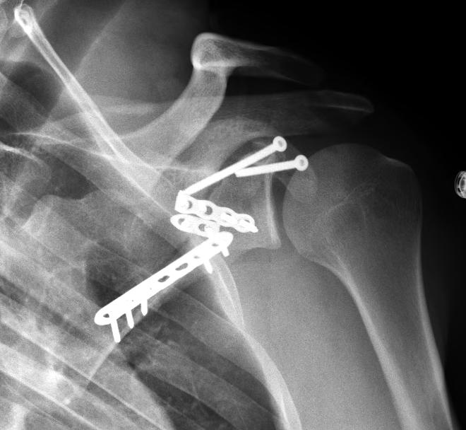
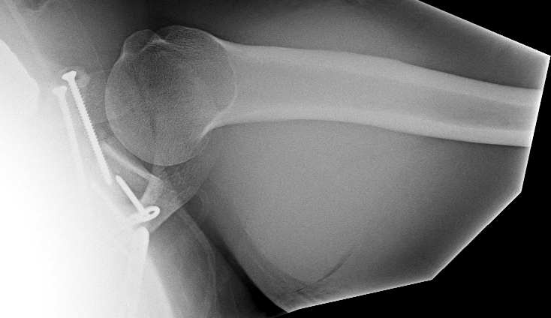
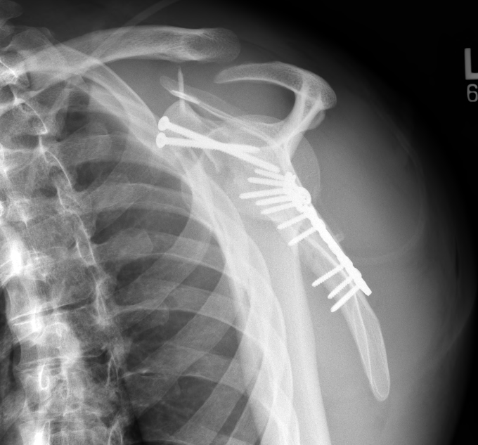
Postoperative

Slide 49
Postoperative, 3 months
Strength: injured/uninjured (pounds of force)
Forward flexion 5/28
Abduction 0/20
External rotation 4/32
EMG

Slide 50
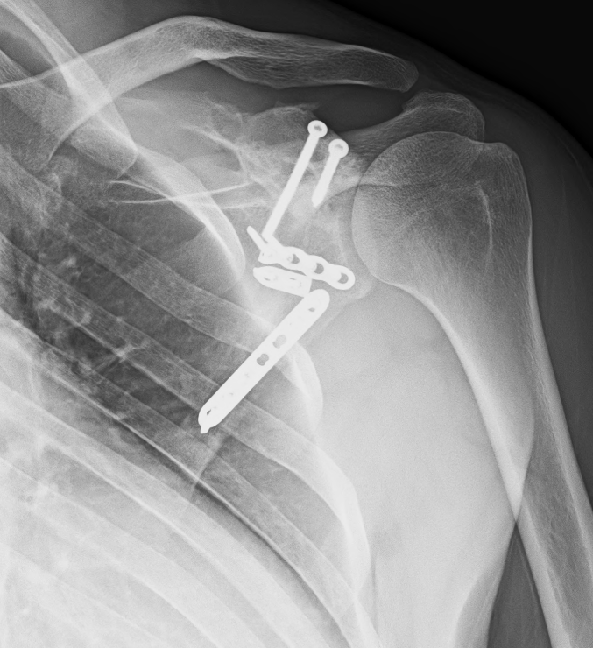
Postoperative, 5 years
ROM: injured/uninjured
Forward flexion: 155/150
Abduction: 140/138
External rotation: 39/70
Strength: injured/uninjured
Forward flexion: 27/32
Abduction: 18/26
External rotation: 21/23
DASH: 1

Slide 51
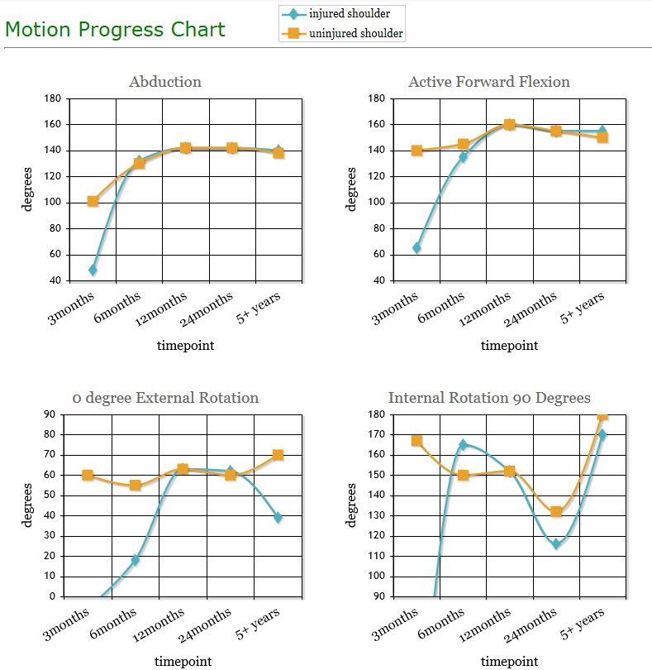

Slide 52
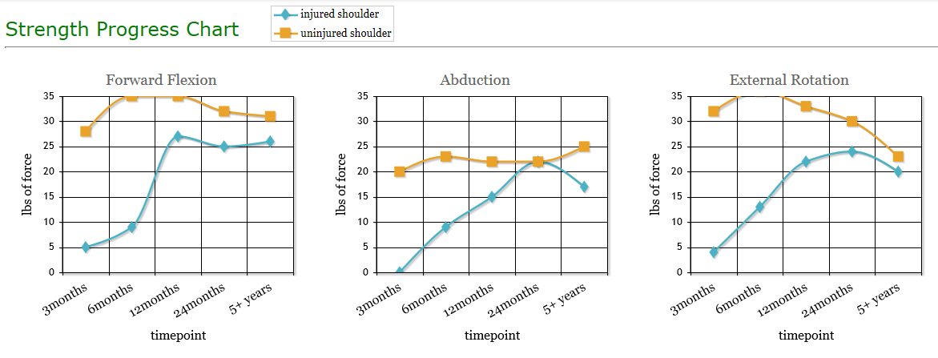
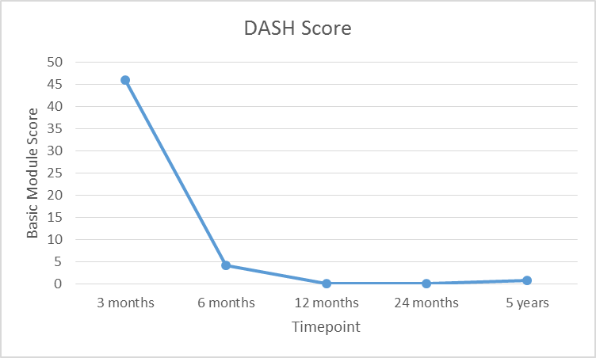

Slide 53
Conclusions
Carefully analyze all injuries on 3-D/2-D CT scans
Physiotherapy individually
Strength normalization could take 2 years

Slide 54
Case 5
AOTrauma Masters course Upper extremity current concepts

Slide 55
Case description
43-year-old
Referred from “elsewhere”
“Healthy”, 200 kg
Grocery store manager
No numbness, motor weakness
In a sling
Isolated injury
Injury occurred 2 weeks ago

Slide 56
Next steps?

Slide 58
C
A

Slide 61
Approach?
Direct posterior
Posterior Judet
Deltopectoral
Transaxillary

Slide 62
Deltopectoral
Anterior glenoid fractures
Coracoid fractures
Ideberg II fractures

Slide 65
Postoperative management?

Slide 66
Take-home messages
Group to formulate major messages

