Slide 1
Author’s solution
Group 1: Proximal humerus and glenoid
AOTrauma Masters course
Reto Babst
Upper extremity

Slide 2
Case description
63-year-old man
Ski accident
Fall on right shoulder
Monotrauma
No other comorbidities
Office worker

Slide 3
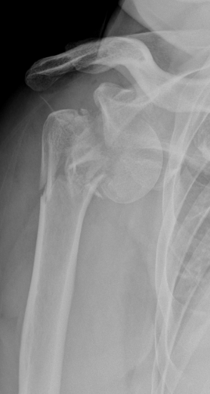
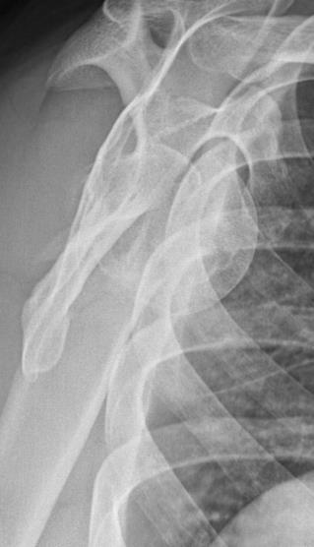
Additional information?

Slide 4
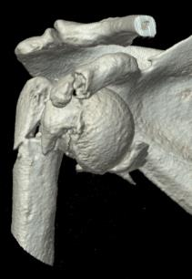
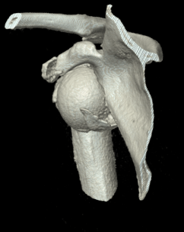
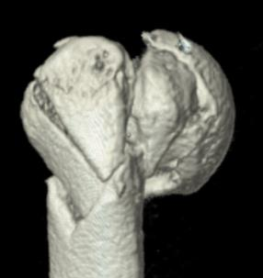
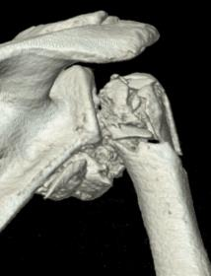
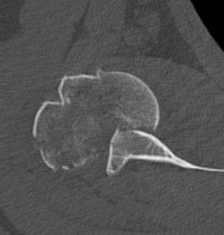
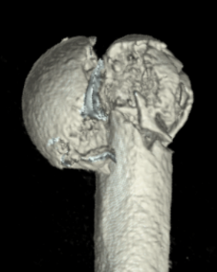

Slide 5
Treatment options
Closed/open reduction?
Positioning?
Approach?
Reconstruction?
Proximal humerus?
Plate
Nail
Glenoid
Hemiarthroplasty
Total/reversed arthroplasty?

Slide 6
Author's solution
Reto Babst, Luzern Kantonspital
Notes:
Treatment possibilities
Advantages – disadvantages of different approaches
Reconstruction-replacement
Stability of fixations – plating (augmentation), nailing

Slide 7
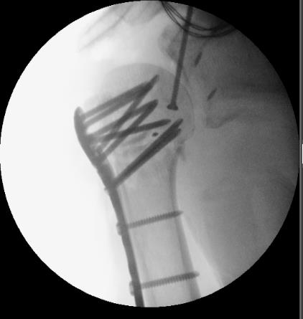
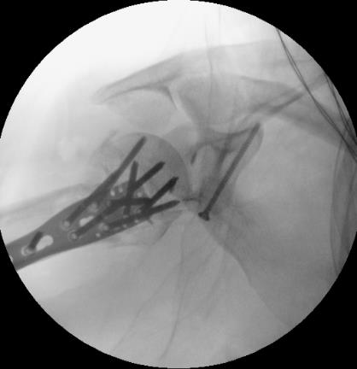
Coracoid osteotomy
Glenoid fixation with anchors

Slide 8
Additional information?

Slide 9
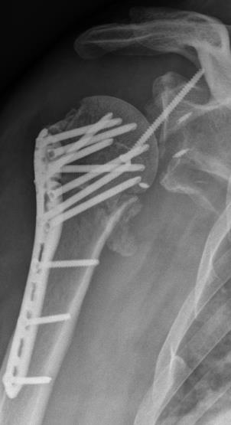
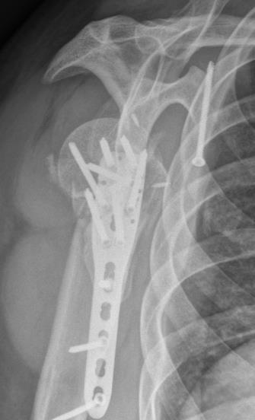
Additional information?

Slide 10
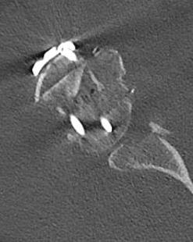
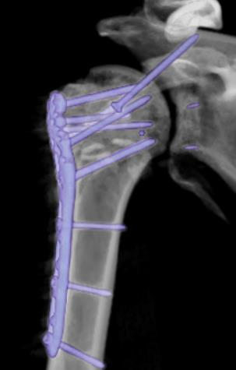
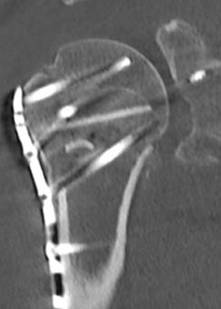
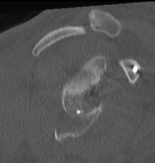
What next?
Leave it?
Revision?

Slide 11
Glenoid fixation?

Slide 13
6 months

Slide 14
1 year ROM decreases F/E: 120/0/30, AR/IR; 40/0/45, no pain

Slide 15
1.5 year— ROM decreases F/E: 100/0/30, AR/IR; 40/0/45, some pain, no pain medication

Slide 16
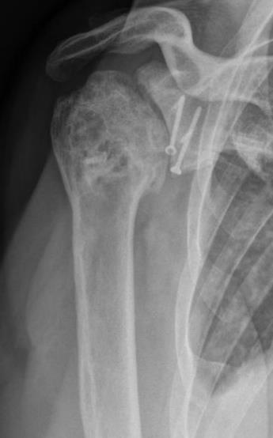
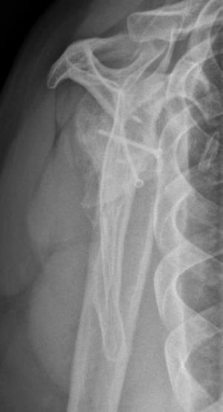
2 years—ROM decreases F/E: 100/0/30, AR/IR; 40/0/45, some pain, no pain medication

Slide 17
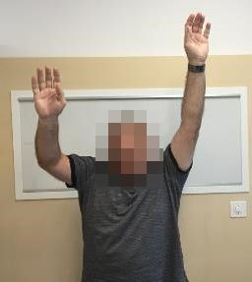
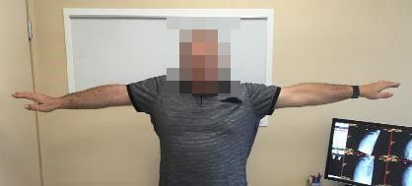
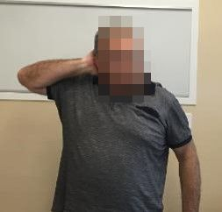
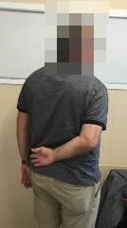
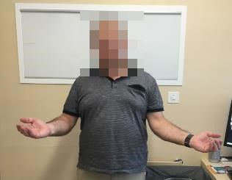

Slide 18
Conclusions
Varus malunion/failure is one of the most frequent complications for LCP proximal humerus
Nailing is the most stable osteosynthesis in neck fractures of proximal humerus
Can be used for not only for fresh cases, but even for nonunion treatment
Notes:
IM nailing is very stable fixation and can be used for the treatment of neck nonunions too
in younger patients reconstruction more advantages than replacement in salvage strategy

