Slide 1
Author’s solution
Group 3: Supracondylar nonunion—complex
AOTrauma Masters course
Upper extremity

Slide 2
Supracondylar fracture distal humerus
42-year-old man
Workers’ Compensation Board (WCB) claim

Slide 3
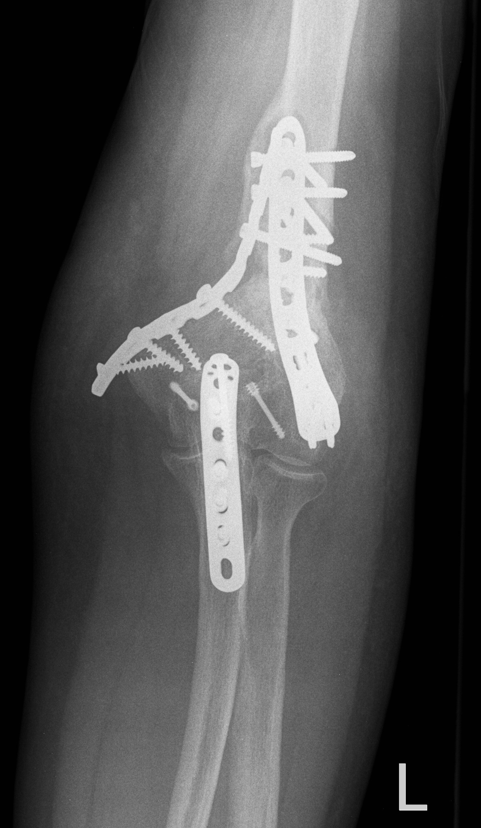

Slide 4
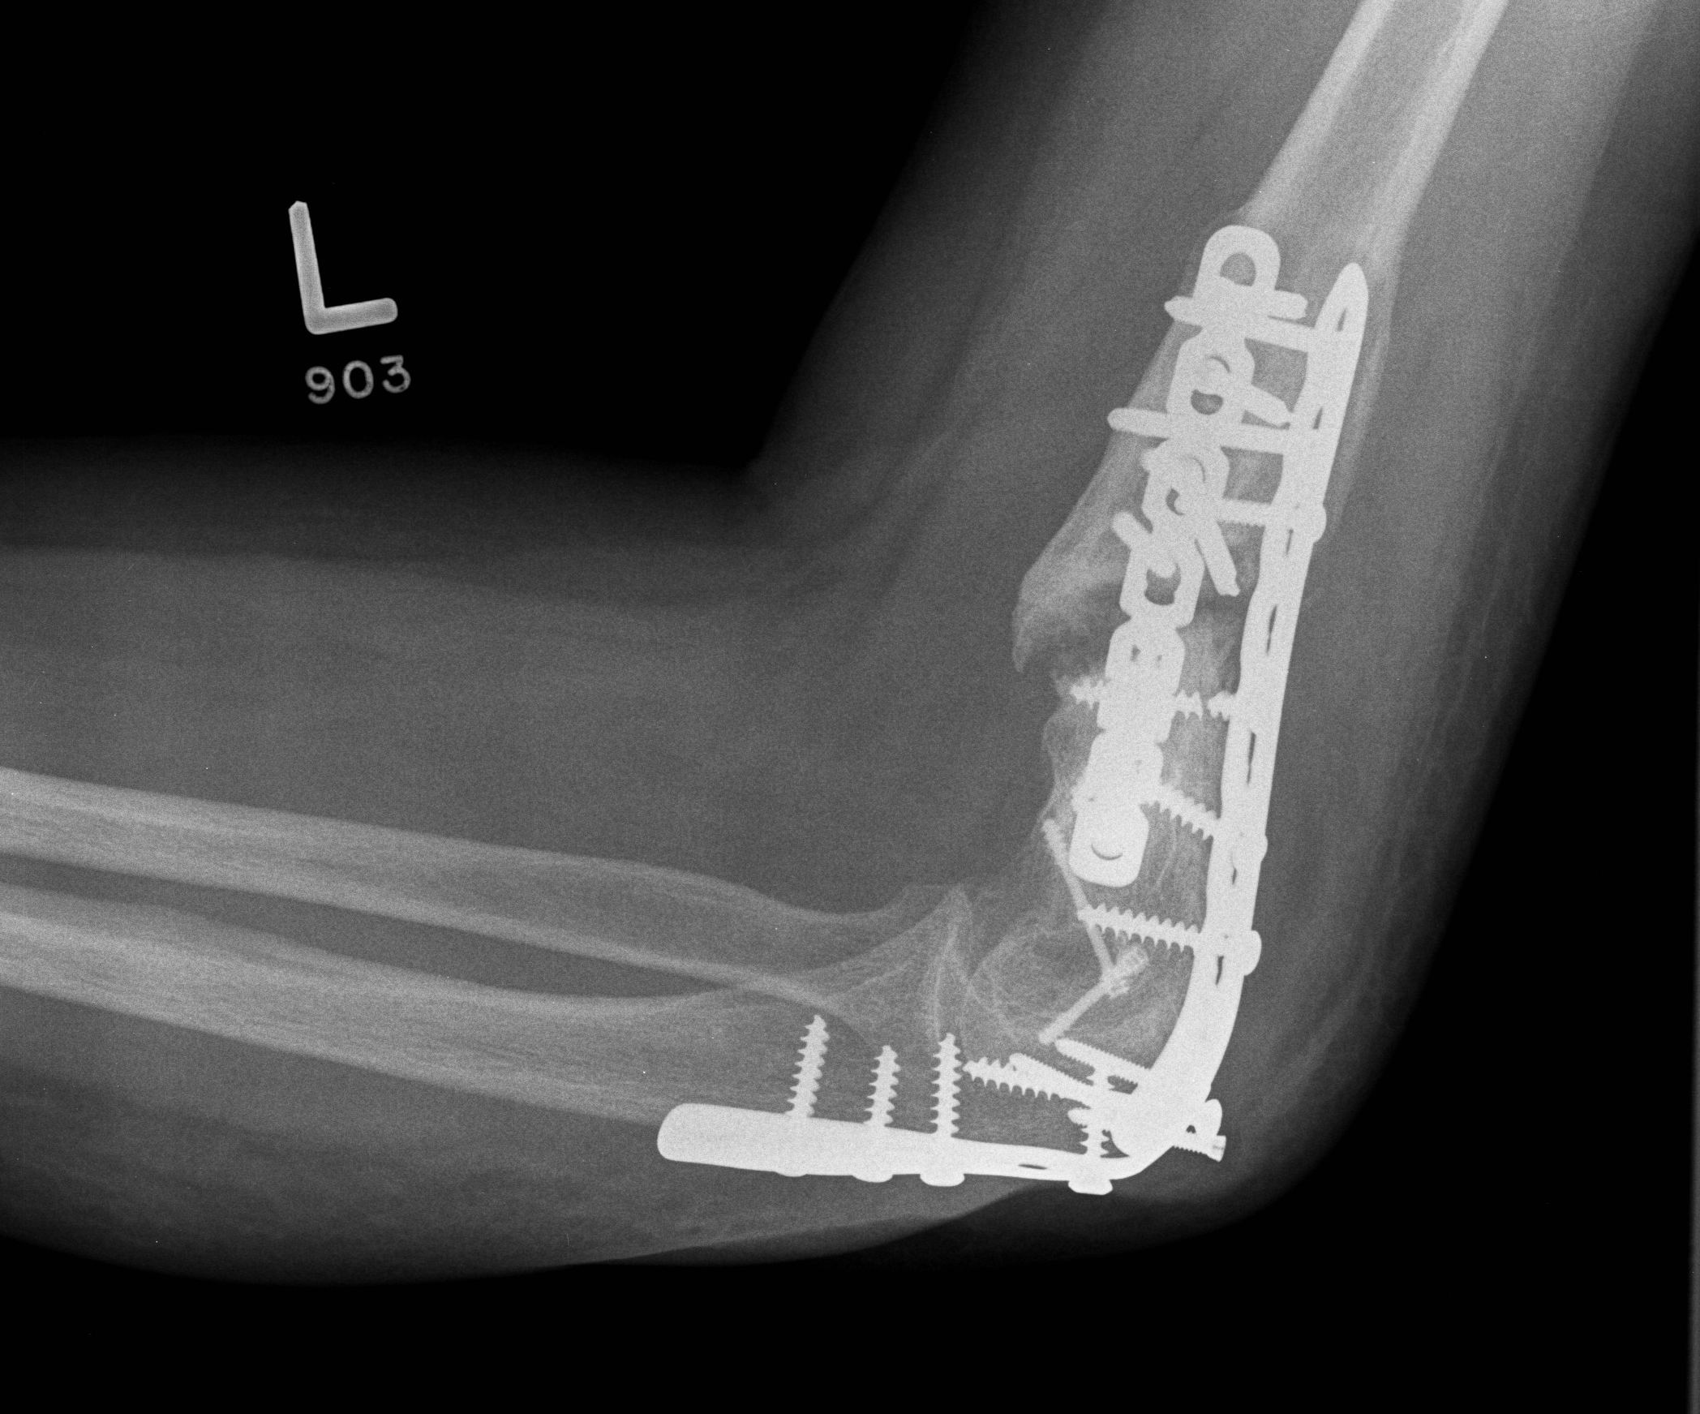

Slide 5
Booked for revision ORIF and iliac crest bone graft (ICBG)
Failed to appear for surgery
Reappeared at WCB clinic 18 months later complaining of more pain and now severe instability of the arm

Slide 6
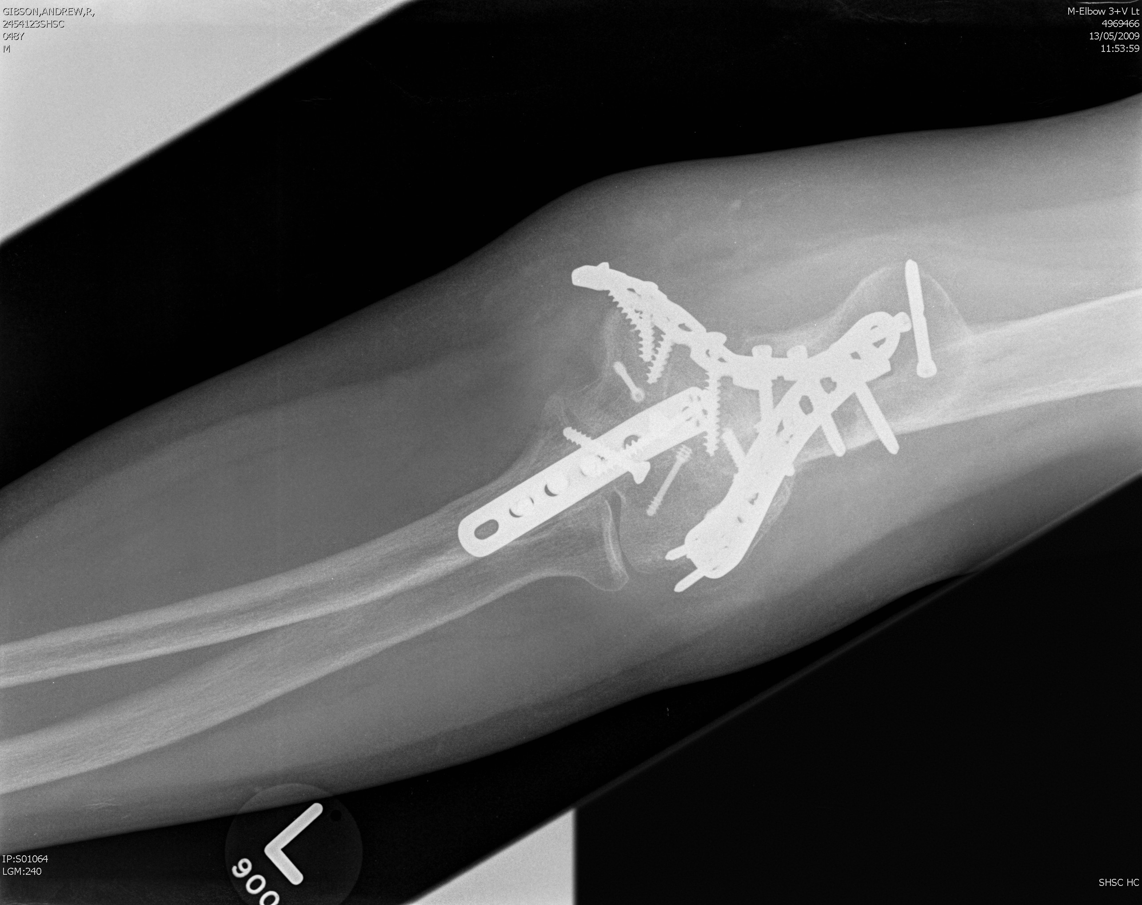

Slide 7
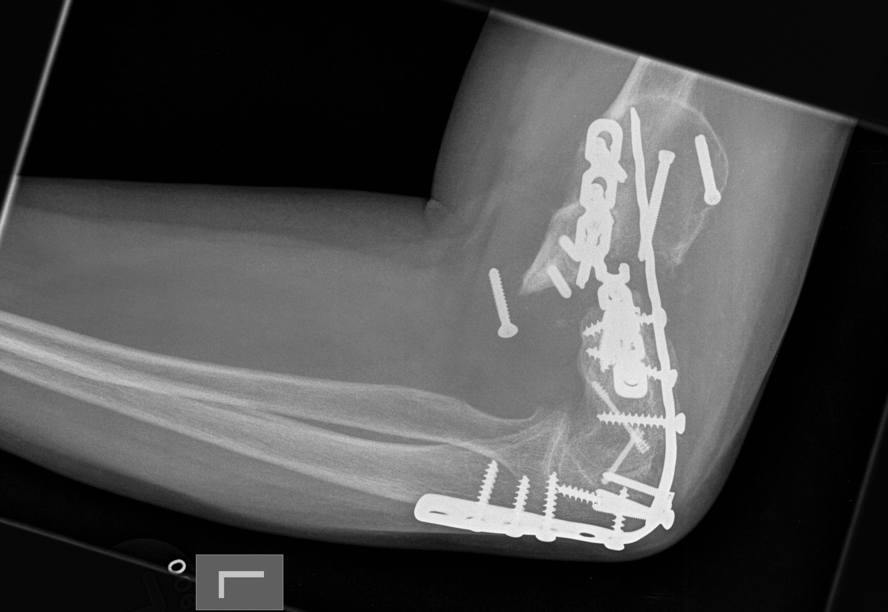

Slide 8
Group task
Decide on surgical tactic and prepare to present

Slide 9
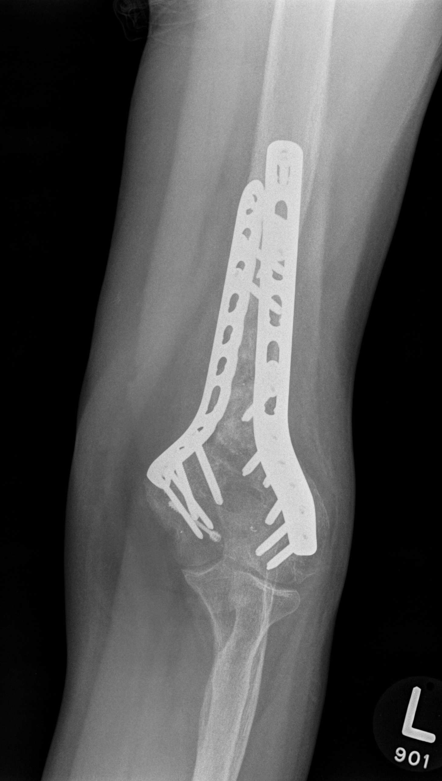

Slide 10
