Slide 1
Welcome to AOVET

Slide 2
Who we are

Slide 3
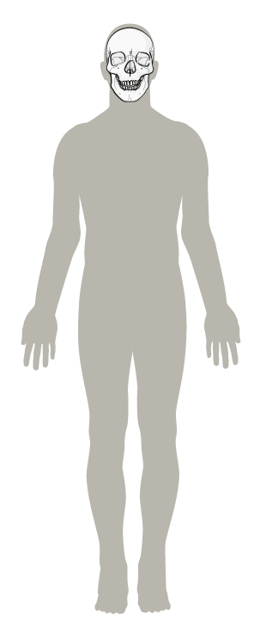
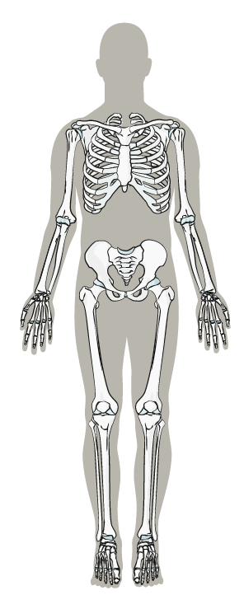
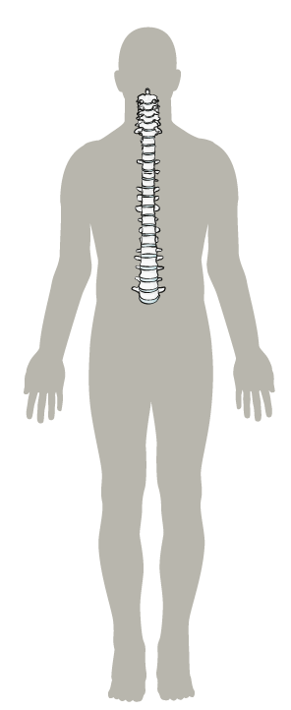
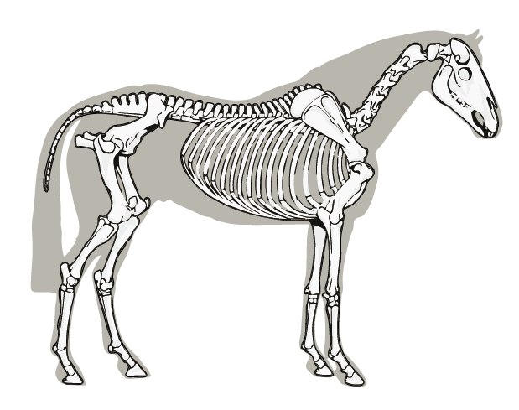
Who we are
The AO Foundation is a medical nonprofit organization with global education and research activities, led by surgeons from different specialties.

Slide 4
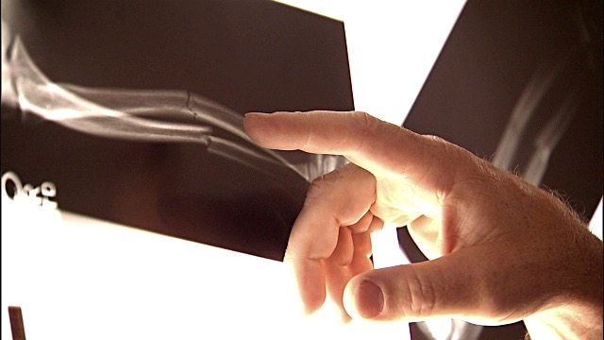
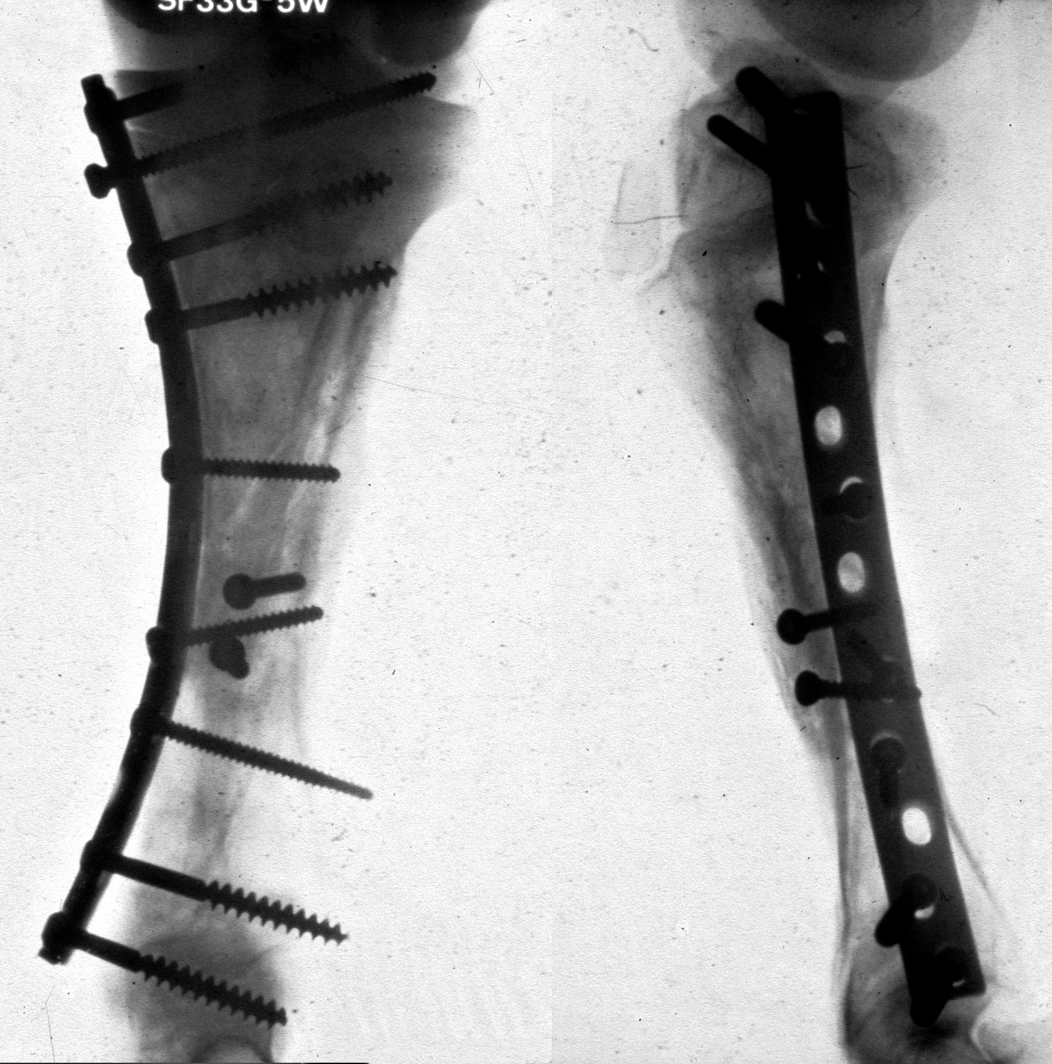
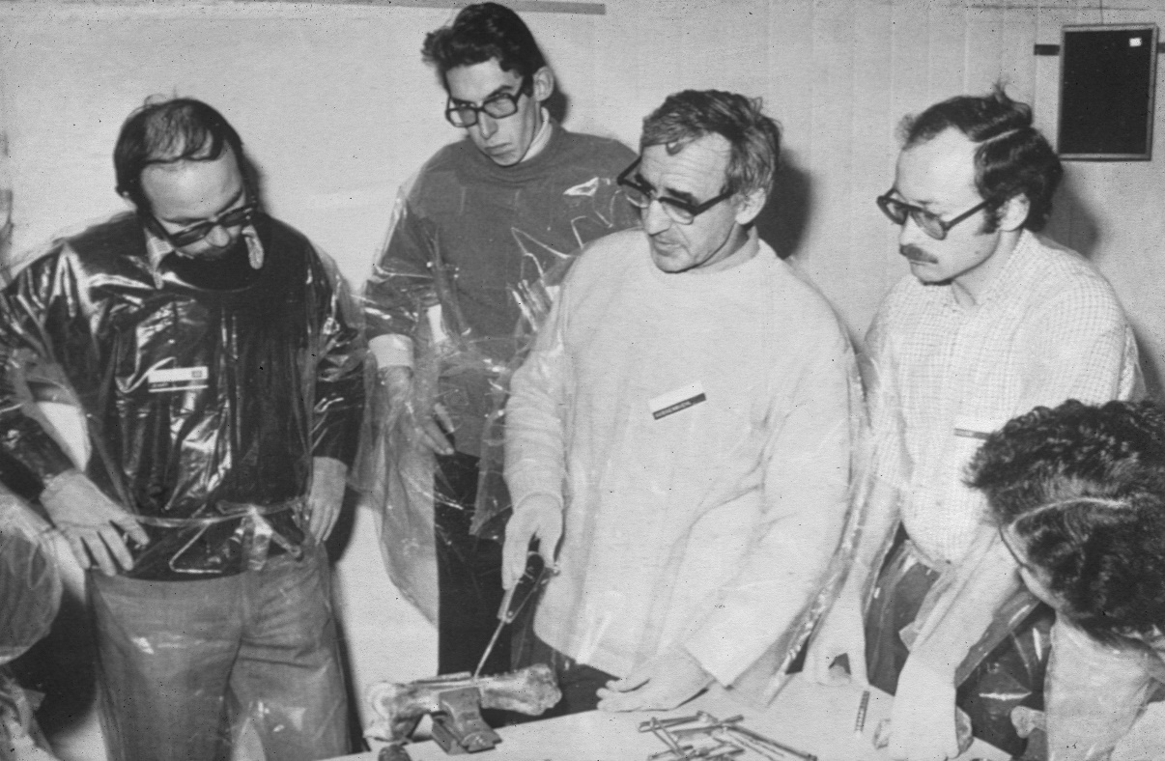
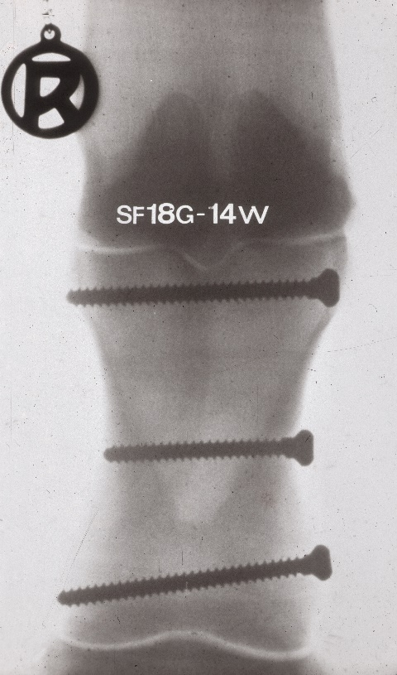
Who we are
AO stands for «Arbeitsgemeinschaft für Osteosynthesefragen».
Prior to 1958 there had been no systematic investigation of the biology of bone healing or fracture repair and knowledge was sparse.
Casting was the mainstay of treatment for most fractures before AO was founded.
Serious long-bone fractures routinely resulted in permanent disability from work.

Slide 5
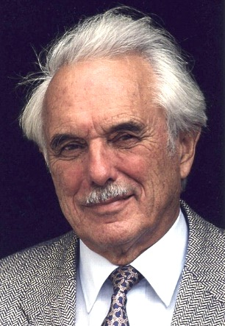
How did we get here?
In 1950 Maurice E. Müller visited Robert Danis in Belgium who was one of the few surgeons stabilizing fractures with implants (early mobilization).
Müller was so impressed that he started treating patients with plates and screws, keeping careful records of the outcomes.
As a result, rigid fixation and early mobilization became the gold standard in management of musculoskeletal trauma.
In 1958 the AO Foundation was established.

Slide 6
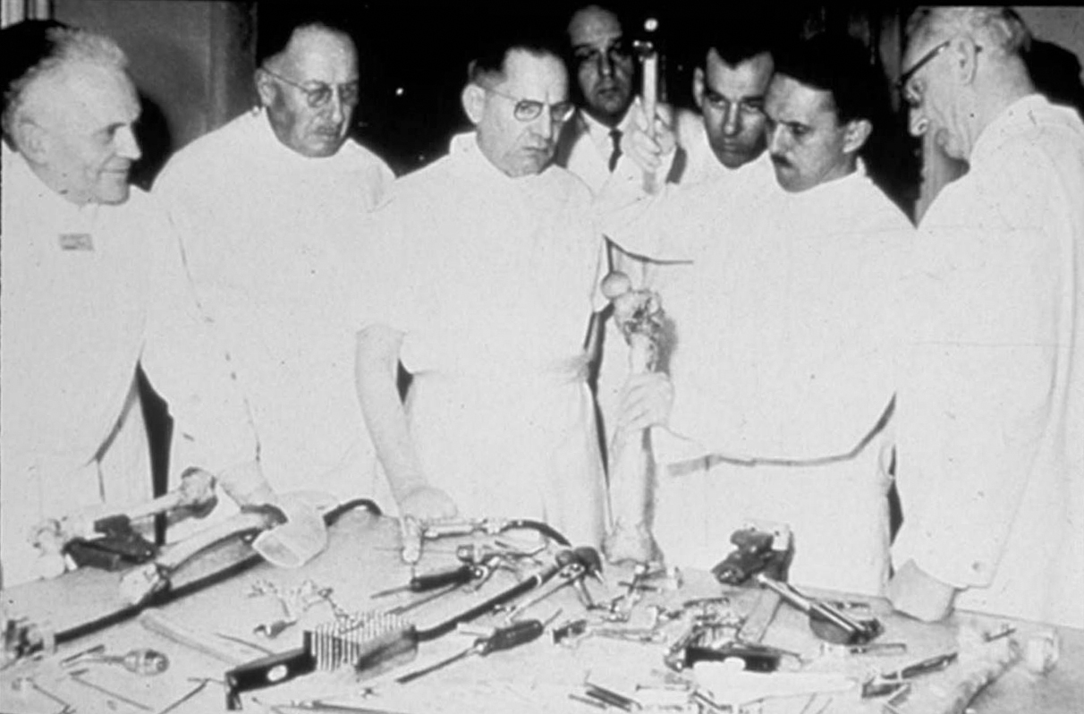
1960
The first AO course

Slide 7
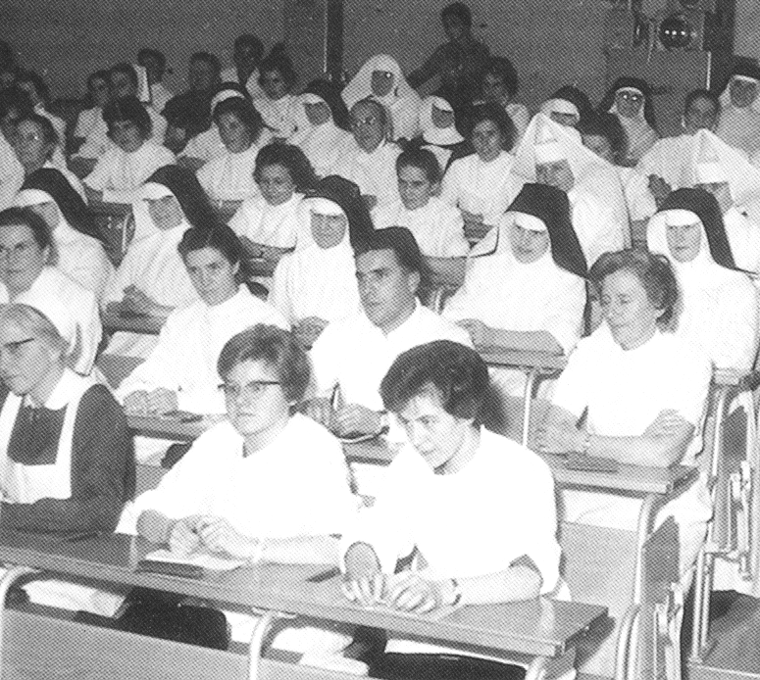
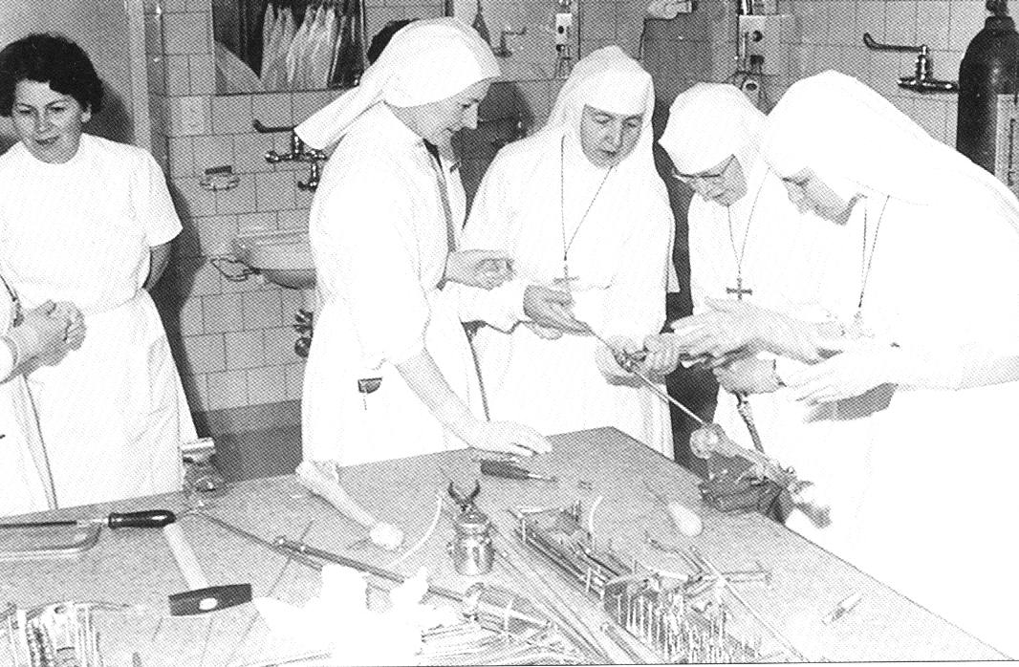
1961
First Course for Operating Room Personnel (ORP)

Slide 8
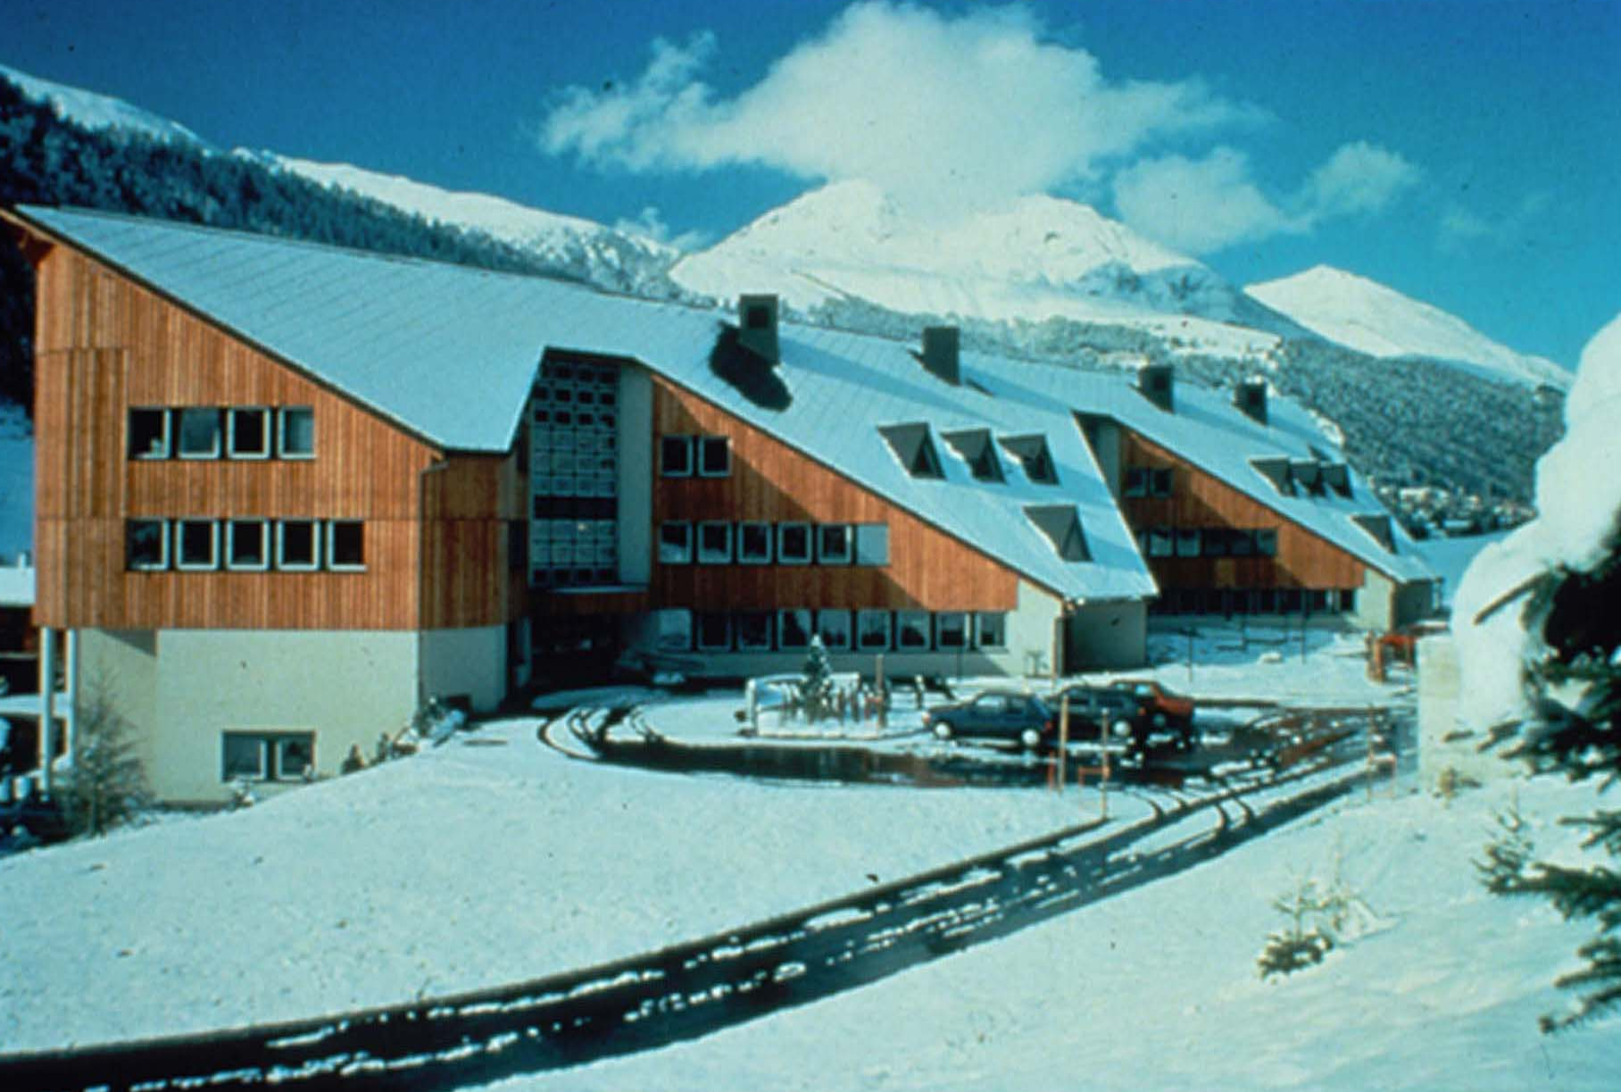
1992
Opening of the AO Foundation Center in Davos

Slide 9
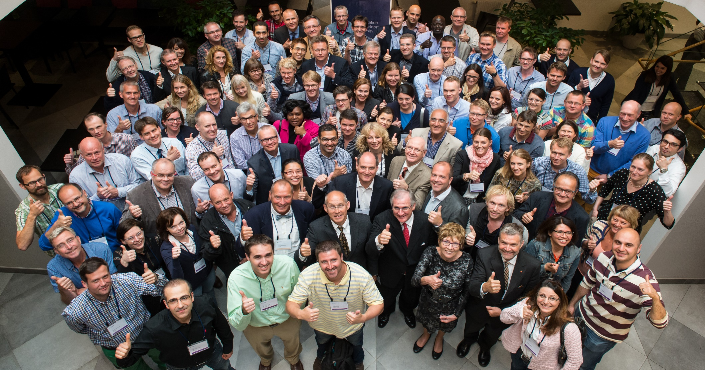
AOVET—different but still the same
AOVET is an independent nonprofit organization that represents a global network of surgeons, scientists, and other professionals highly specialized in the field of veterinary surgery of the musculoskeletal system.

Slide 10
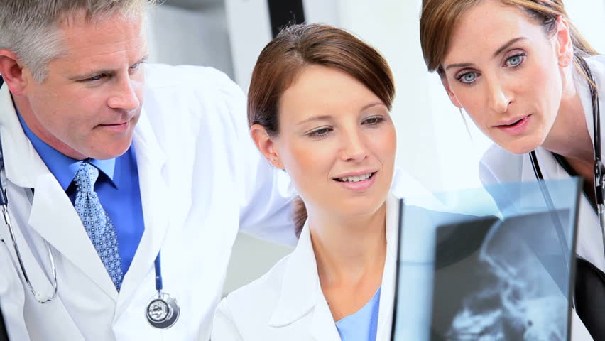
Improving patient care worldwide
The AOVET community
AOVET is the voice and professional resource for individuals working in the field of veterinary orthopedic trauma and reconstruction as well as musculoskeletal disorders. The AOVET community embodies a culture of teaching and learning, combined with research and development.
Our
vision

Slide 11
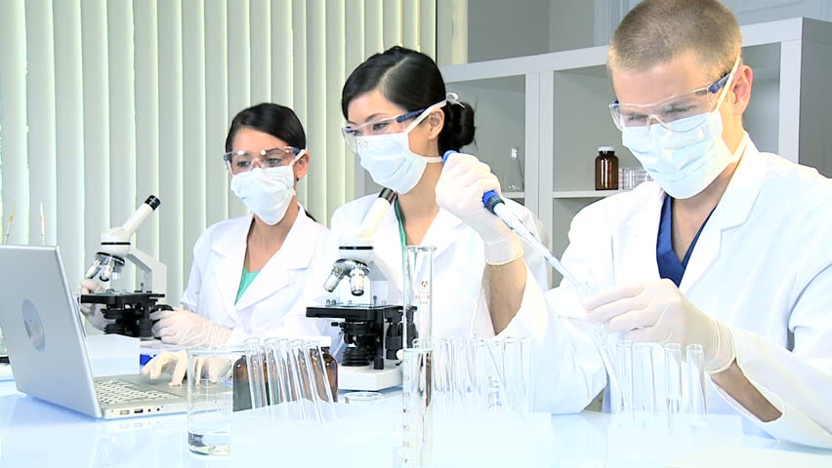
Improving patient care worldwide
To achieve
excellence in veterinary surgery across species
Our
goal

Slide 12
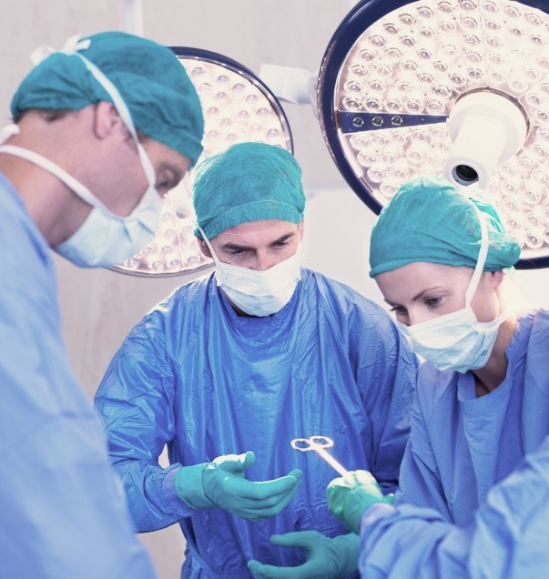
Improving patient care worldwide
Offer access to a dynamic global network of experts who share a strong interest in VET orthopedic trauma and reconstruction, as well as musculoskeletal disorders.
Support younger surgeons in pursuing fulfilling careers and becoming a leader within the AOVET community.
Improve patient care standards by supplying a valuable education and network throughout a surgeon’s career.
Special focus areas
Notes:
To pursue fulfilling careers and take leadership opportunities within the AOVET governance structure.

Slide 13
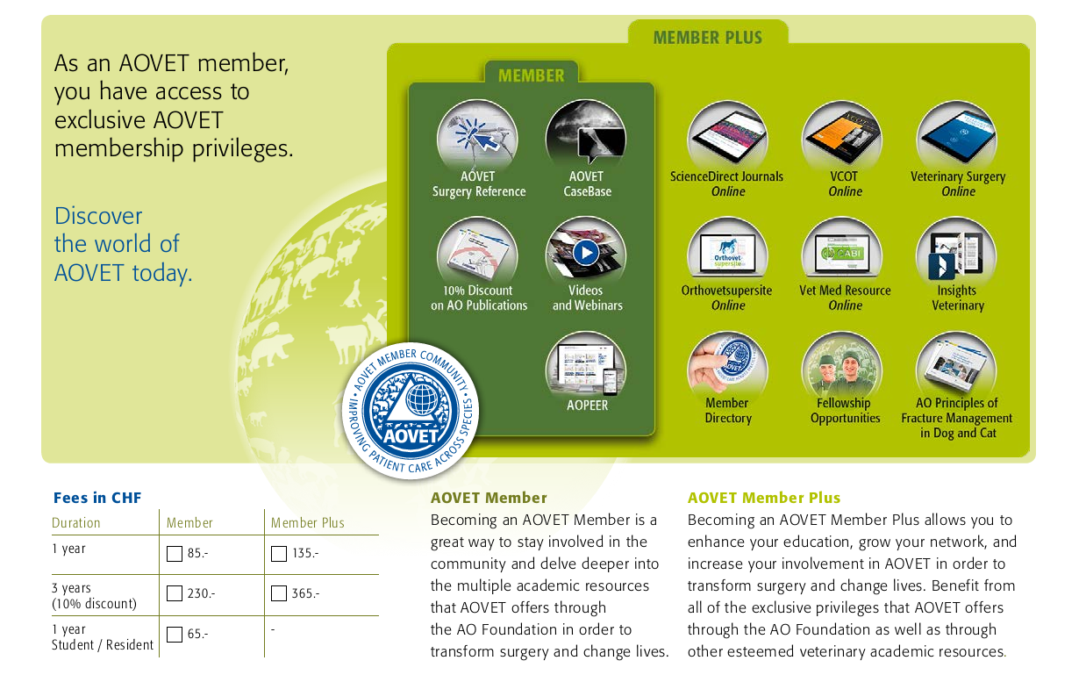
AOVET membership scheme

Slide 14
Your AOVET member benefits
Refine your expertise as a clinician and keep it up to date. Full access to a number of top medical publications, including the VCOT journal.
Share your knowledge and improve patient care.
Focus on the topics most important to you professionally.
Unlimited access to the AOVET network. Get expert insights to help improve your skills and advance your medical career.
Shape the future of AOVET.

Slide 15
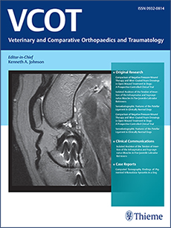
VCOT Journal
Veterinary and Comparative Orthopaedics and Traumatology:
VCOT meets its readers demands by focusing on both traumatological and practical aspects.
Articles of a high scientific standard are published in English by international authors.
Review articles, original papers, clinical communications, case reports, letters to the Editor, as well as the latest news in basic research inform the reader about new operating techniques and improvements.
VCOT is published 6 times a year.

Slide 16
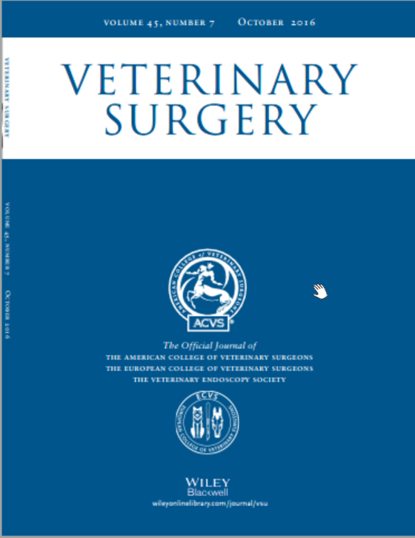
Veterinary Surgery Journal
Veterinary Surgery:
The the official journal of the American College of Veterinary Surgeons, the European College of Veterinary Surgeons, and the Veterinary Endoscopy Society.
A source of up-to-date coverage of surgical and anesthetic management of animals, addressing significant problems in veterinary surgery with relevant case histories and observations.
Contains original, peer-reviewed articles with timely articles on surgical techniques, diagnostic aims, care of infections, and advances in knowledge of metabolism as it affects the surgical patient.

Slide 17
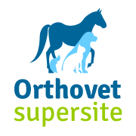
Online veterinary resources
Online Resources:
Orthovet Supersite provides online abstracts and exchange of information in veterinary orthopaedic and traumatology community.
VetMed Resource is an internet site providing access to the world’s largest database covering all areas of veterinary medicine. The information in this resource includes the veterinary part of the CAB Abstracts Database which goes back to 1972, and is updated weekly, providing a unique collection of veterinary information.

Slide 18
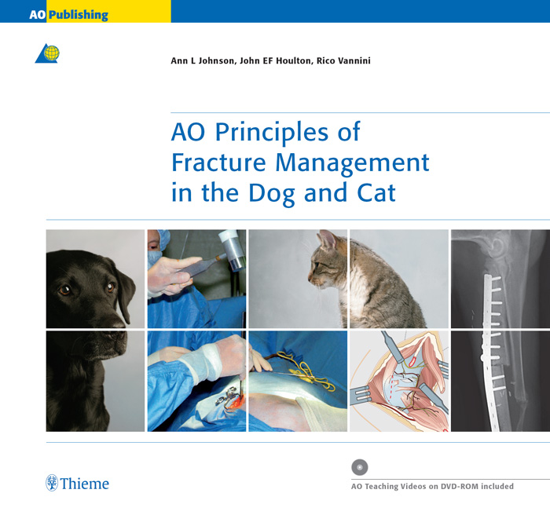
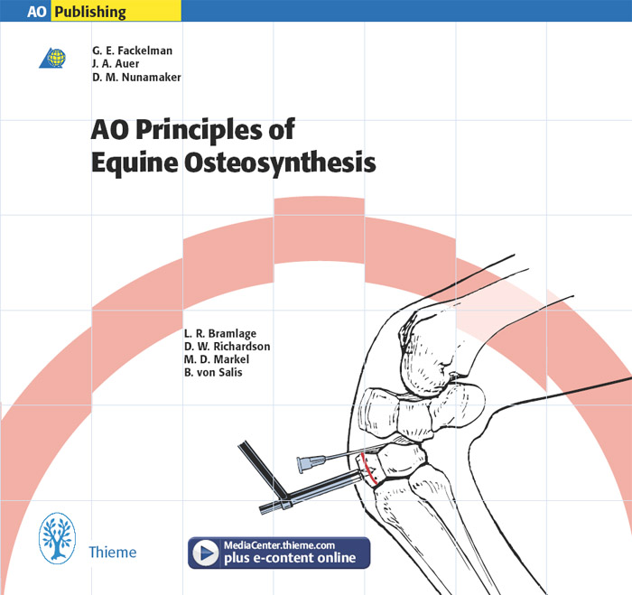
AOVET Manuals
Must-have books:
Our fantastic book Principles of Fracture Management in the Dog and Cat presents the pioneering approaches and the latest advancements in VET small animal surgery.
Our extraordinary book Principles of Equine Osteosynthesis presents the pioneering approaches and the latest advancements in VET equine surgery.
10% membership discount
Hardcopy order online http://thieme.com
E-book order online
http://ebookstore.thieme.com

Slide 19
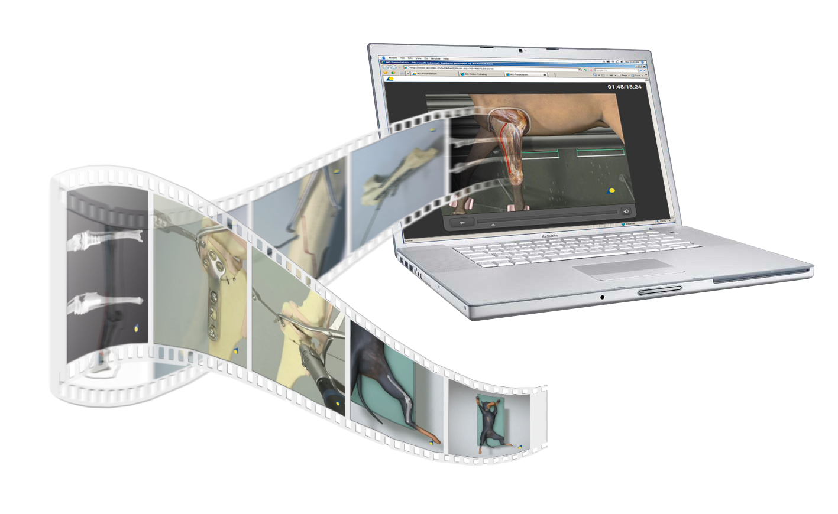
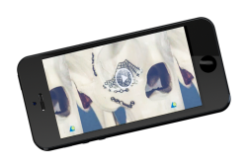
AOVET teaching videos
Digital teaching and learning material, live webcasts, and event coverage for educational purposes—this and more members can find in the AOVET video directory.

Slide 20
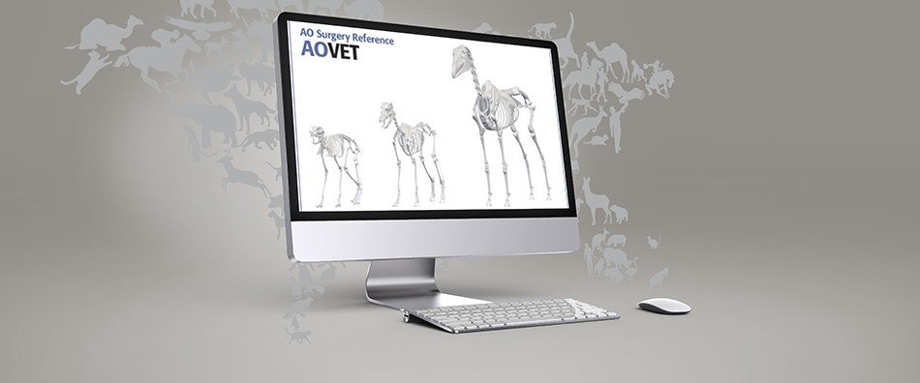
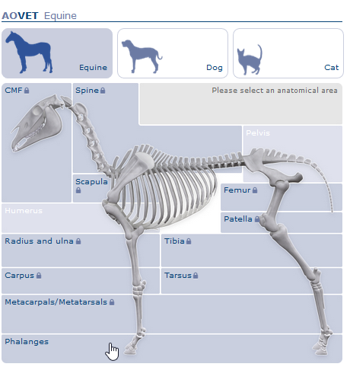
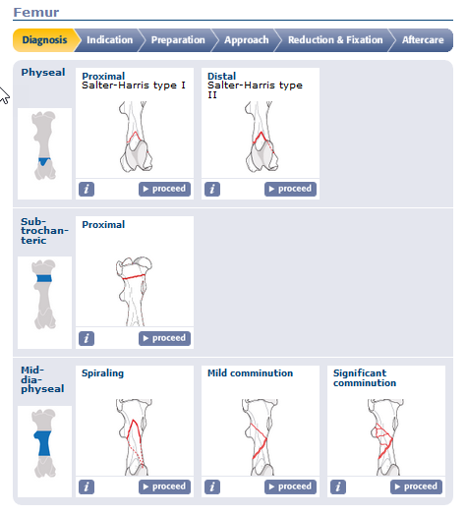
AOVET Surgery Reference
A tool for learning by doing:
Is an online reference tool for dozens of indications.
Contains step-by-step instruction for patient treatment from diagnosis, to indication, preparation, approach, reduction, and fixation to aftercare.
Comprises 7,000 pages, detailing hundreds of procedures.
Contains illustrations, photos, videos, and clinical reports.
Is a prize-winning app offers both young and experienced surgeons a step-by-step guide to surgical management.
Offers AOVET members access to additional content
Additional material for AOVET members only

Slide 21
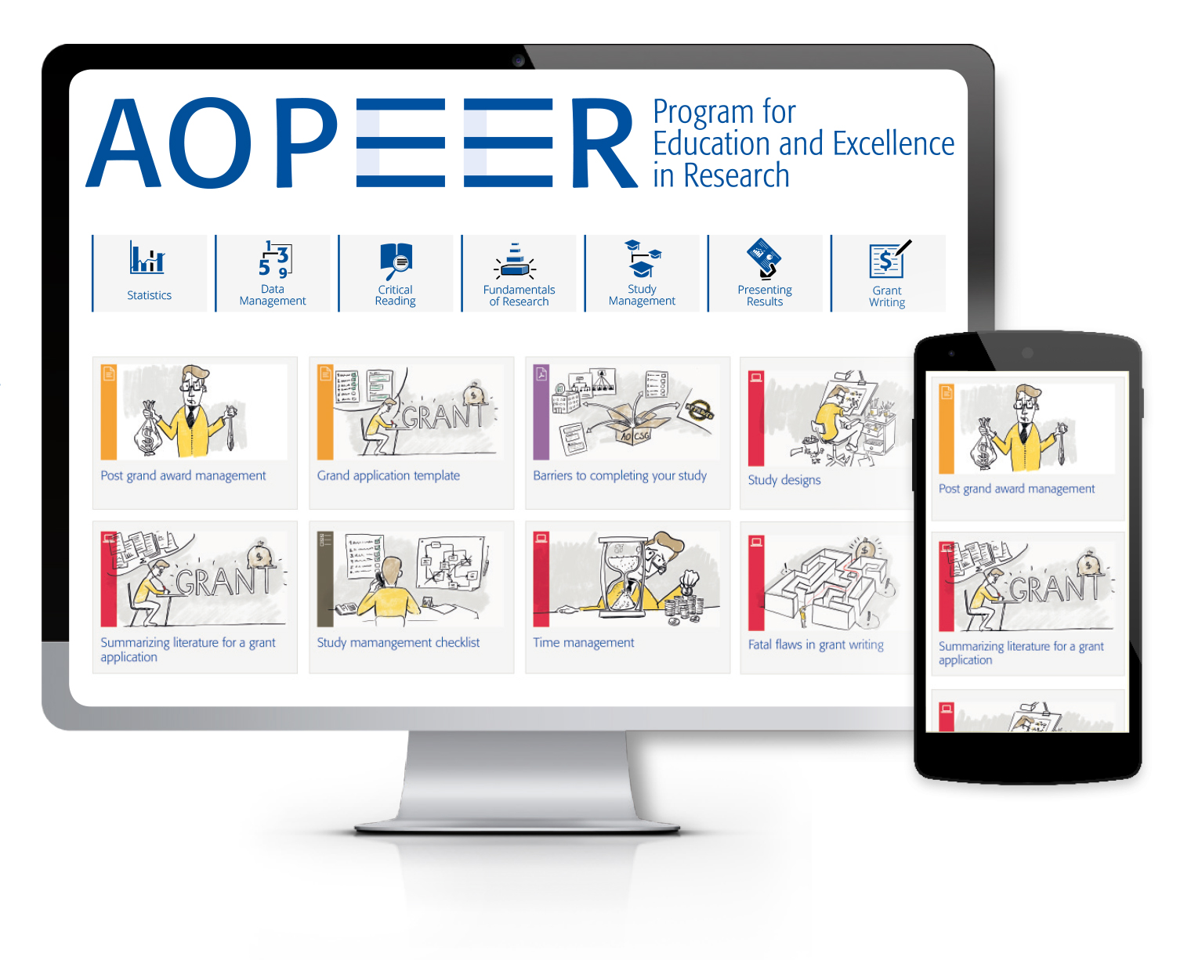
AOPEER
Resources to support your research:
The fundamentals of research
Critical writing of literature
How to write a grant or a study proposal
Statistics
Study management
Data management
How to publish your results

Slide 22
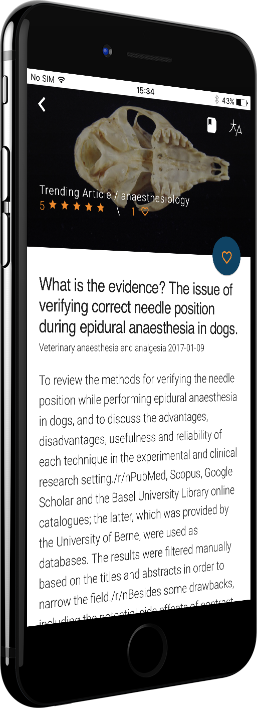
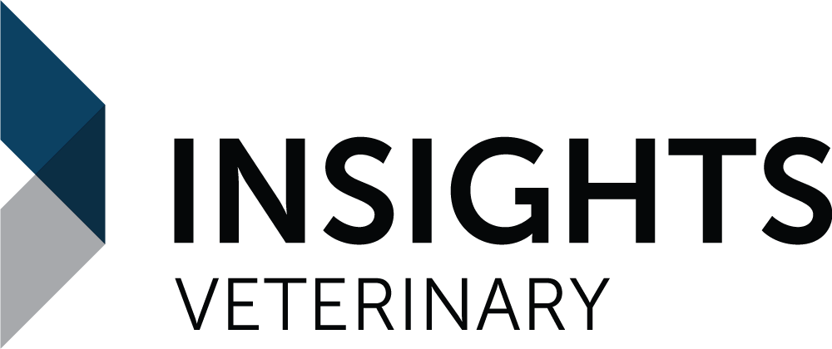
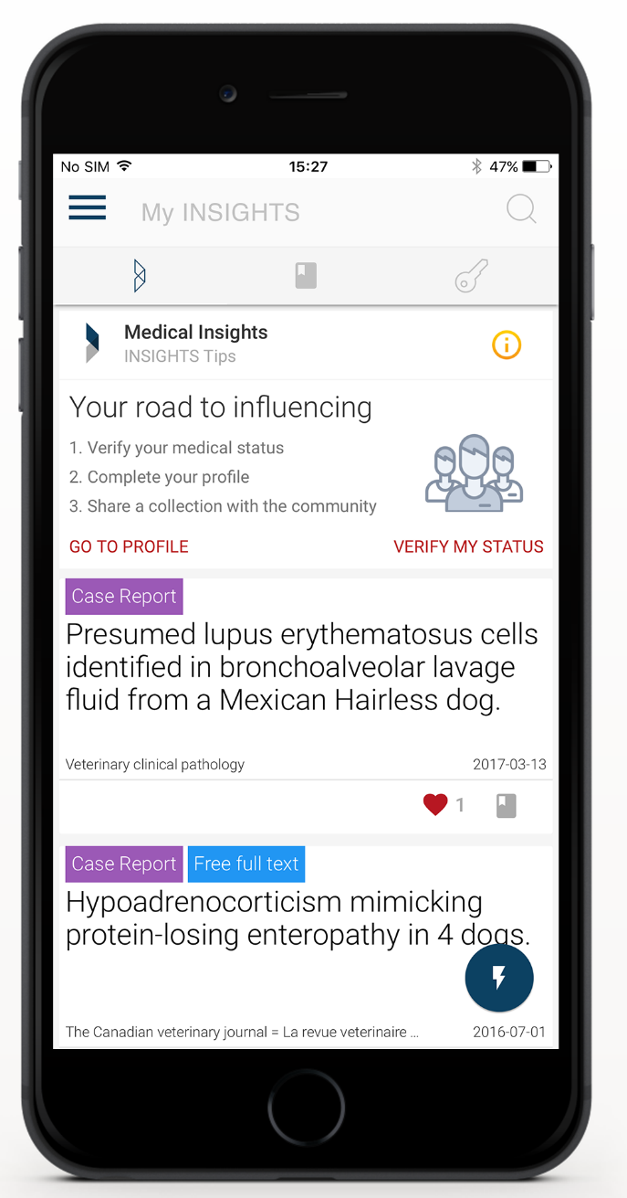
All in one place—INSIGHTS VET
We’re proud to present INSIGHTS VET
In-depth search
Advance search algorithms provide access to journal articles, images, case studies, videos, and more.
Evolving sources
Constantly evolving source base, including videos, news, journals and more, to keep you up to date.
Download
it now—
it is free!
Auto-Translate
Veterinary Medicine is a global field, so we included translation. Simply tap on the translate button and get any content that you’re reading translated into your native language.
Personal digests
Based upon your specialization and interests, our digests send curated knowledge to your e-mail once a week.

Slide 23
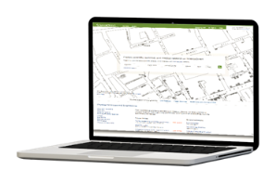
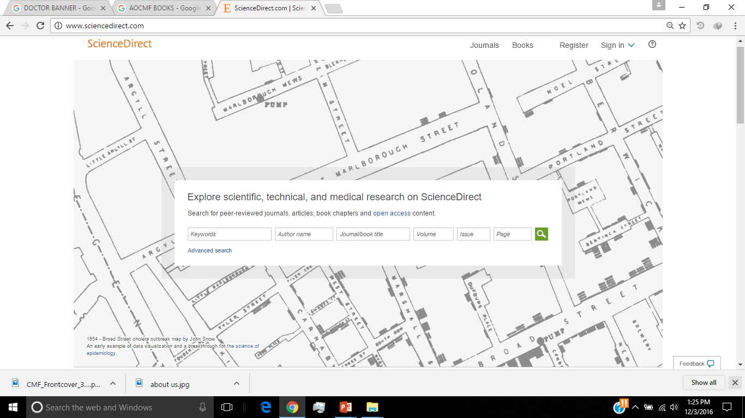
ScienceDirect
Access to nine current scientific journals:
International Journal of Oral and Maxillofacial Surgery
Journal of Oral and Maxillofacial Surgery
Operative Techniques in Otolaryngology – Head and Neck Surgery
American Journal of Ophthalmology
British Journal of Oral and Maxillofacial Surgery
Journal of Cranio-Maxillofacial Surgery
Journal of Plastic, Reconstructive & Aesthetic Surgery
Oral Surgery, Oral Medicine, Oral Pathology, Oral Radiology
Oral and Maxillofacial Surgery Clinics of North America
Access to archives for 23 scientific journals
Online access to top medical journals

Slide 24
Your future starts here—fellowships
Great training opportunities for young surgeons!
AOVET host clinics are located around the world
four to eight fellowships per year to provide additional experience in AO techniques for young active veterinary surgeons with an interest in orthopedics and musculoskeletal disorders.
real-world experience but often lead to residencies for our fellows.
AOVET scholarships are available in four-week increments under the guidance of AOVET member mentors at hospitals and private clinics worldwide.

Slide 25
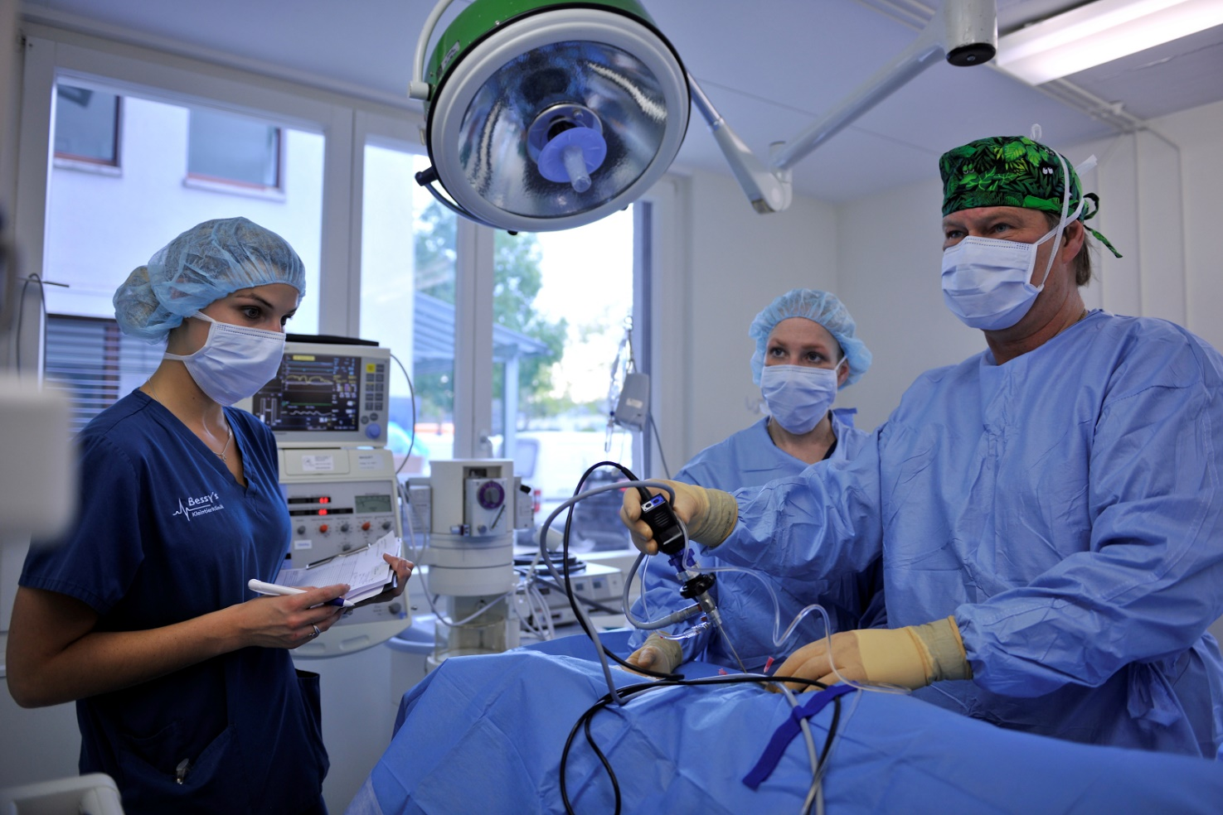
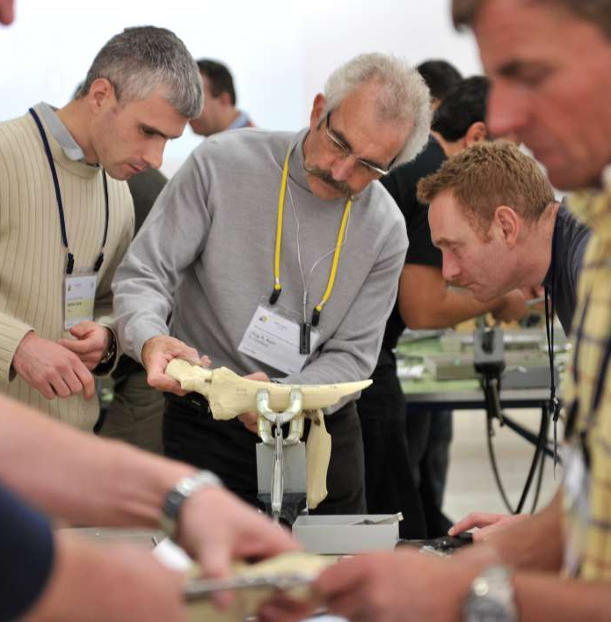
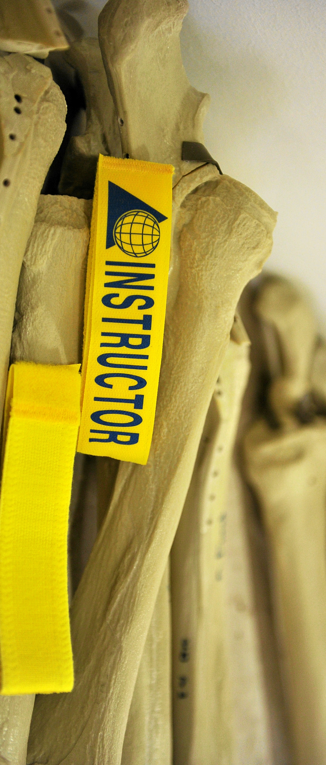
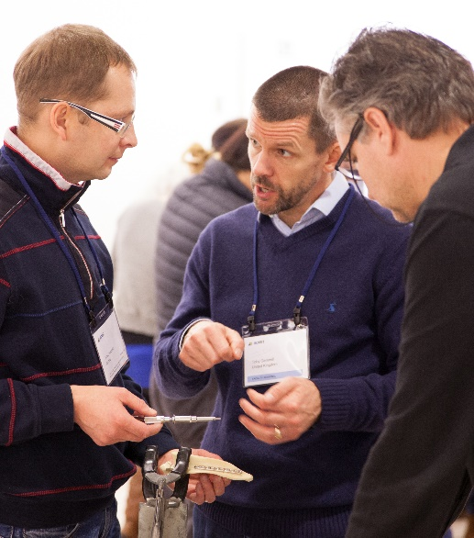
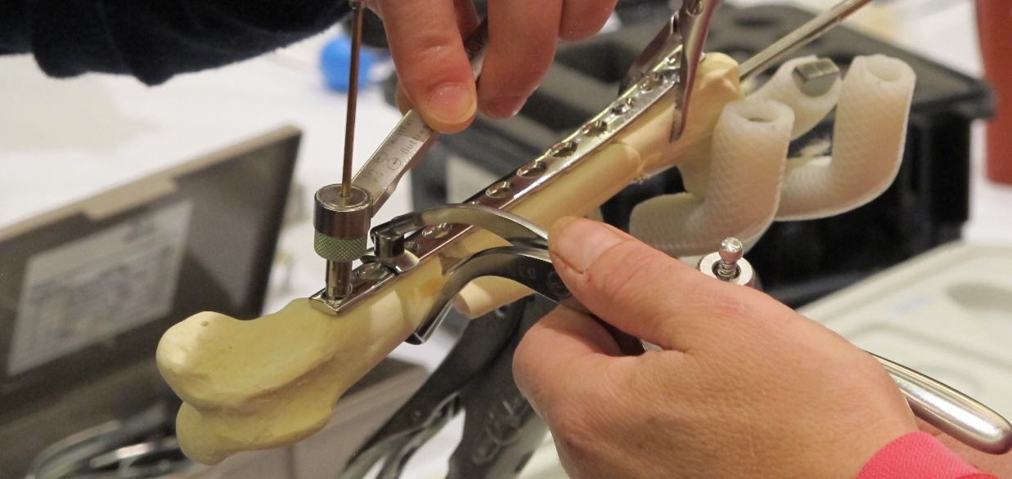
AOVET education—over 59 courses, seminars and symposia in 2018
Over 2,000 participants at AOVET educational events worldwide per year.
Educational offerings provide continuing education online, with and without practical exercises on four levels: Principles—Advanced—Masters — Focus
Note—AOVET membership is a precondition for becoming AO faculty.

Slide 26
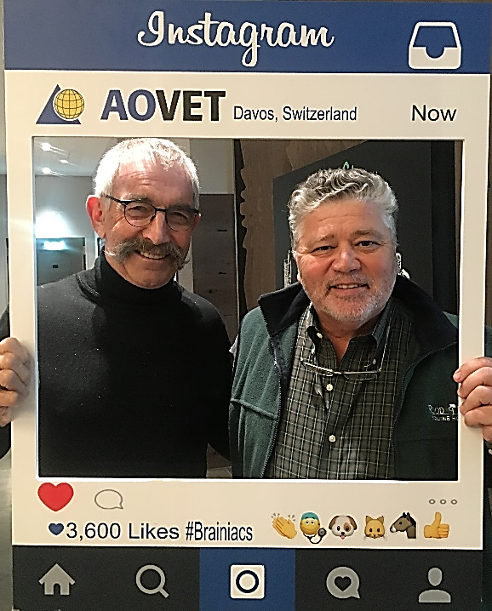
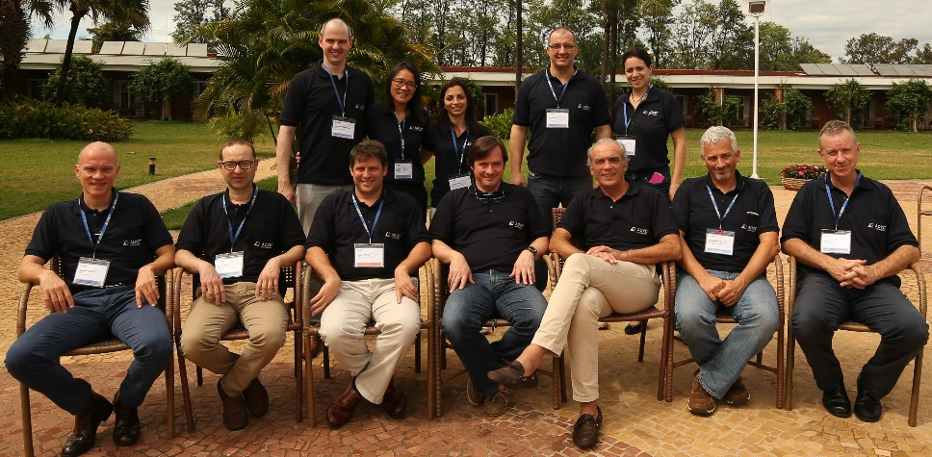
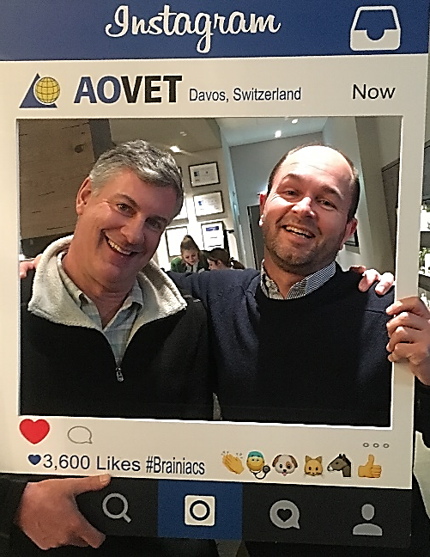
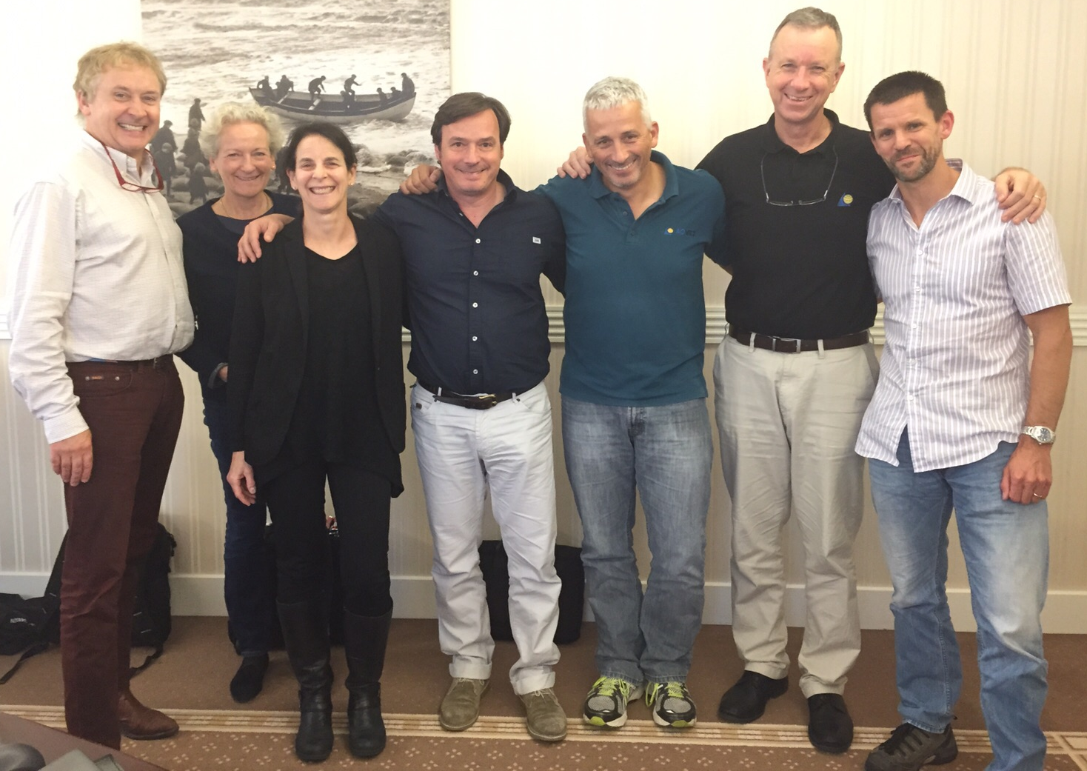
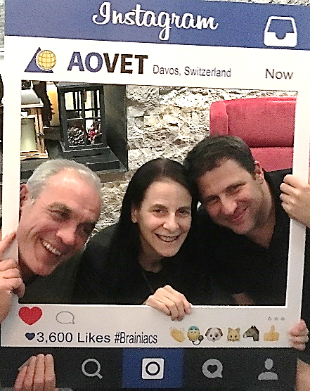
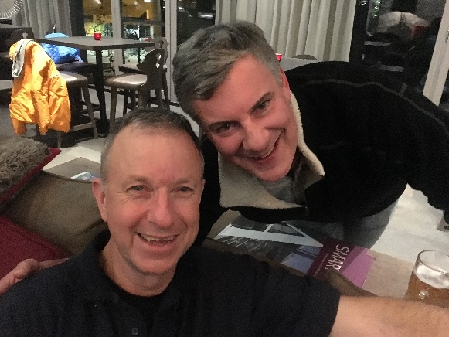
My best AO moments

Slide 27
AOVET—excellence in veterinary surgery across species
Join us in our mission to improve patient care worldwide!
www.aovet.org
AO Foundation AOVET Community Development Clavadelerstrasse 8 7270 Davos Switzerland
+41 81 414 21 11

Slide 28
Membership

